Slide 1
CJ Date’s Rules Christopher J. Date’s Rule / Chris Date’s Rule

Slide 2

DDB has complex, but can solve by proper methodology and logics
The set of rules developed by C. J. Date has become a measure for evaluating distributed databases.

Slide 3
CJ Date’s rules
Local autonomy.
No reliance on a central site.
Continuous operation.
Location independence (Location Transparency)
Fragmentation independence (Fragmentation Transparency)
Replication independence (replication transparency)
Distributed query processing
Distributed transaction management
Hardware independence.
Operating system independence.
Network independence.
DBMS independence

Slide 4
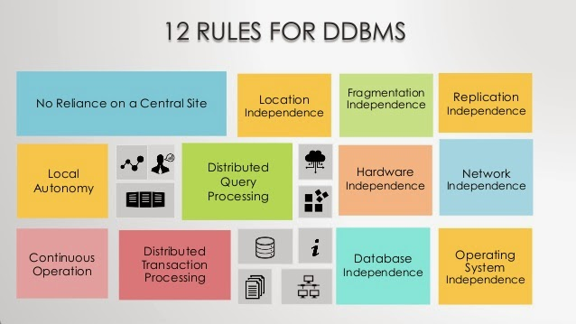
CJ Date’s rules…

Slide 5
Date's 12 Rules for DDBs
1. Local site independence: Each site in the DDB should act independently with respect to vital DBM functions.
Security
Concurrency Control
Backup
Recovery

Slide 6
Date's 12 Rules for DDBs
2. Central site independence: Each site in the DDB should act independently with respect to
The central site
All other remote sites
Note: All sites should have the same capabilities, even though some sites may not necessarily exercise all these capabilities at a given point in time.

Slide 7
Date's 12 Rules for DDBs
3. Failure independence: The DDBMS should be unaffected by the failure of a node or nodes; the rest of the nodes, and the DDBMS as a whole, should continue to work.
Note: In similar fashion, the DDBMS should continue to work if new nodes are added.

Slide 8
Date's 12 Rules for DDBs
4. Location transparency: Users should not have to know the location of a data in order to retrieve it.

Slide 9
Date's 12 Rules for DDBs
5. Fragmentation transparency: The user should be unaffected by, and not even notice, any fragmentation of the DDB. The user can retrieve data without regard to the fragmentation of the DDB.

Slide 10
Date's 12 Rules for DDBs
6. Replication transparency: The user should be able to use the DDB without being concerned in any way with the replication of the data in the DDB.

Slide 11
Date's 12 Rules for DDBs
7. Distributed query processing: A query should be capable of being executed at any node in the DDBMS that contains data relevant to the query. Many nodes may participate in the response to the user's query without the user's being aware of such participation.

Slide 12
Date's 12 Rules for DDBs
8. Distributed transaction processing: A transaction may access and modify data at several different sites in the DDB without the user's being aware that multiple sites are participating in the transaction.

Slide 13
Date's 12 Rules for DDBs
9. Hardware independence: The DDB and its associated DDBMS should be capable of being implemented on any suitable platform, i.e., on any computer with appropriate hardware resources regardless of what company manufactured the computer.
Note: Current DDBMSs often fail to achieve this goal.

Slide 14
Date's 12 Rules for DDBs
10. Operating system independence: The DDB and its associated DDBMS should be capable of being implemented on any suitable operating system, i.e., on any operating system capable of handling multiple users.
Note: At present this means Windows NT and 2000, and the various varieties of Unix including Linux.

Slide 15
Date's 12 Rules for DDBs
11. Network independence: The DDB and its associated DDBMS should be capable of being implemented on any suitable network platform.
Note: At present, this goal means that the DDBMS should be able to run on Windows NT, on Windows 2000, on any variant of Unix, and on Novell Networks.

Slide 16
Date's 12 Rules for DDBs
12. Database independence: The design of the DDB should render it capable of being supported by suitable, i.e., of sufficient power and sophistication, DDBMS from any vendor.
Note: In terms of logical design, this goal is currently often achieved, even though actual implementations rarely use more than one or two DDBMSs.

Slide 17
Summary
Date's 12 Rules emphasize the following goals:
Independence of individual sites within the system from other sites and non-dependence of the system on any one site (independence of the system internally): Rules 1-3
Transparency, to users, of the operations of the system and the distribution of the data: Rules 4-6
Distributed nature of query and transaction processing: Rules 7-8
Independence of the system with respect to hardware, operating systems, network software, and particular database-management systems (independence of the system with respect to its external environment): Rules 9-12

