Slide 1
Module 1: Introduction to algorithm analysis
ITA5002 – Problem Solving with Data Structures and Algorithms
Prepared by,
Nagarajan B
SITE, VIT, Vellore.

Slide 2
Module 1: Introduction to Algorithm Analysis
The Problem-solving Aspect
Analysis framework
Asymptotic notations
Growth rate of functions
Complexity analysis
Mathematical analysis of recursive and non-recursive algorithms.

Slide 3
Data Structures
Data Structure is a way to store and organize data in memory, efficiently i.e array in C language.
It is also used for processing, retrieving, and storing data
A data structure is a specialized format for organizing, processing, retrieving and storing data.
Static data structure: the size is allocated at the compile time. The maximum size is fixed.
Dynamic data structure: the size is allocated at the run time. The maximum size is flexible.

Slide 4
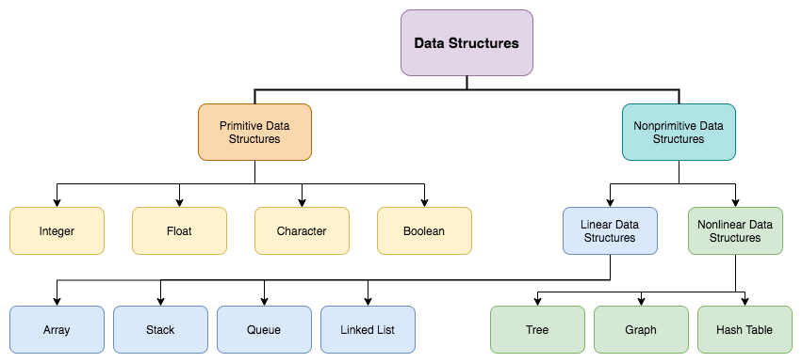
Data Structures

Slide 5
Data Structures
Linear Data Structure: Elements are arranged in linear dimension. (ordered sequence)
Example: lists, stack, queue, etc.
Non-Linear Data Structure: Elements are arranged in one-many, many-one and many-many dimensions.
Example: tree, graph, table, etc.

Slide 6
Algorithm
An algorithm is a clearly specified set of simple instructions to be followed to solve a problem.
It is finite sequence of instructions used to solve a particular problem or to perform a computation.
An algorithm is a sequence of unambiguous instructions for solving a problem, i.e., for obtaining a required output for any legitimate input in a finite amount of time.

Slide 7
Algorithm
Characteristics of an Algorithm
Unambiguous − Each of its steps and their inputs/outputs should be clear and must lead to only one meaning.
Input − algorithm should have 0 or more well-defined inputs.
Output − algorithm should have 1 or more well-defined outputs, and should match the desired output.
Finiteness − Algorithms must terminate after a finite number of steps.
Feasibility − Should be feasible with the available resources.
Independent − An algorithm must be language-independent.

Slide 8
Algorithm
Why are Algorithms Important to Understand?
The ability to define clear steps to solve a problem, is crucial in many different fields (machine learning and artificial intelligence).
Even if we are not conscious of it, we use algorithms and algorithmic thinking all the time.
Algorithmic thinking allows us to break down problems and conceptualize solutions in terms of discrete steps.
Being able to understand and implement an algorithm requires us to practice structured thinking and reasoning abilities.

Slide 9
Algorithm
Steps in Designing and Analyzing an Algorithm
Understanding the Problem
Development of a Model
Specification of an Algorithm
Design an Algorithm and Data Structures
Proving the correctness of an Algorithm
Analyzing an Algorithm
Coding an Algorithm

Slide 10
Algorithm
Steps in Designing and Analyzing an Algorithm
Understanding the Problem
  What are the problem objects?
  What are the operations applied to the objects?
Development of a Model
  How the objects would be represented?
  How the operations would be implemented?
Specification of an Algorithm
Design an Algorithm and Data Structures
  Build a computational model of the solving process

Slide 11
Algorithm
Steps in Designing and Analyzing an Algorithm
Proving the correctness of an Algorithm
  Correct output for every legitimate input in finite time
  Based on correct math formula
Analyzing an Algorithm
  Efficiency: time and space
  Simplicity
  Generality: range of inputs, special cases
  Optimality: no other algorithm can do better
Coding an Algorithm
  How the objects and operations in the algorithm are represented in the chosen programming language?

Slide 12
Types of Algorithms
Divide and conquer algorithms
Brute force algorithms
Randomized algorithms
Greedy algorithms
Recursive algorithms
Backtracking algorithms
Dynamic programming algorithms

Slide 13
Types of Algorithms
Divide and conquer algorithms – divide the problem into smaller subproblems of the same type; solve those smaller problems, and combine those solutions to solve the original problem.
Brute force algorithms – try all possible solutions until a satisfactory solution is found.
Randomized algorithms – use a random number at least once during the computation to find a solution to the problem.
Greedy algorithms – find an optimal solution at the local level with the intent of finding an optimal solution for the whole problem.
Notes:
Merge sort, quick sort, binary search
Knapsack

Slide 14
Types of Algorithms
Recursive algorithms – solve the lowest and simplest version of a problem to then solve increasingly larger versions of the problem until the solution to the original problem is found.
Backtracking algorithms – divide the problem into subproblems, each which can be attempted to be solved; however, if the desired solution is not reached, move backwards in the problem until a path is found that moves it forward.
Dynamic programming algorithms – break a complex problem into a collection of simpler subproblems, then solve each of those subproblems only once, storing their solution for future use instead of re-computing their solutions.

Slide 15
Analysis of Algorithms
Issues:
  Correctness
  time efficiency
  space efficiency
  Optimality
Approaches:
  theoretical analysis
  empirical analysis

Slide 16
Theoretical Analysis of Time Efficiency
Time efficiency is analyzed by determining the number of repetitions of the basic operation as a function of input size
Basic operation: the operation that contributes most towards the running time of the algorithm
T(n) ≈ c_{op}C(n)
input size
running time
execution time
for basic operation
Number of times basic operation is executed

Slide 17
Empirical Analysis of Time Efficiency
Select a specific (typical) sample of inputs
Use physical unit of time (e.g., milliseconds)
or
Count actual number of basic operation’s executions
Analyze the empirical data

Slide 18
Why Analysis of Algorithms is important?
To predict the behavior of an algorithm without implementing it on a specific computer.
It is much more convenient to have simple measures for the efficiency of an algorithm than to implement the algorithm and test the efficiency every time a certain parameter in the underlying computer system changes.
It is impossible to predict the exact behavior of an algorithm. There are too many influencing factors.
The analysis is thus only an approximation; it is not perfect.
More importantly, by analyzing different algorithms, we can compare them to determine the best one for our purpose.

Slide 19
Algorithm Complexity
Suppose X is an algorithm and n is the size of input data, the time and space used by the algorithm X are the two main factors, which decide the efficiency of X.
Time Factor − Time is measured by counting the number of key operations such as comparisons in the sorting algorithm.
Space Factor − Space is measured by counting the maximum memory space required by the algorithm.
The complexity of an algorithm f(n) gives the running time and/or the storage space required by the algorithm in terms of n as the size of input data.

Slide 20
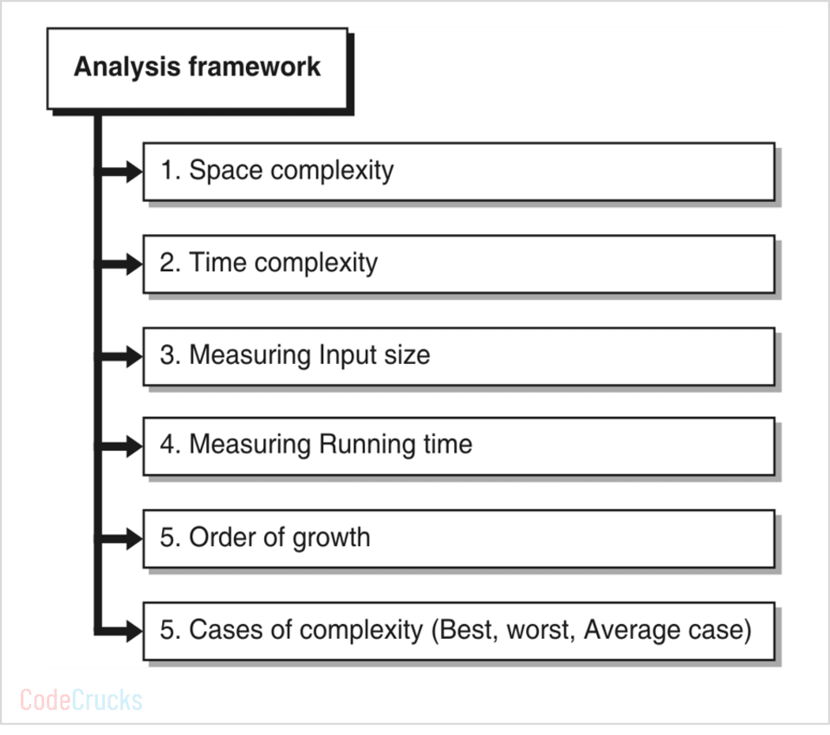
Analysis Framework

Slide 21
Space Complexity
Space complexity of an algorithm represents the amount of memory space required by the algorithm in its life cycle.
The space required by an algorithm is equal to the sum of the following two components −
A fixed part that is a space required to store certain data and variables, that are independent of the size of the problem. For example, simple variables and constants used, program size, etc.
A variable part is a space required by variables, whose size depends on the size of the problem. For example, dynamic memory allocation, recursion stack space, etc.

Slide 22
Space Complexity
Space complexity S(P) of any algorithm P is S(P) = C + S(I), where C is the fixed part & S(I) is the variable part of the algorithm, which depends on instance characteristic I.
Following is a simple example that tries to explain the concept Algorithm: SUM(A, B)
  Step 1 - START
  Step 2 - C ← A + B + 10
  Step 3 - Stop
Here we have three variables A, B, and C and one constant. Hence S(P) = 1 + 3. Now, space depends on data types of given variables and constant types and it will be multiplied accordingly.

Slide 23
Time Complexity
Time complexity of an algorithm represents the amount of time required by the algorithm to run to completion.
Time requirements can be defined as a numerical function T(n), where T(n) can be measured as the number of steps, provided each step consumes constant time.
For example, addition of two n-bit integers takes n steps. Consequently, the total computational time is T(n) = c ∗ n, where c is the time taken for the addition of two bits.
Here, we observe that T(n) grows linearly as the input size increases.

Slide 24
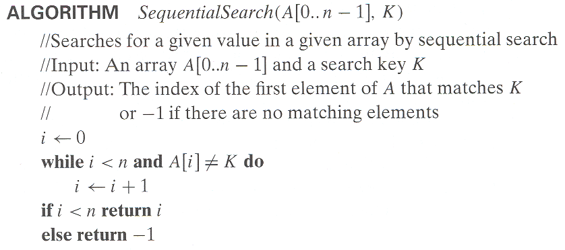
Example: Sequential search

Slide 25
Best-case, average-case, worst-case
For some algorithms efficiency depends on form of input:
Worst case: C_{worst}(n) – maximum over inputs of size n
Best case: C_{best}(n) – minimum over inputs of size n
Average case: C_{avg}(n) – “average” over inputs of size n
  Number of times the basic operation will be executed on typical input
  NOT the average of worst and best case
  Expected number of basic operations considered as a random variable under some assumption about the probability distribution of all possible inputs

Slide 26
Best-case, average-case, worst-case
Exact formula
e.g., C(n) = n(n-1)/2
Formula indicating order of growth with specific multiplicative constant
e.g., C(n) ≈ 0.5 n²
Formula indicating order of growth with unknown multiplicative constant
e.g., C(n) ≈ cn²

Slide 27
Time Complexity Classes
Class | Example | Description
Constant | 1 | Doing a single task at most a fixed number of times. Example: retrieving the first element in a list.
Logarithmic | logn | Breaking down a large problem by cutting its size by some fraction. Example: Binary Search.
Linear | n | "Touches" each element in the input. Example: printing a list.
Linearithmic | nlogn | Breaking up a large problem into smaller problems, solving them independently, and combining the solutions. Example: Mergesort.
Quadratic | n² | "Touches" all pairs of input items. Example: Insertion Sort.
Exponential | c^{n} ,c>1 | Often arises in brute-force search where you are looking for subsets of a collection of items that satisfy a condition.
Factorial | n! | Often arises in brute-force search where you are looking for permutations of a collection of items that satisfy a condition.

Slide 28
Growth Rate Function
O(1) – constant time, the time is independent of n, e.g. array look-up
O(log n) – logarithmic time, usually the log is base 2, e.g. binary search
O(n) – linear time, e.g. linear search
O(n*log n) – e.g. efficient sorting algorithms
O(n²) – quadratic time, e.g. selection sort
O(n^{c}) – polynomial (where c is some constant)
O(2^{n}) – exponential time, very slow!
Order of growth of some common functions
O(1) < O(log n) < O(n) < O(n * log n) < O(n²) < O(n^{c}) < O(2^{n})

Slide 29
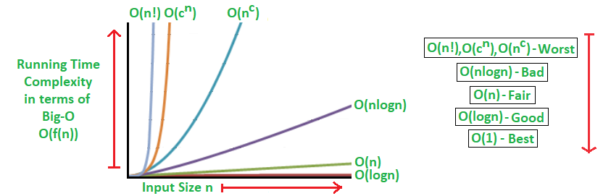
Growth Rate Function

Slide 30
Asymptotic Notations
Asymptotic analysis of an algorithm refers to defining the mathematical foundation/framing of its run-time performance.
The time required by an algorithm falls under three types −
  Best Case − Minimum time required for program execution.
  Average Case − Average time required for program execution.
  Worst Case − Maximum time required for program execution.
Following are the commonly used asymptotic notations to calculate the running time complexity of an algorithm.
  Ο Notation
  Ω Notation
  θ Notation

Slide 31
Asymptotic Notations
Asymptotic analysis of an algorithm refers to defining the mathematical foundation/framing of its run-time performance.
A way of comparing functions that ignores constant factors and small input sizes
O(g(n)): class of functions f(n) that grow no faster than g(n)
Θ(g(n)): class of functions f(n) that grow at same rate as g(n)
Ω(g(n)): class of functions f(n) that grow at least as fast as g(n)

Slide 32
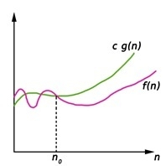
Asymptotic Notations – Big - Oh(O)
Big-Oh (O) notation gives an upper bound for a function f(n) to within a constant factor.
We write f(n) = O(g(n)), If there are positive constants n₀ and c such that, to the right of n₀ the f(n) always lies on or below c*g(n).
O(g(n)) = { f(n) : There exist positive constant c and n₀ such that 0 ≤ f(n) ≤ c g(n), for all n ≥ n₀}

Slide 33
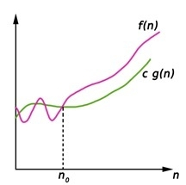
Asymptotic Notations - Big- Omega(Ω)
Big-Omega (Ω) notation gives a lower bound for a function f(n) to within a constant factor.
We write f(n) = Ω(g(n)), If there are positive constants n₀ and c such that, to the right of n₀ the f(n) always lies on or above c*g(n).
Ω(g(n)) = { f(n) : There exist positive constant c and n₀ such that 0 ≤ c g(n) ≤ f(n), for all n ≥ n₀}

Slide 34
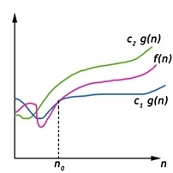
Asymptotic Notations - Big- Theta (Θ)
Big-Theta(Θ) notation gives bound for a function f(n) to within a constant factor.
We write f(n) = Θ(g(n)), If there are positive constantsn0 and c1 and c2 such that, to the right of n0 the f(n) always lies between c1*g(n) and c2*g(n) inclusive.
Θ(g(n)) = {f(n) : There exist positive constant c1, c2 and n0 such that 0 ≤ c1 g(n) ≤ f(n) ≤ c2 g(n), for all n ≥ n0}

Slide 35

Asymptotic Notations – Little - oh (o)
Little o notation is used to describe an upper bound that cannot be tight. In other words, loose upper bound of f(n).
We can say that the function f(n) is o(g(n)) if for any real positive constant c, there exists an integer constant n0 ≤ 1 such that f(n) > 0.
Mathematical Relation of Little o notation
Using mathematical relation, we can say that f(n) = o(g(n)) means,

Slide 36
Asymptotic Notations – Little - Omega (ω)
Little ω Notations
Little omega (ω) notation is used to describe a loose lower bound of f(n).

Slide 37
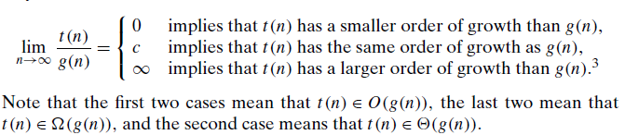
Asymptotic Notations – Little - Omega (ω)
Examples:
10n vs. n²
n(n+1)/2 vs. n²

Slide 38
Mathematical Analysis of non-recursive Algorithms
General Plan for Analysis
Decide on parameter n indicating input size
Identify algorithm’s basic operation
Determine worst, average, and best cases for input of size n
Set up a sum for the number of times the basic operation is executed
Simplify the sum using standard formulas and rules

Slide 39
Useful summation formulas and rules
Σ_{l≤i≤u}1 = 1+1+…+1 = u - l + 1
In particular, Σ_{l≤i≤u}1 = n - 1 + 1 = n ∈ Θ(n)
Σ_{1≤i≤n} i = 1+2+…+n = n(n+1)/2 ≈ n²/2 ∈ Θ(n²)
Σ_{1≤i≤n} i² = 1²+2²+…+n² = n(n+1)(2n+1)/6 ≈ n³/3 ∈ Θ(n³)
Σ_{0≤i≤n} a^{i} = 1 + a +…+ a^{n} = (a^{n+1} - 1)/(a - 1) for any a ≠ 1
In particular, Σ_{0≤i≤n} 2^{i} = 2⁰ + 2¹ +…+ 2^{n} = 2^{n+1} - 1 ∈ Θ(2^{n} )
Σ(a_{i} ± b_{i} ) = Σa_{i} ± Σb_{i} Σca_{i} = cΣa_{i} Σ_{l≤i≤u}a_{i} = Σ_{l≤i≤m}a_{i} + Σ_{m+1≤i≤u}a_{i}

Slide 40
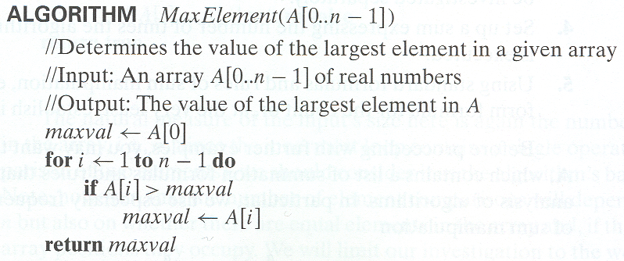
Example 1: Maximum Element
C(n) є Θ(n)

Slide 41
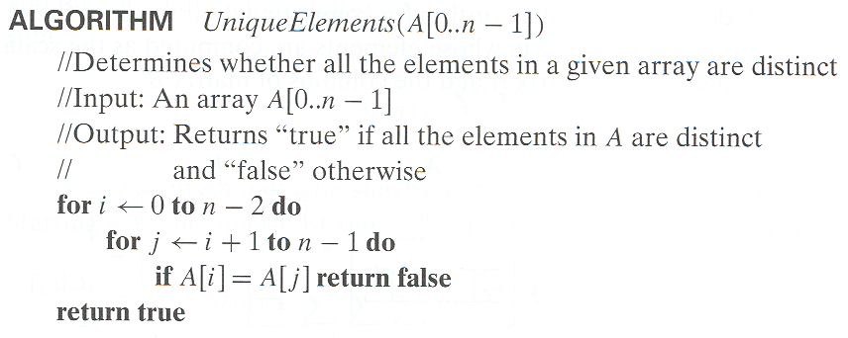
Example 2: Element Uniqueness Problem
C(n) є Θ(n²)

Slide 42
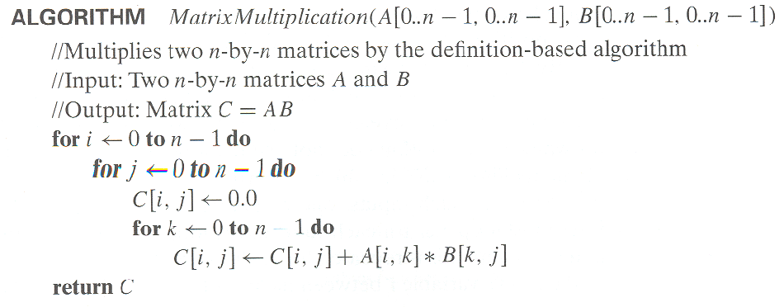
Example 3: Matrix Multiplication
C(n) є Θ(n³)

Slide 43
Mathematical Analysis of Recursive Algorithms
General Plan for Analysis
Decide on a parameter indicating an input’s size.
Identify the algorithm’s basic operation.
Check whether the number of times the basic op. is executed may vary on different inputs of the same size. (If it may, the worst, average, and best cases must be investigated separately.)
Set up a recurrence relation with an appropriate initial condition expressing the number of times the basic op. is executed.
Solve the recurrence (or, at the very least, establish its solution’s order of growth) by backward substitutions or another method.

Slide 44
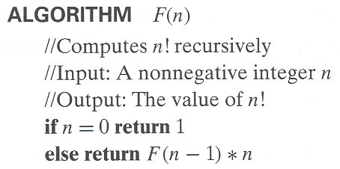
Example 1: Recursive evaluation of n!
Definition: n ! = 1 ∗ 2 ∗ … ∗(n-1) ∗ n for n ≥ 1 and 0! = 1
Recursive definition of n!: F(n) = F(n-1) ∗ n for n ≥ 1 and
F(0) = 1

Slide 45
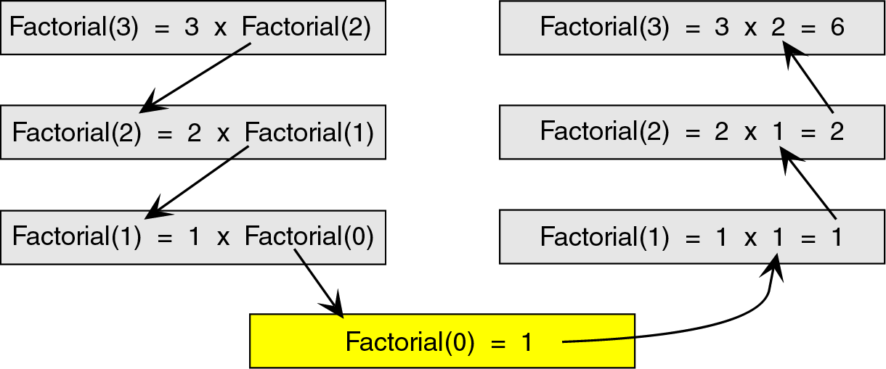
Example 1: Recursive evaluation of n!
To see how the recursion works, let’s break down the factorial function to solve factorial(3)

Slide 46
Example 1: Recursive evaluation of n!
Recurrence Relation
  M(n) = M(n-1) + 1
  M(0) = 0
Solve by the method of backward substitutions
    M(n) = M(n-1) + 1
    = [M(n-2) + 1] + 1 = M(n-2) + 2 substituted M(n-2) for M(n-1)
    = [M(n-3) + 1] + 2 = M(n-3) + 3 substituted M(n-3) for M(n-2)
    .. a pattern evolves
    = M(0) + n
    = n
Therefore M(n) ε Θ(n)

Slide 47
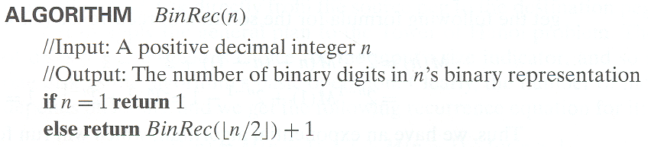
Example 2: Counting #bits - Analysis

Slide 48
Example 2: Counting #bits
Recursive relation including initial conditions
  A(n) = A(floor(n/2)) + 1, IC A(1) = 0
substitute n = 2^{k} (also k = lg(n))
  A(2^{k}) = A(2^{k-1}) + 1 and IC A(2⁰) = 0
  A(2^{k}) = [A(2^{k-2}) + 1] + 1 = A(2^{k-2}) + 2
  = [A(2^{k-3}) + 1] + 2 = A(2^{k-3}) + 3
  ...
  = A(2^{k-i}) + i
  ...
  = A(2^{k-k}) + k
  A(2^{k}) = k
Substitute back k = lg(n)
A(n) = lg(n) ε Θ(lg n)

Slide 49
Example 3: Tower of Hanoi
A
B
C
A
B
C
Given: Three Pegs A, B and C
  Peg A initially has n disks, different size, stacked up,
  larger disks are below smaller disks
Problem: to move the n disks to Peg C, subject to
  Can move only one disk at a time
  Smaller disk should be above larger disk
  Can use other peg as intermediate
Notes:
*
07/16/96
*
##

Slide 50
Tower of Hanoi
How to Solve: Strategy…
  Generalize first: Consider n disks for all n ≥ 1
  Our example is only the case when n=4
Look at small instances…
  How about n=1
    Of course, just “Move disk 1 from A to C”
  How about n=2?
    “Move disk 1 from A to B”
    “Move disk 2 from A to C”
    “Move disk 1 from B to C”

Slide 51
Tower of Hanoi (Solution!)
General Method:
  First, move first (n-1) disks from A to B
  Now, can move largest disk from A to C
  Then, move first (n-1) disks from B to C
Try this method for n=3
    “Move disk 1 from A to C”
    “Move disk 2 from A to B”
    “Move disk 1 from C to B”
    “Move disk 3 from A to C”
    “Move disk 1 from B to A”
    “Move disk 1 from B to C”
    “Move disk 1 from A to C”

Slide 52
Algorithm for Towel of Hanoi (recursive)
Recursive Algorithm
  when (n=1), we have simple case
  Else (decompose problem and make recursive-calls)
Hanoi(n, A, B, C);
(* Move n disks from A to C via B *)
begin
if (n=1) then “Move top disk from A to C”
else (* when n>1 *)
Hanoi (n-1, A, C, B);
“Move top disk from A to C”
Hanoi (n-1, B, C, A);
endif
end;

Slide 53
Analysis of TOH
Recursive relation for moving n discs
  M(n) = M(n-1) + 1 + M(n-1) = 2M(n-1) + 1
  IC: M(1) = 1
Solve using backward substitution
  M(n) = 2M(n-1) + 1
  = 2[2M(n-2) + 1] +1 = 2²M(n-2) + 2+1
  =2²[2M(n-3) +1] + 2+1 = 2³M(n-3) + 2² + 2 + 1
  ..
  M(n) = 2^{i}M(n-i) + ∑_{j=0}^{-i}2^{j} = 2^{i}M(n-i) + 2^{i}-1
  ...
  M(n) = 2^{n-1}M(n-(n-1)) + 2^{n-1}-1 = 2^{n-1}M(1) + 2^{n-1}-1 = 2^{n-1} + 2^{n-1}-1 = 2^{n}-1
  M(n) ε Θ(2^{n})

Slide 54
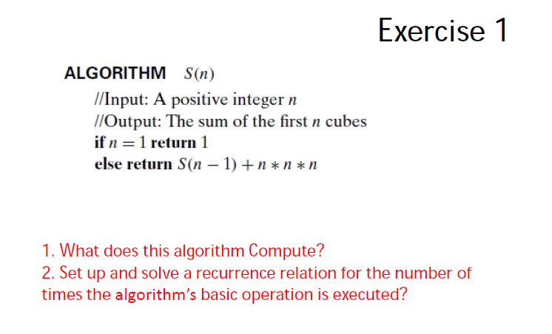
Exercises

Slide 55
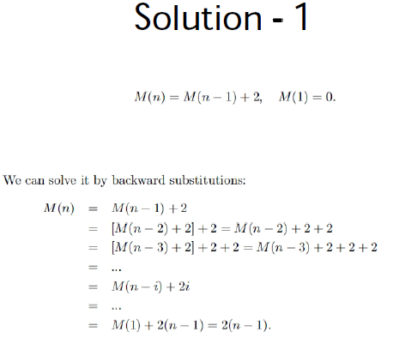
Exercises

Slide 56
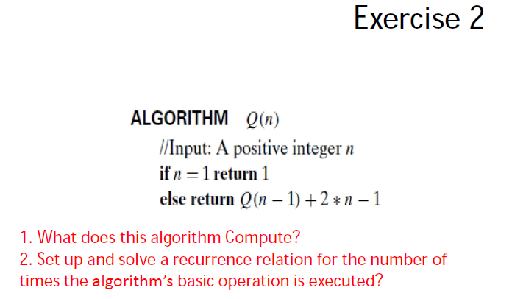
Exercises

Slide 57
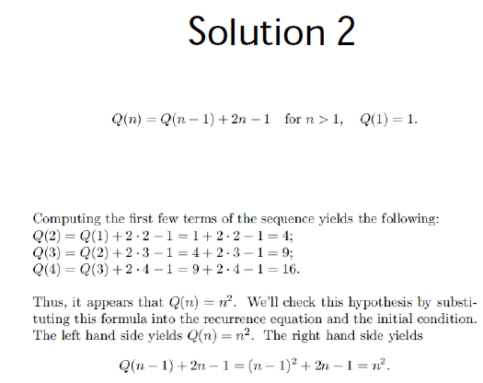
Exercises

Slide 58
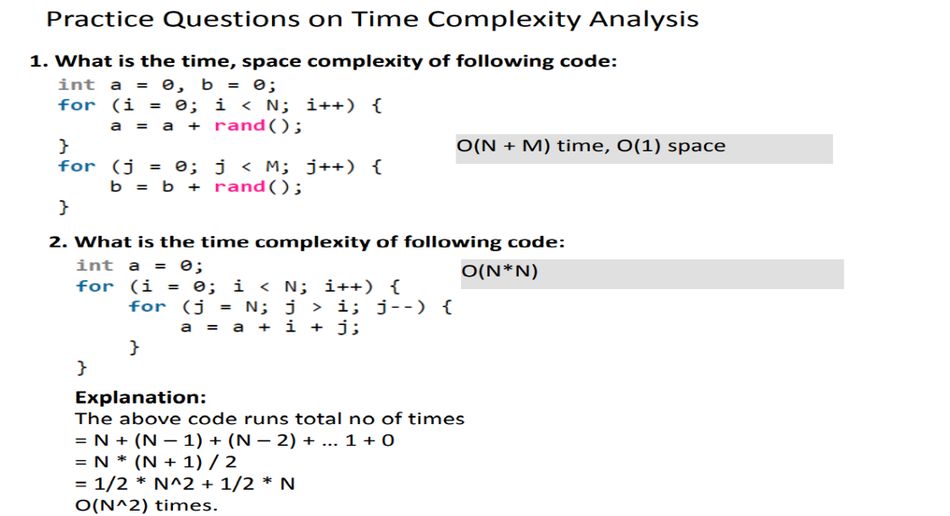

Slide 59
