Slide 1
Module 2: Stacks
ITA5002 – Problem Solving with Data Structures and Algorithms

Slide 2
Abstract Data Type
The ADT is special kind of datatype, whose behavior is defined by a set of values and set of operations.
ADT is a type (or class) for objects whose behavior is defined by a set of values and a set of operations.
The keyword “Abstract” is used as we can use these datatypes, we can perform different operations.
Those operations are hidden from the user.
The ADT is made of with primitive datatypes, but operation logics are hidden.

Slide 3
Stack ADT
Stack can be defined as a container in which insertion and deletion can be done from the one end known as the top of the stack.
A stack is a list with the restriction that insertions and deletions can be performed in only one position, namely, the end of the list, called the top.

Slide 4

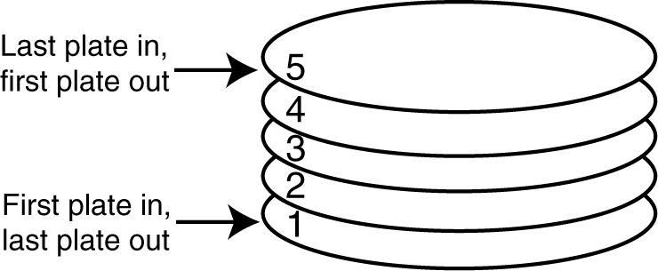
Stack ADT
A stack is a data structure that stores and retrieves items in a last-in-first-out (LIFO) manner.

Slide 5
Stack ADT - Applications
Computer execution systems use stacks during a program’s to store function return addresses, local variables, etc.
Some calculators use stacks for performing mathematical operations.
Maze Problem
Infix and Postfix Evaluation
Breadth First Search
Undo sequence in a text editor
Browser History

Slide 6
Stack ADT – Limitations
Once an array is created, its size cannot be altered.
Array provides inadequate support for inserting, deleting, sorting, and searching operations.

Slide 7
Stack ADT – Static and Dynamic Stacks
Static Stacks
  Fixed size
  Can be implemented with an array
Dynamic Stacks
  Grow in size as needed
  Can be implemented with a linked list

Slide 8
Stack ADT – Implementations
Basic Operations
Push
  causes a value to be stored in (pushed onto) top of the stack
Pop
  retrieves and removes a value from the top of the stack
  need to keep the index of or have a pointer to the top element

Slide 9
Stack ADT – Implementations
Basic Operations
peek() − get the top data element of the stack, without removing it.
isFull() − check if stack is full.
isEmpty() − check if stack is empty.
A stack can be implemented by means of Array, Structure, Pointer and Linked List.
Stack can either be a fixed size one or it may have a sense of dynamic resizing.

Slide 10
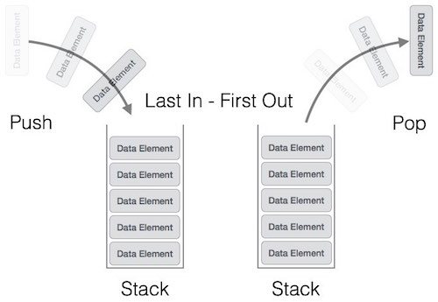
Stack ADT – Implementations

Slide 11
Stack ADT – Push Operation
The process of putting a new data element onto stack is known as a Push Operation. Push operation involves a series of steps −
Step 1 − Checks if the stack is full.
Step 2 − If the stack is full, produces an error and exit. (Overflow)
Step 3 − If the stack is not full, increments top to point next empty space. (top=top+1)
Step 4 − Adds data element to the stack location, where top is pointing. (new element becomes top)
Step 5 − Returns success.

Slide 12
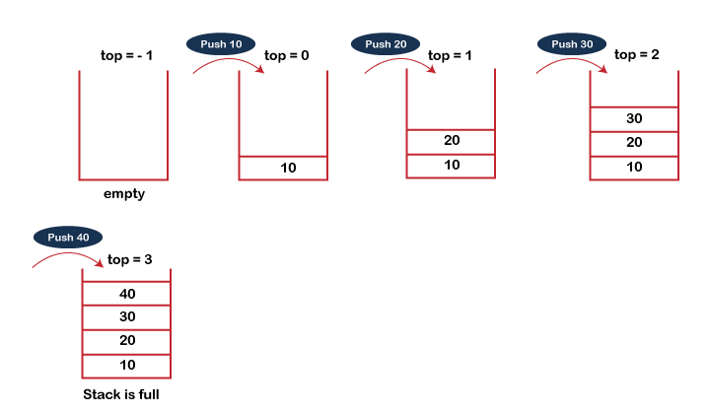
Stack ADT – Push Operation

Slide 13
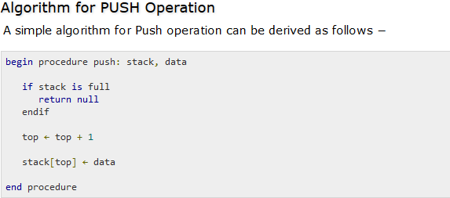
Stack ADT – Push Operation

Slide 14
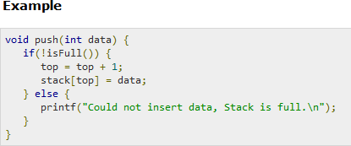
Stack ADT – Push Operation

Slide 15
Stack ADT – Pop Operation
Accessing the content while removing it from the stack, is known as a Pop Operation.
In an array implementation of pop() operation, the data element is not actually removed, instead top is decremented to a lower position in the stack to point to the next value.
But in linked-list implementation, pop() actually removes data element and deallocates memory space.

Slide 16
Stack ADT – Pop Operation
A Pop operation may involve the following steps −
Step 1 − Checks if the stack is empty.
Step 2 − If the stack is empty, produces an error and exit. (Underflow)
Step 3 − If the stack is not empty, accesses the data element at which top is pointing.
Step 4 − Decreases the value of top by 1.(top=top-1)
Step 5 − Returns success.

Slide 17
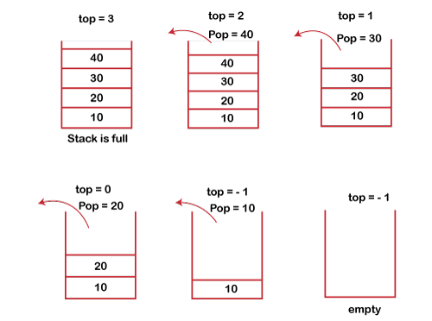
Stack ADT – Pop Operation

Slide 18
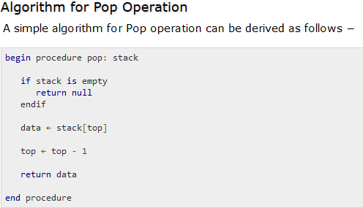
Stack ADT – Pop Operation

Slide 19
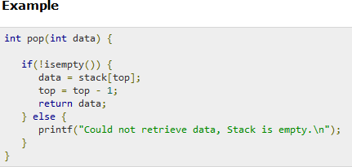
Stack ADT – Pop Operation

Slide 20
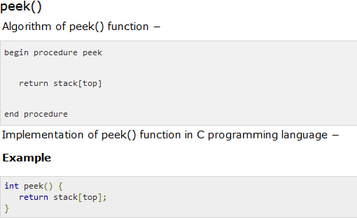

Slide 21
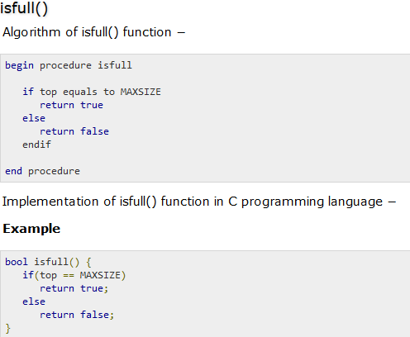

Slide 22
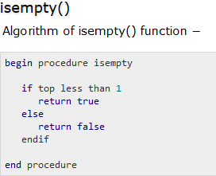
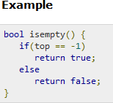

Slide 23
Stack Summary
Stack Operation Complexity for Different
Implemen
tations
 | Array Fixed-Size | Array Expandable (doubling strategy) | Singly Linked List
Pop() | O(1) | O(1) | O(1)
Push(o) | O(1) | O(n) Worst Case O(1) Best Case O(1) Average Case | O(1)
Top() | O(1) | O(1) | O(1)
Size(), isEmpty() | O(1) | O(1) | O(1)

Slide 24
Applications of Stacks
Balancing Parenthesis
Evaluating Postfix Expression
Infix to postfix Conversion (reverse polish notation)
Infix to prefix Conversion (Polish Notation)
Function calls

Slide 25
Arithmetic Expressions
One of the most important applications of stacks is the evaluation of arithmetic expressions
An expression consists of constants, variables, and symbols. Symbols can be operators or parenthesis.
Consider the simple arithmetic expression
  X + Y
We have three possibilities for the positioning of the operator.

Slide 26
Arithmetic Expressions – Expression Parsing
The way to write arithmetic expression is known as a notation.
An arithmetic expression can be written in three different but equivalent notations, i.e., without changing output of an expression. These notations are −
Infix Notation
Prefix (Polish) Notation
Postfix (Reverse-Polish) Notation

Slide 27
Arithmetic Expressions – Infix Notation
We write expression in infix notation, e.g. a - b + c, where operators are used in-between operands.
It is easy for us humans to read, write, and speak in infix notation but the same does not go well with computing devices.
An algorithm to process infix notation could be difficult and costly in terms of time and space consumption.

Slide 28
Arithmetic Expressions – Prefix Notation
In this notation, operator is prefixed to operands, i.e. operator is written ahead of operands.
For example, + a b. This is equivalent to its infix notation a + b.
Prefix notation is also known as Polish Notation.

Slide 29
Arithmetic Expressions – Postfix Notation
This notation style is known as Reversed Polish Notation.
In this notation style, the operator is postfixed to the operands i.e., the operator is written after the operands.
For example, ab+. This is equivalent to its infix notation a + b.

Slide 30
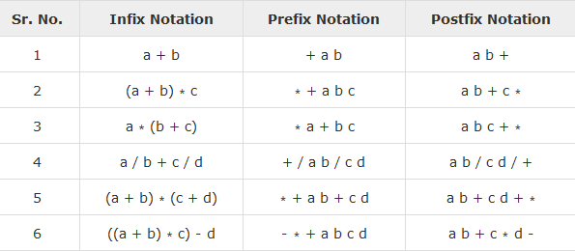

Slide 31

Operator Precedence
When an operand is in between two different operators, which operator will take the operand first, is decided by the precedence of an operator over others. For example −
As multiplication operation has precedence over addition, b * c will be evaluated first. A table of operator precedence is provided later.

Slide 32
Associativity
Associativity describes the rule where operators with the same precedence appear in an expression.
For example, in expression a + b − c, both + and – have the same precedence, then which part of the expression will be evaluated first, is determined by associativity of those operators.
Here, both + and − are left associative, so the expression will be evaluated as (a + b) − c.

Slide 33
Operator Precedence
Sr. No. | Operator | Precedence
1 | Exponentiation ^ | Highest
2 | Multiplication ( ∗ ) & Division ( / ) | Second Highest
3 | Addition ( + ) & Subtraction ( − ) | Lowest

Slide 34
Conversion of Infix to Postfix
Use the stack data structure for the conversion of infix expression to prefix expression.
Whenever an operator will encounter, we push operator into the stack.
If we encounter an operand, then we append the operand to the expression.

Slide 35
Rules for the conversion from infix to postfix expression
Print the operand as they arrive.
If the stack is empty or contains a left parenthesis on top, push the incoming operator on to the stack.
If the incoming symbol is '(', push it on to the stack.
If the incoming symbol is ')', pop the stack and print the operators until the left parenthesis is found.
If the incoming symbol has higher precedence than the top of the stack, push it on the stack.

Slide 36
Rules for the conversion from infix to postfix expression
If the incoming symbol has lower precedence than the top of the stack, pop and print the top of the stack. Then test the incoming operator against the new top of the stack.
If the incoming operator has the same precedence with the top of the stack then use the associativity rules. If the associativity is from left to right then pop and print the top of the stack then push the incoming operator. If the associativity is from right to left then push the incoming operator.
At the end of the expression, pop and print all the operators of the stack.

Slide 37
Infix Expression : A+(B*C+D)/E
Input Token | Stack | Postfix Expression | Action
A |  | A | Add A into expression string
+ | + | A | Push ‘+’ into stack
( | +( | A | Push ( into stack
B | +( | AB | Add B into expression string
* | +(* | AB | Push ‘*’ into stack
C | +(* | ABC | Add C into expression string
+ | +(+ | ABC* | ‘+’ operator has less precedence than ‘*’, so pop * and add to expression string
D | +(+ | ABC*D | Add D into expression string
) | + | ABC*D+ | ) has come so pop + and add it to expression string
/ | +/ | ABC*D+ | / has higher precedence than + so push / into stack
E | +/ | ABC*D+E/+ | Add E into expression string and pop all operators one by one from stack and add it to expression string

Slide 38
Infix expression: K + L - M*N + (O^P) * W/U/V * T + Q
Input Expression | Stack | Postfix Expression
K |  | K
+ | +
L | + | K L
- | - | K L+
M | - | K L+ M
* | - * | K L+ M
N | - * | K L + M N
+ | + | K L + M N* K L + M N* -
( | + ( | K L + M N *-
O | + ( | K L + M N * - O
^ | + ( ^ | K L + M N* - O
P | + ( ^ | K L + M N* - O P
) | + | K L + M N* - O P ^
* | + * | K L + M N* - O P ^
W | + * | K L + M N* - O P ^ W
/ | + / | K L + M N* - O P ^ W *
U | + / | K L + M N* - O P ^W*U
/ | + / | K L + M N* - O P ^W*U/
V | + / | KL + MN*-OP^W*U/V
* | + * | KL+MN*-OP^W*U/V/
T | + * | KL+MN*-OP^W*U/V/T
+ | + | KL+MN*-OP^W*U/V/T* KL+MN*-OP^W*U/V/T*+
Q | + | KL+MN*-OP^W*U/V/T*Q
 |  | KL+MN*-OP^W*U/V/T*+Q+

Slide 39
Balancing Parenthesis
The parentheses are used to represent the mathematical representation.
The balanced parentheses problem is one of the common programming problems that is also known as Balanced brackets.
Characters such as "(", ")", "[", "]", "{", and "}" are considered brackets.
The balanced parenthesis means that when the opening parenthesis is equal to the closing parenthesis, then it is a balanced parenthesis.
Every right brace, bracket, and parenthesis must correspond to its left counterpart.

Slide 40
Balancing Parenthesis
Make an empty stack.
Read characters until end of file.
  If the character is an opening symbol, push it onto the stack.
  If it is a closing symbol and the stack is empty, report an error. Otherwise, pop the stack.
If the symbol popped is not the corresponding opening symbol, then report an error.
At end of file, if the stack is not empty, report an error.

Slide 41
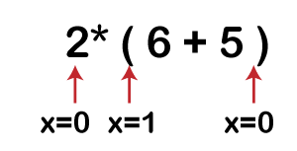
Balancing Parenthesis
Solution: First, the x variable is initialized by 0. The scanning starts from the variable '2', when it encounters '(' then the 'x' variable gets incremented by 1 and when the x reaches to the last symbol of the expression, i.e., ')' then the 'x' variable gets decremented by 1 and it's final value becomes 0. We have learnt in the above algorithm that if x is equal to 0 means the expression is balanced; therefore, the above expression is a balanced expression.

Slide 42
Evaluating Postfix Expressions
Postfix notation (Reverse Polish Notation) is a way to represent an expression, where operators follow their corresponding operands.
Evaluating an expression represented as postfix notation can easily be done using the stack data structure.
Example 1
Input : 2 3 * 4 5 + * Output: 54
Example 2
Input : 5 2 3 * * Output: 30
Example 3
Input : 2 3 1 * + 9 - Output: -4

Slide 43
Evaluating Postfix Expressions
Begin
for each character ch in the postfix expression, do
if ch is an operator op , then
a := pop first element from stack
b := pop second element from the stack
res := b op a
push res into the stack
else if ch is an operand, then
add ch into the stack
done
return element of stack top
End

Slide 44
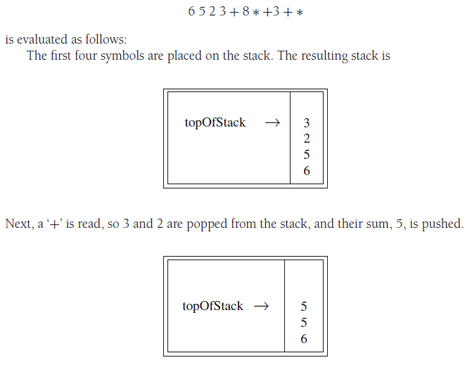
Evaluating Postfix Expressions

Slide 45
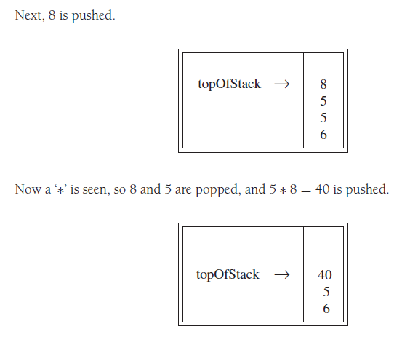
Evaluating Postfix Expressions

Slide 46
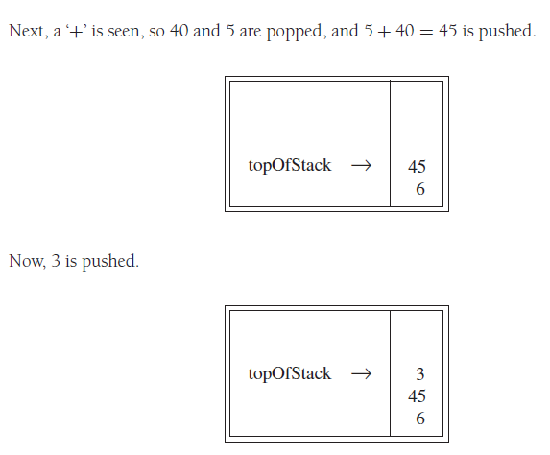
Evaluating Postfix Expressions

Slide 47
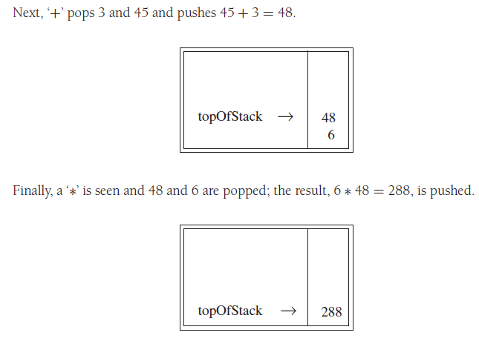
Evaluating Postfix Expressions

Slide 48
Evaluating Postfix Expressions
Example: 10 22 + 8 / 6 * 5 +
The time to evaluate a postfix expression is O(N), because processing each element in the input consists of stack operations and therefore takes constant time.
The algorithm to do so is very simple.
Notice that when an expression is given in postfix notation, there is no need to know any precedence rules; this is an obvious advantage.

