Slide 1
Module 2: Linked List
ITA5002 – Problem Solving with Data Structures and Algorithms

Slide 2
Linked List
Linked list is a linear data structure that includes a series of connected nodes.
Linked list can be defined as the nodes that are randomly stored in the memory.
A node in the linked list contains two parts, i.e., first is the element (data) and second is the address of the next element (next pointer).
The last node of the list contains a pointer to the null.
It does not waste memory space.
It can grow or shrink in size during execution of a program.
head
A
B
C

Slide 3
Linked List
Linked list is useful because –
It allocates the memory dynamically.
All the nodes of the linked list are non-contiguously stored in the memory and linked together with the help of pointers.
In linked list, size is no longer a problem since we do not need to define its size at the time of declaration.
The declaration of linked list is given as follows –
struct node {
int data;
struct node *next;
}

Slide 4
Linked List – Basic Operations
Keeping track of a linked list:
  Must know the pointer to the first element of the list (called start, head, etc.).
Linked lists provide flexibility in allowing the items to be rearranged efficiently.
  Insert an element
  Delete an element
Other Operations
  Creating a list
  Traversing the list
  Concatenating two lists into one

Slide 5
Basic Operations – Creating a List
To start with, we have to create a node (the first node), and make head point to it.
Node Creation
struct node
{
int data;
struct node *next;
};
struct node *head, *ptr;
ptr = (struct node *)malloc(sizeof(struct node *));

Slide 6
Basic Operations – Creating a List
Example
  struct stud {
  int roll;
  char name[25];
  int age;
  struct stud *next;
  };
  /* A user-defined data type called “node” */
  typedef struct stud node;
  node *head;

Slide 7
Basic Operations – Creating a List
Example
head
roll
name
age

Slide 8
Basic Operations – Insert an Element
When a node is added at the beginning,
  Only one next pointer needs to be modified.
    head is made to point to the new node.
    New node points to the previously first element.
When a node is added at the end,
  Two next pointers need to be modified.
    Last node now points to the new node.
    New node points to NULL.
When a node is added in the middle,
  Two next pointers need to be modified.
    Previous node now points to the new node.
    New node points to the next node.

Slide 9
Illustration: Insertion
A
B
C
X
Item to be inserted
tmp
A
A
B
C
curr
X

Slide 10
Pseudo-code for insertion
typedef struct nd {
struct item data;
struct nd * next;
} node;
void insert(node *curr)
{
node * tmp;
tmp=(node *) malloc(sizeof(node));
tmp->next=curr->next;
curr->next=tmp;
}

Slide 11
Inserting a node in singly linked list
Insert node at End
while(p->next != NULL)
{
p=p-> next;
}
p->next = new_node; new_node->next=NULL
Insert node at beginning
new_node->next= head;
head= new_node;
Insert node at Middle while(p!= insert-position)
{
p=p->next;
}
store_next=p->next;
P->next=new_node;
New_node ->next = store_next;

Slide 12
Basic Operations – Delete an Element
Here also we are required to delete a specified node.
  Say, the node whose roll field is given.
Here also three conditions arise:
  Deleting the first node.
  Deleting the last node.
  Deleting an intermediate node.

Slide 13
Illustration: Deletion
Item to be deleted
A
B
C
tmp
curr
A
B
C

Slide 14
Pseudo-code for Deletion
typedef struct nd {
struct item data;
struct nd * next;
} node;
void delete(node *curr)
{
node * tmp;
tmp=curr->next;
curr->next=tmp->next;
free(tmp);
}

Slide 15
Deleting a node in singly linked list
Node *delete(node* head, char d)
{
node*p, *q; q=head;
if(q->data==d)// start node
{
head=p; delete(q);
}
else
{
while(p->data!=d)
{
p=p->next;
q=q->next;
}
if(p->next==NULL)//Last
{
q->next=NULL
delete(p);
}
else
{
q->next=p->next;//middle delete(p);
}
}
}

Slide 16
Try Yourself
Write a function to:
  Concatenate two given list into one big list.
    node *concatenate (node *head1, node *head2);
  Insert an element in a linked list in sorted order. The function will be called for every element to be inserted.
    void insert_sorted (node **head, node *element);

Slide 17
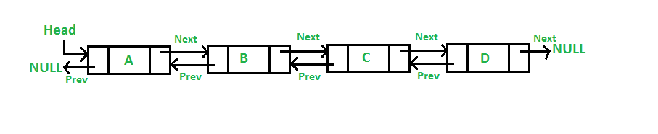
Doubly Linked List
Doubly linked list is a type of linked list in which a node contains a pointer to the previous as well as the next node in the sequence.
In a doubly linked list, a node consists of three parts: node data, pointer to the next node in sequence (next pointer) , pointer to the previous node (previous pointer).
A sample structure of a doubly linked list is shown in the figure.

Slide 18
Doubly Linked List
In C, structure of a node in doubly linked list can be given as :
    struct node
    {
    struct node *prev;
    int data;
    struct node *next;
    }
The prev part of the first node and the next part of the last node will always contain null indicating end in each direction.

Slide 19
Doubly Linked List
Advantages of DLL over the singly linked list:
A DLL can be traversed in both forward and backward directions.
The delete operation in DLL is more efficient if a pointer to the node to be deleted is given.
We can quickly insert a new node before a given node.
Disadvantages of DLL over the singly linked list:
Every node of DLL Requires extra space for a previous pointer.
All operations require an extra pointer previous to be maintained.

Slide 20
Doubly Linked List - Insertions
A node can be added in four ways:
At the front of the DLL
Node in the middle
At the end of the DLL

Slide 21
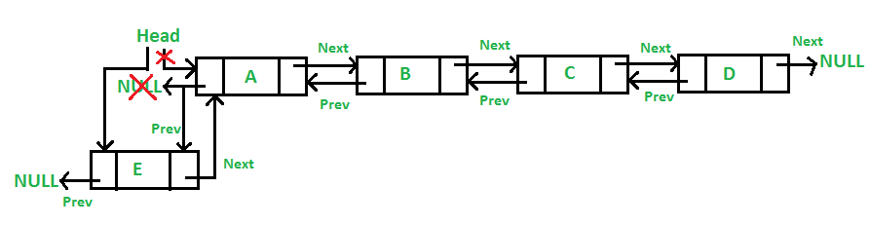
Doubly Linked List - Insertions
Insertion at the front of the DLL
The new node is always added before the head of the given Linked List. And newly added node becomes the new head of DLL.

Slide 22
Doubly Linked List - Insertions
Insertion at the front of the DLL
void insert(struct Node** head_ref, int new_data)
{
struct Node* new_node = (struct Node*)malloc(sizeof(struct Node));
new_node->data = new_data;
new_node->next = (*head_ref);
new_node->prev = NULL;
if ((*head_ref) != NULL)
(*head_ref)->prev = new_node;
(*head_ref) = new_node;
}

Slide 23
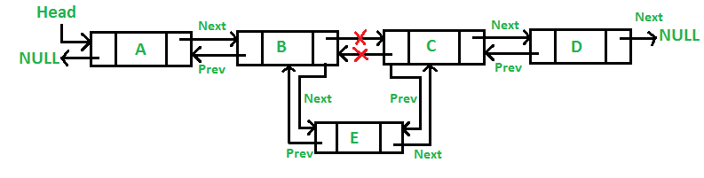
Doubly Linked List - Insertions
Insert Node at middle
We are given a pointer to a node as prev node, and the new node is inserted after the given node.

Slide 24
Doubly Linked List - Insertions
Insert Node at middle
void insertAfter(struct Node* prev_node, int new_data)
{
if (prev_node == NULL) {
printf("the given previous node cannot be NULL");
return;
}
struct Node* new_node = (struct Node*)malloc(sizeof(struct Node));
new_node->data = new_data;
new_node->next = prev_node->next;
prev_node->next = new_node;
new_node->prev = prev_node;
if (new_node->next != NULL)
new_node->next->prev = new_node;
}

Slide 25
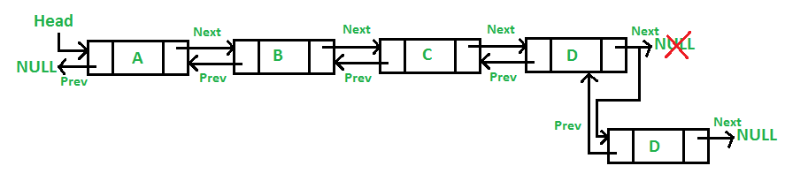
Doubly Linked List - Insertions
Add a node at the end:
The new node is always added after the last node of the given Linked List.
For example, if the given DLL is 5->1->0->1->5->2 and we add item 30 at the end, then the DLL becomes 5->1->0->1->5->2->30.
Since a Linked List is typically represented by its head of it, we have to traverse the list till the end and then change the next of last node to the new node.

Slide 26
Doubly Linked List - Insertions
Add a node at the end:
struct Node* new_node = (struct Node*)malloc(sizeof(struct Node));
struct Node* last = *head_ref;
new_node->data = new_data;
new_node->next = NULL;
if (*head_ref == NULL) {
new_node->prev = NULL;
*head_ref = new_node;
return;
}
while (last->next != NULL)
last = last->next;
last->next = new_node;
new_node->prev = last;
return;
}

Slide 27
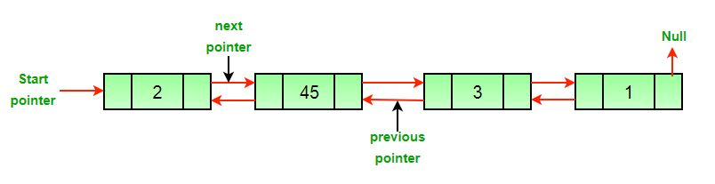
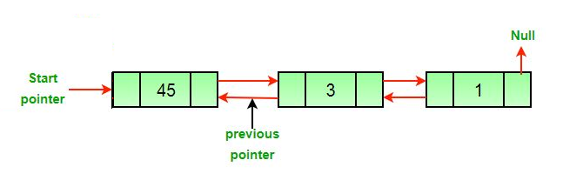
Doubly Linked List - Deletion
After the deletion of the head node.

Slide 28
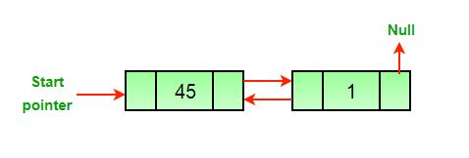
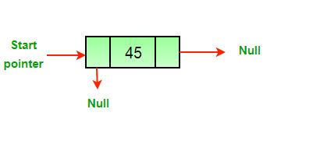
Doubly Linked List - Deletion
After the deletion of the middle node.
After the deletion of the last node.

Slide 29
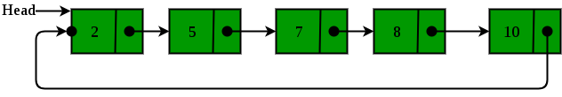
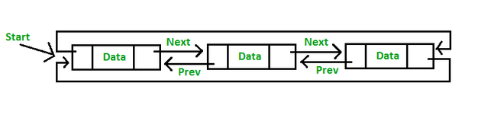
Circular Linked List
The circular linked list is a linked list where all nodes are connected to form a circle.
In a circular linked list, the first node and the last node are connected to each other which forms a circle.
There is no NULL at the end.

Slide 30
Circular Linked List - Representation
struct Node{
int value;
Node next;
}
Operations on the circular linked list:
We can do some operations on the circular linked list similar to the singly linked list which are:
Insertion
Deletion

Slide 31
Circular Linked List - Representation
1. Insertion in the circular linked list:
A node can be added in three ways:
Insertion at the beginning of the list
Insertion at the end of the list
Insertion in between the nodes
1) Insertion at the beginning of the list: To insert a node at the beginning of the list, follow these steps:
  Create a node, say T.
  Make T -> next = last -> next.
  last -> next = T.

Slide 32
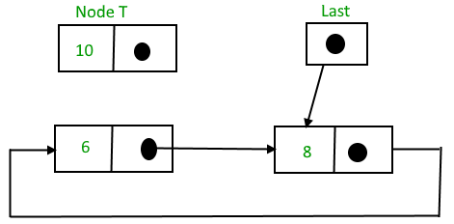
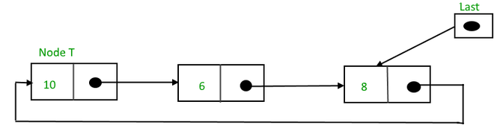
Circular Linked List - Insertion

Slide 33
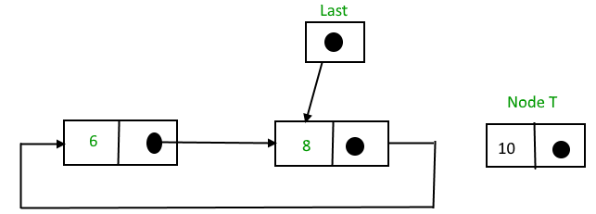
Circular Linked List - Insertion
2) Insertion at the end of the list: To insert a node at the end of the list, follow these steps:
  Create a node, say T.
  Make T -> next = last -> next;
  last -> next = T.
  last = T.

Slide 34
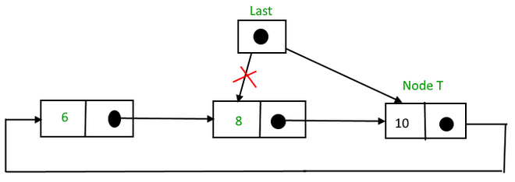
Circular Linked List - Insertion

Slide 35
Circular Linked List - Insertion
3) Insertion in between the nodes: To insert a node in between the two nodes, follow these steps:
  Create a node, say T.
  Search for the node after which T needs to be inserted, say that node is P.
  Make T -> next = P -> next;
  P -> next = T.

Slide 36
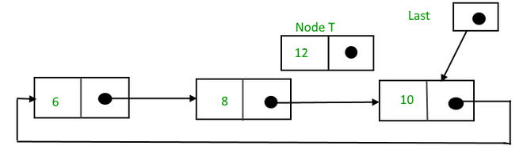
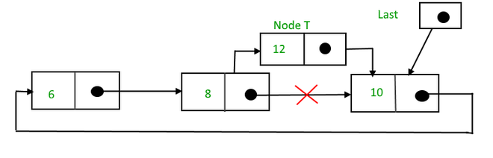
Circular Linked List - Insertion

Slide 37
Circular Linked List - Deletion
1) Delete the node only if it is the only node in the circular linked list:
Free the node’s memory
The last value should be NULL node always points to another node, so NULL assignment is not necessary.
2) Deletion of the last node:
Locate the node before the last node (let it be temp)
Keep the address of the node next to the last node in temp
Delete the last memory
Put temp at the end

Slide 38
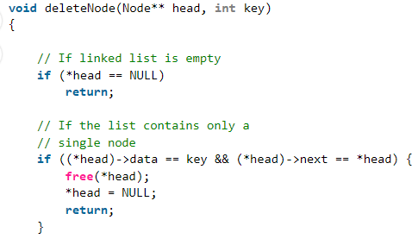
Circular Linked List - Deletion
3) Delete any node from the circular linked list:
We will be given a node and our task is to delete that node from the circular linked list.

Slide 39
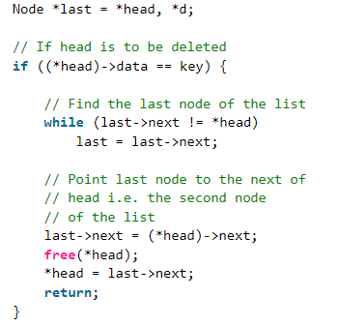
Circular Linked List - Deletion

Slide 40
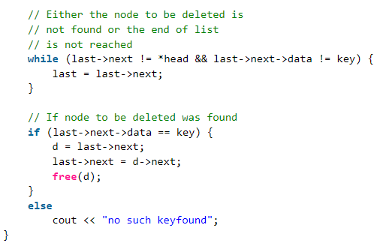
Circular Linked List - Deletion

Slide 41
Circular Linked List
Advantages of Circular Linked Lists:
Can traverse the whole list by starting from any point.
Useful for implementation of a queue.
Circular lists are useful in applications to repeatedly go around the list.
Circular Doubly Linked Lists are used for the implementation of Fibonacci Heap.
Applications of circular linked lists:
Multiplayer games use this to give each player a chance to play.
A circular linked list can be used to organize multiple running applications on an operating system. These applications are iterated over by the OS.

