Slide 1
NORMALIZATION: DATABASE DESIGN THEORY

Slide 2
Contents
Informal design guidelines for relation schemas,
Functional Dependencies,
Normal Forms Based on Primary Keys,
Second and Third Normal Forms,
Boyce-Codd Normal Form,
Multivalued Dependencies and Fourth Normal Form,
Join Dependencies and Fifth Normal Form.
Normalization Algorithms: Inference Rules,
Equivalence, and Minimal cover,
Properties of Relational Decompositions,
Algorithms for Relational Database Schema Design.

Slide 3
Informal design guidelines for relation schemas
Four informal guidelines that may be used as measures to determine the quality of relation schema design:
Making sure that the semantics of the attributes is clear in the schema
Reducing the redundant information in tuples
Reducing the NULL values in tuples
Disallowing the possibility of generating spurious tuples

Slide 4
Semantics of the Relation Attributes
Semantics, specifies how to interpret the attribute values stored in a tuple of the relation-in other words, how the attribute values in a tuple relate to one another.

Slide 5
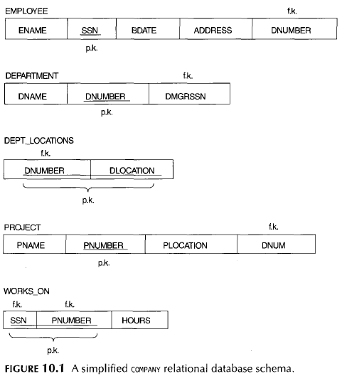

Slide 6
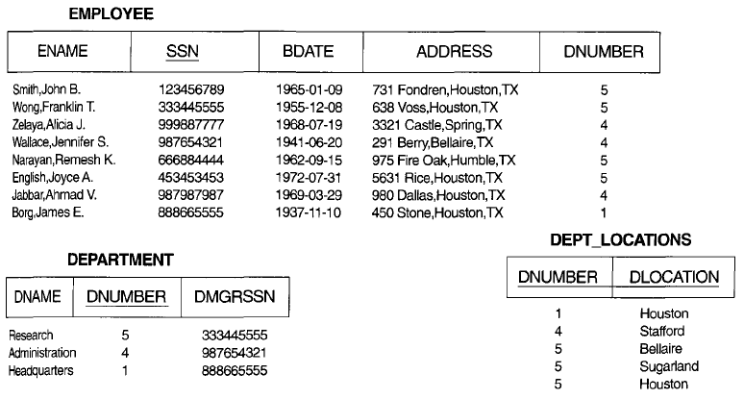
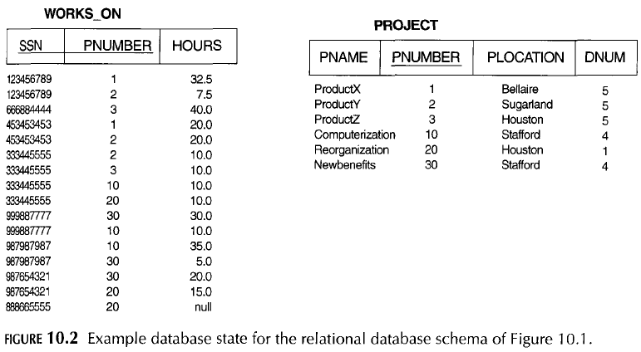

Slide 7
The DNUMBER attribute is a foreign key that represents an implicit relationship between EMPLOYEE and DEPARTMENT.
The ease with which the meaning of a relation's attributes can be explained is an informal measure of how well the relation is designed.
In DEPT_LOCATIONS and WORKS_ON, the schema DEPT_LOCATIONS represents a multi-valued attribute of DEPARTMENT, where as WORKS_ON represents an M:N relationship between EMPLOYEE and PROJ ECT
Hence, all the relation schemas may be considered as easy to explain and hence good from the standpoint of having clear semantics. We can thus formulate the following informal design guideline.

Slide 8
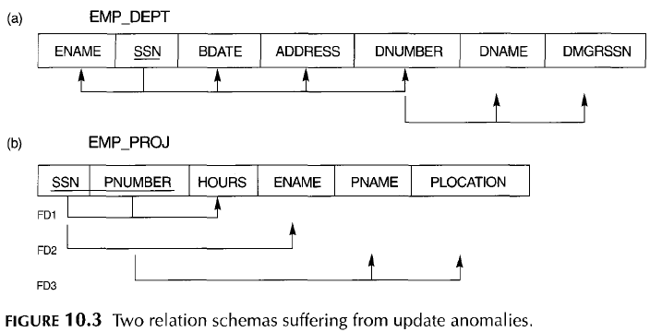
GUIDELINE 1
Design a relation schema so that it is easy to explain its meaning.
Do not combine attributes from multiple entity types and relationship types into a single relation.
There is nothing wrong logically with these two relations, they are considered poor designs because they violate Guideline 1 by mixing attributes from distinct real-world entities

Slide 9
Redundant Information in Tuples and Update Anomalies
One goal of schema design is to minimize the storage space used by the base relations.
These can be classified into
insertion anomalies,
deletion anomalies and,
modification anomalies.

Slide 10
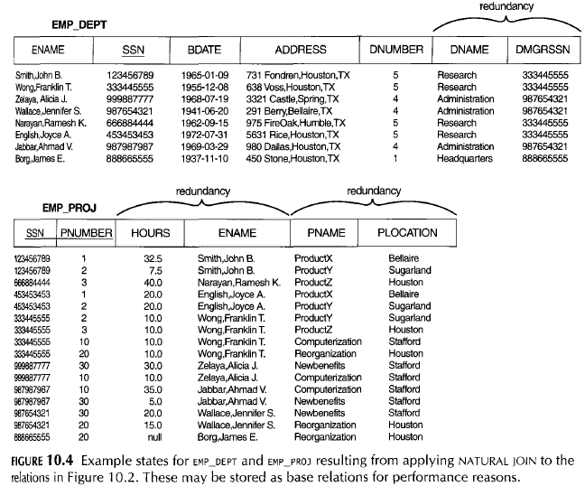

Slide 11
Insertion Anomalies:
An Insert Anomaly occurs when certain attributes cannot be inserted into the database without the presence of other attributes.
Insertion anomalies can be differentiated into two types, illustrated by the following examples based on the EMP_DEPT relation.
To insert a new employee tuple into EMP_DEPT, we must include either the attribute values for the department that the employee works for, or nulls.
It is difficult to insert a new department that has no employees as yet in the EMP_DEPT relation.

Slide 12

we can't add a new course unless we have at least one student enrolled on the course.

Slide 13

Deletion Anomalies:
A Delete Anomaly exists when certain attributes are lost because of the deletion of other attributes.
If we delete from EMP_DEPT an employee tuple that happens to represent the last employee working for a particular department, the information concerning that department is lost from the database
Consider what happens if Student S30 is the last student to leave the course - All information about the course is lost.

Slide 14

Modification Anomalies:
An Update Anomaly exists when one or more instances of duplicated data is updated, but not all.
In EMP_DEPT, if we change the value of one of the attributes of a particular department-say, the manager of department 5-we must update the tuples of all employees who work in that department; otherwise, the database will become inconsistent.
Consider Jones moving address - you need to update all instances of Jones's address.

Slide 15
Based on the preceding three anomalies, we can state the guideline that follows
GUIDELINE 2
Design the base relation schemas so that no insertion, deletion, or modification anomalies are present in the relations.
If any anomalies are present, note them clearly and make sure that the programs that update the database will operate correctly.

Slide 16
Null Values in Tuples
In some schema designs, we may group many attributes together into a "fat" relation.
If many of the attributes do not apply to all tuples in the relation, we end up with many nulls in those tuples.
Moreover, nulls can have multiple interpretations, such as the following:
The attribute does not apply to this tuple.
The attribute value for this tuple is unknown.
The value is known but absent; that is, it has not been recorded yet.

Slide 17
GUIDELINE 3:
As far as possible, avoid placing attributes in a base relation whose values may frequently be null.
If nulls are unavoidable, make sure that they apply in exceptional cases only and do not apply to a majority of tuples in the relation.

Slide 18
Generation of Spurious Tuples
A spurious tuple is, basically, a record in a database that gets created when two tables are joined badly.
Let us consider two relation schema
Emp_Locs(ename, plocation)
Emp_proj1(eno, pnumber, hours, pname, plocation)
If we attempt a natural join operation on above relation schema, the result produces many more tuples than the original set of tuples. Additional tuples that were not there in Emp_proj are called spurious tuples because they represent wrong information which is not valid

Slide 19
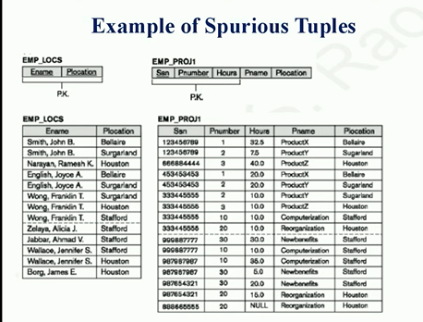

Slide 20
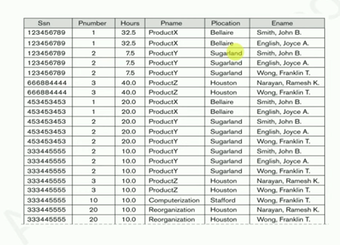

Slide 21
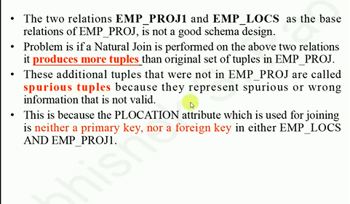

Slide 22
GUIDELINE 4
Design relation schemas so that they can be joined with equality conditions on attributes that are either primary keys or foreign keys in a way that guarantees that no spurious tuples are generated.
Avoid relations that contain matching attributes that are not (foreign key, primary key) combinations, because joining on such attributes may produce spurious tuples.

Slide 23
Summary and Discussion of Design Guidelines
The problems we pointed out, which can be detected without additional tools of analysis, are as follows:
Anomalies that cause redundant work to be done during insertion into and modification of a relation, and that may cause accidental loss of information during a deletion from a relation
Waste of storage space due to nulls and the difficulty of performing aggregation operations and joins due to null values
Generation of invalid and spurious data during joins on improperly related base relations

Slide 24
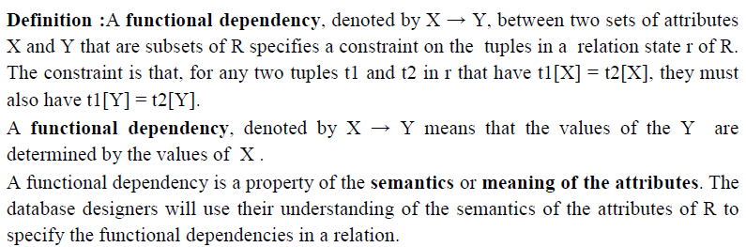
Functional Dependencies

Slide 25
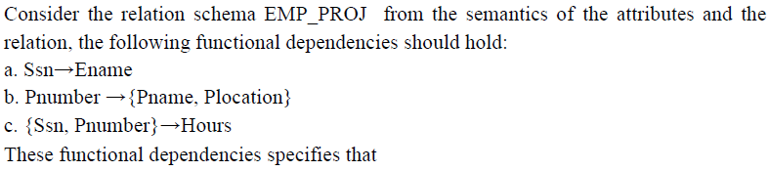
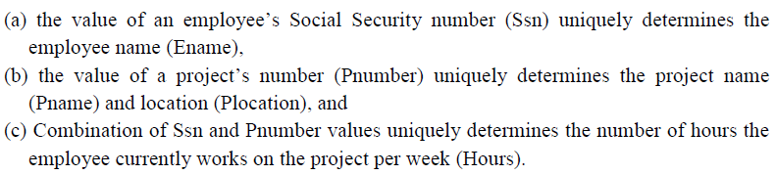

Slide 26
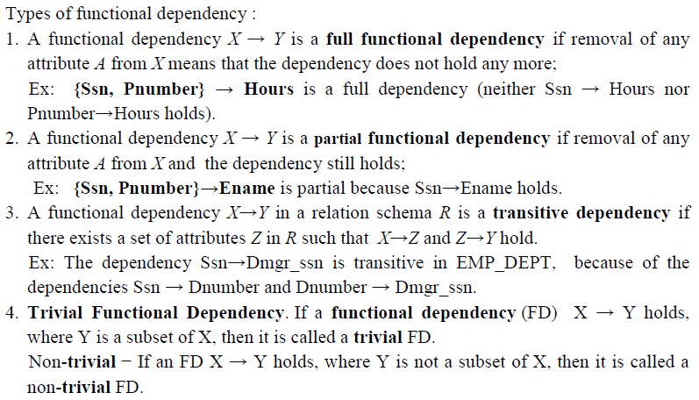

Slide 27
Normal Forms Based on Primary Keys
Normalization of Relations
The normalization process, as first proposed by Codd (1972). Codd proposed three normal forms, which he called first, second, third normal form and Boyce-Codd normal form (BCNF). All these normal forms are based on functional dependencies among the attributes of a relation. Later, a fourth normal form (4NF) and a fifth normal form (5NF) were proposed, based on the concepts of multivalued dependencies and join dependencies, respectively;

Slide 28
Normalization of data can be considered a process of analyzing the given relation schemas based on their FDs and primary keys to achieve the desirable properties of (1) minimizing redundancy and (2) minimizing the insertion, deletion, and update anomalies.
It can be considered as a “filtering” or “purification” process to make the design have successively better quality.
Definition. The normal form of a relation refers to the highest normal form condition that it meets, and hence indicates the degree to which it has been normalized.

Slide 29
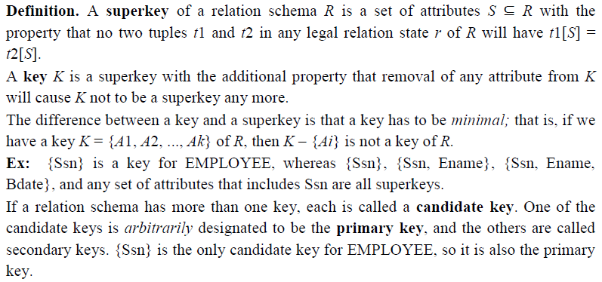
Definitions of Keys and Attributes Participating in Keys.

Slide 30
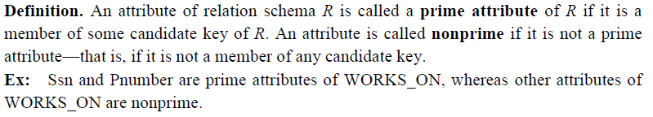

Slide 31
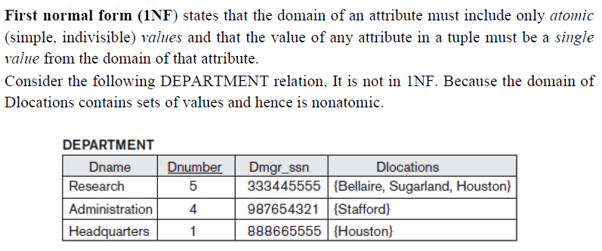
First Normal Form (1NF)

Slide 32
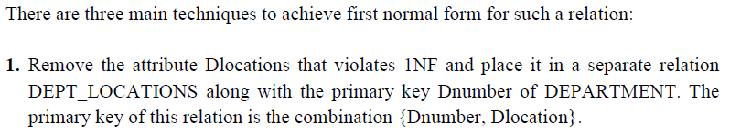
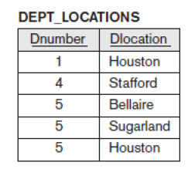

Slide 33
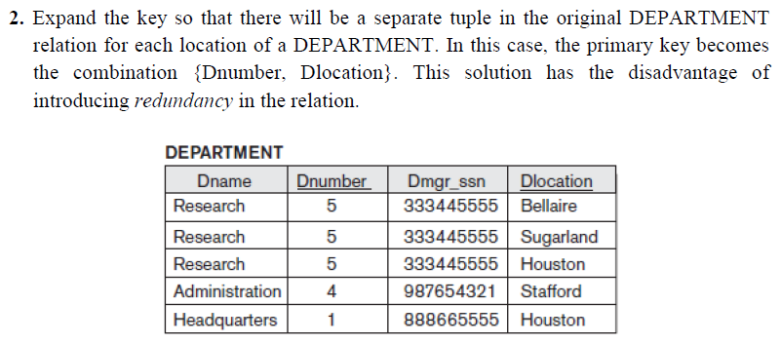

Slide 34
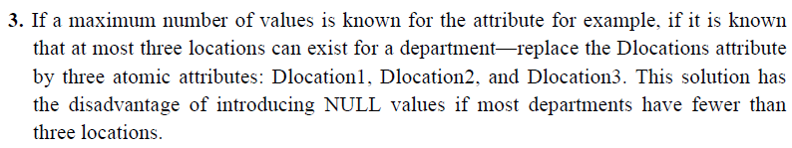

Slide 35
Remove repeating groups from the table
Create a separate table for each set of related data
Identify each set of related data with a primary key

Slide 36


Slide 37


Slide 38
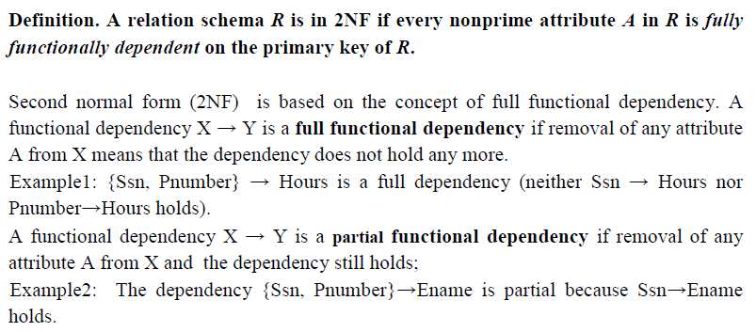
Second Normal Form (2NF)

Slide 39
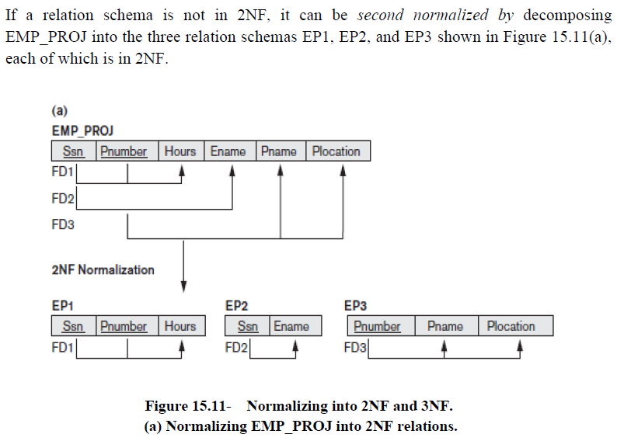

Slide 40
It has to be in 1st normal from
Table also should not contain partial dependency

Slide 41
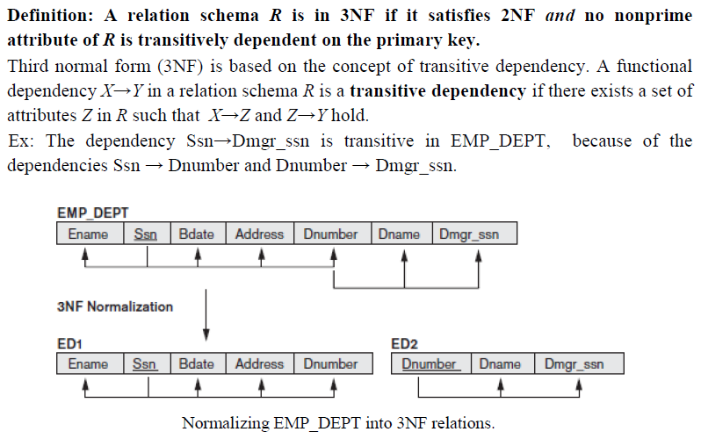
Third Normal Form (3NF)

Slide 42
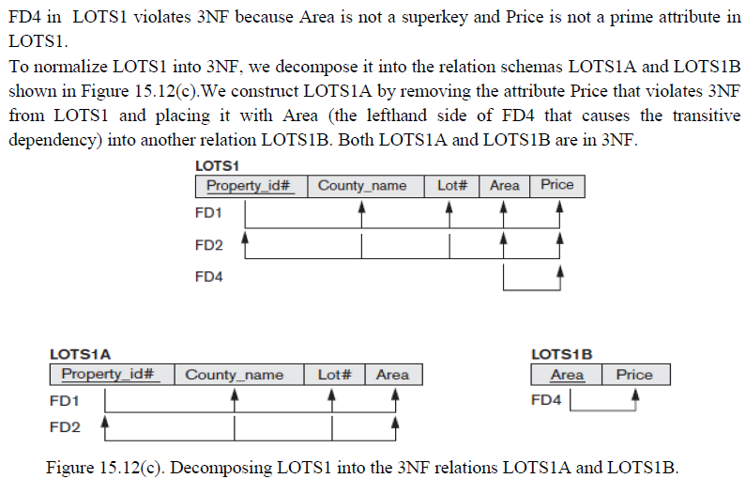

Slide 43
It has to be in 2nd Normal from
There should be no transitive dependency for non- prime attributes
Non- prime attributes must depends on the prime attributes
Need to eliminate undesirable data anomalies and to reduce the need for restructuring over time and finally.

Slide 44


Slide 45
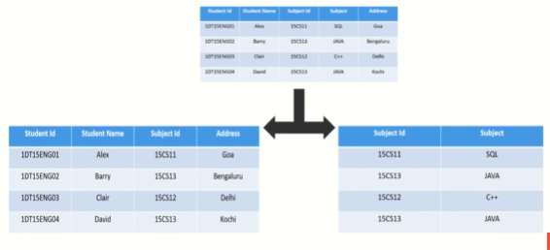

Slide 46
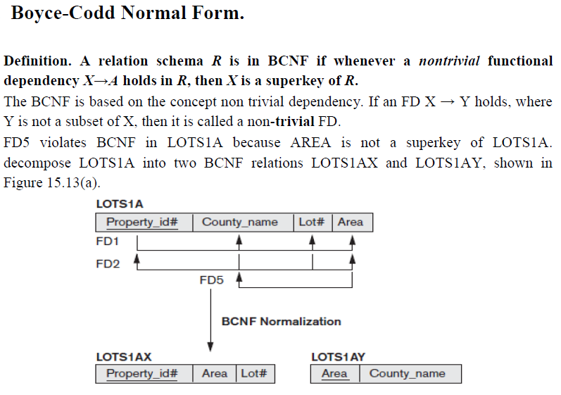

Slide 47
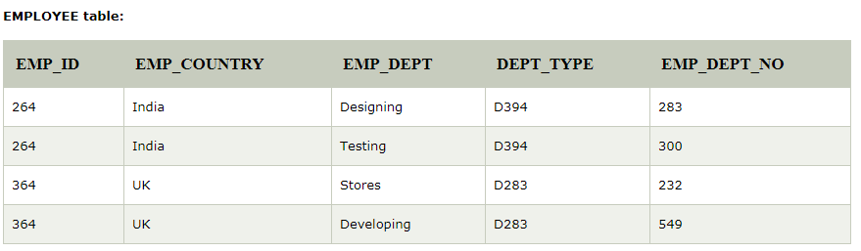
Boyce Codd normal form (BCNF)
BCNF is the advance version of 3NF. It is stricter than 3NF.
A table is in BCNF if every functional dependency X → Y, X is the super key of the table.
For BCNF, the table should be in 3NF, and for every FD, LHS is super key.
Example: Let's assume there is a company where employees work in more than one department.

Slide 48
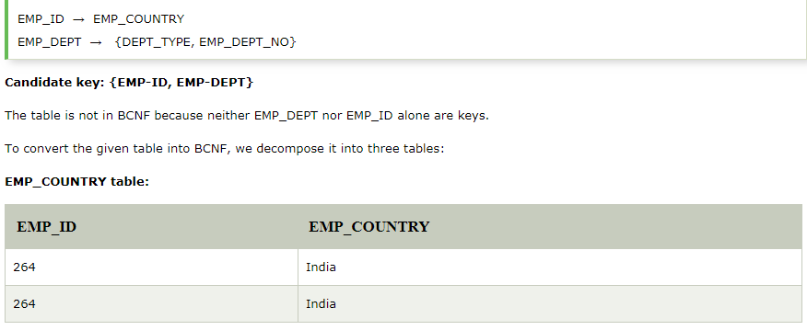

Slide 49
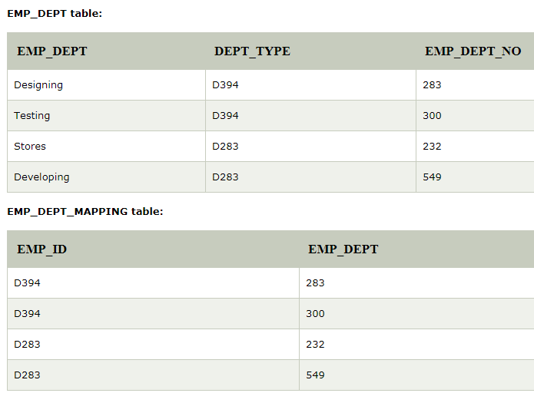

Slide 50
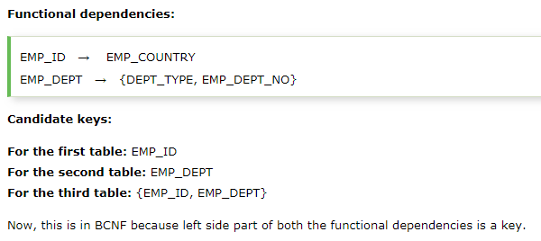

Slide 51
Fourth normal form (4NF)
A relation will be in 4NF if it is in Boyce Codd normal form and has no multi-valued dependency.
For a dependency A → B, if for a single value of A, multiple values of B exists, then the relation will be a multi-valued dependency.

Slide 52
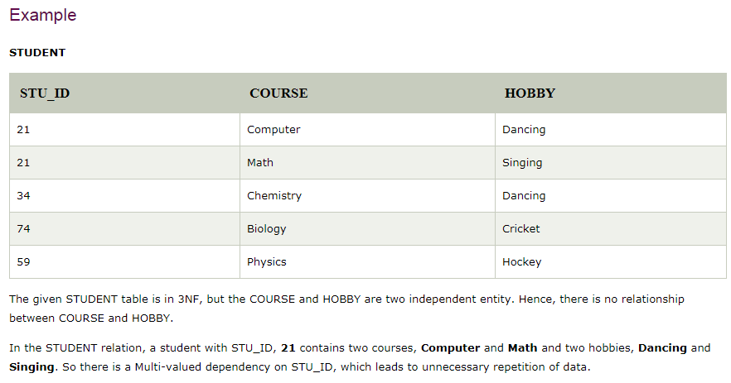

Slide 53


Slide 54

Fifth normal form (5NF)
A relation is in 5NF if it is in 4NF and not contains any join dependency and joining should be lossless.
5NF is satisfied when all the tables are broken into as many tables as possible in order to avoid redundancy.
5NF is also known as Project-join normal form (PJ/NF).

Slide 55
In the above table, John takes both Computer and Math class for Semester 1 but he doesn't take Math class for Semester 2. In this case, combination of all these fields required to identify a valid data.
Suppose we add a new Semester as Semester 3 but do not know about the subject and who will be taking that subject so we leave Lecturer and Subject as NULL. But all three columns together acts as a primary key, so we can't leave other two columns blank.
So to make the above table into 5NF, we can decompose it into three relations P1, P2 & P3:

Slide 56


Slide 57


Slide 58
Inference Rules for Functional Dependencies
Armstrong's axioms are used to conclude functional dependencies on a relational database.
The inference rule is a type of assertion. It can apply to a set of FD(functional dependency) to derive other FD.
Using the inference rule, we can derive additional functional dependency from the initial set.
The Functional dependency has 6 types of inference rule:
1. Reflexive Rule (IR₁)
2. Augmentation Rule (IR₂)
3. Transitive Rule (IR₃)
4. Union Rule (IR₄)
5. Decomposition Rule (IR₅)
6. Pseudo transitive Rule (IR₆)

Slide 59
1. Reflexive Rule (IR₁)
In the reflexive rule, if Y is a subset of X, then X determines Y. If X ⊇ Y then X → Y
Ex: {fname, lname} → {fname}
2. Augmentation Rule (IR₂)
The augmentation is also called as a partial dependency. In augmentation, if X determines Y, then XZ determines YZ for any Z. If X → Y then XZ → YZ
Ex: If {SSN} → {fname} then: {SSN, DName} → {fname, DName}
3. Transitive Rule (IR₃)
In the transitive rule, if X determines Y and Y determine Z, then X must also determine Z.
If X → Y and Y → Z then X → Z
Ex: If: {SSN} → {DNO}; {DNO} → {DName}
Then: {SSN} → {DName}

Slide 60
4. Union Rule (IR₄)
Union rule says, if X determines Y and X determines Z, then X must also determine Y and Z.
If X → Y and X → Z then X → YZ
Proof:
1. X → Y (given) 2. X → Z (given) 3. X → XY (using IR₂ on 1 by augmentation with X. Where XX = X) 4. XY → YZ (using IR₂ on 2 by augmentation with Y) 5. X → YZ (using IR₃ on 3 and 4)
5. Decomposition Rule (IR₅)
Decomposition rule is also known as project rule. It is the reverse of union rule.
This Rule says, if X determines Y and Z, then X determines Y and X determines Z separately.
If X → YZ then X → Y and X → Z

Slide 61
Ex: If {SSN} → {fname, DNO}
Then {SSN} → {fname}
{SSN} → { DNO}
Proof:
1. X → YZ (given) 2. YZ → Y (using IR₁ Rule) 3. X → Y (using IR₃ on 1 and 2)
6. Pseudo transitive Rule (IR₆)
In Pseudo transitive Rule, if X determines Y and YZ determines W, then XZ determines W.
If X → Y and YZ → W then XZ → W
Proof:
1. X → Y (given) 2. WY → Z (given) 3. WX → WY (using IR₂ on 1 by augmenting with W) 4. WX → Z (using IR₃ on 3 and 2)

Slide 62
A systematic way to determine these additional functional dependencies is first to determine each set of attributes X that appears as a left-hand side of some functional dependency in F and then to determine the set of all attributes that are dependent on X.
Definition. For each such set of attributes X, we determine the set X+ of attributes that are functionally determined by X based on F; X+ is called the closure of X under F.

Slide 63
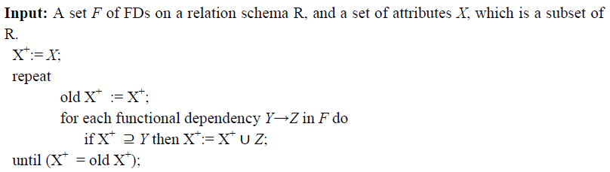
Algorithm. Determining X+, the Closure of X under F

Slide 64
Example 1, consider the relation schema EMP_PROJ from the semantics of the attributes, the following set F of functional dependencies are identified.
F = {
Ssn → Ename,
Pnumber → {Pname, Plocation},
{Ssn, Pnumber} → Hours
}
Using above algorithm, we calculate the following closure sets with respect to
F: {Ssn} + = {Ssn, Ename}
{Pnumber}+ = {Pnumber, Pname, Plocation}
{Ssn, Pnumber}+ = {Ssn, Pnumber, Ename, Pname, Plocation, Hours}

Slide 65
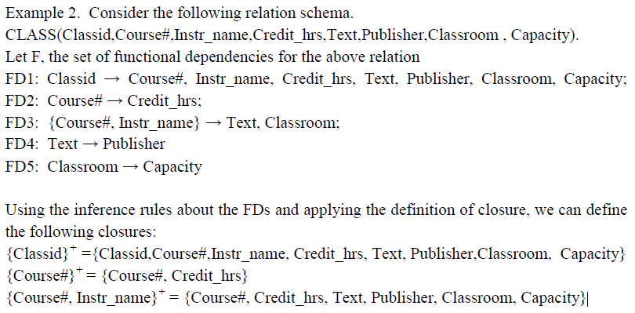

Slide 66
Equivalence of Sets of Functional Dependencies:
A set of functional dependencies F is said to cover another set of functional dependencies E if every FD in E is also in F+; that is, if every dependency in E can be inferred from F; alternatively, we can say that E is covered by F.
Two sets of functional dependencies E and F are equivalent if E+ = F+. Therefore, equivalence means that every FD in E can be inferred from F, and every FD in F can be inferred from E; that is, E is equivalent to F if both the conditions E covers F and F covers E hold.
We can determine whether F covers E by calculating X+ with respect to F for each FD X → Y in E, and then checking whether this X+ includes the attributes in Y. If this is the case for every FD in E, then F covers E.

Slide 67
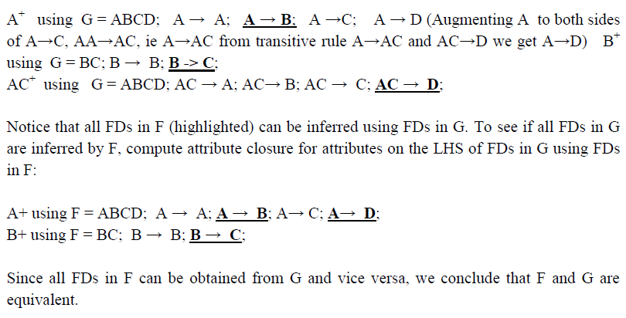
Consider two sets of FDs, F and G, F = {A → B, B → C, AC→D} and G = {A→B, B→C, A→D} Are F and G equivalent? Take the attributes from the LHS of FDs in F and compute attribute closure for each using FDs in G:

