Slide 1
Structured Query Language (SQL)

Slide 2
SQL
It is a comprehensive database language that facilitates
data definition,
data manipulation &
view definition.
SQL follows ANSI & ISO standard.

Slide 3
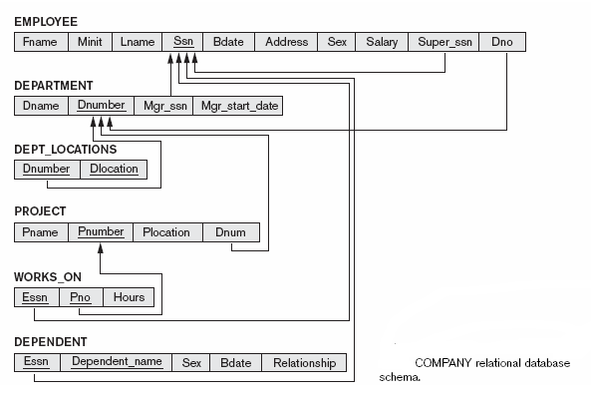

Slide 4
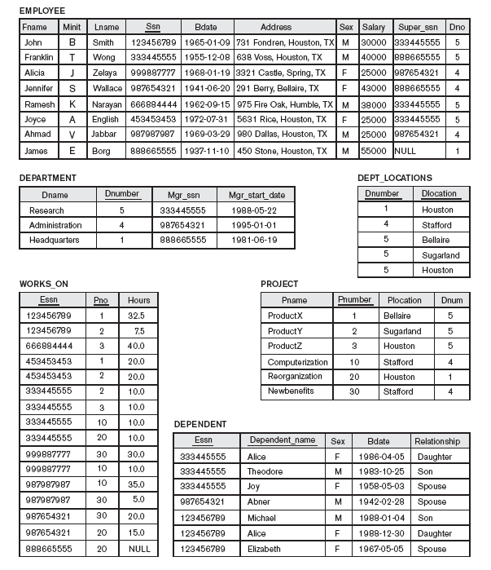

Slide 5
Table creation
create table employee (
fname varchar(12) not null,
minit char(1), lname varchar(12) not null,
ssn char(9) primary key, bdate date,
address varchar(40), gender char(1),
salary number(8) not null, super_ssn char(9),
dno number(1)
);

Slide 6
Table creation
create table department (
dnumber number(1) primary key,
dname varchar(10) unique,
mgr_ssn references employee,
mgr_start_date date
);

Slide 7
Table creation
create table dept_locations (
dnumber references department,
dlocation varchar(20),
primary key(dnumber, dlocation)
);

Slide 8
Table creation
create table project (
pnumber number(2) primary key,
pname varchar(12) unique,
plocation varchar(20),
dnum references department
);

Slide 9
Table creation
create table works_on (
essn references employee,
pno references project, hours number(2),
primary key(essn, pno)
);

Slide 10
Table creation
create table dependent (
essn references employee,
dependent_name varchar(20), gender char(1),
bdate date, relationship varchar(12),
primary key(essn, dependent_name)
);

Slide 11
Defining foreign key
alter table employee add foreign key(super_ssn) references employee(ssn);
alter table employee add foreign key(dno)
references department(dnumber);

Slide 12
You may assign name to a constraint
alter table employee add constraint emp_fk1
foreign key(super_ssn) references employee;
alter table employee add constraint emp_fk2
foreign key(dno) references department;

Slide 13
Defining constraint after table creation
alter table employee add primary key(ssn);
alter table department add primary key(dnumber);
alter table department add unique(dname);
alter table works_on add primary key(essn, pno);

Slide 14
Assigning name to a constraint
alter table employee
add constraint emp_pk primary key(ssn);
alter table department
add constraint dept_pk primary key(dnumber);
alter table works_on
add constraint works_on_pk primary key(essn, pno);
alter table department
add constraint dept_un unique(dname);

Slide 15
Removing constraint
alter table employee drop constraint emp_fk1;
alter table employee drop constraint emp_fk2;
alter table department drop constraint dept_un;
alter table works_on drop constraint works_on_pk

Slide 16
Disabling & Enabling constraint
alter table employee disable constraint emp_fk2;
alter table employee enable constraint emp_fk2;

Slide 17
Adding new column to a table
alter table employee add email varchar(20);
alter table employee add mobile char(10);
alter table employee add (email varchar(20), mobile char(10));

Slide 18
Removing columns from a table
alter table employee drop column minit;
alter table employee drop (mobile, email);

Slide 19
Modifying column definition
alter table employee modify address varchar(30);
alter table employee modify address not null;
alter table employee modify address varchar(30) not null;
alter table employee
modify (email varchar(24) not null, mobile char(13));

Slide 20
Check constraint
Make sure that the relationship column of dependent table can assume only one of the three values {spouse, son, daughter}
alter table dependent add constraint depd_chk check(relationship in ('spouse', 'son', 'daughter'));
alter table dependent add
check(relationship in ('spouse', 'son', 'daughter'));
Notes:
Ray

Slide 21
Check constraint
Make sure that the salary value of any employee must be at least $10000 but it cannot exceed $80000.
alter table employee
add check(salary between 10000 and 80000);

Slide 22
Check constraint
Make sure that department number can be only one of the three values namely, 1, 5 & 4.
alter table department add check (dnumber in (1, 5, 4));

Slide 23
Check constraint
Make sure that email address has @ as one of the characters
alter table employee add check (email like '%@%');

Slide 24
Check constraint
Make sure that mobile number must start with +91.
alter table employee add check (mobile like '+91%');

Slide 25
Remove a table
drop table <table_name>;
drop table <table_name> cascade constraint;
drop table employee;
drop table employee cascade constraint;

Slide 26
Data entry (Insert statement)
insert into employee values ('Richard', 'K', 'Marini',
'653653653', '30-dec-82', '98 Oak Forest, Katy, TX', 'M',
37000, '888665555', 4 );
Entering data into selective column:
insert into employee (fname, lname, ssn, salary, dno)
values ('Richard', 'Marini', '888665555', 40000, 4);

Slide 27
Failure of Insert statement
Insert statement fails if
Primary key constraint is violated,
Unique key constraint is violated,
Entity integrity constraint is violated,
Not null constraint is violated,
Domain constraint is violated
Referential integrity constraint is violated

Slide 28
Changing existing data (Update statement)
update employee set salary = 65000
where ssn = '888665555';
update employee set salary = salary + 5000
where dno = 5;
update employee set dno = 5, salary = salary*1.2
where dno = 4;

Slide 29
Update statement
update employee set salary = null where ssn = '123456789';
update employee set salary = salary + salary*0.1;

Slide 30
Failure of update statement
Update statement fails if
Primary key constraint is violated,
Unique key constraint is violated,
Entity integrity constraint is violated,
Not null constraint is violated,
Referential integrity constraint is violated

Slide 31
Removing rows from table (Delete statement)
delete from employee;
delete from employee where ssn = '888665555';
delete from employee where salary > 30000;
delete from employee where salary > 30000 and dno = 4;

Slide 32
Failure of delete statement
Delete statement fails if
Referential integrity constraint is violated

Slide 33
Commit & Rollback
Use commit so that changes made are not lost
SQL> commit;
Use rollback so as to undo the changes made, perhaps inadvertently
SQL> rollback;

Slide 34
Select statement (Retrieving data from database)
Select statement
Retrieves data from a database
It can only read data from a database but cannot modify a database.

Slide 35
Examples of data retrieval
Reading balance in bank account
Viewing term end results
Viewing attendance status
Looking for availability of rail/flight ticket
Browsing through an Ecommerce site to find out the availbility of desired items

Slide 38
Select statement
Retrieve all information of all projects. (English query)
select * from project;
Retrieve name of all projects and its location.
select pname, plocation from project;

Slide 39
Select statement
Find out the name of the employees, their address and salary.
select fname, minit, lname, address, salary from employee;

Slide 40
Select statement with WHERE clause
Find out the last name & first name of the employees whose
salary is more than $40000. (English query)
select lname, fname from employee where salary > 40000;

Slide 41
Select statement with WHERE clause
select lname, fname from employee
where salary > 30000 and salary < 55000;
select lname, fname from employee
where salary between 30000 and 40000;

Slide 42
Select statement with WHERE clause
Retrieve name of employees whose last name starts with an S.
select fname, minit, lname from employee
where lname like 'S%';
(% → zero or more characters)

Slide 43
Select statement with WHERE clause
Retrieve first name & last name of employees who live in Texas.
select fname, lname from employee where address like '%TX%';

Slide 44
Select statement with WHERE clause
Retrieve first name and last name of employees whose
first name has an o as the second character.
select fname, lname from employee
where fname like '_o%';
( _ → exactly one character)

Slide 45
Select statement with WHERE clause
Retrieve the first name and last name of employees
whose last name has an a as the fourth character.
select fname, lname from employee
where lname like '___a%';

Slide 46
Select statement with WHERE clause
Find out first name and last name of employees
with _ as one of the characters in their address.
select fname, lname from employee
where address like '%\_%' escape '\';

Slide 47
Select statement with WHERE clause
Find out first name and last name of employees
with % as one of the characters in their address.
select fname, lname from employee
where address like '%\%%' escape '\';

Slide 48
Testing absence/presence of data
Tell me the name of the employee who do not work under a
supervisor.
select fname, minit, lname from employee
where super_ssn is null;

Slide 49
Testing absence/presence of data
Retrieve first name and last name employees who work under a
supervisor.
select fname, lname from employee
where super_ssn is not null;

Slide 50
Eliminating duplicates
To eliminate duplicate rows from the output of select statement use distinct clause
select distinct dno from employee;
select distinct salary from employee;
select distinct fname, lname from employee;
Select distinct super_ssn from employee;
null is treated as different from any other value.

Slide 51
Arithmetic operator in selection list
What would be the salary of the employees if
they get a hike of 10%?
select ssn, fname, lname, salary*1.1
from employee;

Slide 52
ORDER BY clause
Retrieve first name, last name and salary of employees in ascending order of salary.
select fname, lname, salary from employee
order by salary;

Slide 53
ORDER BY clause
Retrieve first name, last name and salary of employees in descending order of salary.
select fname, lname, salary from employee
order by salary desc;

Slide 54
ORDER BY clause
Retrieve first name, last name and salary of employees in descending order of salary and ascending order of department number.
select fname, lname, salary from employee
order by salary desc, dno;

Slide 55
ORDER BY with WHERE clause
select fname, lname, salary
from employee
where salary < 60000
order by salary desc;

Slide 56
Aggregate functions
Aggregate functions compute summary of data.
count, max, min, sum, avg
count returns number of rows specified in a query.
sum, avg, max, min applicable on numeric columns
max & min may also be applicable on date, strings as well.

Slide 57
Query using aggregate function
select sum(salary) from employee;
select avg(salary) from employee;
select sum(salary), avg(salary), max(salary), min(salary), count(*)
from employee;

Slide 58
GROUP BY clause
GROUP BY clause is used to compute summary data for groups of rows.
Grouping of rows is done based on one or more columns and these columns are called grouping columns

Slide 59
GROUP BY clause
select <selection list> from <table_name> group by <list of grouping columns>
The selection list can contain grouping columns and summary data only.
A column which is not a grouping column cannot appear in the selection list
If grouping column(s) contain(s) null value then a separate group is created for null value;

Slide 60
GROUP BY clause
Find out average salary of employees for each department.
select avg(salary) from employee group by dno;

Slide 61
GROUP BY clause
Find out department number and average salary of employee for each department.
select dno, avg(salary) from employee group by dno;

Slide 62
GROUP BY clause
Retrieve project number and the number of employees working on each project.
select pno, count(essn) from works_on group by pno;

Slide 63
GROUP BY clause
Retrieve social security number of employees and the number of projects each employee works on.
select essn, count(pno) from employee group by essn;

Slide 64
GROUP BY with WHERE & ORDER BY clause
select dno, avg(salary) from employee
where salary > 40000
group by dno
order by avg(salary)

Slide 65
HAVING clause
HAVING <condition>
condition may involve aggregate function and grouping column(s).
having avg(salary) > 30000;
having dno > 1 (if dno is grouping column)
having avg(salary) > 30000 and dno > 1
having salary > 30000 (incorrect)

Slide 66
Query involving HAVING clause
Retrieve those department numbers that have average
salary greater than $40000;
select dno from employee group by dno
having avg(salary) > 40000;

Slide 67
Query involving HAVING clause
Retrieve social security number of employees who
spend on an average more than 20 hours on project.
select essn from works_on group by essn
having avg(hours) > 20;

Slide 68
Query involving HAVING clause
Find out those project numbers that involve at least
three employees.
select pno from works_on group by pno
having count(essn) >= 3;

Slide 69
Format of select statement
SELECT <selection list>
FROM <list of tables>
WHERE <selection condition>
GROUP BY <list of grouping columns>
HAVING <condition on summary data, grouping column>
ORDER BY <grouping column(s), aggregate functions>

Slide 70
Multiple tables in select statement - Joining tables
List the name of project and the name of controlling department.

Slide 73
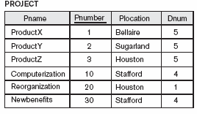
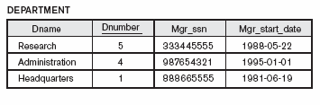

Slide 74
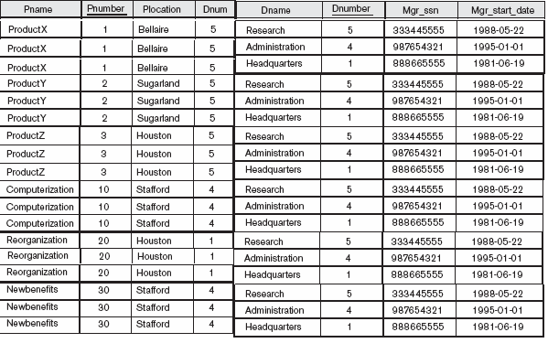
*
*
*
*
*
*
*
*
*
*
*
*

Slide 75
Query involving join
List the name of project and the name of
controlling department.
select pname, dname from project, department
where dnum = dnumber;

Slide 76
Query involving join
Retrieve the name of employee and name of the department
she/he belongs to.
select fname, minit, lname, dname
from employee, department
where dno = dnumber;

Slide 77
Query involving join
select fname, minit, lname, dname
from employee, department
where dno = dnumber;
select fname, minit, lname, dname
from employee inner join department
on dno = dnumber;

Slide 78
Query involving join
Find out first name, last name and address of all employees who
work in Administration department.
select fname, lname, address
from employee, department
where dno = dnumber and dname = 'Administration';
select fname, lname, address
from employee inner join department on dno = dnumber
where dname = 'Administration';

Slide 79
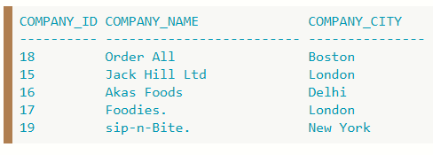
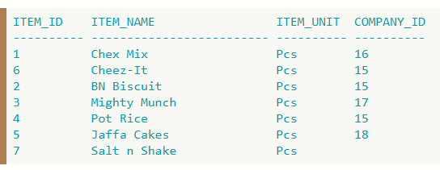
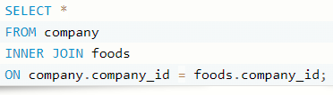
COMPANY_ID COMPANY_NAME COMPANY_CITY ITEM_ID iTEM_NAME ITEM_UNIT COMPANY_ID
---------- --------------- --------------- ---------- --------------- ---------- ----------
16 Akas Foods Delhi 1 Chex Mix Pcs 16
15 Jack Hill Ltd London 6 Cheez-It Pcs 15
15 Jack Hill Ltd London 2 BN Biscuit Pcs 15
17 Foodies. London 3 Mighty Munch Pcs 17
15 Jack Hill Ltd London 4 Pot Rice Pcs 15
18 Order All Boston 5 Jaffa Cakes Pcs 18

Slide 80
Natural join
If the name of foreign key column is the same as that of primary key column then we can use natural join.
select dname, dlocation
from department natural join dept_locations;

Slide 81
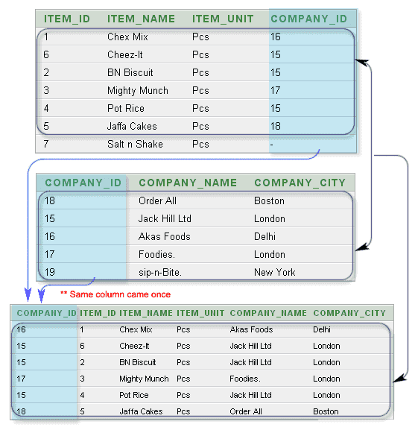

Slide 82
Self join
For each employee, retrieve the employee’s first name
and the first name of his or her immediate supervisor.
select e.fname, s.fname
from employee e, employee s
where s.super_ssn = e.ssn;

Slide 83
Self join
Find out first name of pair of employees who have the same date of birth.
select e.fname, e1.fname
from employee e, employee e1
where e.ssn <> e1.ssn and e.bdate = e1.bdate;

Slide 84
Self join
Find out the first name of pair of employees who work on the same project.
select distinct ew.pno, ew.fname, ew1.fname from (select pno, ssn, fname from employee, works_on where essn = ssn) ew,
(select pno, ssn, fname from employee, works_on where essn = ssn) ew1
where ew.ssn <> ew1.ssn and ew.pno = ew1.pno;

Slide 85
Left outer join
Find out first name and last name of department managers listing out also employees who are not managers.
select fname, lname
from employee left outer join department
on mrg_ssn = ssn;

Slide 86
Right outer join
List the first name and last name of employees and name of their dependent listing first name and last name of all employees.
select fname, lname, dependent_name
from dependent right outer join employee
on essn = ssn;

Slide 87
Full outer join
the FULL OUTER JOIN combines the results of both left and right outer joins and returns all (matched or unmatched) rows from the tables on both sides of the join clause.
select fname, lname, dependent_name
from dependent full outer join employee
on essn = ssn;

Slide 88
Nested query
Query 1 (Query 2)
Correlated nested query
Uncorrelated nested query
=, all, any, some, in
exists & not exists function
where exists(Query 2)
where not exists(Query 2)

Slide 89
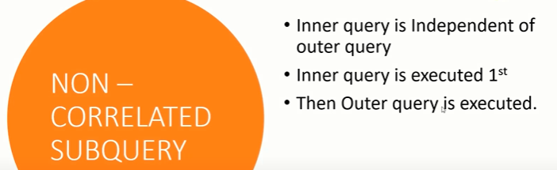

Slide 90
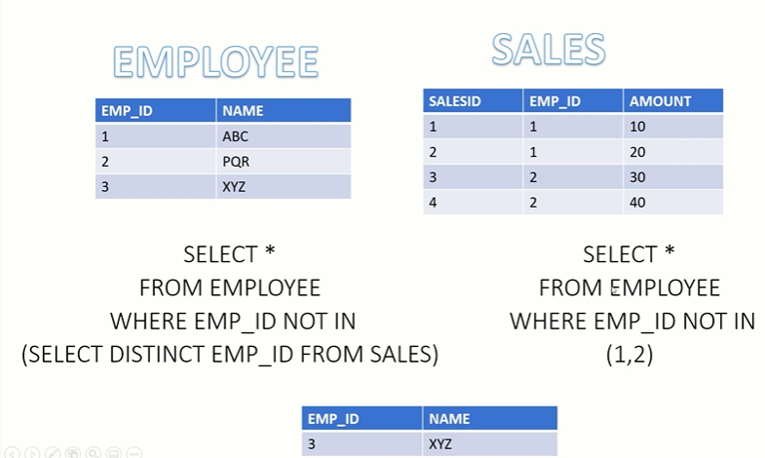

Slide 91
Uncorrelated nested query
Find out first name and last name of employee(s) who draw the highest salary.
select fname, lname from employee where salary = (select max(salary) from employee)

Slide 92
Uncorrelated nested query
Find out first name and last name of employee(s) who draw salary higher than the salary of any employee of department number 4.
select fname, lname from employee where salary > all(select salary from employee where dno = 4);
select fname, lname from employee where salary > any(select salary from employee where dno = 4);

Slide 93
Uncorrelated nested query
Find out first name and last name of employee(s) who draw salary higher than the salary of at least one employee of department number 4.
select fname, lname from employee where salary > some(select salary from employee where dno = 4);

Slide 94
Uncorrelated nested query
Find out first name of employees who work in the same
department as Franklin does.
select fname from employee where dno =
(select dno from employee where fname = 'Franklin') and
fname <> 'Franklin';
select fname from employee where dno in
(select dno from employee where fname = 'Franklin') and
fname <> 'Franklin';

Slide 95
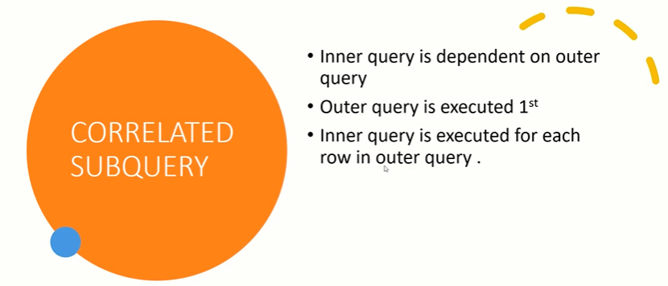

Slide 96
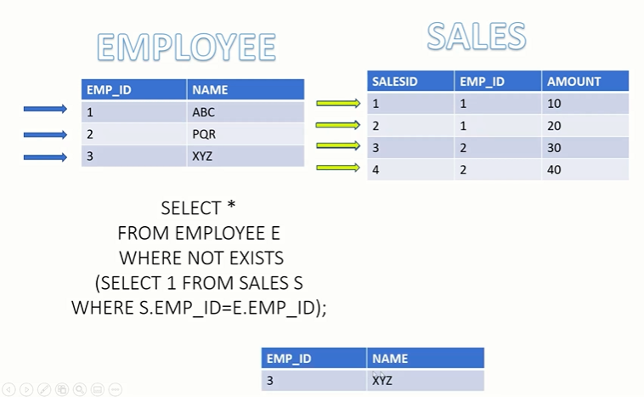

Slide 97
Correlated nested query
Find out first name of employees who have at least one dependent.
select fname from employee where exists (select * from dependent where essn = ssn)

Slide 98
Correlated nested query
Find out first name of employees who have no dependent.
select fname from employee where not exists
(select * from dependent where essn = ssn);

Slide 99
Correlated nested query
Retrieve the name of each employee who has a dependent with the same name as the first name of the employee.
select fname, lname from employee where ssn in
(select essn from dependent where essn = ssn and
fname = dependent_name);

Slide 100
Correlated nested query
Find out name of employees who have at least two dependents.
select fname, lname from employee where
(select count(*) from dependent where essn = ssn) >= 2;

Slide 101
Correlated nested query
Find out first name and last of employees who work on all the projects on which Smith works.
select fname, lname from employee
where not exists
(select pno from works_on, employee where essn = ssn and lname = 'Smith' minus
select pno from works_on where essn = ssn)
and lname <> 'Smith';

Slide 102
Set operations
union, intersect & minus
tables must be union compatible
List name of employees who have no dependent
select fname, lname from employee minus select fname, lname from employee, dependent where essn = ssn;

Slide 103
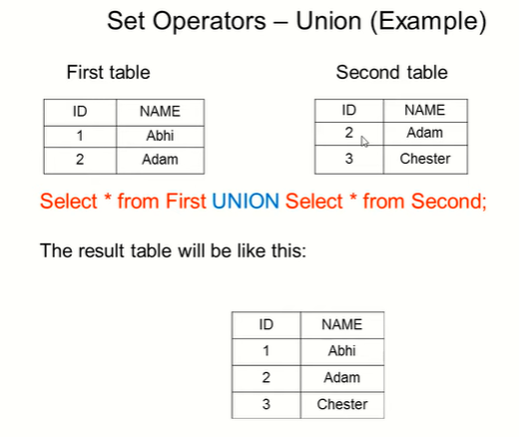

Slide 104
Set operations
Find out name of employees who are either department manager or work on at least four projects.
select fname, lname from employee, department where mgr_ssn = ssn
union
select fname, lname from employee where ssn in (select essn from works_on group by essn having count(pno) >= 4);

Slide 105
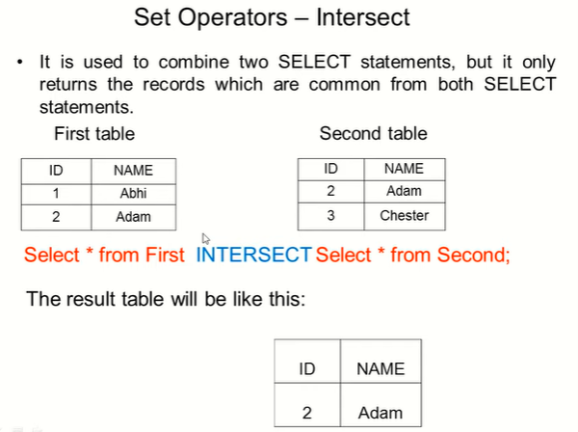

Slide 106
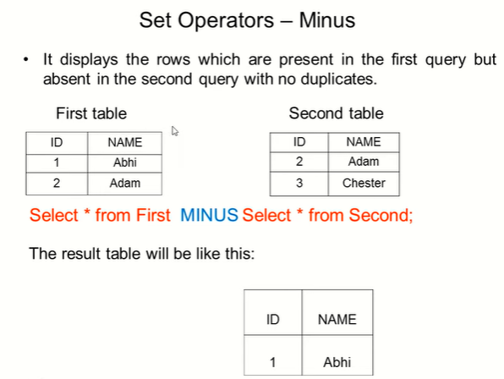

Slide 107
Set operations
Find out name of projects that are worked on by Franklin and John.
select pname from project, employee, works_on where essn = ssn and pno = pnumber and fname = 'Franklin'
intersect
select pname from project, employee, works_on where essn = ssn and pno = pnumber and fname = 'John';

Slide 108
Duplicates
union all, intersect all, minus all
<query 1> union all <query 2>
<query 1> intersect all <query 2>
<query 1> minus all <query 2>

Slide 109
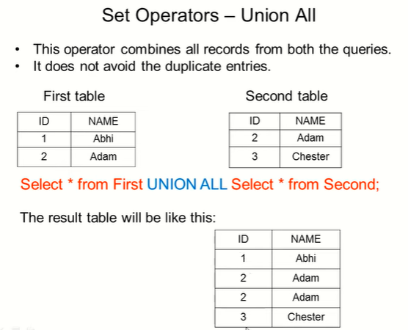

Slide 110
create table … select…
create table <table_name> as <query>;
create table emp_dependent as select ssn, fname, lname, dependent_name from employee left join dependent on essn = ssn;
create table emp_duplicate as select * from employee;
create table emp_duplicate_1 as select * from employee where 2 > 3;

Slide 111
insert into … select
insert into <table_name> <query>;
insert into emp_duplicate1 select * from employee;

Slide 112
Views
A view is a perspective of a database.
Views are virtual tables
create or replace view view_name as <query>;
Create a view that contains employee name and department name.
create or replace view emp_dept as
select fname, lname, dname from employee, department where dno = dnumber;
select * from emp_dept;

Slide 113
Exercise
PERSON (Driver_id, Name, Address)
CAR (License, Model, Year)
ACCIDENT (Report_no, A_date, Location)
OWNS (Driver_id, License)
PARTICIPATED (Driver_id, License, Report_no, Damage_amount)

Slide 114
Creating tables
create table person (driver_id char(6) primary key, name varchar(26), address varchar(40));
create table car (license char(8) primary key, model varchar(12), year char(4));
create table accident (report_no char(6) primary key, a_date date, location varchar(16));

Slide 115
Creating tables
create table owns (driver_id references person, license references car, primary key(driver_id, license));
create table participated (driver_id references person, license references car, report_no references accident, damage_amount number(6), foreign key(driver_id, license) references owns, primary key(driver_id, license, report_no));

Slide 116
Transactions
Find the total number of people who owned cars that were involved in accidents in 1989.
Find the number of accidents in which the cars belonging to John Smith were involved.
Add a new accident to the database; assume any values for required attributes.
Delete the Mazda belonging to John Smith.
Update the damage amount for the car with license number AABB2000 in the accident with report number AR2197 to $3000.

Slide 117
SQL statement
Find the total number of people who owned cars that were involved in accidents in 1989.
select count(driver_id) from participated natural join owns natural join accident where extract(year from a_date) = '1989';

Slide 118
SQL statement
Find the number of accidents in which the cars belonging to John Smith were involved.
select count(driver_id) from person natural join owns natural join participated natural join accident where name = 'John Smith';

Slide 119
SQL statement
Add a new accident to the database; assume any values for required attributes.
insert into accident values ('AD3425', '22-Jan-91', 'Texas');
commit;

Slide 120
SQL statement
Delete the Mazda belonging to John Smith.
delete from car where model = 'Mazda' and license in (select license from owns where driver_id = (select driver_id from person where name = 'John Smith‘));
commit;

Slide 121
SQL statement
Update the damage amount for the car with license number AABB2000 in the accident with report number AR2197 to $3000.
update participated set damage_amount = 3000 where license = 'AABB2000' and report_no = 'AR2197' ;
commit;

Slide 122
Summary
Table creation
Constraint definition
Data entry, deletion & update
Data retrieval
Single table query
Join
Nested query
Set operation
Views

