Slide 1
DATABASE SCHEMA AND THREE SCHEMA ARCHITECTURE OF DBMS
Vinay M
Asst. Professor
SITE

Slide 2
DATABASE SCHEMA
The Description of a database
Includes the structure and the constraints that should hold on the database.

Slide 3
THREE-SCHEMA ARCHITECTURE OF DBMS
The goal of three- Schema architecture is to separate the use
r application and physical database.
Proposed to support DBMS characteristics of:
Program-data independence
Support of multiple views of the data

Slide 4
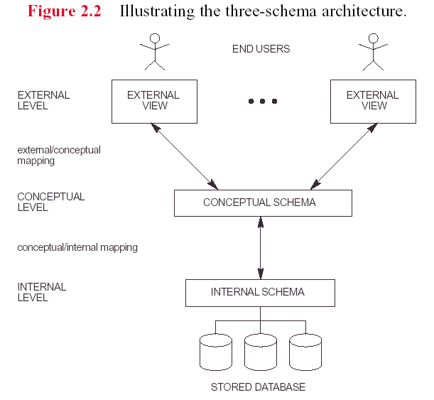

Slide 5
For example
The Bank ATM
Insert card in to machine
Provide card details pin
Specify amount to be withdrawn
Machine does processing
Transaction completed and database updated.

Slide 6
Define DBMS Schemas at three levels:
External Schemas
- it includes a number of external Schemas or User views.
- Describes the part of the database that a particular user group is interested in and hides the rest of the database from that user group.
Conceptual Schema
Describe the structure and constraints for the whole database

Slide 7
Internal Schema
Describe physical storage structures and access paths (on the disk)

Slide 8
Mapping among schema levels are needed to transform requests and data. Programs refer to an external schema and are mapped by the DBMS to the internal Schema for execution.

Slide 9
SQL Language Statements

Slide 10
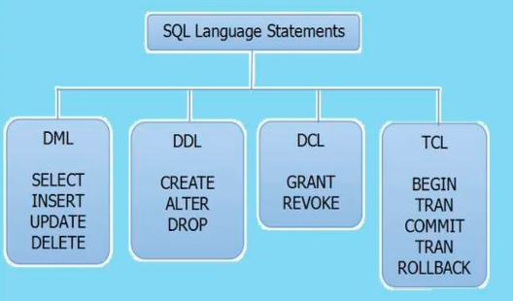

Slide 11
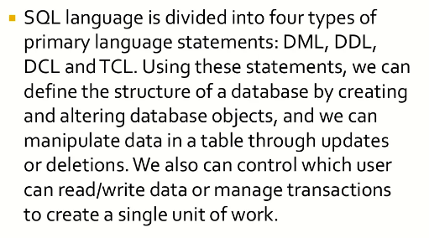

Slide 12
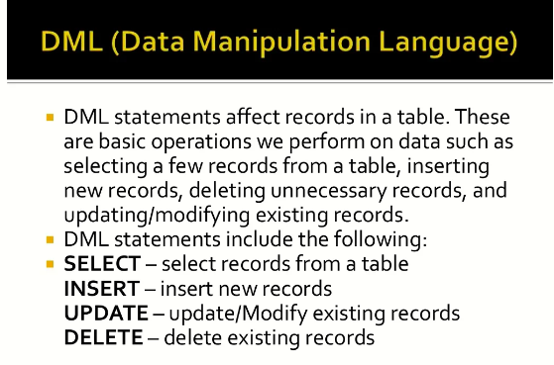

Slide 13
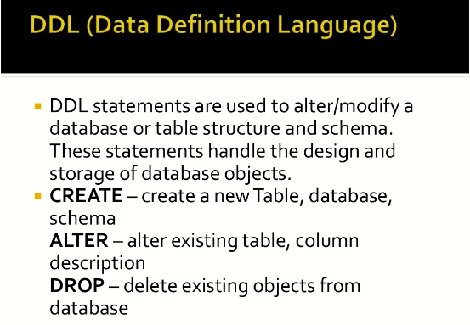

Slide 14
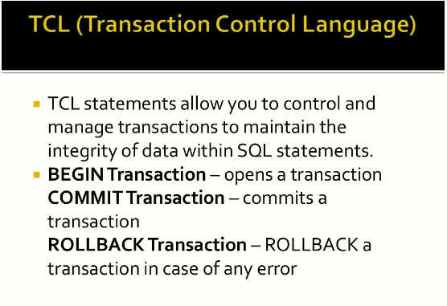

Slide 15
