Slide 1
Introduction to Data Modeling
Vinay. M
Asst. Prof
SITE

Slide 2
Data models in DBMS help to understand the design at the conceptual, physical, and logical levels as it provides a clear picture of the data making it easier for developers to create a physical database.
Data models are used to describe how the data is stored, accessed, and updated in a DBMS.
Unstructured data does not have predefined format so data model are defined only the structure of data.

Slide 3
A data model can be thought of as comprising three components:
A structural part, consisting of a set of rules according to which databases can be constructed.
A manipulative part, defining the types of operation that are allowed on the data (this includes the operations that are used for updating or retrieving data from the database and for changing the structure of the database)
A set of integrity constraints, which ensures that the data is accurate.

Slide 4
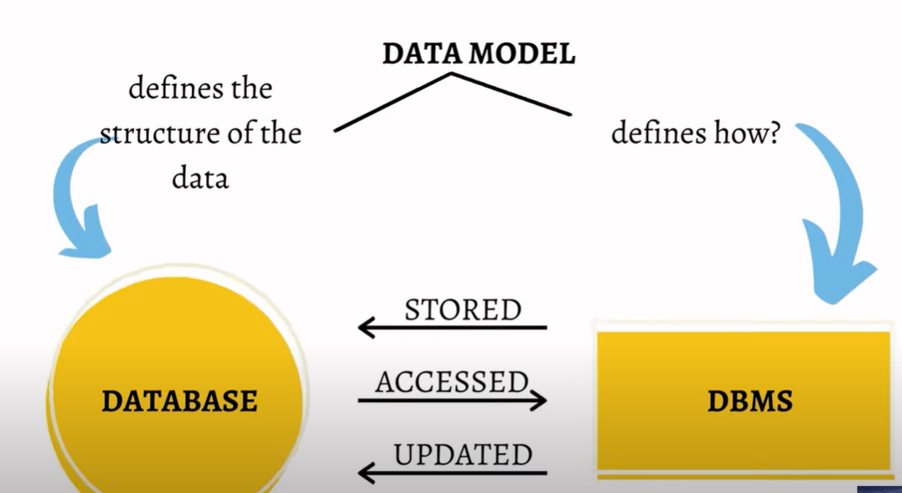

Slide 5
Three Categories of Data Models
There have been many data models proposed in the literature. They fall into three broad categories :
1. object-based
2. record-based, and
3. physical data models.
The first two are used to describe data at the conceptual and external levels, the third is used to describe data at the internal level.

Slide 6
Object-based Data Models:
Object-based data models use concepts such as entities, attributes, and relationships.
An entity is a distinct object (a person, place, thing, concept, event) in the organization that is to be represented in the database.
An attribute is a property that describes some aspect of the object that we wish to record, and a relationship is an association between entities.
Some of the more common types of object-based data model are:
• Entity-Relationship (ER)
• Semantic
• Functional
• Object-oriented

Slide 7
Record-based Data Models
In a record-based model, the database consists of a number of fixed-format records, possibly of differing types. Each record type defines a fixed number of fields, typically of a fixed length.
There are three principal types of record-based logical data model:
1. The Relational Data Model,
2. The Network Data Model, And
3. The Hierarchical Data Model

Slide 8
Relational Data Model
The relational data model is based on the concept of mathematical relations.
In the relational model, data and relationships are represented as tables, each of which has a number of columns with a unique name.
Data are organized in 2D tables and Relations is mainted by common field.
Mainly in form of tables with rows and columns
Tabls are known as relations.

Slide 9
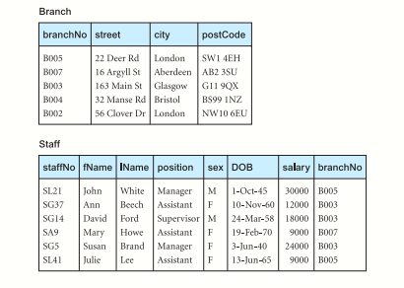

Slide 10
The Hierarchical Data Model
The hierarchical model is a restricted type of network model. Again, data is represented as collections of records and relationships are represented by sets.
the hierarchical model allows a node to have only one parent. A hierarchical model can be represented as a tree graph, with records appearing as nodes (also called segments) and sets as edges.
Example: food recipe's, indexes.

Slide 11
The Network Data Model
In the network model, data is represented as collections of records, and relationships are represented by sets.
The records are organized as generalized graph structures with records appearing as nodes (also called segments) and sets as edges in the graph.

Slide 12
3 Physical Data Models
Physical data models describe how data is stored in the computer, representing information such as record structures, record orderings, and access paths. There are not as many physical data models as logical data models; the most common ones are the unifying model and the frame memory
How data are stored in computer memory?
How they are scattered and ordered in the memory?
How they would be retrieved from memory?

Slide 13
