Slide 1
Entity-Relationship model (ER model)
ER model describes data in terms of entity types and relationship types.
An entity is an object or a thing that has independent existence.
The structure of an entity is called entity type and is described by a name and a list of attributes.
Attributes are characteristics of entity type.
Entities have values of attributes.
ER model

Slide 2
Attribute
Simple attribute
An attribute that cannot be decomposed into simpler
attributes is called a simple attribute.
e.g. Regno., Ssn, UID,…
Composite attribute
An attribute that can be decomposed into simpler attributes
is called a composite attribute.
e.g. Address, Name. e.g. Name(Fname, Minit, Lname)
A(A₁, A₂, …, A_{n})

Slide 3
Single valued & Multi valued attribute
Single valued attribute
An attribute is called single valued attribute if it may assume
at most one value for an entity. e.g. Ssn, Salary, Regno
Multi valued attribute
An attribute is called multi valued attribute if it can assume
any number of values for an entity.
e.g. color of a car {Color},
phone number {Phone_number}

Slide 4
Complex attribute
Multi valued & composite attribute are called complex
attribute
e.g. persons with multiple residential address – multiple addresses & each address may be considered as composite
e.g. {Address (House_no, Street, City, State, Country)}
A = multi valued composite attribute with components A₁,
A₂, … A_{n}
{A(A₁, A₂, … A_{n})}

Slide 5
Stored & derived attribute
Stored & derived attribute
When the value of an attribute (say A) may be computed
from the value of some other attribute (say B) then the later
is called a stored attribute and the former is called a derived
attribute.
The two attributes (A & B) may belong to two different
entity type (e.g. DEPARTMENT & EMPLOYEE)
Bdate is a stored attribute & Age is a derived attribute,
Basic_ salary is a stored attribute and Gross_pay is a
derived attribute.

Slide 6
Entity Type
An Entity Type defines structure of an entity.
Each entity type is described by its name and attributes.
e.g. EMPLOYEE(Ssn, Fname, …)
A collection of entities of an entity type is called an
Entity Set.
The same name is used to refer to an entity type and the
corresponding entity set. e.g. EMPLOYEE
An attribute is a characteristic of an entity type.

Slide 7
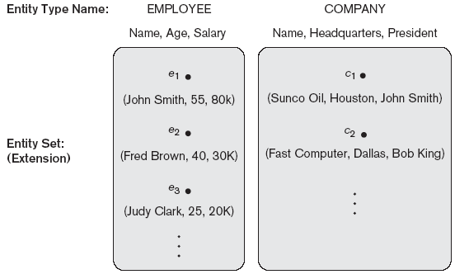
Entity type & Entity set

Slide 8
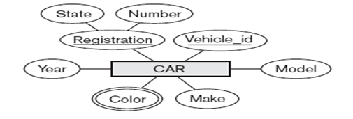
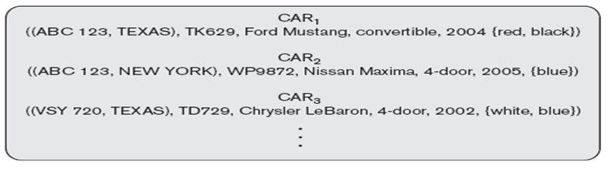
Entity type & Entity set
Pictorial representation
of Entity Type &
Attributes
Entity Set

Slide 9
Entity type (Intension), Entity set (Extension) –
Call them by the same name
An entity type is called an intension and an entity set is
called an extension of the entity type.
An entity set changes with time but entity type changes
infrequently.
In ER model, entity type and entity set are called by the
same name.

Slide 10
Key
An attribute of an entity type that uniquely identifies entities
of an entity type is called a key of the entity type.
When a set of attributes can uniquely identify the entities in
an entity set then the set of attributes is called a key of the
entity type.
A key consisting of multiple attributes is called a composite
key.
The value of a key (defined by its attributes) is distinct for
each entity.

Slide 11
Key
In a composite key, the combination of attribute values
is distinct in each entity.
A composite key must contain minimal number of attributes.
i.e. subset of a key cannot be a key.
Specifying a key of an entity type →
Specifying a key (uniqueness) constraint on the entity type.

Slide 12
Keys & Multiple keys
Key constraint holds on any entity set of an entity type.
So it is a constraint on entity type.
Key constraint is derived from constraint of mini world the
DB represents.
An entity type may have multiple keys.
e.g. DEPARTMENT(Dnumber, Dname, {Location})

Slide 13
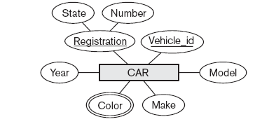
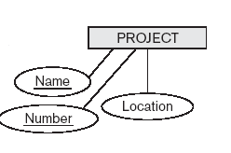
Entity type CAR has multiple keys,
Entity type PROJECT has multiple keys

Slide 14
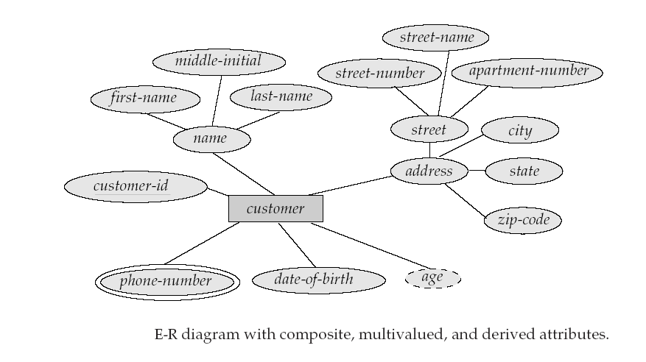

Slide 15
Weak & Strong entity type
An entity type without a key is called a weak entity type.
An entity type with a key is called a strong entity type.
Strong entity type is also called Identifying entity type /
Owner entity type / Parent entity type

Slide 16
Value set (domain) of attribute
The set all possible values that an attribute may
assume is called value set of the attribute.
The value set of Ssn is a set of all possible strings
of exactly nine numeric characters.
V(Ssn) = { string of exactly nine numeric characters }
V(Fname) = { string of alphabetic characters of varying length without space}
Value sets are not displayed on ER diagram.

Slide 17
Value set
At the level of implementation, value set is specified using
data type.
In SQL, value set of an attribute is defined by SQL data
type and if required, check constraint and not null
constraint.
A value set defines all possible values of an attribute.
Usually, a subset of this set is found in a database
state.
V(Dnumber) = {single digit number}

Slide 18
ER model – Relationship Instance,
Relationship Type & Relationship Set
A Relationship Instance is a particular association of an
entity with some other entity.
When an entity is associated with some other entity, a
Relationship Instance is said to have been created.

Slide 19
ER model – Relationship Instance, Relationship Type, Relationship Set
A Relationship Type defines structure of a relationship
instance.
A collection of relationship instances, each of which
describes same type of association, constitute a
Relationship Set.
Relationship type & Relationship set are called by the
same name.

Slide 20
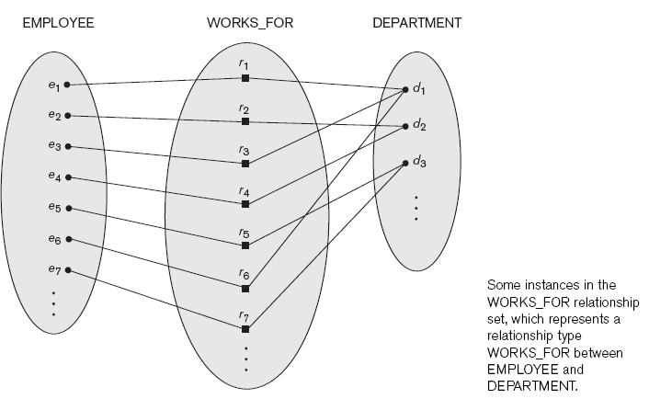
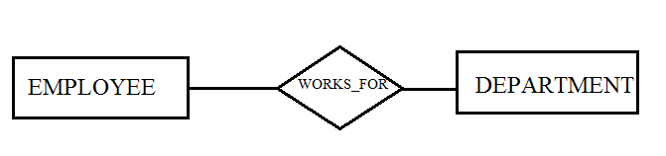
Pictorial representation of relationship instance & relationship set & ER diagram

Slide 21
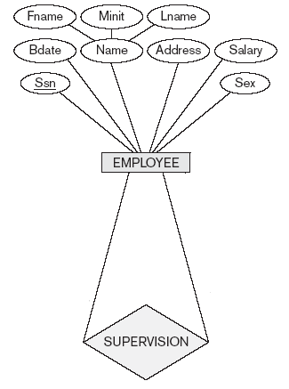
A unary relationship type

Slide 22
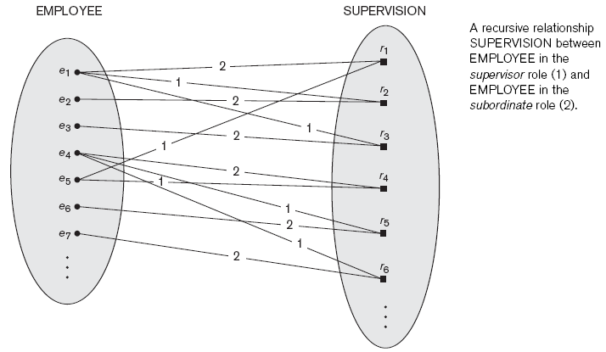
Unary (recursive) relationship instances & ER diagram

Slide 23
Degree of relationship type
Every relationship type involves one or more entity types.
The number of distinct entity types involved in a
relationship type is called Degree of relationship type.
Relationship type involving two entity types is called Binary
relationship type (relationship is called binary
relationship).

Slide 24
Degree of relationship type
Relationship type involving three distinct entity types is
called a Ternary relationship type
N-ary relationship type – relationship type involving n
distinct entity types
Unary relationship type – association of an entity type
with itself (AKA Recursive relationship type).

Slide 25

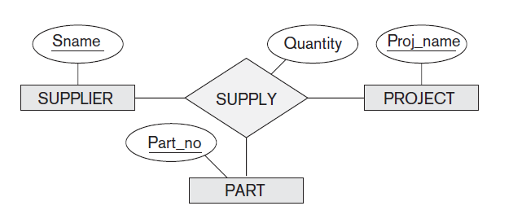
A ternary relationship type

Slide 26
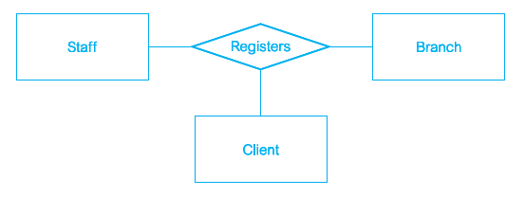

A ternary relationship type

Slide 27
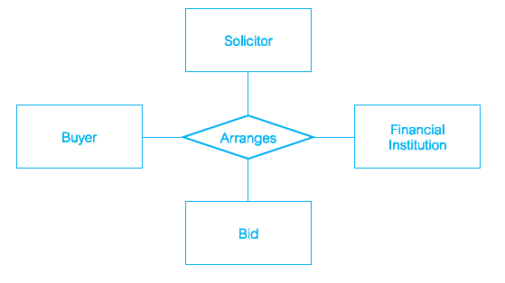

A quaternary relationship type

Slide 28
Merging attribute of relationship type
If cardinality ratio is 1:1 then merge attributes of
relationship type with any of the participating entity types,
preferably with the one that has total participation.
If cardinality ratio is N:1 or 1:N then merge attributes to N
side.
If cardinality ratio is M:N then retain attribute (s).

Slide 29
Participating entity type
An entity type involved in a relationship type is called a
Participating Entity Type.
Each relationship instance involves exactly one entity from
participating entity type (s).

Slide 30
Constraints on relationship type –
Cardinality ratio & Participation constraint
Cardinality ratio
Cardinality ratio of a binary relationship specifies the
maximum number of entities that may be associated with
some other entity.
N:1, 1:N, 1:1, M:N [M Many, N aNy]

Slide 31
Participation
Participation specifies the minimum number of entities
that may participate in a relationship instance with some
other entity.
If every entity in any entity set of a participating entity type
is involved in a relationship instance then the participation of
the entity type in the relationship type is said to be total.
If every entity of a participating entity type is not involved in
a relationship instance then the participation of the PET in
the RT is called partial.

Slide 32
Weak entity type
An entity type without a key is called a weak
entity type.
An entity type with a key is called a strong
entity type.
The relationship type between a strong entity type
& a weak entity type is called an identifying
relationship type.
The strong entity type in this case is called
identifying (owner) entity type.

Slide 33
Weak entity type – partial key
A set of attributes of a weak entity type that can
uniquely identify weak entities that are related to
the same owner entity is called a partial key
(discriminator).

Slide 34
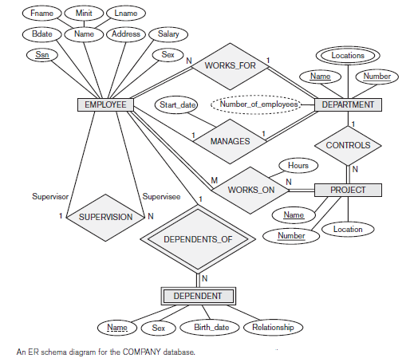

Slide 35
Role name of participating entity type
Nature of association of a participating entity
type in a relationship type defines the role of the
entity type in the relationship type.

Slide 36
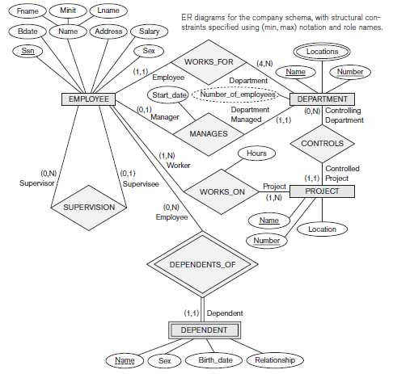

Slide 37
Alternative design –
Weak entity type as attribute
A weak entity type can be represented as a complex
attribute of the identifying entity type.
Choice is made by the DB designer.

Slide 38
When not to represent weak entity type as attribute
If there are many attributes in the weak entity type, then retain the weak entity type, do not represent weak entity type as an attribute.
If weak entity type participates in some other relationship independently then retain the weak entity type, do not represent weak entity type as an attribute.

Slide 39
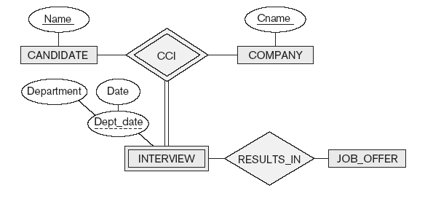
Weak entity type participating in some other relationship independently

Slide 40
Weak entity type
A owner entity type may itself be a weak entity type.
There may exist weak entity types at any number of levels.
A weak entity type may have more than one identifying
entity type.
A weak entity type may be found to be involved in a
relationship type of degree greater than two.

Slide 41
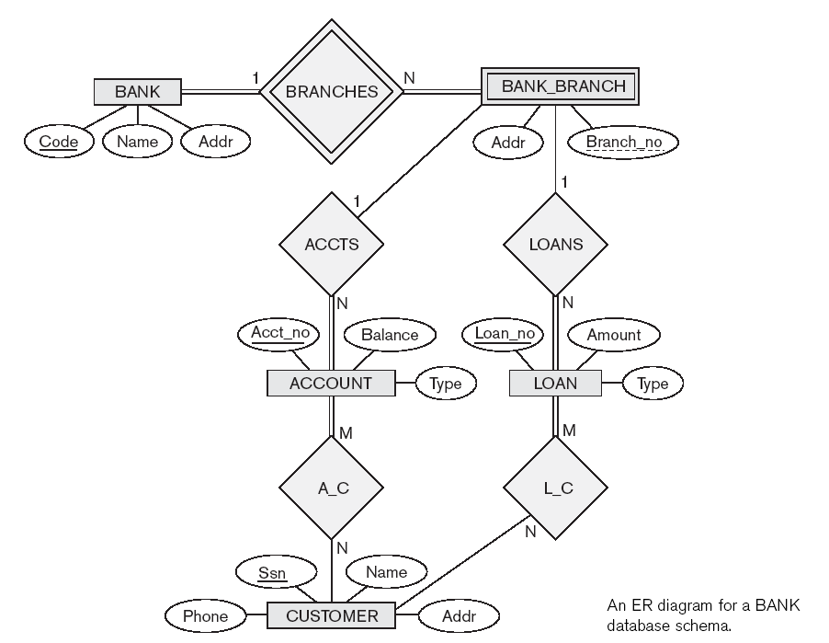

Slide 42
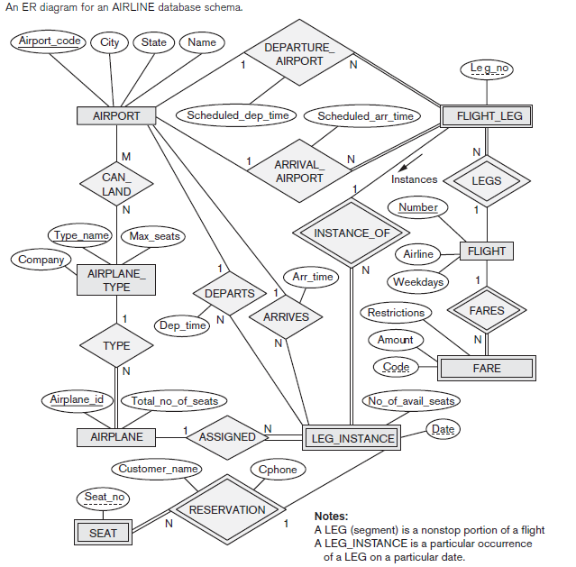

Slide 43
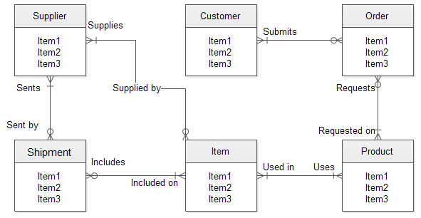
ER diagram with crow’s foot notation

Slide 44
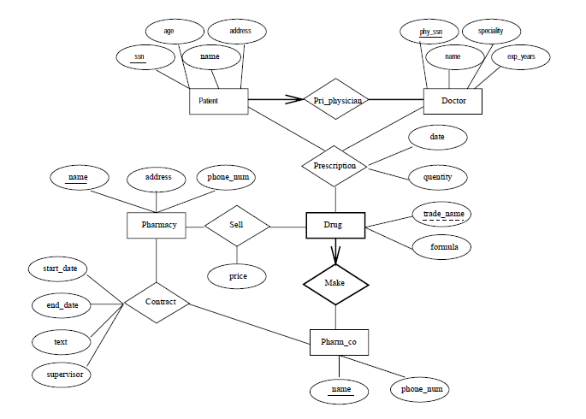
ER diagram for a chain of pharmacies

Slide 45
Designing ER schema (Movie database)
Consider a MOVIE database in which data is
recorded about the movie industry. The data
requirements are summarized as follows:
Each movie is identified by title and year of
release. Each movie has a length in minutes.
Each has a production company, and each is
classified under one or more genres (such as
horror, action, drama and so forth).

Slide 46
Designing ER schema (Movie database)
Each movie has one or more directors and one or
more actors appear in it. Each movie also has a
plot outline.
Finally, each movie has zero or more quotable
quotes, each of which is spoken by a particular
actor appearing in the movie.
Actors are identified by name and date of birth
and appear in one or more movies. Each actor has
a role in the movie.

Slide 47
Designing ER schema (Movie database)
Directors are also identified by name and date of
birth and direct one or more movies. It is possible
for a director to act in a movie (including one that
he or she may also direct).
Production companies are identified by name and
each has an address. A production company
produces one or more movies.
Design an Entity-Relationship diagram for the
movie database.

Slide 48
Designing an ER schema (Example 2)
Notown Records has decided to store information
about musicians who perform on its albums (as
well as other company data) in a database.
The following are the data requirements:
Each musician that records at Notown has an
SSN, a name, an address, and a phone number.
Poorly paid musicians often share the same
address, and no address has more than one
phone.

Slide 49
Designing an ER schema (Example 2)
Each instrument used in songs recorded at
Notown has a unique identification number, a
name (e.g., guitar, synthesizer, flute) and a
musical key (e.g., C, B-flat, E-flat).
Each album recorded on the Notown label has
a unique identification number, a title, a
copyright date, a format (e.g., CD or MC), and
an album identifier.

Slide 50
Designing an ER schema (Example 2)
Each song recorded at Notown has a title and an
author.
Each musician may play several instruments, and
a given instrument may be played by several
musicians.
Each album has a number of songs on it, but no
song may appear on more than one album.

Slide 51
Designing an ER schema (Example 2)
Each song is performed by one or more
musicians, and a musician may perform a number
of songs.
Each album has exactly one musician who acts as
its producer. A musician may produce several
albums.
Design an Entity-Relationship diagram for the
Notown Records database.

Slide 52
Designing ER schema (Example 3)
The following are data requirements for a university:
Professors have an SSN, a name, an age, a rank,
and a research specialty.
Projects have a project number, a sponsor name
(e.g., DST), a starting date, an ending date, and a
budget.
Graduate students have an SSN, a name, an age,
and a degree program (e.g., M.C.A., B.Tech.,
M.Tech., M.S. or Ph.D.).

Slide 53
Designing ER schema (Example 3)
Each project is managed by one professor (known
as the project's principal investigator).
Each project is worked on by one or more
professors (known as the project's co-
investigators).
Professors can manage and/or work on multiple
projects.

Slide 54
Designing ER schema (Example 3)
Each project is worked on by one or more
graduate students (known as the project's
research assistants).
When graduate students work on a project, a
professor must supervise their work on the
project.

Slide 55
Designing ER schema (Example 3)
Graduate students can work on multiple projects,
in which case they will have a (potentially
different) supervisor for each one.
Departments have a department number, a
department name, and a main office.
Departments have a professor (known as the
chairman) who runs the department.

Slide 56
Designing ER schema (Example 3)
The professors work in one or more department
and for each department that they work in, a time
percentage is associated with their job.
Graduate students have one major department in
which they are working on their degree.
Each graduate student has another, more senior
graduate student (known as a student advisor) who
advises him or her on what courses to take.
Design and draw an ER diagram that captures the information about the
university.

