Slide 1
Database
A database is a collection of related data.
By data, we mean known facts that can be
recorded and that have implicit meaning
(semantic).
A collection of related data with implicit
meaning is called a database.

Slide 2
Database
A database may be of any size & complexity,
A database usually has a very long life.
Manual database (library card catalog) or
Computerized database
Computerized database with or without DBMS
software.
1

Slide 3
Database Management System
A database management system (DBMS) is a
collection of programs that enables users to
create and maintain a database.
The DBMS is a general-purpose software system
that facilitates the processes of defining,
constructing, manipulating, and sharing databases
among various users and applications.
We call the database and DBMS software together
a database system.

Slide 4
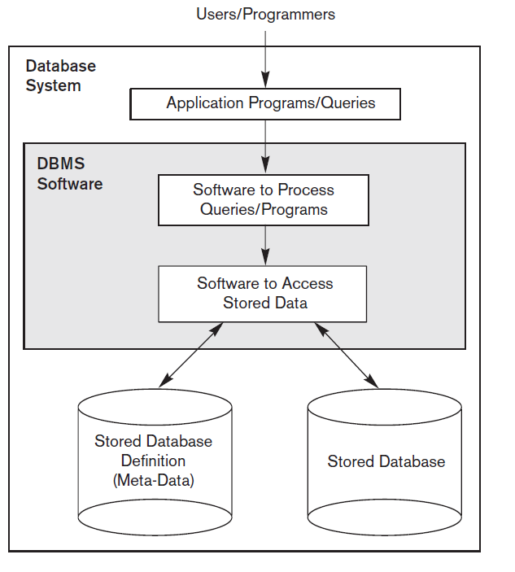
A simplified database system environment

Slide 5
Data model
A data model is a collection of concepts that can
be used to describe the schema of a database.
A data model provides data abstraction.
Conceptual representation of data is known as
data abstraction.

Slide 6
Examples of data model
Entity-relationship model (ER model),
Relational model,
Object data model,
Object-relational model,
Hierarchical model,
Network model
(Hierarchical data model & Network data model
are called legacy data model)

Slide 7
Category of data model
1) Conceptual data model describes data using
concepts such as entities, attributes, and
relationships.
e.g. ER model is a high level conceptual data
model
2) Physical data model describes how data are
actually stored in computer storage media.
3) Representational or implementation data
model
i) falls between PDM and CDM,
ii) describes data in a way that can be
mapped to computer storage media.
e.g. relational model, legacy models.

Slide 8
Database Schema
The description of a database is called the
database schema.
A displayed schema is called a schema diagram.
Each object in a schema diagram is called a
schema construct.
A construct is a representation of a concept.

Slide 9
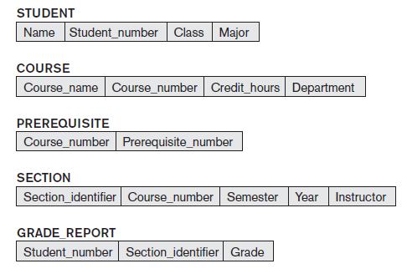
Schema diagram of a database

Slide 10
Database State
The data in a database at a particular moment in
time is called a database state or database
snapshot or database instance.
The schema is sometimes called the intension,
and a database state is called an extension of
the schema.
DBMS stores the descriptions of the schema
constructs and constraints (also called meta-data)
in the DBMS catalog.

Slide 11
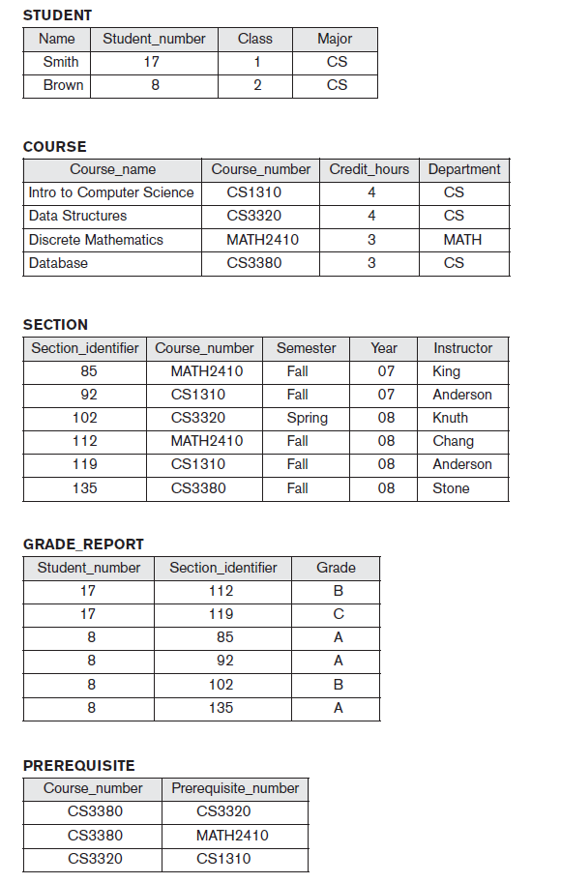



Slide 12
DBMS architecture
Centralized DBMS architecture
Client/Server DBMS architecture

Slide 13
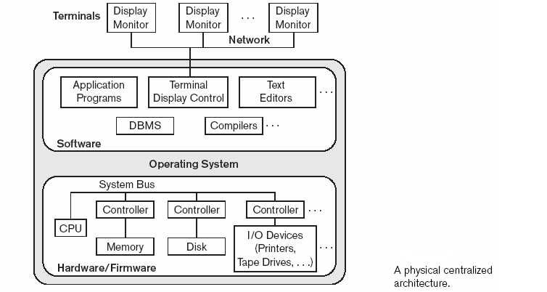
Centralized DBMS architecture
Entire DBMS software is installed in a single high-end machine.

Slide 14
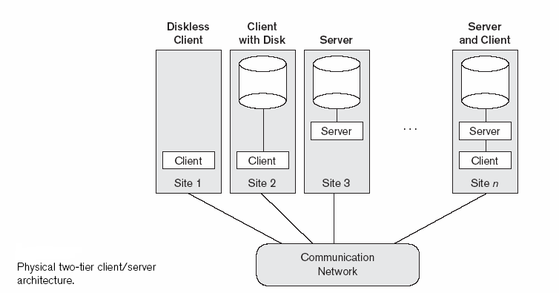
Client/Server DBMS architecture
A part called client part of the DBMS software is installed in a client
machine & server part installed in server a machine. Two-tier, 3-tier, n-tier.

Slide 15
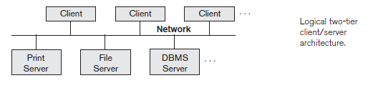
Logical two-tier client/server architecture

Slide 16
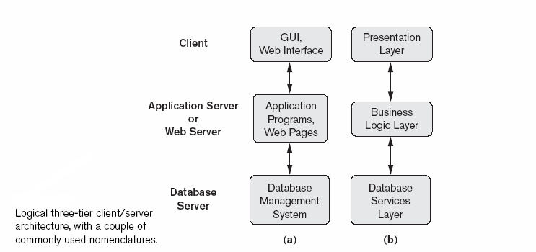
Logical three-tier client/server architecture

