Slide 1
HBase
N.C. SENTHILKUMAR
C.RANICHADNRA
CRA

Slide 2
NO SQL
Not Only SQL
being non-relational, distributed, open-source and horizontally scalable.
> 255 No SQL Databases
Categorized as
    Column store/column families: HBASE, Accumulo, IBM Informix
    Document Store: Azure Document DB, Mongo DB, IBM Cloudant
    Key Value/ Tuple Store: Dynamo DB, Azure Table Storage, Oracle NoSQL DB
    Graph Databases: AllegroGraph, Neo4J, OrientDB
CRA

Slide 3
NO SQL
Since 1970 , RDBMS is the only solution for data storage and manipulation and maintenance
After the data changed in all dimension(Vs), companies realized the solutions for processing big data
Solution: Hadoop, but only sequential access
CRA

Slide 4
HBase
Hbase is a distributed column-oriented database built on top of HDFS
Based on Google’s Big Table, provides random access on structured data
It’s a part of Hadoop Eco system, which provides random r/w access on HDFS
CRA

Slide 5
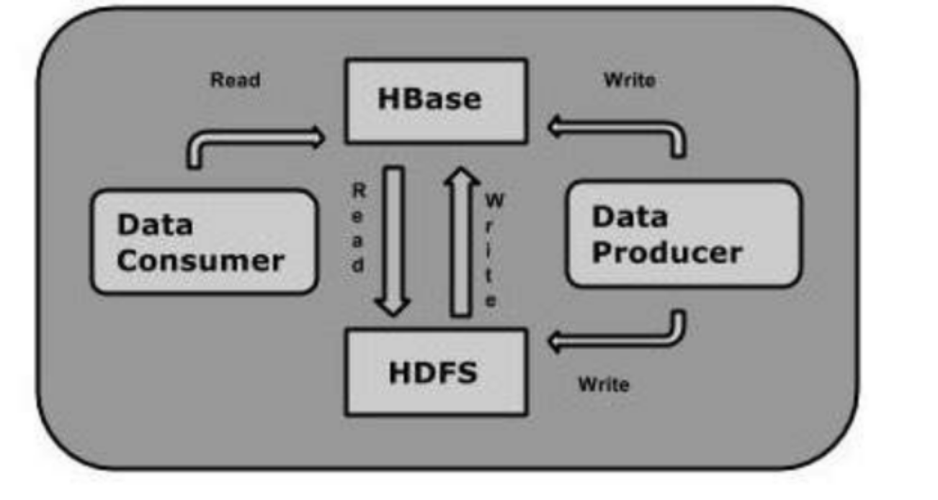
Random R/W
CRA

Slide 6
HDFS and HBASE
HDFS | HBASE
Distributed FS | Database on HDFS
Provides high latency batch processing | Low latency access to single rows
Only sequential access of data | Random access by hash index
CRA

Slide 7
Storage Mechanism in HBase
Column –oriented
Table schema defines only column families , which are key value pairs
Rowid | Column family |  |  | Column family
 | Col1 | Col2 | Col3 | Col1 | Col2 | col3
1
2
CRA

Slide 8
Logical View of Customer Contact Information in HBase
Row Key | Column Family: {Column Qualifier:Version:Value}
00001 | CustomerName: {‘FN’: 1383859182496:‘John’, ‘LN’: 1383859182858:‘Smith’, ‘MN’: 1383859183001:’Timothy’, ‘MN’: 1383859182915:’T’} ContactInfo: {‘EA’: 1383859183030:‘John.Smith@xyz.com’, ’SA’: 1383859183073:’1 Hadoop Lane, NY 11111’}
00002 | CustomerName: {‘FN’: 1383859183103:‘Jane’, ‘LN’: 1383859183163:‘Doe’, ContactInfo: { ’SA’: 1383859185577:’7 HBase Ave, CA 22222’}
CRA

Slide 9
Hbase and RDBMS
HBASE | RDBMS
Schema less | Schema oriented
Built for wide tables, horizontally scalable | Thin and built for small tables, hard to scale
No transactions-Suitable for OLAP | Transactional
Denormalized data | Normalized data
Good for semi structured and structured data | Good for structured
CRA

Slide 10
Applications of Hbase
Need to write heavy applications
Random access of data
Facebook , twitter, yahoo and Adobe use Hbase internally
CRA

Slide 11
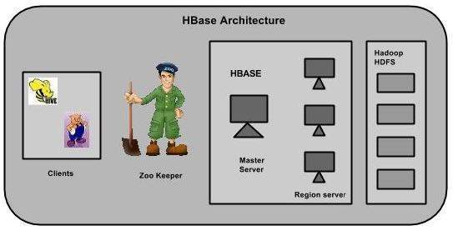
Hbase Architecture
Tables are split into regions and served by region server, Regions are divided into stores and stored in HDFS
CRA

Slide 12
HBase Shell Commands
General:
      Status
      Version
      Table_help
      Whoami
DDL:
      Create
      List
      Disable
      Is_disabled
      Enable
      Is_enabled
      Describe
      Alter
      Exists
      Drop_all –drop tables matching regex commands
CRA

Slide 13
HBase Shell Commands
DML
  Put- a cell value
  Get- get row or cell
  Delete – delete a cell value
  Delete all- delete all the cells in a row
  Scan- scan and return table value
  Count- number of rows in a table
  Truncate- disable, drop and recreate a specified table
CRA

Slide 14
DDL
Create <table name> <family name>
List
Disable <table name>
Describe <table name>
Drop <table name>
Drop_all <regexp>
alter <tablename>, NAME=><column familyname>, VERSIONS=>5
alter <table name> , NAME =><cf> , METHOD => 'delete'
CRA

Slide 15
DML Commands
Put <'tablename'>,<'rowname'>,<'columnvalue'>, <'value'>
Scan <‘tablename’>
get 'table name', ‘rowid’, {COLUMN ⇒ ‘column family:column name ’}
delete <'tablename'>,<'row name'>,<'column name'>
deleteall <'tablename'>, <'rowname'>
truncate <tablename>
CRA

Slide 16
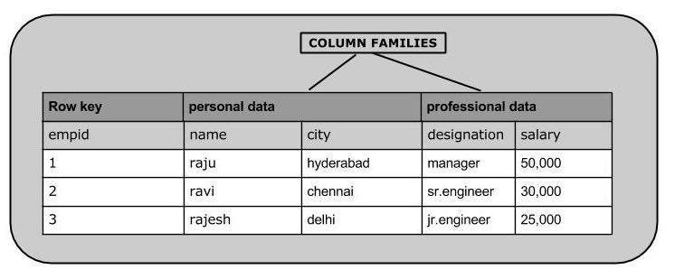
Example
CRA

Slide 17
DDL+DML Commands
  create 'emp', 'personal data', ’professional data’
put 'emp','1','personal data:name','raju‘
put 'emp','1','personal data:city','hyderabad‘
put 'emp','1','professional data:designation','manager
put 'emp','1','professional data:salary','50000’
Scan ‘emp’
CRA

Slide 18
DDL+DML Commands
get 'emp', '1‘
get 'emp', ‘1', {COLUMN ⇒ 'personal data: name'}
Get ‘emp’, ‘1’, {FILTER=>’personal data:name’ =‘sakthi’}
delete 'emp', '1', 'personal data:city‘
deleteall 'emp','1‘
put 'emp',‘1','personal data:city', 'Delhi‘
count 'emp‘
truncate 'emp‘
Drop ‘emp’
CRA

Slide 19
Exercise-MBA Admissions
Application no | Personal Data |  |  | Academic details
 | Name | Gender | Address | UG qualification | University/ college | Overall percentage
CRA

