Slide 1
Sorted Lists
CS 302 - Data Structures
Sections 4.1, 4.2 & 4.3

Slide 2
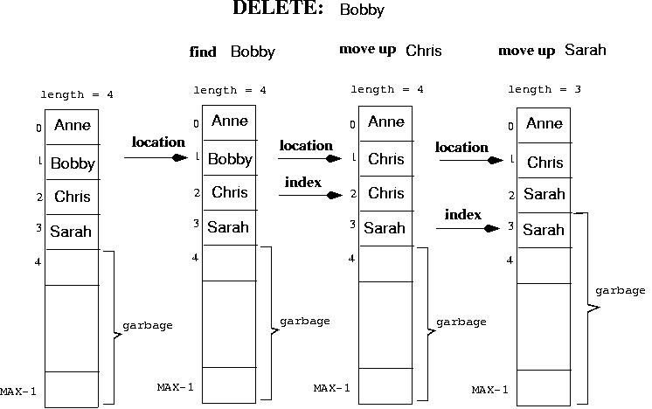
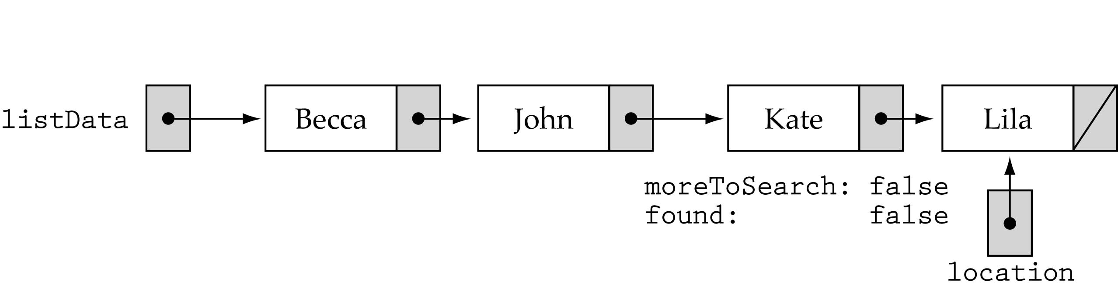
Sorted List Implementations
Array-based
Linked-list-based

Slide 3
Array-based Implementation
template<class ItemType>
class SortedType {
public:
void MakeEmpty();
bool IsFull() const;
int LengthIs() const;
void RetrieveItem(ItemType&, bool&);
void InsertItem(ItemType);
void DeleteItem(ItemType);
void ResetList();
bool IsLastItem();
void GetNextItem(ItemType&);
private:
int length;
ItemType info[MAX_ITEMS];
int currentPos;
};

Slide 4
InsertItem
InsertItem (ItemType item)
Function: Adds item to list
Preconditions: (1) List has been initialized, (2) List is not full, (3) item is not in list (4) List is sorted by key member. Postconditions: (1) item is in list, (2) List is still sorted.

Slide 5
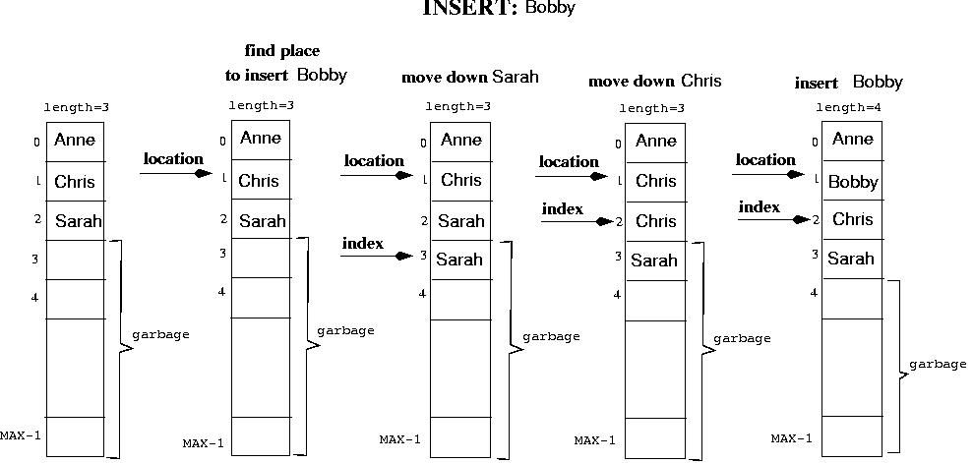

Slide 6
Array-based Implementation
template<class ItemType>
void SortedType<ItemType>::InsertItem(ItemType item)
{
int location = 0;
bool found;
found = false;
while( (location < length) && !found) {
if (item < info[location])
found = true;
else
location++;
}
O(N)
(cont)

Slide 7
Array-based Implementation
for (int index = length; index > location; index--)
info[index] = info[index - 1];
info[location] = item;
length++;
}
O(N)
O(1)
Total time: O(N)

Slide 8
DeleteItem
DeleteItem(ItemType item)
Function: Deletes the element whose key matches item's key
Preconditions: (1) List has been initialized, (2) Key member of item has been initialized, (3) There is only one element in list which has a key matching item's key, (4) List is sorted by key member.
Postconditions: (1) No element in list has a key matching item's key, (2) List is still sorted.

Slide 10
Array-based Implementation
template<class ItemType>
void SortedType<ItemType>::DeleteItem(ItemType item)
{
int location = 0;
while (item != info[location])
location++;
for (int index = location + 1; index < length; index++)
info[index - 1] = info[index];
length--;
}
O(N)
O(N)
Total time: O(N)

Slide 11
RetrieveItem (ItemType& item, boolean& found)
Function: Retrieves list element whose key matches item's key (if present).
Preconditions: (1) List has been initialized,
(2) Key member of item has been initialized.
Postconditions: (1) If there is an element someItem whose key matches item's key, then found=true and item is a copy of someItem; otherwise, found=false and item is unchanged, (2) List is unchanged.

Slide 12
Naive approach: use Linear Search Algorithm
item is in the list
item is not in the list
retrieve
“Sarah”
retrieve
“George”
Might not have to
search the whole list!

Slide 13
Improved RetrieveItem()
template<class ItemType>
void SortedType<ItemType>::RetrieveItem (ItemType& item, bool& found)
{
int location = 0;
found = false;
while ( (location < length) && !found) {
if ( item > info[location]) {
location++;
else if(item < info[location])
location = length; // to break out of the loop…
else {
found = true;
item = info[location];
}
}
Still
O(N) …

Slide 14
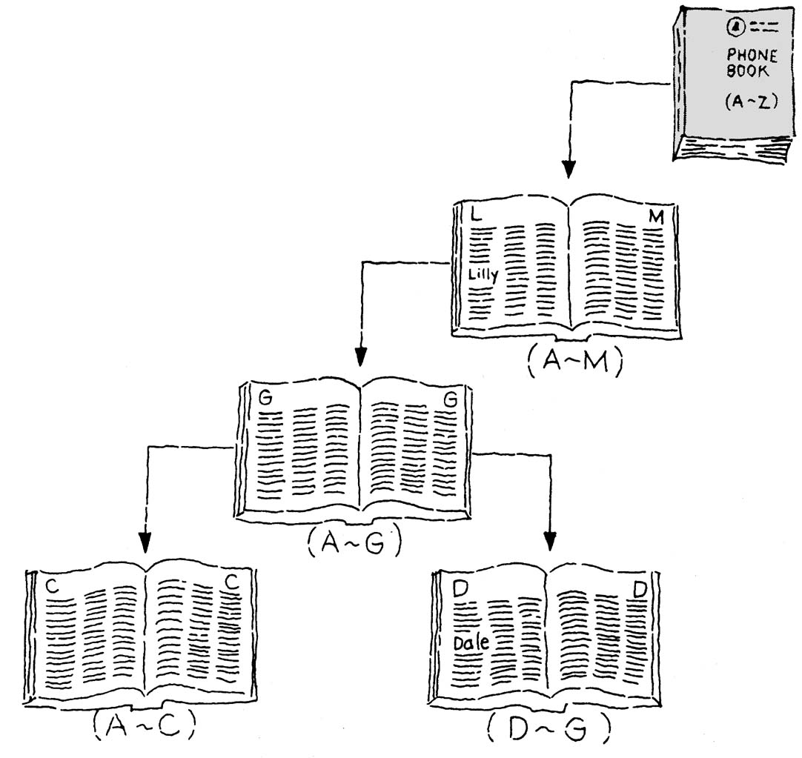
Binary Search Algorithm
Split the current search area in half, and if the item is not found there, then search the appropriate half.

Slide 15
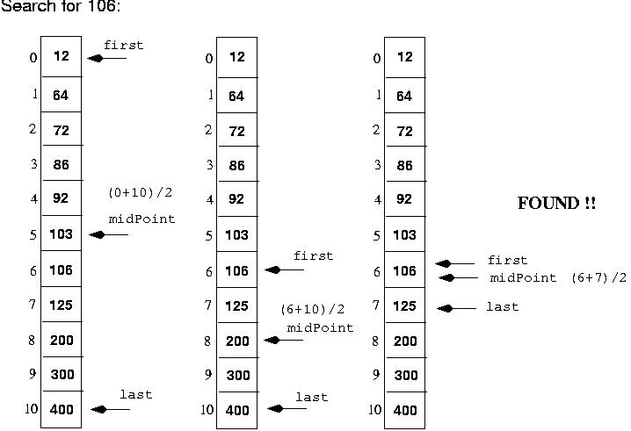

Slide 16
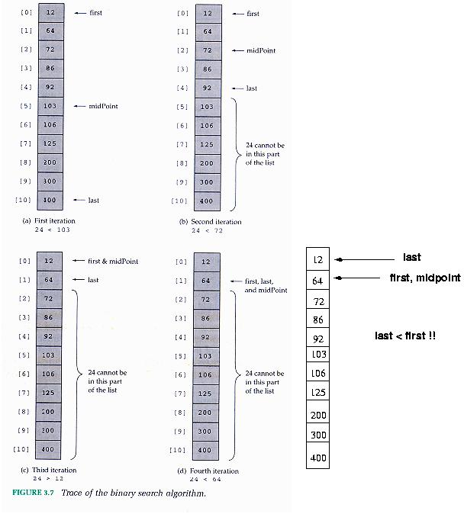
- Search for 24:

Slide 17
Binary Search Algorithm (cont.)
template<class ItemType>
void SortedType<ItemType>::
RetrieveItem(ItemType& item, bool& found)
{
int midPoint;
int first = 0;
int last = length - 1;
found = false;
while( (first <= last) && !found) {
midPoint = (first + last) / 2;
if (item < info[midPoint])
last = midPoint - 1;
else if(item > info[midPoint])
first = midPoint + 1;
else {
found = true;
item = info[midPoint];
}
}
}
O(logN)

Slide 18
Binary Search Efficiency
(1) Number of iterations:
  For a list of 11 elements, it never iterates more than 4 times (e.g., approximately log₂ 11 times).
  Linear Search can iterate up to 11 times.
Number of Iterations
List Length | Linear Search (average) | Binary Search
10 | 5.5 | 3.3
100 | 50.5 | 6.6
1,000 | 500.5 | 10
10,000 | 5000.5 | 13.3

Slide 19
Binary Search Efficiency (cont’d)
(2) Number of computations per iteration:
  Binary search does more work per iteration than Linear Search
Linear search iterations
Binary search iterations
while ( (location < length) && !found) {
if ( item > info[location]) {
location++;
else if(item < info[location])
location = length; // to break out of the loop…
else {
found = true;
item = info[location];
}
}
while( (first <= last) && !found) {
midPoint = (first + last) / 2;
if (item < info[midPoint])
last = midPoint - 1;
else if(item > info[midPoint])
first = midPoint + 1;
else {
found = true;
item = info[midPoint];
}

Slide 20
Is Binary Search more efficient?
Overall, it can be shown that:
  If the number of list elements is small (typically, under 20), then Linear Search is faster.
  If the number of list elements is large, then Binary Search is faster.

Slide 21
List Implementations
Big-O Comparison of List Operations
Operation | Unsorted | Sorted
MakeEmpty | O(1) | O(1)
LengthIs | O(1) | O(1)
IsFull | O(1) | O(1)
ResetList | O(1) | O(1)
GetNextItem | O(1) | O(1)
RetrieveItem | O(N) | O(log N)
InsertItem | O(1) | O(N)
DeleteItem | O(N) | O(N)

Slide 22
Example
Suppose we have a million elements in an sorted list; which algorithm would be faster?
(1) A binary search on a 500-MHz computer or
(2) A linear search on a 5-GHz computer

Slide 23
Example (cont’d)
Assumptions:
(1) Each iteration of a linear search will be twice as fast as each iteration of a binary search on the same computer.
(2) Each instruction on the 5-GHz computer is 10 times faster than each instruction on the 500-MHz computer.

Slide 24
Example (cont’d)
Consider number of iterations first:
Binary Search Linear Search
log₂(1,000,000) ~ 20 1,000,000 iterations (worst-case)
(worst-case) or 500,000 (average-case)
Binary search will be 500,000/20 = 25,000 faster than linear search.

Slide 25
Example (cont’d)
Assuming same computers and using assumption (1):
  Binary search would be 25,000/2 = 12,500 faster!

Slide 26
Example (cont’d)
Assuming different computers and using both assumptions (1) and (2):
  Binary search will be 25,000/20 = 1250 times faster on the 500-MHz computer than linear search on the 5-GHz computer!

Slide 27
Linked-list-based Implementation
template <class ItemType>
struct NodeType;
template<class ItemType>
class SortedType {
public:
SortedType();
~SortedType();
void MakeEmpty();
bool IsFull() const;
int LengthIs() const;
void RetrieveItem(ItemType&, bool&);
void InsertItem(ItemType);
void DeleteItem(ItemType);
void ResetList();
bool IsLastItem() const;
void GetNextItem(ItemType&);
private:
int length;
NodeType<ItemType>* listData;
NodeType<ItemType>* currentPos;
};

Slide 28
RetrieveItem (ItemType& item, boolean& found)
Function: Retrieves list element whose key matches item's key (if present).
Preconditions: (1) List has been initialized,
(2) Key member of item has been initialized.
Postconditions: (1) If there is an element someItem whose key matches item's key, then found=true and item is a copy of someItem; otherwise, found=false and item is unchanged, (2) List is unchanged.

Slide 29
RetrieveItem
Could use linear search → O(N) time

Slide 30
RetrieveItem (cont.)
template<class ItemType>
void SortedType<ItemType>::RetrieveItem(ItemType& item, bool& found)
{
NodeType<ItemType>* location;
location = listData;
found = false;
while( (location != NULL) && !found) {
if (location→info < item)
location = location→next;
else if (location→info == item) {
found = true;
item = location→info;
}
else
location = NULL; // to break out of the loop …
}
}
O(N)

Slide 31
What about Binary Search?
Not efficient any more!
  Cannot find the middle element in O(1) time.

Slide 32
InsertItem
InsertItem (ItemType item)
Function: Adds item to list
Preconditions: (1) List has been initialized, (2) List is not full, (3) item is not in list (4) List is sorted by key member. Postconditions: (1) item is in list, (2) List is still sorted.

Slide 33
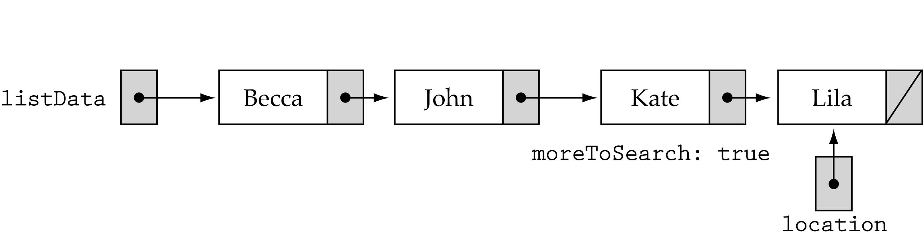
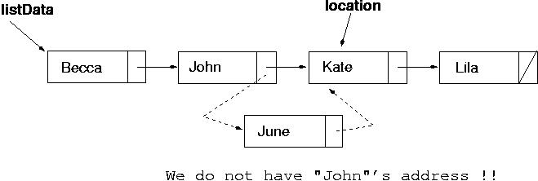
InsertItem

Slide 34
InsertItem (cont.)
Can we compare one item ahead?
  Yes, but we need to check for special cases …
In general, we must keep track of the previous pointer, as well as the current pointer.

Slide 35
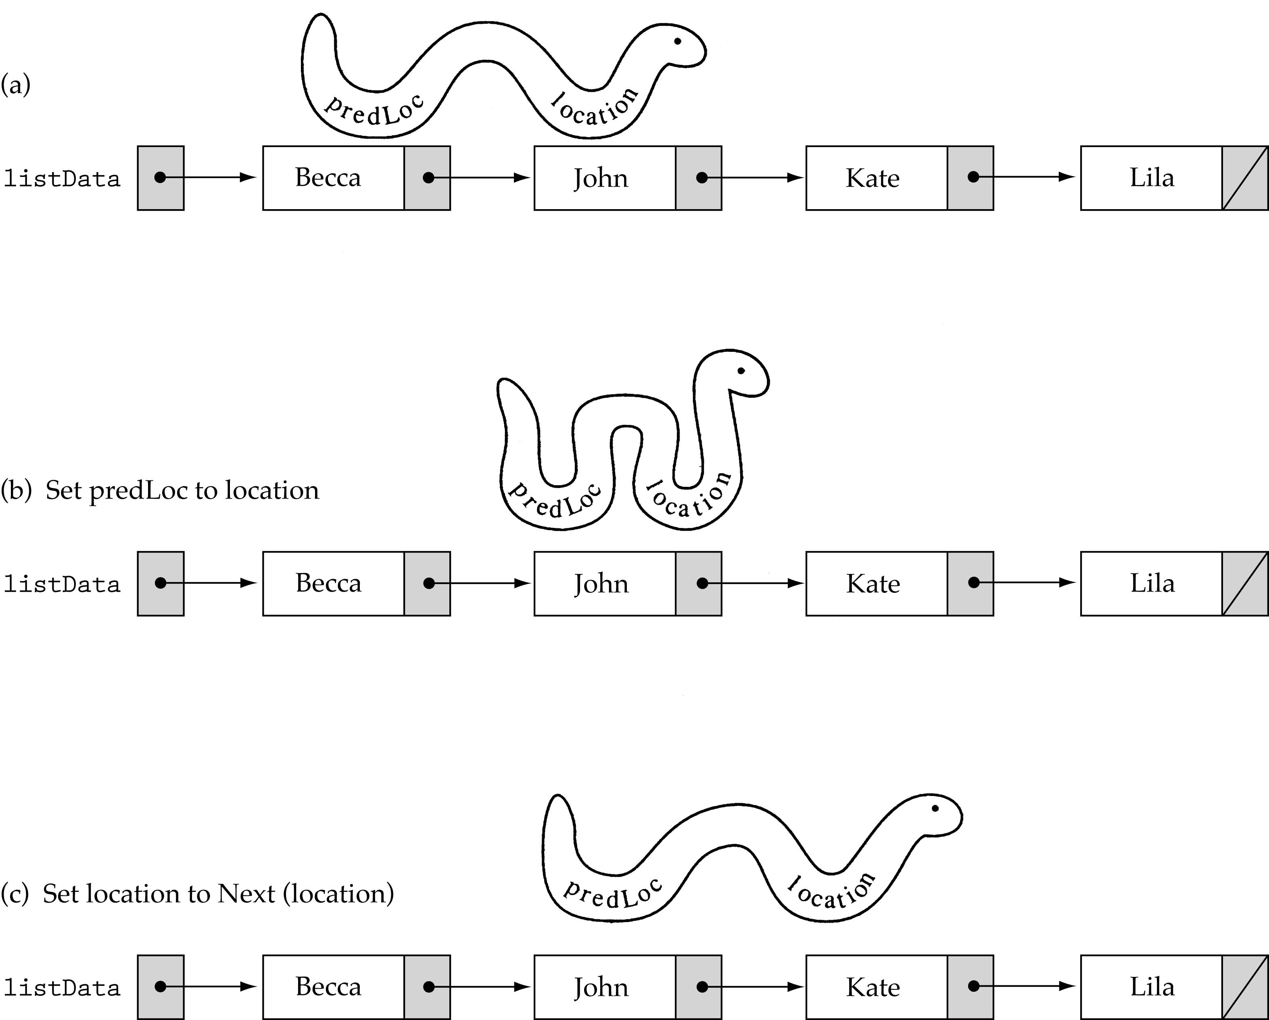
InsertItem (cont.)
prevLoc = location
location =
location→next

Slide 36
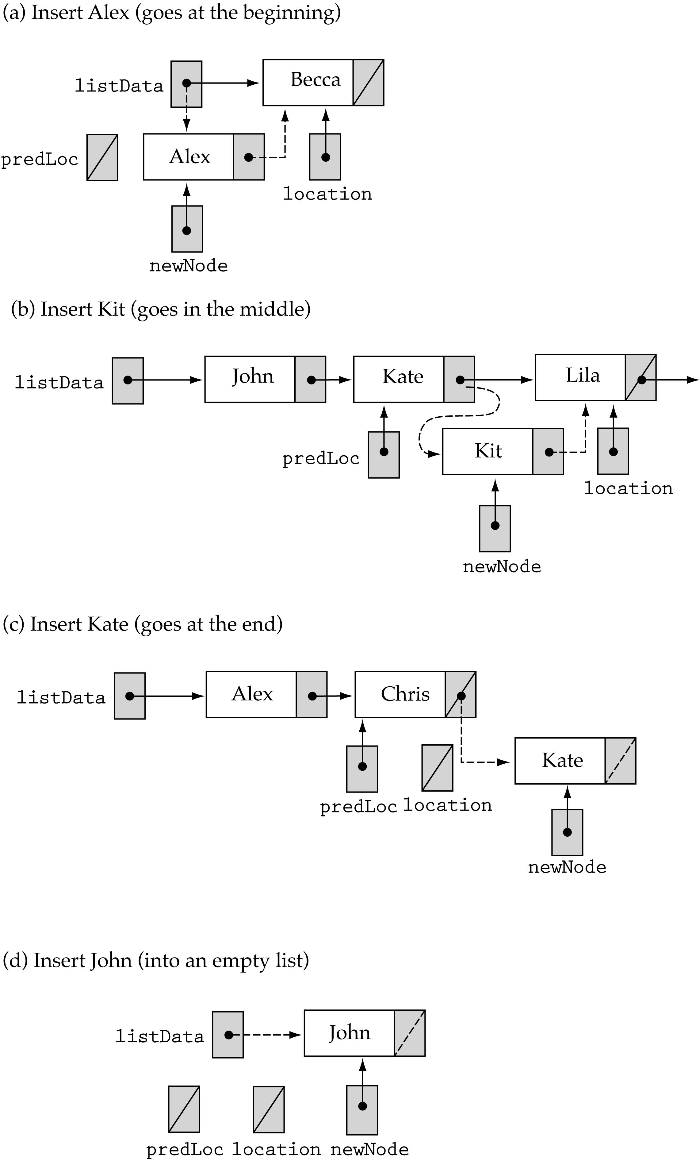
Insert at the beginning of the list
Case 1
newNode→next=
location;
listData=newNode;

Slide 37
Insert between first and last elements
Case 2
newNode→next=location;
prevLoc→next = newNode;

Slide 38
Insert at the end of the list
newNode→next=location;
prevLoc→next = newNode;
Case 3

Slide 39
Insert into an empty list
newNode→next=location;
listData=newNode;
Case 4

Slide 40
(1)
(2)
newNode→next= location;
listData=newNode;
newNode→next=location;
prevLoc→next = newNode;
(4)
(3)
newNode→next=location;
listData=newNode;
newNode→next=location;
prevLoc→next = newNode;

Slide 41
InsertItem (cont.)
template <class ItemType>
void SortedType<ItemType>::InsertItem(ItemType newItem)
{
NodeType<ItemType>* newNode;
NodeType<ItemType>* predLoc;
NodeType<ItemType>* location;
bool found;
found = false;
location = listData;
predLoc = NULL;
while( location != NULL && !found) {
if (location→info < newItem) {
predLoc = location;
location = location→next;
}
else
found = true;
}
O(1)
O(N)

Slide 42
InsertItem (cont.)
newNode = new NodeType<ItemType>;
newNode→info = newItem;
if (predLoc == NULL) {
newNode→next = listData; cases (1) and (4)
listData = newNode;
}
else {
newNode→next = location;
predLoc→next = newNode; cases (2) and (3)
}
length++;
}
O(1)
O(1)
O(1)

Slide 43
DeleteItem
DeleteItem(ItemType item)
Function: Deletes the element whose key matches item's key
Preconditions: (1) List has been initialized, (2) Key member of item has been initialized, (3) There is only one element in list which has a key matching item's key, (4) List is sorted by key member.
Postconditions: (1) No element in list has a key matching item's key, (2) List is still sorted.

Slide 44
DeleteItem
The DeleteItem we wrote for unsorted lists would work for sorted lists too!
Another possibility is to write a new DeleteItem based on several cases (see textbook)

Slide 45
Other SortedList functions
Same as in the UnsortedList class ...

Slide 46
Sorted List Implementations
Big-O Comparison of Sorted List Operations
Operation | Array Implementation | Linked Implementation
Class constructor | O(1) | O(1)
Destructor | O(1) | O(N)
MakeEmpty | O(1) | O(N)
IsFull | O(1) | O(1)
LengthIs | O(1) | O(1)
ResetList | O(1) | O(1)
GetNextItem | O(1) | O(1)
RetrieveItem | O(logN) | O(N)
InsertItem | O(N) | O(N)
DeleteItem | O(N) | O(N)

Slide 47
Exercise: Write a client function that splits a sorted list into two sorted lists using the following specification.
SplitLists (SortedType list, ItemType item, SortedType& list1, SortedType& list 2)
Function: Divides list into two lists according to the key of item.
Preconditions: list has been initialized and is not empty.
Postconditions: list1 contains all the items of list whose keys are less than or equal to item’s key. list2 contains all the items of list whose keys are greater than item’s key.

Slide 48
void SplitLists(const SortedType& list, ItemType item,
SortedType& list1, SortedType& list2)
{
ItemType listItem;
list1.MakeEmpty();
list2.MakeEmpty();
list.ResetList();
while (!list.IsLastItem()) {
list.GetNextItem(listItem);
if(listItem > item)
list2.InsertItem(listItem);
else
list1.InsertItem(listItem);
}
}
What is the running time
using big-O?
O(N²)

Slide 49
Exercise: Write a client function that takes two lists (unsorted or sorted) and returns a Boolean indicating whether the second list is a sublist of the first.
(i.e., the first list contains all the elements in the second list but it might contain other elements too).

Slide 50
bool IsSubList (SortedType list1, SortedType list2)
{
ItemType item;
bool found=true;
list2.ResetList();
while ( !list2.IsLastItem() && found) {
list2.GetNextItem (item);
list1.RetrieveItem (item, found);
}
return found;
}
What is the running time
using big-O?
O(NlogN) assuming array-based
O(N²) assuming array-based

