Slide 1
LDPC Code
The LDPC code, namely low density parity check code, is essentially a linear block code.
LDPC codes provide a means to control errors in data transmissions over unreliable or noisy communication channels.
LDPC can be use in both BSC and BEC channel.

Slide 2
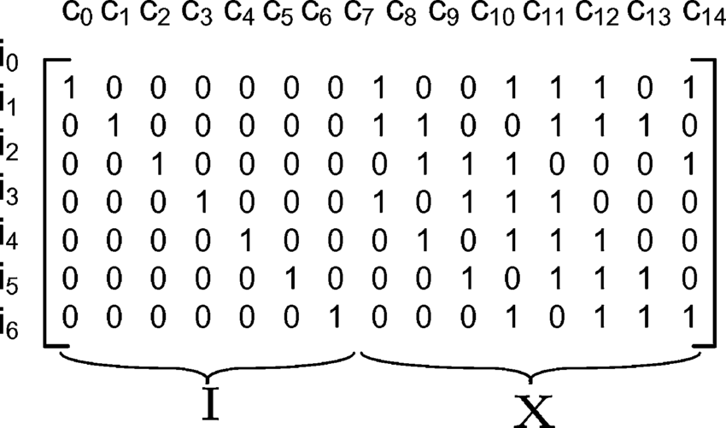
LDPC Code-Encoding
LDPC code encode k message bit into n bit where n>k.
n-k is the size of Syndrome vector which is used for error correction and detection.
LDPC code transfer k-bit into n-bit by Generator matrix(G).
The dimension of Generator matrix is n x k. This n x k matrix multiply with
k x 1 vector of message which will give n x 1 vector. That n x 1 vector is our codeword which will transfer through the channel.
C(nx1) = G(nxk) * M(kx1)
C=Codeword Matrix
G=Generator Matrix
M=Information Matrix

Slide 3
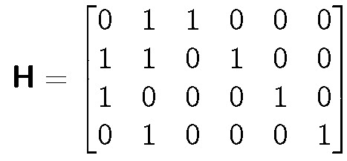
LDPC-Decoding
LDPC code decode n-bit to check whether it have an error or not,It uses Parity-check matrix(H) for decoding.
The dimension of H matrix is (n-k) x k.
It multiply the H matrix to the codeword which we have received over channel. it will the (n-k)x1 matrix which is called Syndrome Matrix,if that matrix is zero matrix then we can say that there is no error in the codeword but if it is non-zero then there is error in the codeword.
S(n-k x 1) = H(n-k x n) * C(nx1)
C=Codeword Matrix
H=Parity check Matrix
S=Syndrome Matrix

Slide 4
Product Code
Product Codes are a special case of LDPC code.
Product code are restricted as the last rows and last columns of H
matrix is for parity checking,
If k i.e. #message bits increases then the size of parity check matrix increases squarely, but the parity check bits in n-bit message increases linearly.
Hence the power of product code decreases as k increases and hence on a noisy channel if data is transmitted with large k.

Slide 5
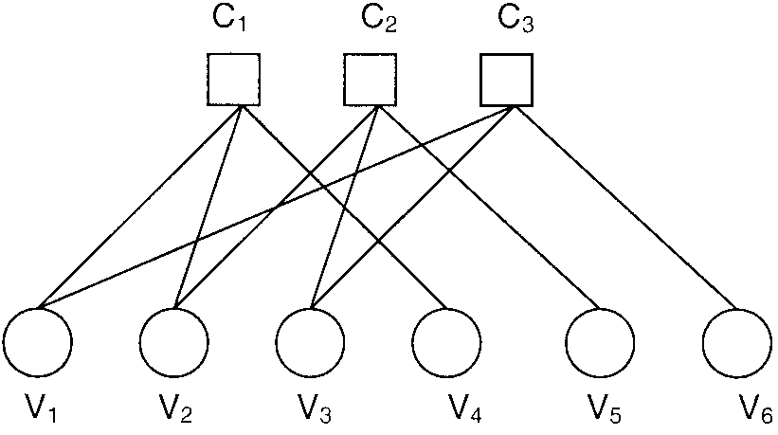
Message Passing
Message Passing is for correction the error.Here,All the bit of codeword is called Variable nodes(VN) and all the bit Syndrome is called check nodes(CN).
Message can be passed from VN to CN and CN to VN.But message can not passed from VN to VN or CN to CN.
It will work as Bipartite Graph.This is also called as Tanner Graph.

Slide 6
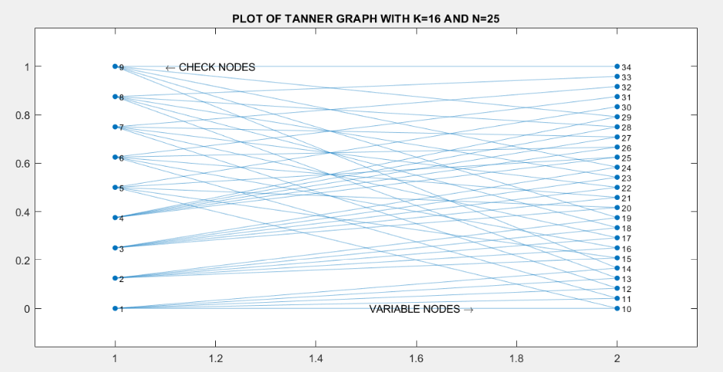
Tanner Graph
For n=25 and k=16

Slide 7
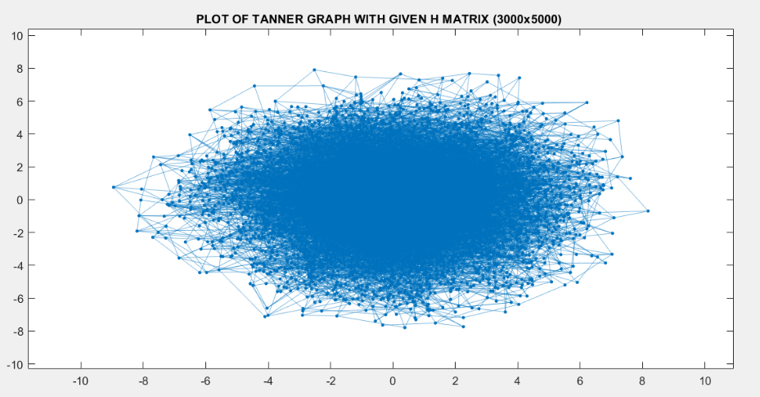
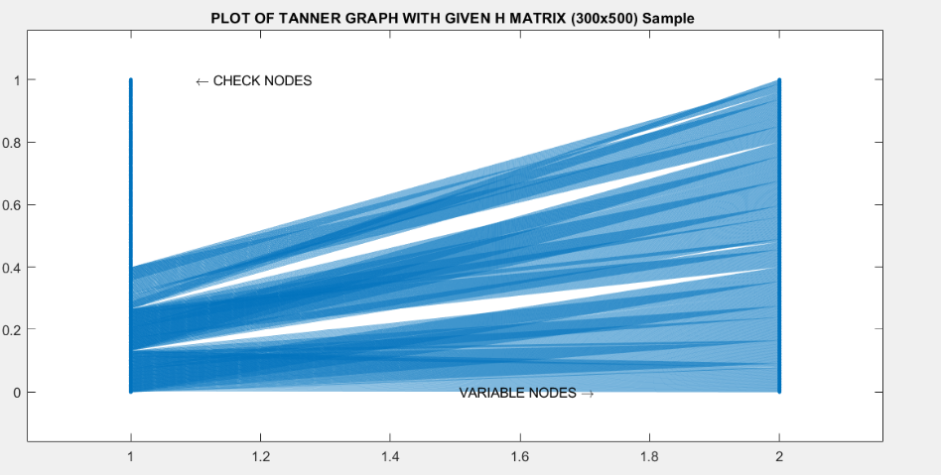
Tanner Graph
For n=5000 and k=2000 for H(1:300,1:500)

Slide 8
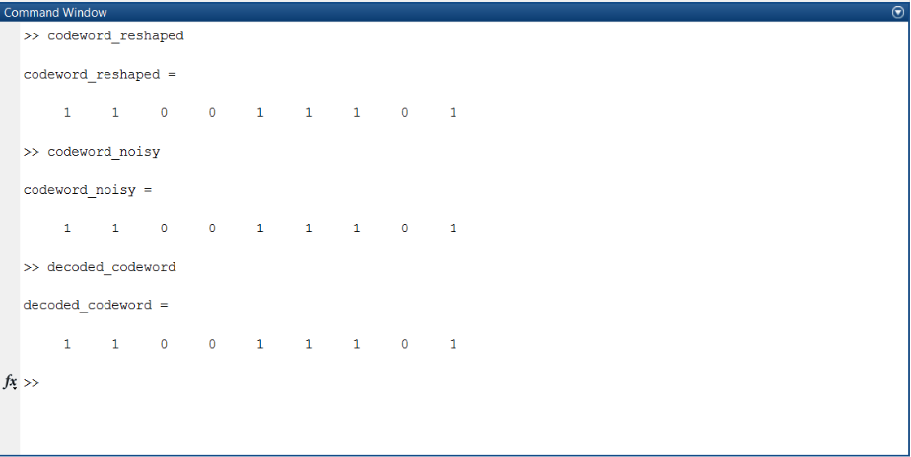
Message Passing Decoding on Product Code(9,4) over BEC

Slide 9
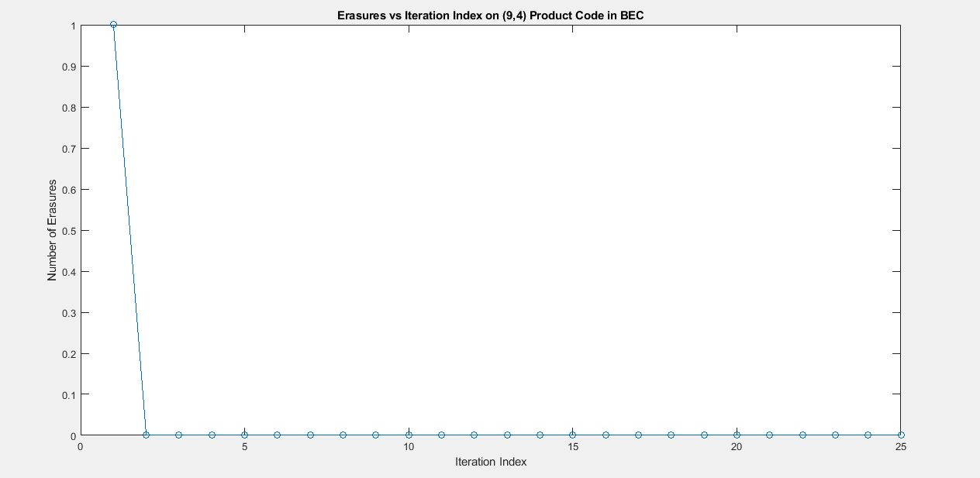
BEC Simulation- For (9,4) Product Code

Slide 10
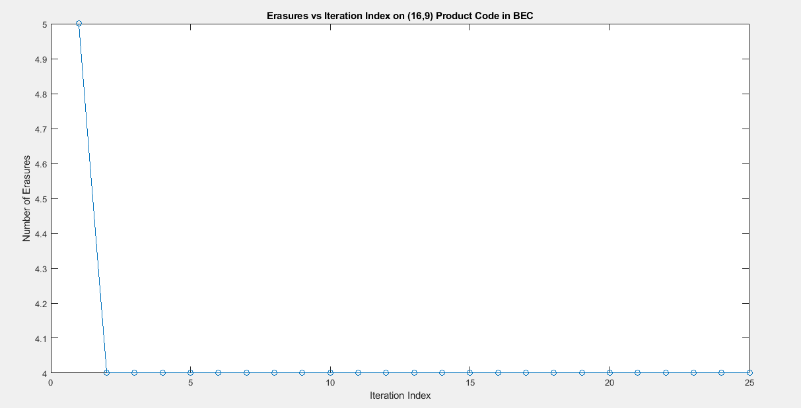
BEC Simulation- For (16,9) Product Code

Slide 11
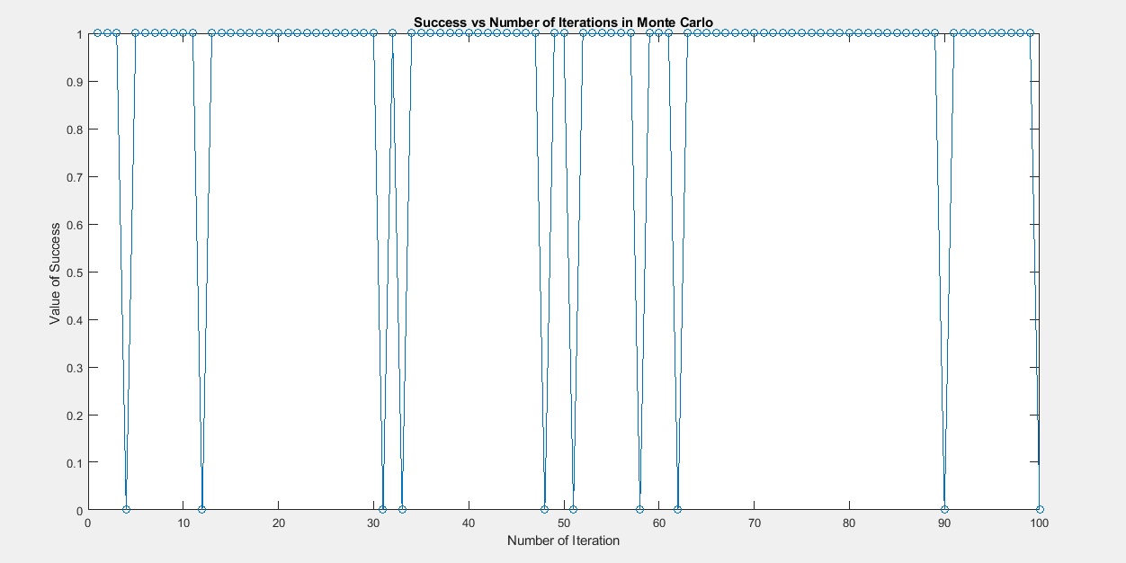
Monte Carlo Simulation- BEC Product Code(9,4)

Slide 12
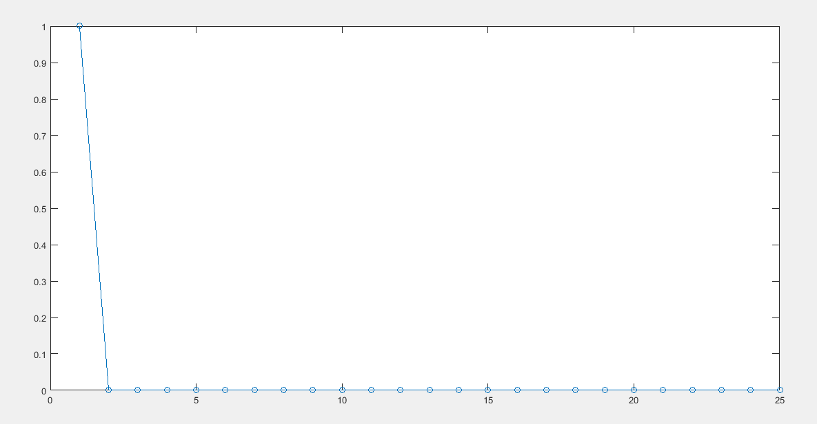
BSC Simulation- For (25,16) Product Code (Bit Errors vs Iteration Index)

Slide 13
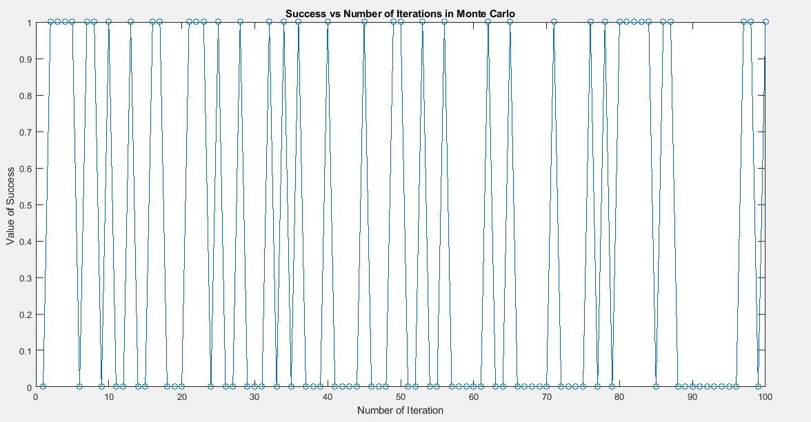
Monte Carlo Simulation- BSC Product Code(25,16) p=0.05

Slide 14
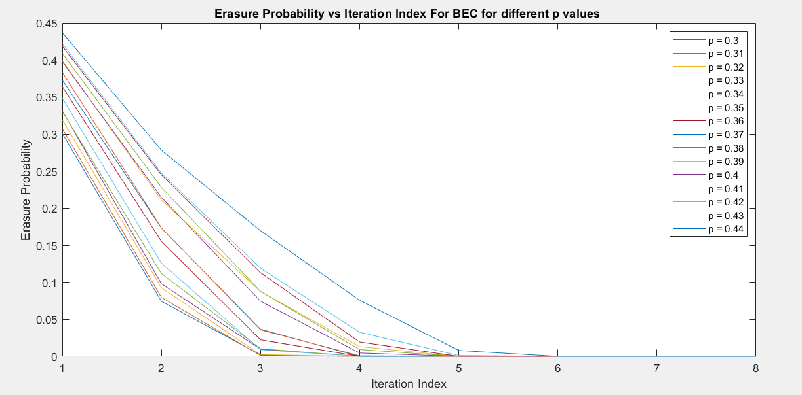
Erasure Probability vs Iteration Index For BEC for different p values(0.3-0.44) H(3000X5000)

Slide 15
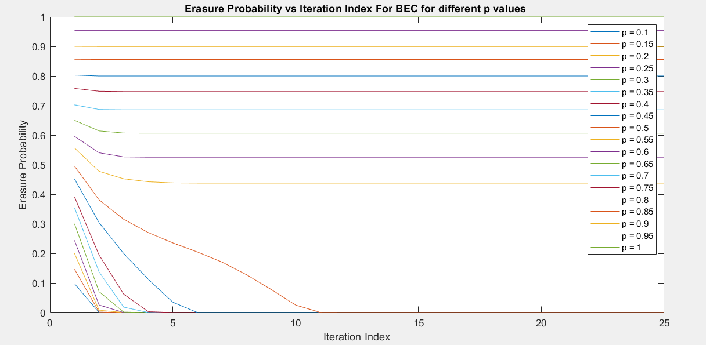
Erasure Probability vs Iteration Index For BEC for different p values(0.1-1) H(3000X5000)

Slide 16
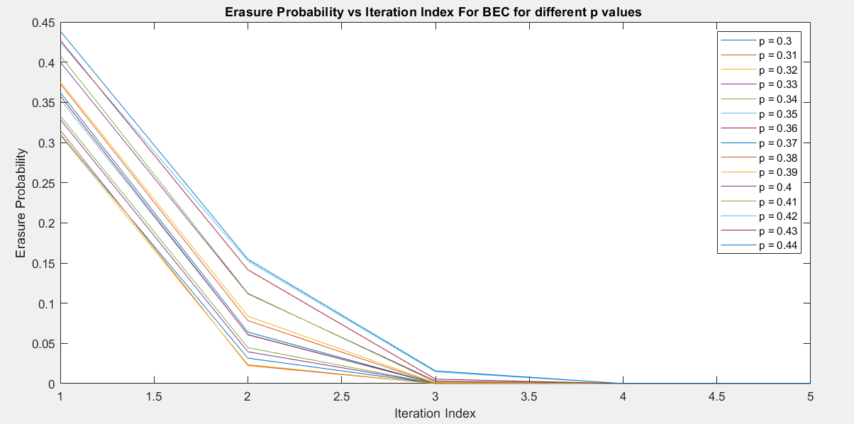
Erasure Probability vs Iteration Index For BEC for different p values(0.3-0.44) H(3792X5056)

Slide 17
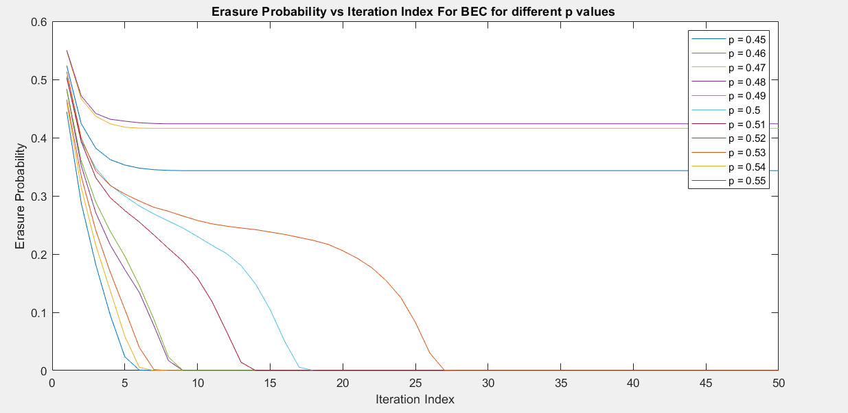
Erasure Probability vs Iteration Index For BEC for different p values(0.45-0.55) H(3000X5000) 50 Iterations this time. Didn't get decoded for p=0.55,0.54 and 0.52

Slide 18
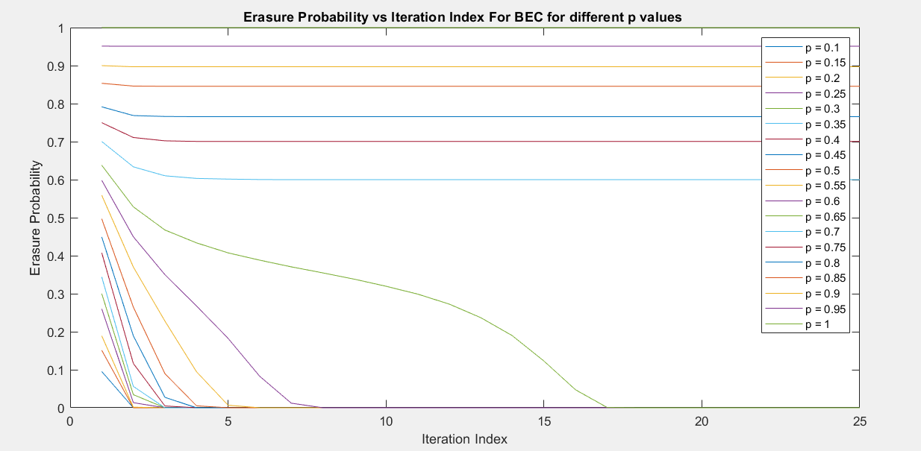
Erasure Probability vs Iteration Index For BEC for different p values(0.1-1) H(3792X5056)

Slide 19
THANK YOU…

