Slide 1
ZS Data Science Challenge
(19-22 July 2019)
Presented by:
Rajat Kumar
M. Tech | ICT
DA-IICT, Gandhinagar

Slide 2
Flow
Dataset Overview
Problem Overview
Removing Useless Attributes
Data Preprocessing
Attributes after Pre-Processing
Data Visualization
Data Analysis
Dimensionality Reduction (PCA)
Best Model (ANN)
Results before dimensionality reduction
Results after dimensionality reduction
Conclusion/Observations

Slide 3
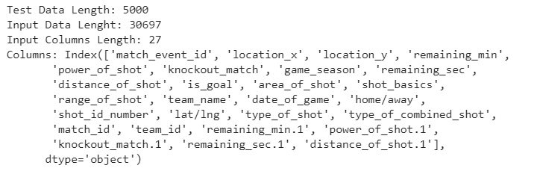
Dataset Overview

Slide 4
2. Problem Overview
This problem is a regression based problem.
The attribute ‘is_goal’ is the output. It’s either 0 or 1.
But the expected output is a probability value between 0 and 1.
Based on the 27 attribute input vector, predict the probability of happening of goal.
How to approach solving this? We need regression models.

Slide 5
3. Removing Useless Attributes
'Shot_id_number', 'match_event_id' (ID’s don’t contribute)
'Game_season' (Month and Year doesn’t matter for goal)
'team_name', (Since Team name = Manchester United Only)
'Date_of_game'
''Match_id', 'team_id', (Again ID’s)

Slide 6
4. Data Pre-processing
Convert home/away to 0.8 for in home, 0.2 for out of home matches, 0 for Nan.
Combine columns 'type_of_shot', 'type_of_combined_shot' to one column
Dropping rows having ‘is_goal’ as ‘nan’.
Convert categorical attributes to numerical values (0,1, 2….)
Categorical Attributes: ‘game_season’, ‘area_of_shot’, ‘shot_basics’, ‘range_of_shot’, ‘home/away’, ‘lat/lng’, ‘type_of_shot’, ‘type_of_combined_shot’,
Find X and Y for fitting model

Slide 7
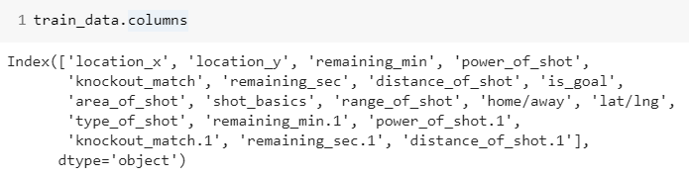
5. Attributes left after Pre-Processing (18)
‘Is_goal’ is the output attribute

Slide 8
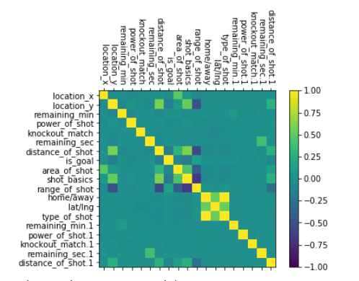
6. Data Visualization
Correlation Matrix
Observations:
Any Multicollinearity?
See Blue patches and green patches too- Is that a problem?
A. 'shot_basics' and 'range_of_shot' are highly correlated
B. 'area_of_shot' and 'range_of_shot' are also highly correlated
C. 'range_of_shot' and 'distance_of_shot' are correlated
D. 'range_of_shot' and 'location_y' are also correlated

Slide 9
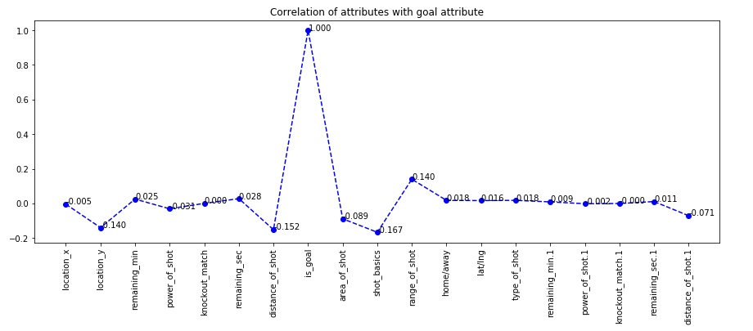
Correlation of Attributes with ‘is_goal’

Slide 10
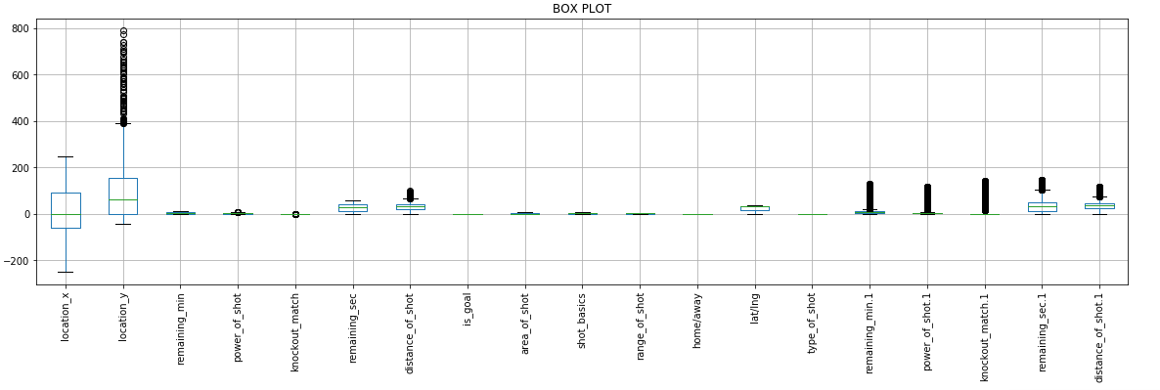
Box Plot Analysis

Slide 11
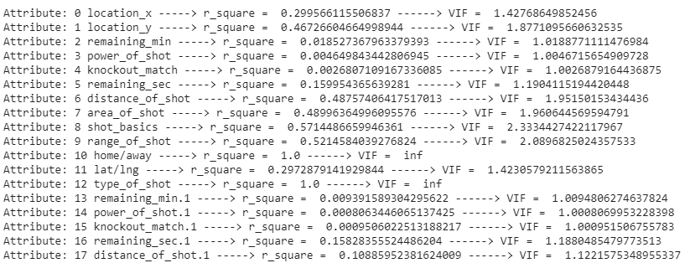
Variance Inflation Factor
As we can see, VIF is infinity for 'home/away' and 'type_of_shot', so we need to remove these attributes.
So now only 16 attributes are left.

Slide 12
7. Data Analysis
Observation:
1. As we can see, 'location_y', 'distance_of_shot', 'remaining_min.1', 'power_of_shot.1', 'remaining_sec.1', 'distance_of_shot.1' have many outliers which may confuse regression models which are affected by outliers. Linear Regression model is worst affected by outliers.
2. Multicollinearity also exists among attributes which might also confuse the models.

Slide 13
Final Attributes (16 left)
'location_x', 'location_y',
'remaining_min', 'power_of_shot', 'knockout_match', 'remaining_sec',
'distance_of_shot', 'area_of_shot', 'shot_basics', 'range_of_shot', 'lat/lng',
'remaining_min.1', 'power_of_shot.1', 'knockout_match.1',
'remaining_sec.1', 'distance_of_shot.1'

Slide 14
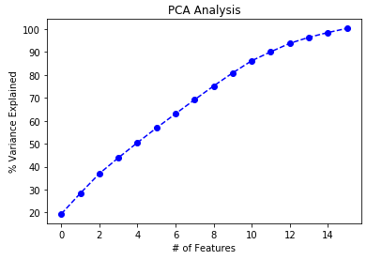

8. Dimensionality Reduction (PCA)
16 to 14 dimensions
In the above array we see that the first feature explains roughly 19% of the variance within our data set while the first two explain 28.4 and so on. If we employ 14 features we capture 96.4% of the variance within the dataset, thus we gain very little by implementing an additional feature.

Slide 15
Why Dimensionality Reduction?
When the number of features is very large relative to the number of observations in your dataset, certain algorithms struggle to train effective models. This is called the “Curse of Dimensionality,” and it’s especially relevant for clustering algorithms that rely on distance calculations.

Slide 16
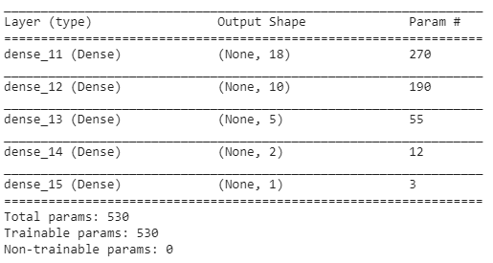
9. Best Model Fit - ANN
Most Significant variables in model :
Activation: Relu
Epochs : 50
Training Parameters: 530

Slide 17
10. Results (With 16 dimension input vector)
Model Used | MSE
Linear Regression | 0.2384
Logistic Regression | 0.4091
SVM Regressor | 0.2646
KNN Regressor | 0.2463
Decision Tree Regressor | 0.4622
Random Forest Regressor | 0.2364
XGBoost Regressor | 0.2367
ANN (50 epochs) | 0.2283

Slide 18
11. Results (After Dimensionality Reduction to 14)
Model Used | MSE
Linear Regression | 0.2385
Logistic Regression | 0.4101
SVM Regressor | 0.2654
KNN Regressor (30 neighbours) | 0.2460
Decision Tree Regressor | 0.4743
Random Forest Regressor | 0.2376
XGBoost Regressor | 0.2378
ANN (50 epochs) | 0.2293

Slide 19
12. Conclusion/Observations
The dataset had 27 attributes but only 18 were of actual use.
4 attributes were categorical type.
2 attributes have infinite Variance Inflation Factor. So need to be removed.
Dropping attributes having outliers doesn’t help much.
Correlation between attributes and output is between -2 to 2. But that doesn’t imply that there is no correlation between them.
The most important observation is that dimensionality reduction helps a little bit in this example dataset.
Finally, after trying with other models, ANN performs the best.
K-fold cross validation can be used.
‘Nan’ values can be filled with mean values of particular column.

Slide 20
Thanks

