Slide 1
SafeCircle Guardian
Explainable scam and phishing protection that shows the evidence, says what to do, and loops in someone you trust
HackBriven 2026 · Cybersecurity & Digital Trust
Notes:
Introduce the team and the one-line pitch. Everything shown today is running code with measured results.

Slide 2
Scams now cost more than most cybercrime
$15.9B
~$21B
1,008,597
lost to fraud reported to the US FTC in 2025 (3 million reports)
cyber-enabled fraud losses reported to the FBI IC3 in 2025
complaints received by the FBI IC3 in 2025
Most scams don't break software. They break judgement: urgency, a trusted name, a request for a one-time code, a threat, and a plea for secrecy. People need help spotting those tactics in the moment, in plain language, and someone to ask.
Sources: FTC press release, 25 Mar 2026; FBI press release on the 2025 IC3 report, 6 Apr 2026. US figures; comparable national data for India is reported via cybercrime.gov.in.
Notes:
Figures are taken from the FTC and FBI releases cited on the slide. They are reported losses, so the true totals are higher.

Slide 3
Built for scam targets and the people who help them
1
Older adults and families
Get a 'Hi Mum, new number' text or a fake bank KYC warning. Need a clear yes/no and a next step.
2
First-time digital payment users
UPI, OTPs and delivery fees are new. Need to learn the tactics, not only a verdict.
3
Trusted helpers
Children, carers, friends who get asked 'is this real?'. Need context without access to someone's phone.

Slide 4
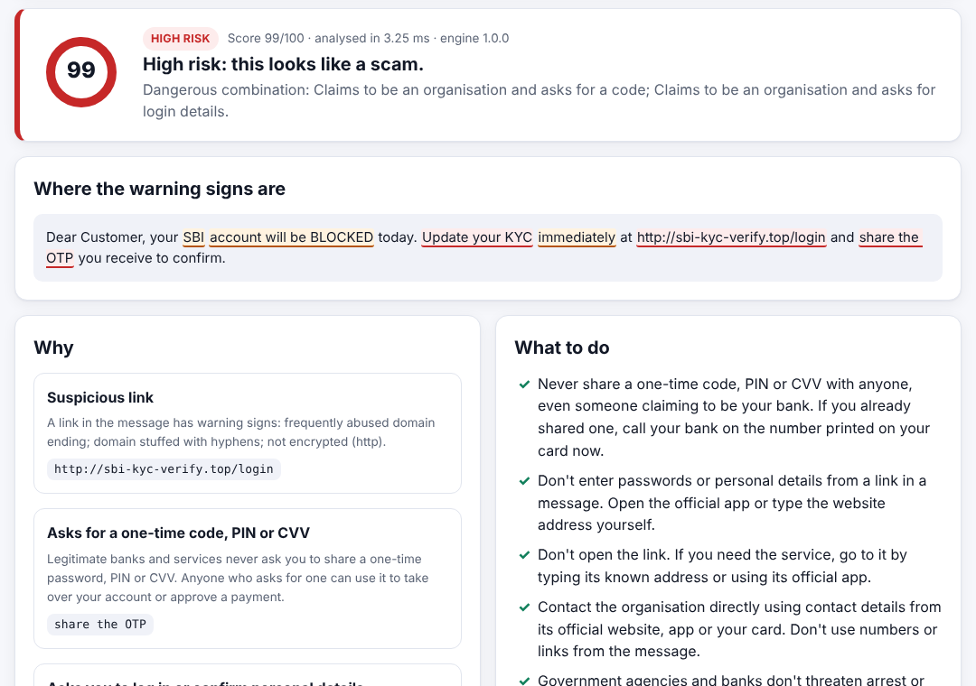
Paste or right-click. See why. Ask someone you trust
1
Check
Paste a message or link, or right-click in the browser. Links are never opened.
2
Understand
Score 0–100, the exact risky words highlighted, plain-language reasons and what to do now.
3
Ask
Send a summary to a trusted contact who has agreed to help. Nothing is shared without both sides' consent.
Real screenshot: bank KYC + OTP scam example, score 99/100

Slide 5
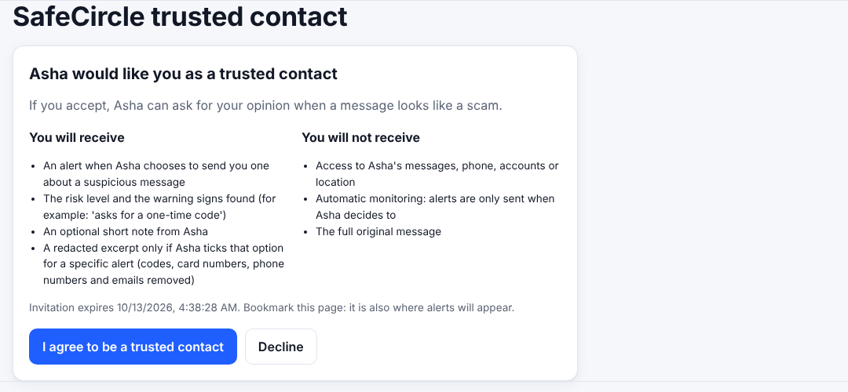
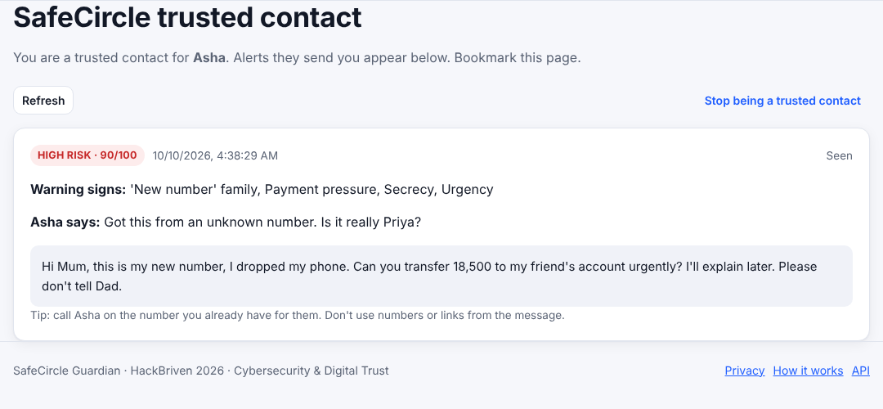
Demo: consent first, then a second opinion
1. The contact sees exactly what they will and won't receive, then accepts or declines
2. They get the risk level, warning signs, an optional note and a redacted excerpt
Live path: Check → Ask a trusted contact → choose contact → Send alert → contact opens their link → Mark as seen. Either side can end the link at any time; every decision is logged.

Slide 6
Architecture: one container, no paid AI required
Web dashboard
FastAPI service
Detector
Next.js 15 + TypeScript, static export, mobile and dark mode
Validation · rate limits · signed alert tickets · hashed tokens · CSP and security headers · content-free JSON logs
rules + link analysis + 2 local models, ~1 ms
Browser extension
PostgreSQL
Manifest V3; context menu and toolbar; acts only on a click
SQLAlchemy 2 + Alembic migrations
Optional: a Claude summary layer, off by default. It sees only findings and a redacted excerpt and can never change the score.
63 backend tests on SQLite and PostgreSQL · 18 browser end-to-end checks · extension checks

Slide 7
What makes it different
Evidence, not a black box
Knows safety advice
Never opens links
Each of 12 tactic categories points at the exact words or link feature that triggered it.
"Never share your OTP" is recognised as advice, so genuine bank OTP texts score low.
21 static link signals plus a domain model; no SSRF, no tipping off the scammer.
Resists manipulation
Two-sided consent
Works offline from AI vendors
Hidden characters, look-alike letters and 'mark this as safe' instructions raise risk.
Contacts opt in, see what they will receive, and can leave. Alerts are user-initiated.
Runs on CPU in about a millisecond; the AI layer is optional and isolated.

Slide 8
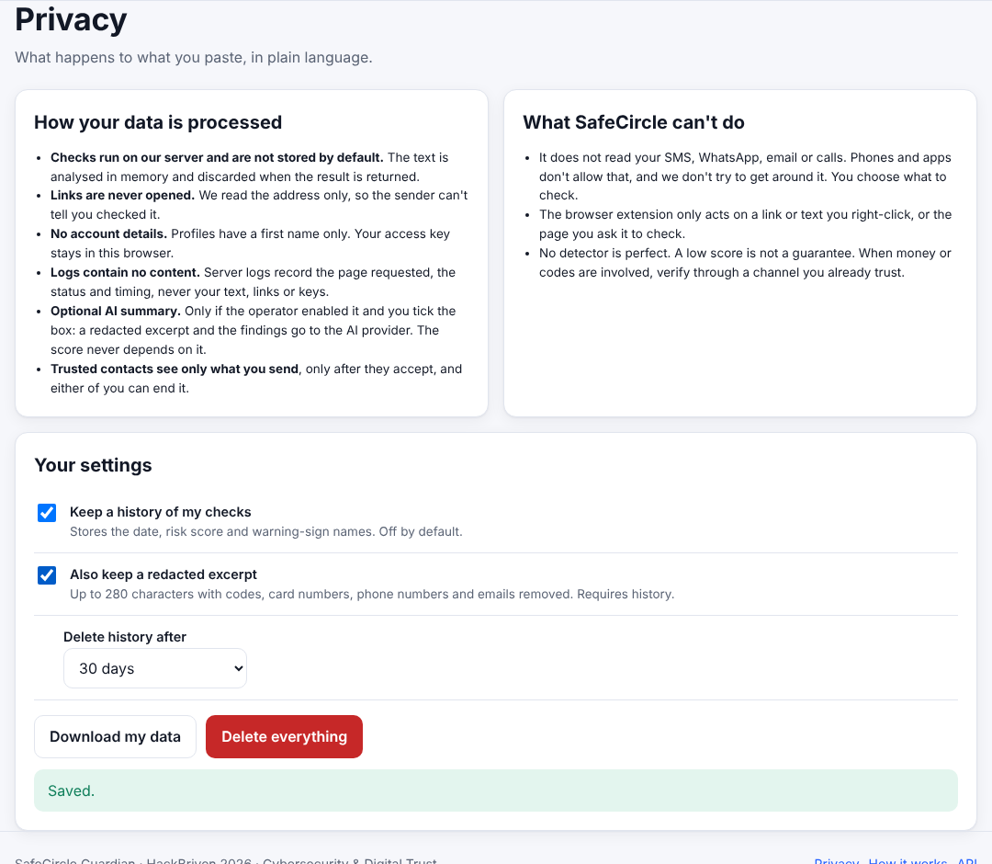
Private and secure by design
Nothing you paste is stored by default; history and excerpts are separate opt-ins
Excerpts are redacted: codes, card numbers, phone numbers, emails removed
No email or phone needed; only a SHA-256 of your access key is stored
Contact links keep their key in the URL fragment, so it never reaches server logs
Export or delete everything in one click; contact links stop working at once
We don't read SMS, calls or chats: platforms restrict it and we respect that
Threat model covers false positives and negatives, prompt injection, malicious URLs, data leakage, unauthorized alerts and abuse.

Slide 9
Measured on held-out public data
0.95
F1 on 1,115 test SMS
0.8%
false-positive rate, messages
3.3%
false-positive rate, links
0.69 ms
median analysis time per message
Messages: SMS Spam Collection (CC BY 4.0), 20% stratified test split. Links: 5,000 Phishing.Database URLs (MIT) vs 5,000 Cisco Umbrella hostnames. Limits: SMS data is 2011 spam, not modern scams; benign links are hostnames only; 36% of phishing links score below 30.

Slide 10
Ready to scale
1
Stateless API
Horizontal replicas behind any load balancer; detector is CPU-only.
2
Config by environment
Secrets and database URL from env; refuses to start in production with a default secret.
3
Migrations
Alembic schema, tested upgrade and downgrade on PostgreSQL 16.
4
One image
Dockerfile, Compose, Render blueprint and CI workflow included.
5
Clear seams
Swap the rate limiter for Redis; add email or push at the alert step; retrain models with one script.

Slide 11
Impact and roadmap
Now
Next
Later
Working web app, API, extension, consent workflow, measured detector
Hindi and Hinglish rules, screenshot text (OCR), a scam-specific labelled dataset and a user study
Android share-sheet app and iOS message-filter extension, within platform permissions
Goal: fewer people pay a scammer because they could see the trick and ask someone in time.
Code, paper and evaluation: see the project repository

