Slide 1

SafeCircle Guardian
AI-DRIVEN SCAM PATTERN RECOGNITION · PROBLEM STATEMENT 02
Detect the pattern. Disrupt the scam.
Protect the user.
A UPI, banking or wallet scam rarely arrives as one message. SafeCircle follows the whole episode, explains every piece of evidence, and warns once, when the risk actually changes.
EXPLAINABLE RULES · NO PAID AI API
USER-INITIATED CHECKS ONLY
ALL EXAMPLES: SYNTHETIC DEMO DATA
Amazon AI Cyber Security Hackathon · Problem Statement 02
Notes:
Open on the problem statement in one line: AI-enabled scam workflows across UPI, banking and wallets, and the requirement to alert at the right time without alert fatigue. SafeCircle's answer is to treat a scam as a pattern over several events, not as one message. Mention up front that every example in this deck is synthetic DEMO DATA and that the score is a heuristic indicator, not a probability. The helix image is an illustration rendered by our 3D walkthrough, not data.

Slide 2
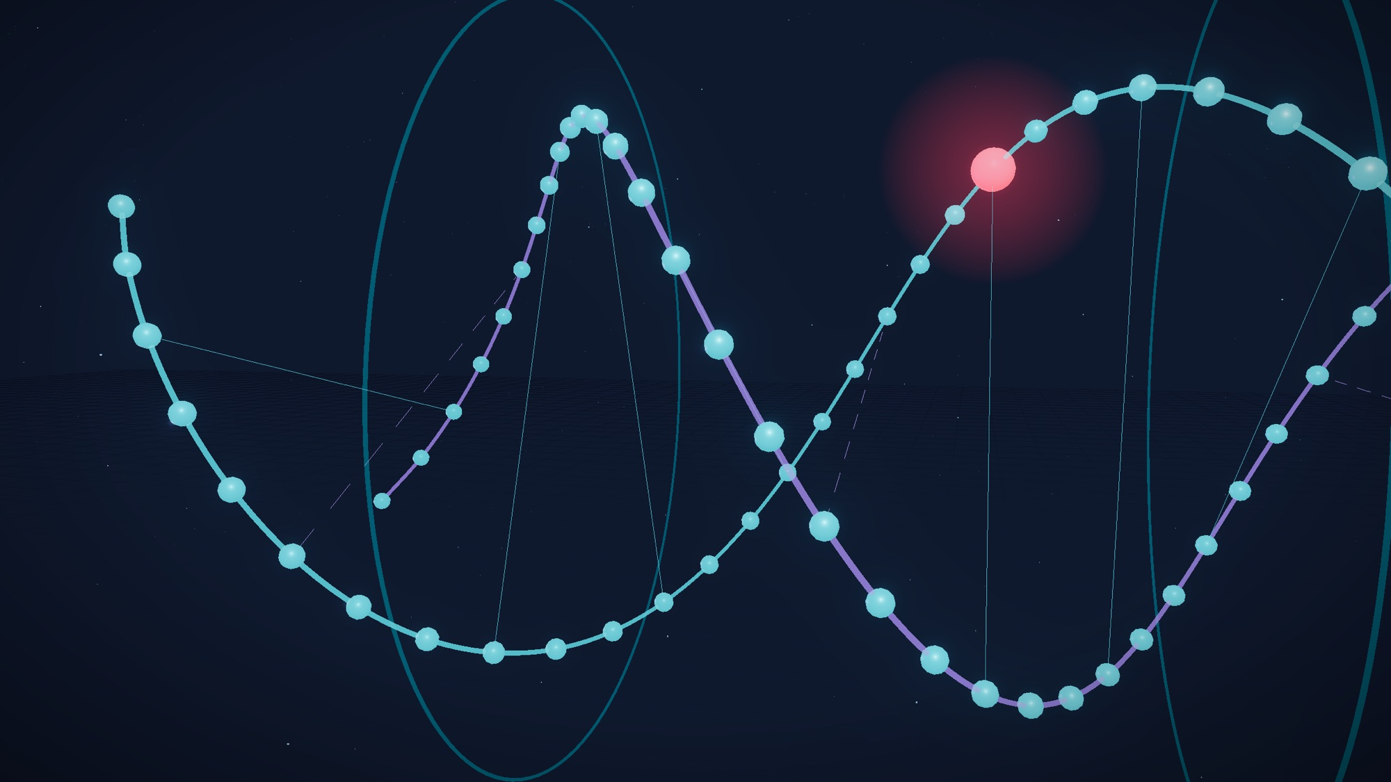
One scam, many harmless-looking pieces
02 · THE THREAT
The problem statement asks for detection of emerging AI-enabled scam workflows in UPI, banking and wallet contexts. Generative tools make each message fluent and on-brand, so a single text often looks plausible.
The signal is the sequence: a lure, then pressure, then a request for a code, then money moves.
01
02
03
04
05
APPROACH
PRESSURE
HARVEST
CONTROL
EXTRACTION
Contact and a borrowed identity or lure
Fear, urgency or authority
OTP, PIN, password or fake login
Remote-access apps
Collect request, transfer or fee
These five stages are the stage model the engine uses (backend/app/scamdna/tactics.py). They organise evidence; they are not measured prevalence.
Notes:
Keep this qualitative: we did not measure how common AI-enabled scams are, so we make no prevalence claim. The point is structural. Each piece can look harmless, but the sequence across SMS, calls, links and QR codes is what gives the scam away. These are the five stages the engine tracks.

Slide 3
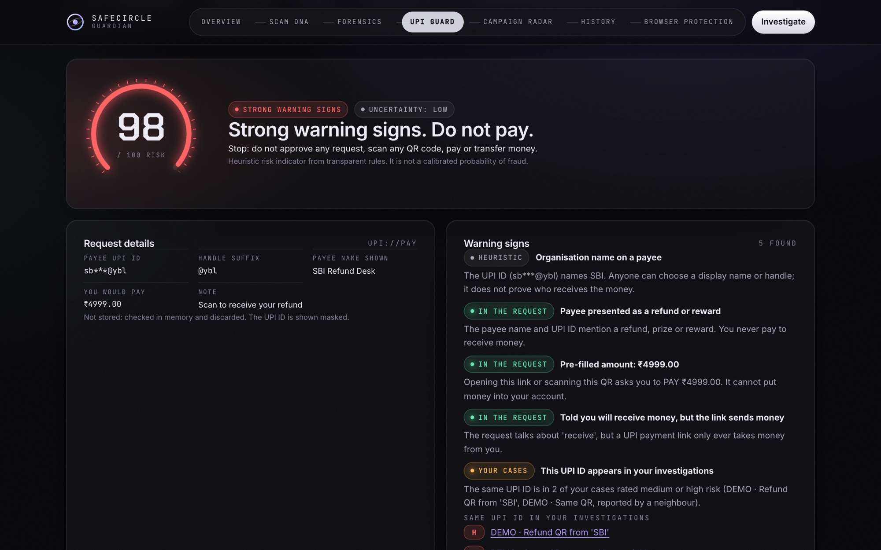
The moment SafeCircle intervenes
03 · THE USER JOURNEY
UPI GUARD
Ordinary shop QR checked before paying
0
low · no false alarm
SCAM DNA
First message: “SBI Refund Desk: your refund of Rs 4,999 has been approved…”
36
medium · alert: new
UPI GUARD
“Refund” QR decoded on the device: it is a payment, not a credit
97
high · do not pay
SCAM DNA
QR attached to the case: 36 → 97
97
high · alert: escalated
Real screenshot: UPI Scam Guard on the refund QR (DEMO DATA).
UPI GUARD
Same check repeated
97
The first message only earns a warning. The alarm comes when the QR contradicts the promise, and repeats do not re-alert.
high · alert: suppressed
SCAM DNA
Caller asks for the OTP
97
high · alert: suppressed
Scores are heuristic 0–100 indicators, not probabilities. Output of the real API on a throwaway database.
Notes:
This is the demo story from docs/demo-runbook.md, replayed through the real API by presentation/scripts/snapshot.py. Point out the restraint: the first message is only medium, the QR check is what proves the contradiction (a payment presented as a refund), and the escalation happens when evidence is joined into one case. Repeats are suppressed, so the user gets one alert, not four. In the live demo the same steps run in the app.

Slide 4
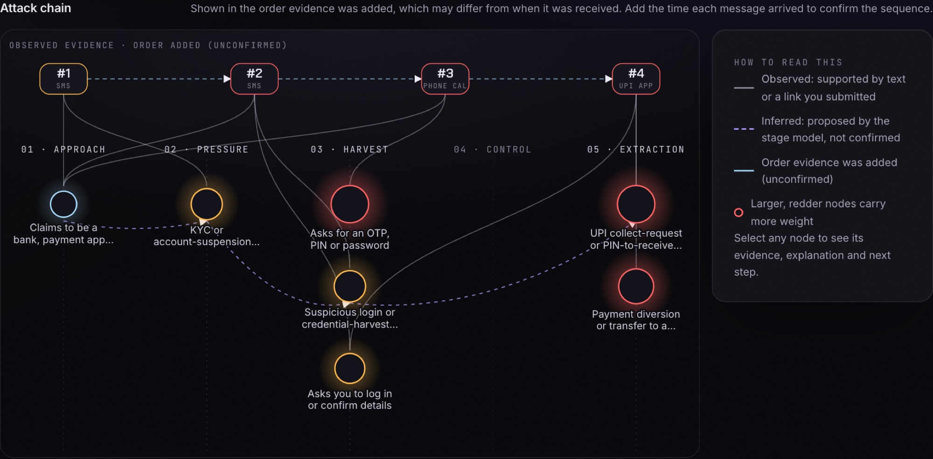
Scam DNA: observed evidence, inferred pattern
04 · CORE INNOVATION
THREE LAYERS PER CASE
Observed evidence
The text, call note, link or QR the user added, stored redacted.
Tactics with matched words
Each tactic keeps the exact words or link signal that triggered it.
Inferred stages
Approach → Extraction, drawn dashed: a proposal, not a fact.
Real screenshot: the attack chain for the synthetic multi-stage case, after four pieces of evidence.
Alerts: new → escalated → updated → updated. Heuristic risk indicator from transparent rules. It is not a calibrated probability of fraud.
Notes:
The core idea: separate what we saw from what we infer. Solid lines are supported by submitted evidence; dashed lines are the stage model's proposal. The chart is the real score after each of the four synthetic messages (45, 82, 94, 99), with the alert decision at each step. The model similarity score is shown beside the result but never changes the score.

Slide 5
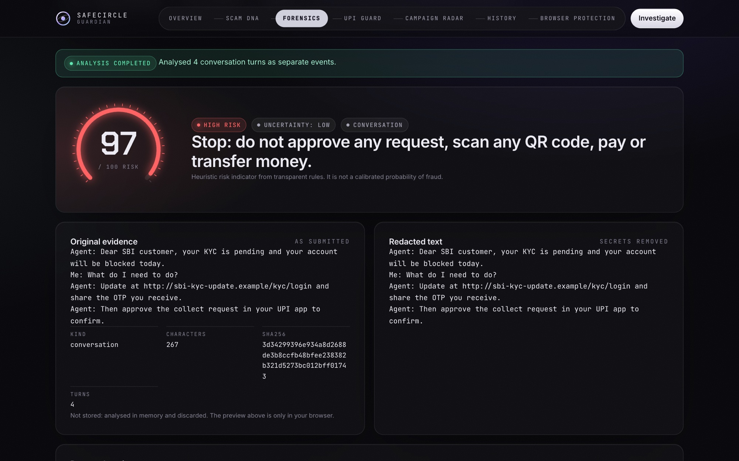
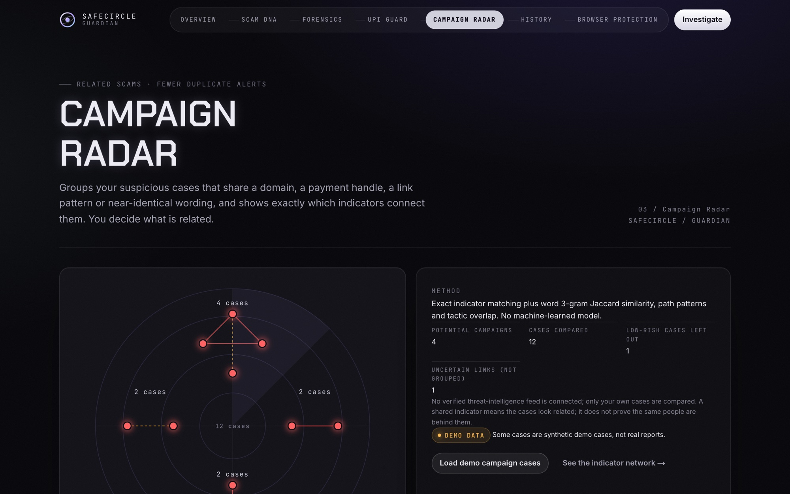
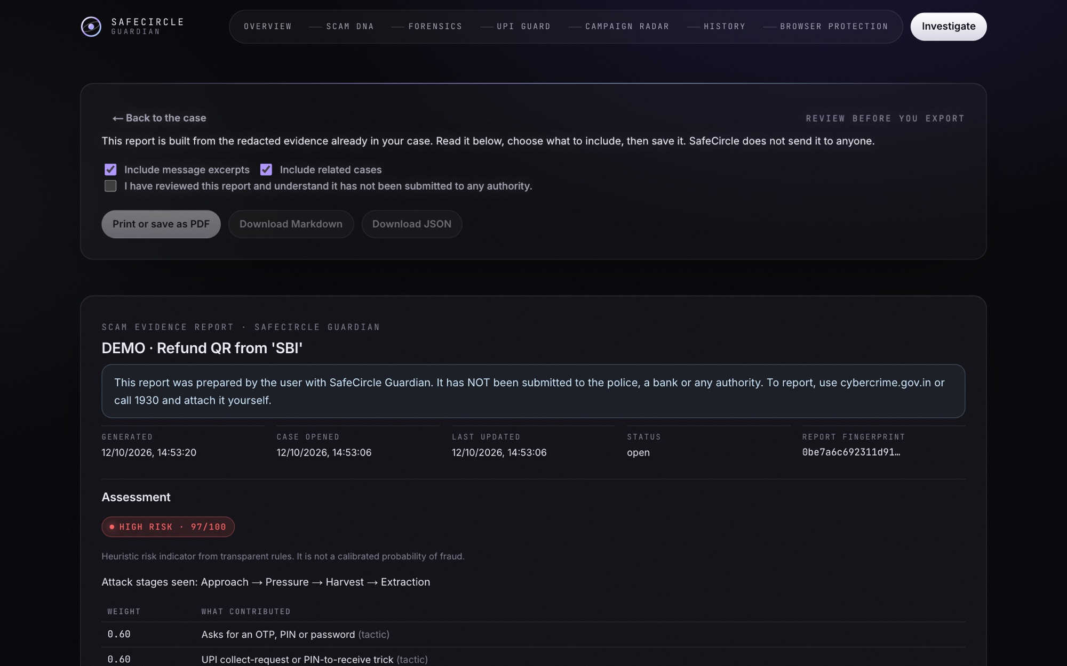
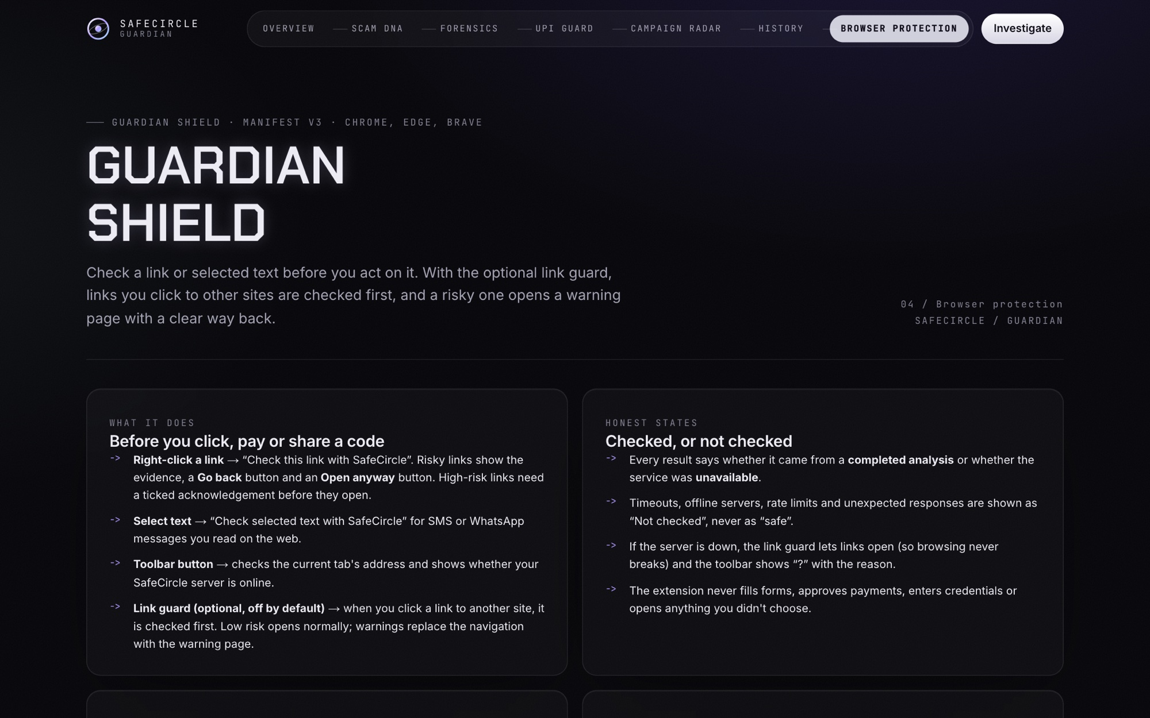
What is built today
05 · THE PRODUCT
SCAM DNA
SCAM FORENSICS
UPI SCAM GUARD
CAMPAIGN RADAR
A case per suspicious episode; each item re-evaluates it, with what changed, missing and conflicting evidence.
Message, conversation, link (never opened) or screenshot read by local Tesseract OCR.
Check a UPI ID or payment QR before paying; QR decoded in the browser.
Groups your own cases by exact shared indicators and, separately, by similarity.
Implemented
Implemented · needs Tesseract
Implemented · no bank/NPCI data
Implemented · own cases only
SCAM NETWORK
EVIDENCE REPORT
GUARDIAN SHIELD
TRUSTED CONTACTS
Graph of cases and shared domains, UPI IDs, phones and claimed organisations.
Redacted timeline and reasoning; exported after review, never sent anywhere.
Chrome MV3 extension: check a selection or link; warning page; opt-in link guard.
Two-sided consent before a contact can receive an alert the user sends.
Implemented
Implemented
Real-browser run not verified
Implemented
Scam Forensics
Campaign Radar
Evidence report
Browser protection page
Notes:
Every module here is in the repository and covered by tests; the status line says what is not verified. The Guardian Shield extension's code is tested with a mocked chrome API and its pages were run in Chrome with a stub, but loading the installed extension in a real Chrome profile has not been verified. Screenshots are from the running app on a scratch database with DEMO DATA.

Slide 6
From evidence to one useful alert
06 · DETECTION AND DECISIONING
01
02
03
04
05
Ingest and redact
Extract
Reassess
Doubt
Decide
Codes, phones, e-mails and card numbers removed; phones and UPI IDs compared as keyed hashes.
Tactics with the matching words; links analysed statically, never fetched.
Every item re-scores the case: strongest weight per tactic, noisy-OR, combination and stage bonuses.
One uncorroborated tactic is held at medium and sent for review; conflicts and missing evidence shown.
Alert only when risk rises or a high-weight tactic appears; duplicates suppressed and logged.
Alert decision | When | Notifies
new | First medium or high, or review needed | yes
escalated | Risk level rose | yes
updated | New high-weight tactic, same level | yes
suppressed | Nothing material changed | no, logged
deescalated | Risk level fell | no, logged
REAL OUTPUT: LONE OTP REQUEST, THEN A RETRACTION
1 · “Hi, I sent a code to your phone by mistake. Please share the OTP you just received.”
medium 59, review required: one tactic cannot make a case high on its own.
2 · “Please ignore the earlier message. We will never ask for your OTP.”
Conflict recorded; score unchanged at 59; alert suppressed. A newer message is not more trustworthy.
Source: backend/app/scamdna/alerts.py
Notes:
Walk the five steps. The two things judges usually ask about are uncertainty and alert fatigue. The right-hand box is real engine output: a lone OTP request is held at 59 and sent for review instead of being called high; a later 'please ignore' message is flagged as a conflict and does not lower the score. The language model's similarity is reported beside the score and never changes it.

Slide 7
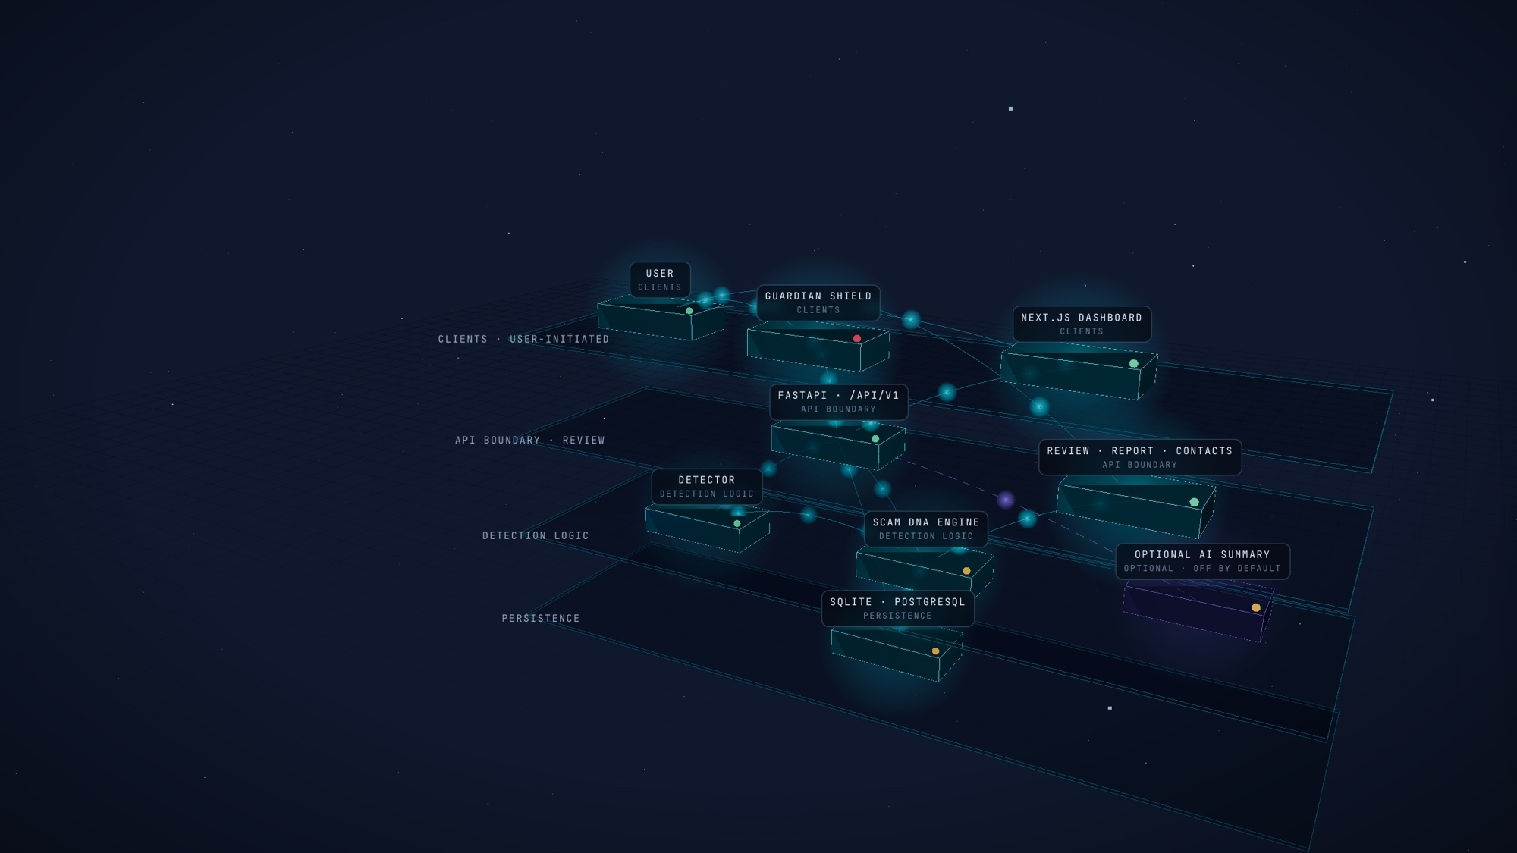
One deployable unit, clear boundaries
07 · SYSTEM ARCHITECTURE
CLIENTS · USER-INITIATED
Guardian Shield extension (MV3)
Next.js 15 static dashboard
API BOUNDARY
FastAPI: validation, rate and size limits, CSP, content-free logs
DETECTION LOGIC
Single-message detector (rules, URL analysis, local models)
Scam DNA case engine and alert decisions
Optional AI summary: off by default, never scores
PERSISTENCE
SQLite locally; PostgreSQL via Docker Compose
REVIEW AND REPORTING
Review states, evidence report, consented alerts
Rendered from the interactive 3D walkthrough (presentation/site, Scene A). No bank, NPCI or threat-intelligence feed is connected; links are never fetched.
Green: implemented and tested · amber: partial or configured only · violet: optional
Notes:
If time allows, switch to the 3D walkthrough here (press A). Every module in Scene A is a real component of the repository; clicking one shows its inputs, outputs, verified status and source files. The deployable unit is one FastAPI container that also serves the static site. The amber items are honest: the extension's real-browser run and the PostgreSQL container image build were not verified in this environment.

Slide 8
Honest numbers on a frozen synthetic set
08 · VALIDATION
65 synthetic scenarios, labels and checksum committed before the first run, scored through the real API with the rules unchanged. 51 are labelled scam (24) or benign (27).
0.885
0.958
0.111
23/26
23/24
3/27
PRECISION
RECALL
FALSE-POSITIVE RATE
ERRORS IN THE FROZEN V2 RUN (BEFORE HARDENING)
False positive: New-login security alert pointing to the official app (warn, 30)
False positive: Genuine delivery OTP that IS meant to be shared with the courier (false-positive trap) (alert, 60)
False positive: LPG booking confirmation (warn, 35)
False negative: Product-rating job with registration fee (clear, 15)
After hardening the courier OTP is warn 59: still a false positive, no longer high. v3 check (32 scenarios, not independent): P 0.778, R 0.933, FPR 0.235, unchanged by the fixes.
Synthetic benchmark performance does not establish real-world fraud-detection accuracy.
Tests on this branch: backend 176/176, extension 25/25, browser suites 18/18, 21/21, 17/17, 30/30 and demo 12/12, all run on 2026-10-12 against a scratch database.
Notes:
Read the numbers with their fractions: 23/26 precision, 23/24 recall, 3/27 false positives. The baselines ran on the same set: a keyword baseline and our own original single-message detector, which flags far more benign messages because it judges each message alone. Then read the errors aloud; they are the honest part. The v3 set was written after reading the rules, so it is a check, not a benchmark. Sources: evaluation/holdout_v2/results_v2_baseline.json and evaluation/holdout_v3/results_v3_postfix.json.

Slide 9
Privacy, consent and a realistic path
09 · TRUST AND DEPLOYMENT
1
You choose what to check
DEPLOYMENT PATHWAY
No SMS, call, WhatsApp or transaction monitoring; mobile platforms restrict that access and we do not work around it.
Stage | Status
Local single process (FastAPI serves the static site) | Runs
Docker Compose with PostgreSQL | Configured; image build not run
Render blueprint (render.yaml) | Written; not deployed
Pilot with consenting users | Proposed
Bank, NPCI or payment-app integration | None
2
Minimal retention
Redacted excerpts only; screenshots discarded after local OCR; history is opt-in; export and delete-everything.
3
Minimal URLs
The extension masks query values and drops fragments before sending a clicked link.
4
Consent
Trusted contacts accept on their side; alerts are sent by the user, never automatically.
5
Human review
Conflicts and single-tactic cases go to review; reports export only after a review tick and are never submitted.
Not production-ready: no external security audit, English only, per-instance rate limiter, no real-world labelled dataset yet. No legal, regulatory or banking certification has been obtained.
6
Alert fatigue
Duplicates and minor additions are suppressed, and every decision is in the case's audit trail.
Notes:
Privacy is a design constraint, not a feature list. The extension change to minimal URLs was measured: about 0.2–0.3% of phishing URLs in our sets lose a warning, which we accept for privacy. The deployment table is deliberately conservative: only the local single-process mode has been run here.

Slide 10
The 48-hour finale plan
10 · 48-HOUR FINALE PLAN
Proposed milestones. Each is judged on data the rules were not tuned on, and each ends with the demo dry run still passing.
H 0–12
H 12–24
H 24–36
H 36–48
Fresh evaluation set
Known errors
Demo hardening
Ship and explain
A v4 synthetic set written by a teammate who has not read the rules, frozen with a checksum before any run.
Single-tactic false positives (login alerts, booking confirmations), the registration-fee job scam, and organisation claims drawn as weaker links.
Rebuild the served site, rename realistic demo UPI handles, rehearse the six-minute story on the presentation laptop.
Publish the repository, deploy the blueprint if hosting is approved, re-run every suite, update the paper with v4 numbers.
Owner: Evaluation lead
Owner: Detection lead
Owner: Product and demo lead
Owner: Whole team
DEMO SUCCESS CRITERIA
demo_story_check.py passes · browser demo suite 12/12 · no console errors · a fresh-set report published with its errors listed · every claim on screen traceable to a file in the repository.
Notes:
Fill in team member names for each owner role before presenting; the roles are placeholders, not people. The plan is deliberately about evidence quality first: a fresh, independent synthetic set before any rule change, because the current sets were written by the same team that wrote the rules.

Slide 11
Appendix
Backup material for questions. Not part of the 10-slide pitch.
Notes:
Only show these slides if asked.

Slide 12
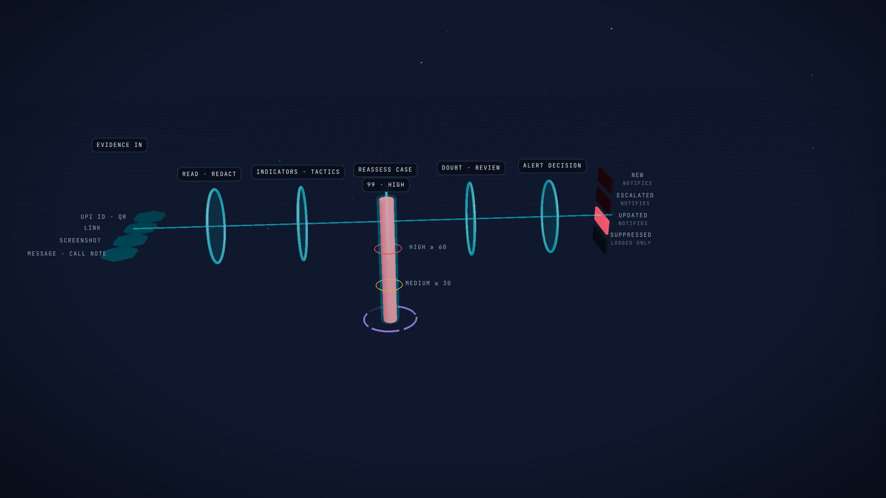
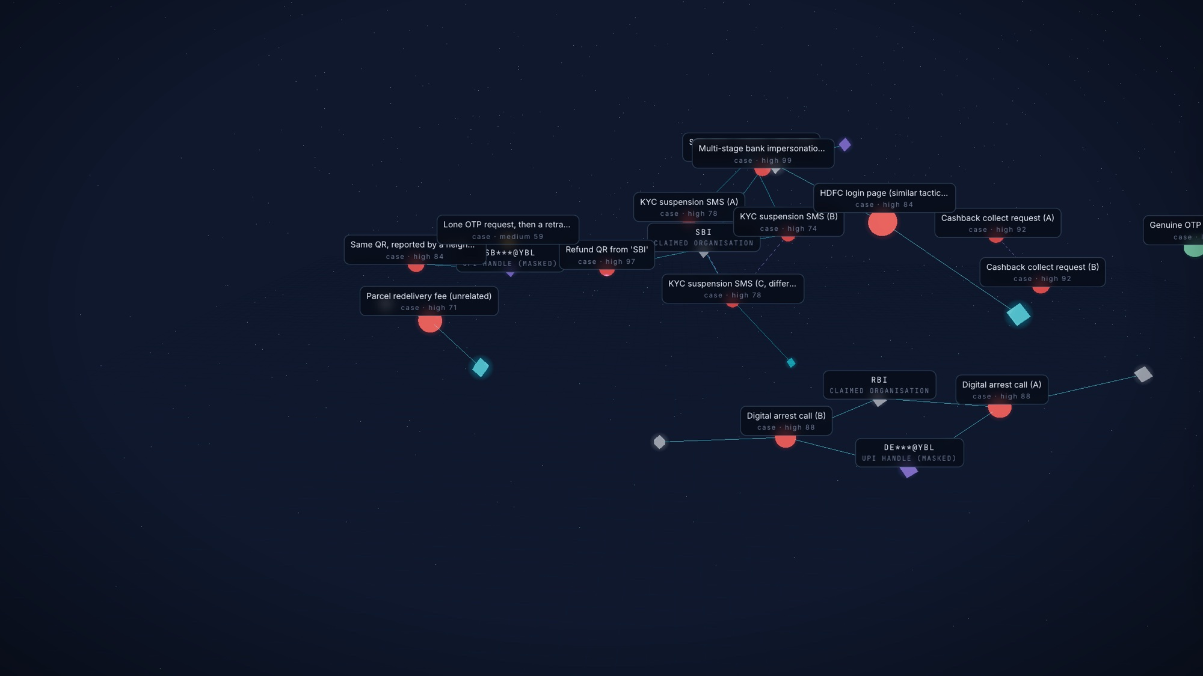
Scenes B and C of the 3D walkthrough
APPENDIX A1 · ARCHITECTURE WALKTHROUGH
Scene B: each evidence item travels through read and redact, indicators and tactics, case reassessment, doubt and review, and the alert decision. Frames are real API output on DEMO DATA.
Scene C: 14 synthetic cases and 13 indicators from GET /api/v1/network. 22 observed links (solid) and 3 inferred similarity links (dashed). Organisation names are claims, not verified senders.
Run it: python3 -m http.server 8090 --bind 127.0.0.1 --directory presentation/site, then open http://127.0.0.1:8090 (see presentation/README.md).
Notes:
The website is a separate deliverable from this deck. It needs no backend: it replays a recorded snapshot of the real API output, labelled DEMO DATA, and can be regenerated with presentation/scripts/snapshot.py.

Slide 13
More measurements, with their limits
APPENDIX A2 · ADDITIONAL EVALUATION
SYNTHETIC V3 (N = 32), FROZEN BEFORE THE HARDENING FIXES, NOT INDEPENDENT
SINGLE-MESSAGE DETECTOR ON PUBLIC DATA (HELD OUT, NOT FULLY BLIND)
System | P | R | FPR | TP/FP/TN/FN
Case engine, before hardening | 0.778 | 0.933 | 0.235 | 14/4/13/1
Case engine, after hardening | 0.778 | 0.933 | 0.235 | 14/4/13/1
Keyword baseline | 0.684 | 0.867 | 0.353 | 13/6/11/2
Single-message detector | 0.560 | 0.933 | 0.647 | 14/11/6/1
Setting | P | R | FPR
Messages, score ≥ 30 | 0.947 | 0.953 | 0.008
Messages, score ≥ 60 | 1.000 | 0.638 | 0.000
Links, full URL | 0.951 | 0.634 | 0.033
Messages: SMS Spam Collection, held-out 20% stratified test split (seed 42) (1115 messages): generic SMS spam, not UPI scams. Links: 5000 reported phishing URLs (Phishing.Database phishing-links-ACTIVE.txt (MIT), random sample) vs 5000 popular hostnames (Cisco Umbrella top-1M hostnames, uniform random sample). Measured on 2026-10-10 before the extension began masking query values. Source: evaluation/results/metrics.json.
FP: Cab ride start PIN to tell the driver (warn, 59)
FP: Card blocked after customer request (warn, 35)
FP: Society maintenance reminder to a known account (warn, 35)
FP: Colleague splits lunch bill (warn, 35)
FN: Telecom SIM block with call-back (clear, 25)
Alert load on v2: 30 notifications across 65 scenarios; 3 benign scenarios received one; 2 scenarios received more than one. Latency per event through the in-process API: p50 7.5 ms (includes local OCR for screenshots; not network latency).
None of these sets is real-world UPI fraud data. They show behaviour on the scenarios we wrote and on public spam and phishing data, not field accuracy.
Notes:
Use only if asked about further numbers. The public-data detector results predate the PS02 case engine and measure generic spam and phishing, so they do not support claims about UPI scams.

Slide 14
Implemented, partial, illustrative and planned
APPENDIX A3 · IMPLEMENTATION STATUS
Capability | Status | Evidence or note
Scam DNA, Forensics, UPI Guard, Campaign Radar, Network, Evidence report, trusted contacts | Implemented | backend 176 tests; browser suites 18, 21, 30 and 12 checks on a scratch database
Guardian Shield extension | Partial | 25/25 node tests (mocked chrome.*), 17/17 pages with a stub; the installed extension in real Chrome is not verified
Screenshot OCR | Implemented, needs Tesseract | Without Tesseract installed, screenshots are reported as unavailable
PostgreSQL deployment | Partial | Compose file present; tests ran on PostgreSQL 16 on 2026-10-10; container image build not run
Optional AI summary | Optional, off | Tested with a mocked client only; never changes the score
Overview globe and demo scenarios | Illustrative / DEMO DATA | Synthetic sample data, labelled as such; not a live threat map
3D helix in this deck and site | Illustrative | Visual metaphor rendered by the walkthrough, not data
Hosted deployment, public repository | Not done | Needs a hosting account and GitHub access (see STATUS.md)
Bank, NPCI or payment-app integration; real-world dataset; Hindi | Planned / not started | No such integration or dataset exists in this repository
Notes:
This table is the answer to 'what is real?'. Everything marked implemented has tests in the repository; partial and illustrative items say exactly what is missing.

