Slide 1

Business Sustainability
Development, Prosperity & Long Term Growth

Slide 2
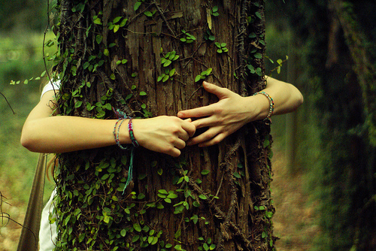
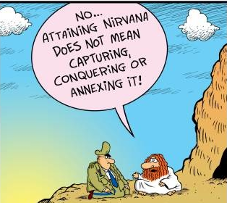
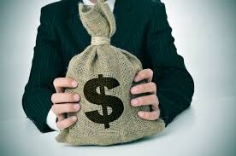
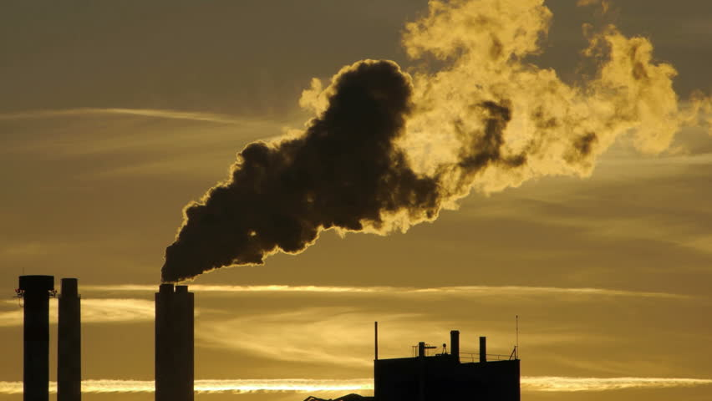
What is Sustainability

Slide 3

What’s the Big Deal?
“According to research, this is what keeps owners, executives, & directors awake at night”
Sustainability and long term growth prospects
Structural change/changing business models
Legal and regulatory compliance
The remaining16 issues
……………………………………………………………………………….
42%
……………………………………………………..
28%
…………………………………
21%
…………………………………
From 20% down to 3%
Research conducted by the AICD
Reference source:
Australian Institute of Company Directors
Director Sentiment Index
First Half 2017

Slide 4

So what is Business Sustainability
“The best possible guarantee that the business will be profitable and still be in business in the future”

Slide 5

Is sustainability a Mind-Set or a Process?
?????
1 What does business sustainability mean ?
2 What if our business is unsustainable?
3 How do we make it truly sustainable?

Slide 6


MBL Mindset
We need to look at business from a Multiple Bottom Line perspective
EGSEEE
Economics $$$
Governance
Social dimensions
Ecological management
Ethics
Energy
“Following a single bottom line philosophy is now fraught with danger”

Slide 7
OVERVIEW
Operational
Results
People
Performance
2. Well
Trained Staff
Point
B
New Knowledge & Skills create better results
Staff & Systems development
Transformation plan
Gaps in
results
Gaps in Skill &
Knowledge
Point A
Current staff cause current results
1. Current staff
1 causes Point A
2 will create Point B

Slide 8
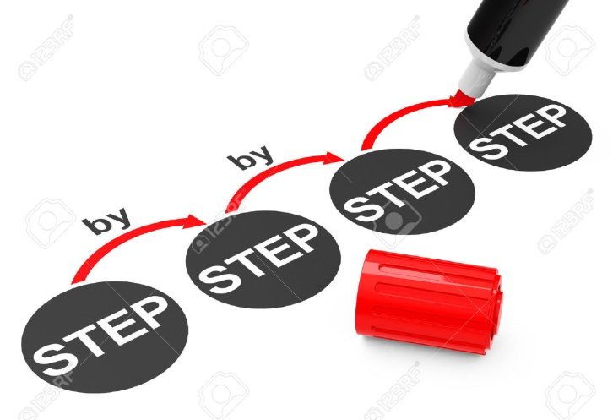
PROCESS
Develop a 5 step process
1. Current business – Point A
2. Future ideal state – Point B
3. Business case for change
4. Transformation Plan
5. Monitoring system
A
Process
B

Slide 9

Step 1
An analysis of all aspects of the business ‘as is’
Finances, Customers, Operations, Staff effectiveness, Training, Revenues, Cashflow, Products, Offices, Warehouse, Location, Core-competencies, Sales per customer, COGS, Industry trends, Technology, Digital structure, Marketing, Sales, Risks, Roadblocks etc
Point A?

Slide 10


Step 2
The ideal business
Finances, Customers, Operations, Staff effectiveness, Training, Revenues, Cashflow, Products, Offices, Warehouse, Location, Core-competencies, Sales per customer, COGS, Industry trends, Technology, Digital structure, Marketing, Sales, Risks, Roadblocks etc
Point B

Slide 11

Step 3
Business Case
Analysis
How much?
How long?
Is it worth it?
Involvement?
Relevance?
Long term view
Future proofing
Governance

Slide 12
Step 4
TRANSFORMATION PLAN
Develop a Transformation plan
Get full ‘buy in’ from everyone Start with ‘low hanging fruit’
Quick ‘n easy fixes first
Keep ‘end objective’ in sight
Use performance indicators
Have progress rewards
Goal focused action

Slide 13
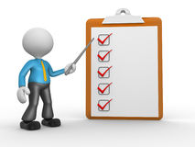
Step 5
Inspect, test, record, assess
MONITORING SYSTEM
Measure and Manage
Revenues V budget etc
Hours worked V hours budgeted
Energy used V energy target
Staff training V performance monitoring
Legal monitoring
Waste monitoring
Warranties - monitor & remedy
Recycling & re-usage
Product & packaging redesign
Develop a measurement system for all critical aspects

Slide 14
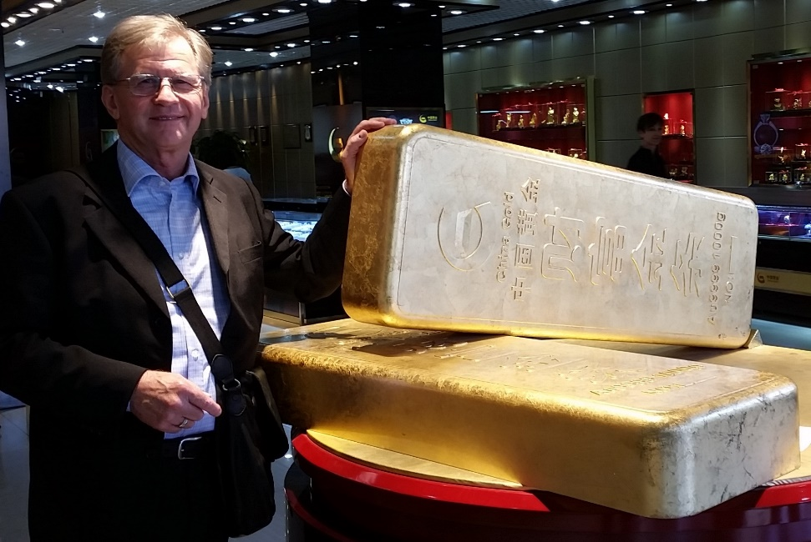
Last Step
Dr Ian Kirkwood
PhD, MAICD, JP
0400 143 063
DrIRK@Live.com
Ian.Kirkwood@jcub.edu.au
“Together we can create a plan and a toolkit that suits any specific SME business”
“We have many masters degree students who are looking for projects to work on as part of their studies – Accounting, IT, MBA, etc”
“I am quite willing to support any SME business in the Brisbane-Logan area”
“This plan is as good as gold”

