Slide 1


Business Etiquette
Ian R. Kirkwood

Slide 2
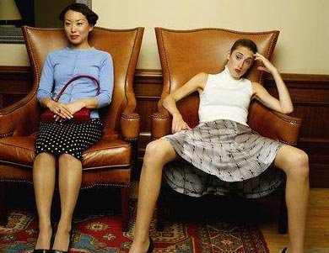
Business Etiquette
Part 1
An Introduction to the World of
Global Business Etiquette

Slide 3
What is Business Etiquette?
Business Etiquette focuses on two key points:
1. Cultivating social skills
2. Developing cultural understanding
This helps to leverage business communications between people of Eastern, Western, and Restern cultures

Slide 4
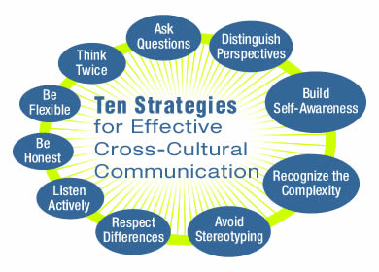
How Should We Look at any Society?
Those who wish to influence the future
must prepare for it.
How do we accomplish this?

Slide 5
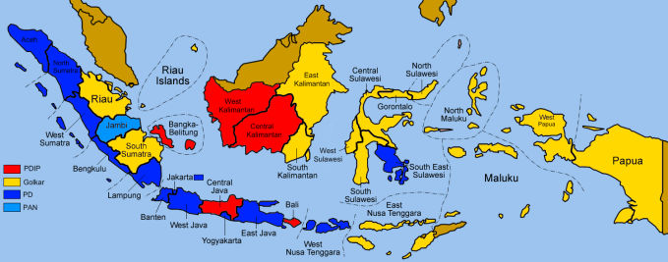
Business Etiquette - Indonesia
Appearance
Women meeting in a more formal office should wear a suit with hosiery.
Women are limited to clothing colors that are muted or dark. Leave brightly colored clothing at home.
Men should wear coat and tie until appropriate to dress more casually. Follow the lead of those you are meeting with.
Behavior
No physical contact between men and women is made in public, except a possible handshake.
Be on time for any meetings. The meetings traditionally start late, and your Indonesian business associates will probably arrive late. However, you are expected on time, and should never make any comment about the meeting starting late or any person arriving late.
Always rise when your host/hostess enters the room.
Communications
Shake hands upon greeting and leaving, and always using your right hand. The handshake is limp and lasts 10-15 seconds.
For religious reasons (Muslim and Hindu) men and women do not touch in public in this culture.
Women do not offer a handshake to an Indonesian man. However, should a man extend his hand, always shake hands. Some Indonesian men may follow western business rules in a business setting.

Slide 6
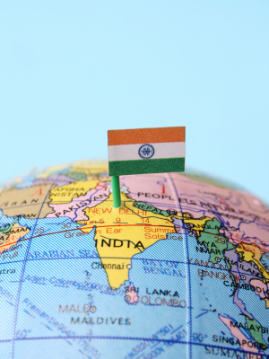
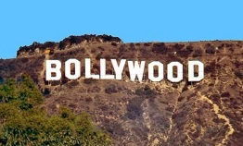
Business Etiquette - India
Appearance
Men are generally expected to wear a suit and tie for business, although the jacket may be removed in the summer. Women should wear conservative dresses or pantsuits.
When dressing casual, short-sleeved shirts and long pants are preferred for men; shorts are acceptable only when exercising. Women must keep their upper arms, chest, back, and legs covered at all times.
The use of leather products including belts or handbags may be considered offensive, especially in temples. Hindus revere cows and do not use leather products.
Behavior
The head is considered the seat of the soul. Never touch someone else’s head, not even to pat the hair of a child.
Beckoning someone with the palm up and wagging one finger can be construed as in insult. Standing with your hands on your hips will be interpreted as an angry, aggressive posture.
Communications
There are more than fourteen major and three hundred minor languages spoken in India. The official languages are English and Hindi.
The word "no" has harsh implications in India. Evasive refusals are more common, and are considered more polite. Never directly refuse an invitation, a vague "I’ll try" is an acceptable refusal.
Do not thank your hosts at the end of a meal. "Thank you" is considered a form of payment and therefore insulting.
Titles are very important. Always use professional titles.

Slide 7
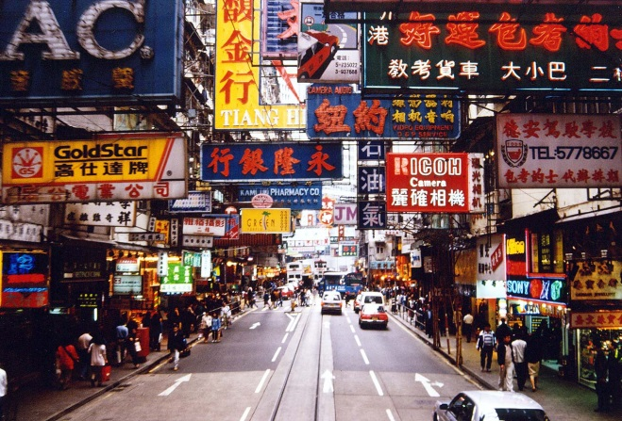
Business Etiquette - Hong Kong
Appearance
The color red is considered a lucky color in Hong Kong.
When dressing for a business meeting select a red tie to
impress your host.
The color white is synonymous with death.
Behavior
The toast is an integral part of the culture in Hong Kong.
All countries have a standard toast however each country has a different pronunciation for the word toast. Ganbei is the popular Chinese toast. It means dry glass or bottoms up.
Everyone is expected to drink a toast.
The guest of honor makes the first toast.
Communications
The handshake is fairly common in Hong Kong, however a slight bow will show a sign of respect.
A round of applause may greet you during your visit. The Chinese like to applaud. You are expected to return the applause out of respect.
Because Hong Kong is so densely populated the Chinese tend to converse very closely together.
Silence is held in high regard in Hong Kong. Allow your host to contemplate without interruption.

Slide 8
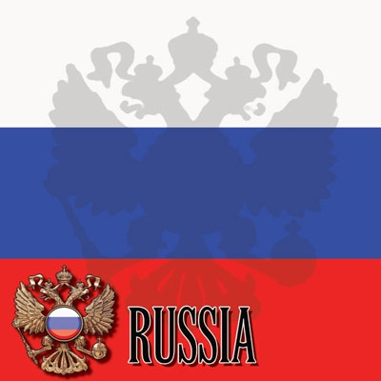
Business Etiquette - Russia
Appearance
Businessmen in Russia usually wear suits that are dark and well tailored along with good dress shoes. A businessman’s wardrobe demonstrates the individual’s image as a professional.
Men often do not take off their jackets in negotiations.
Do not stand with your hands in your pockets. This is considered rude.
Women dress rather conservatively, avoiding overly flashy or gaudy outfits.
Behavior
As a foreigner, you are expected to be on time to all business appointments. However, your Russian counterpart may be late, as this may be a test of your patience. Do not expect an apology from a late Russian, and do not demonstrate any kind of attitude if your business appointments begin one or two hours late. This may also be a test of your patience.
Social events are more relaxed. It is acceptable for foreigners to be 15 to 30 minutes late.
Patience is an extremely important virtue among Russians; punctuality is not.
Communications
Russian is the official language.
Speaking or laughing loudly in public is considered rude, as Russians are generally reserved and somber.
Many Russians speak English, as it is often taught beginning in the third grade.

Slide 9
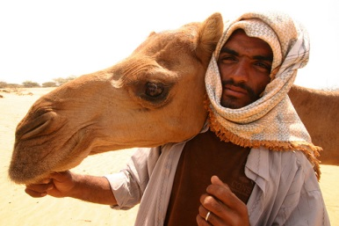

Business Etiquette - Saudi Arabia
Appearance
Never show bare shoulders, stomach, calves and thighs.
Visitors are expected to abide by local standards of modesty however, do not adopt native clothing. Traditional clothes on foreigners may be offensive.
Despite the heat, most of the body must always remain covered.
A jacket and tie are usually required for men at business meetings.
Behavior
It is common to remove your shoes before entering a building. Follow the lead of your host.
Alcohol and pork are illegal.
In the Muslim world, Friday is the day of rest.
There are several styles of greetings used; it is best to wait for your counterpart to initiate the greeting. Men shake hands with other men. Some men will shake hands with a woman; it is advisable for a businesswoman to wait for a man to offer his hand.
Communications
Do not discuss the subject of women, not even to inquire about the health of a wife or daughter. The topic of Israel should also be avoided. Sports is an appropriate topic.
Communications occur at a slow pace. Do not feel obligated to speak during periods of silence. "Yes" usually means "possibly".
Your Saudi host may interrupt your meeting or conversation, leave the room for 15 to 20 minutes for the purpose of his daily prayers.

Slide 10
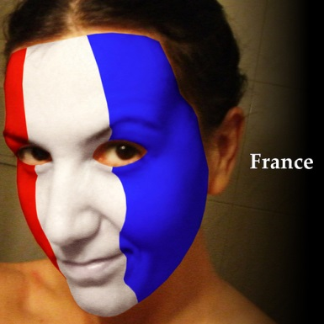

Business Etiquette - France
Appearance
The French are very conscientious of their appearance.
Dress conservative and invest in well-tailored clothing.
Patterned fabrics and dark colors are most acceptable, but avoid bright colors.
Women should also dress conservatively. Avoiding bright or gaudy colors is recommended.
Behavior
Punctuality is treated very casually in France.
France is a highly stratified society, with strong definition and competition between classes.
The French handshake is brief, and is accompanied by a short span of eye contact.
Always shake hands when meeting someone, as well as when leaving. French handshakes are not as firm as in many other Western countries like USA and Australia
Communications
French is the official language in France.
If you do not speak French, it is very important that you apologize for your lack of knowledge
Most individuals in business speak English.
The French have a great appreciation for the art of conversation.

Slide 11
Business Etiquette
http://www.geert-hofstede.com/
Part 2
Breaking Down Society by 4 factors
Power Distance
Uncertainty Avoidance
Masculinity/ Femininity
Individualism/ collectivism

Slide 12
Breaking Down Society
1. Power Distance Index:
Is the extent to which the less powerful members of organizations and institutions (like the family) accept and expect that power is distributed unequally.
Source: Geert Hofstede Cultures and Organizations

Slide 13
Breaking Down Society
2. Uncertainty Avoidance Index
Deals with a society's tolerance for uncertainty and ambiguity; it ultimately refers to man's search for Truth. It indicates to what extent a culture programs its people to feel either uncomfortable or comfortable in unstructured situations.

Slide 14
Breaking Down Society
3. Masculinity versus Femininity
Refers to the distribution of roles between the genders which is another fundamental issue for any society to which a range of solutions are found.

Slide 15
Breaking Down Society
4. Individualism & Collectivism:
On the individualist side we find societies in which the ties between individuals are loose: everyone is expected to look after himself and his immediate family.
On the collectivist side, we find societies in which people from birth onwards are integrated into strong, cohesive in-groups, often extended families which continue protecting them in exchange for unquestioning loyalty.

Slide 16
Business Etiquette
Part 3
Comparing Countries 4 Ways
~~ combination comparisons ~~
1. Power Distance & Collectivism
2. Power Distance & Uncertainty Avoidance
3. Collectivism & Masculinity
4. Collectivism & Uncertainty Avoidance

Slide 17
A Global Overview
USA
Great Britain
Australia
Netherlands
France
India
Chile, Pakistan, Peru, Singapore, Taiwan, Thailand
Singapore
Korea

Slide 18
A Global Overview
Argentina, Belgium, Brazil, Chile, Colombia, France, Greece, Hungary, Italy, Japan, Pakistan, Peru, Poland, Portugal, Spain, Taiwan, Thailand, Turkey, Uruguay
Korea
France
Hong Kong
Australia
Netherlands
Canada
India
Great Britain
Singapore

Slide 19
A Global Overview
Japan
Great Britain
Germany
India
France
Korea
Indonesia, Pakistan, Peru, Singapore, Taiwan, Thailand, West Africa
Netherlands

Slide 20
A Global Overview
Chile, Pakistan, Peru, Taiwan, Thailand, Venezuela
France
Korea
Netherlands
Australia
USA
Canada
India
Great Britain
Hong Kong
Singapore

Slide 21
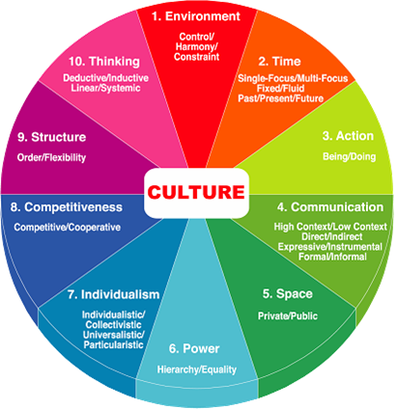
Business Etiquette
Part 4
Which Countries are the Easiest and Hardest to do Business with - due to differences in Cultural Behaviors

Slide 22
Power Distance
Countries Similar to Korea
Countries Not Similar to Korea
15 |  | 65
16 | COLOMBIA | 65
17 | FRANCE | 65
18 | PERU | 65
19 | TURKEY | 65
20 | EAST AFRICA | 64
21 | THAILAND | 64
22 | PORTUGAL | 63
23 | BELGIUM | 60
24 | CHILE | 60
25 | GREECE | 60
26 | IRAN | 60
27 | KOREA | 60
28 | URUGUAY | 60
29 | SPAIN | 58
30 | TAIWAN | 58
31 | JAPAN | 55
39 | CZECH REP | 40
40 | NETHERLANDS | 40
41 | USA | 40
42 | AUSTRALIA | 36
43 | CANADA | 35
44 | COSTA RICA | 35
45 | GERMANY | 35
46 | GREAT BRITAIN | 35
47 | SWITZERLAND | 33
48 | SWEDEN | 32
49 | FINLAND | 30
50 | NORWAY | 30
51 | IRELAND | 28
52 | NEW ZEALAND | 23
53 | DENMARK | 15
54 | ISRAEL | 15
55 | AUSTRIA | 11
BRAZIL

Slide 23
Individualism
Countries Not Similar to Korea
Countries Similar to Korea
1 | USA | 91
2 | AUSTRALIA | 90
3 | GREAT BRITAIN | 89
4 | CANADA | 80
5 | NETHERLANDS | 80
6 | NEW ZEALAND | 80
7 | ITALY | 75
8 | SWEDEN | 73
9 | BELGIUM | 70
10 | DENMARK | 70
11 | FRANCE | 70
12 | IRELAND | 70
13 | NORWAY | 70
14 | SWITZERLAND | 68
15 | GERMANY | 65
40 |  | 20
41 | CHINA | 20
42 | SINGAPORE | 20
43 | THAILAND | 20
44 | WEST AFRICA | 20
45 | KOREA | 18
46 | TAIWAN | 18
47 | INDONESIA | 15
48 | PAKISTAN | 15
49 | PERU | 15
50 | VENEZUELA | 13
51 | COLOMBIA | 10
52 | COSTA RICA | 10
53 | ECUADOR | 10
54 | GUATEMALA | 10
55 | PANAMA | 10
CHILE

Slide 24
Uncertainty Avoidance
Countries Similar to Korea
Countries Not Similar to Korea
1 | GREECE | 100
2 | GUATEMALA | 100
3 | PORTUGAL | 100
4 | URUGUAY | 100
5 | BELGIUM | 94
6 | JAPAN | 93
7 | PERU | 88
8 | SPAIN | 87
9 | CHILE | 86
10 | COSTA RICA | 86
11 | FRANCE | 85
12 | KOREA | 85
13 | PANAMA | 85
14 | TURKEY | 85
15 | ARGENTINA | 82
40 | NORWAY | 50
41 | AUSTRALIA | 48
42 | SOUTH AFRICA | 48
43 | USA | 47
44 |  | 45
45 | PHILIPPINES | 45
46 | CHINA | 40
47 | INDIA | 40
48 | GREAT BRITAIN | 35
49 | IRELAND | 35
50 | MALAYSIA | 35
51 | HONG KONG | 30
52 | SWEDEN | 30
53 | DENMARK | 20
54 | JAMAICA | 15
55 | SINGAPORE | 10
CANADA

Slide 25
Masculinity
Countries Not Similar to Korea
Countries Similar to Korea
1 | JAPAN | 96
2 | AUSTRIA | 79
3 | VENEZUELA | 73
4 | ITALY | 72
5 | IRELAND | 70
6 | JAMAICA | 70
7 | MEXICO | 70
8 | SWITZERLAND | 70
9 | POLAND | 67
10 | GERMANY | 65
11 | GREAT BRITAIN | 65
12 | PHILIPPINES | 65
13 | SOUTH AFRICA | 64
14 | USA | 63
15 | COLOMBIA | 60
40 |  | 43
41 | PERU | 42
42 | EAST AFRICA | 41
43 | FRANCE | 40
44 | URUGUAY | 40
45 | KOREA | 39
46 | GUATEMALA | 35
47 | THAILAND | 35
48 | PORTUGAL | 30
49 | FINLAND | 25
50 | CHILE | 23
51 | COSTA RICA | 15
52 | DENMARK | 15
53 | NETHERLANDS | 15
54 | NORWAY | 10
55 | SWEDEN | 10
SPAIN

Slide 26
Business Etiquette
Part 5
Possible solutions that both Westerner’s and Easterner’s can use in order to increase Business Etiquette Skills

Slide 27
Outline of Issues
Japanese Values, Beliefs and Personal Cultural Sense
Collectivism: Do not want to be spotlighted in public nor break
the group’s harmony. They kept quiet in the meeting because they
believe that saying nothing is the safest policy.
Protection: Sensitive to others’ views of them; they tend to avoid volatile behaviors that could shake the organization. They
also want to protect the ‘face’ of the HR manager and the vice president. If they complain, they feel both people would be embarrassed.
Hierarchy: Conscious of internal rank. “Watching your tongue” in front of seniors is regarded as a tacit rule and even as a virtue.

Slide 28
Outline of Issues
Australian Values, Beliefs and Personal Cultural Sense
Speaking up: Communicate openly and directly. Openly share opinions and ideas. Strongly opinionated and aggressive about promoting personal feelings.
Individualism: Australian organizations are flatter. Lower level employees can make decisions and have direct contact with upper management.
“Time is money”: Efficiency oriented and thinks that talking together, either in formal or informal meetings, is the most effective way to solve a problem.

Slide 29
Possible Solutions
Japanese could try to speak up and express their thoughts and ideas more openly, even in a meeting with their seniors.
They also need to understand Australian ways of problem solving, and would benefit from generating creative solutions instead of complaining. Language barriers could be an impediment to communication with Australian or American management.
Allowing Japanese to report their demands and complaints without giving their names. Needs to understand that Japanese emphasize human relationship and face saving, and make efforts to preserve both.
Australian & American management would do well to create a comfortable atmosphere in which employees can frankly express their ideas and thoughts on the organization. Because Japanese are sensitive to their surroundings, hosting an informal dinner meeting after work might encourage a more open atmosphere and facilitate communication.
Australians would benefit from learning about Japanese language and culture

Slide 30
Outline of Issues
Indian Values, Beliefs and Personal Cultural Sense
Personal-relationship orientation: Congenial interpersonal atmosphere is a prerequisite to doing business.
Contextual worldview: Events can be understood only within their personal, social, and historical context.
Cyclical-time orientation: Present and future can be understood and predicted by looking at the past.
Hierarchy conscious: Authority is sacrosanct; plans and actions depend on the expectations of those in authority.

Slide 31
Outline of Issues
German Values, Beliefs and Personal Cultural Sense
Order: Things should be punctual and orderly; one should arrive on time for meetings.
Personal privacy: Personal and professional matters are kept separate; family matters should not be discussed in professional settings.
Thoroughness: To understand an issue, one must be thorough and focus on task-relevant details. To achieve a task, one must systematically and analytically plan each step.
Rationality: Expectations are expressed in a direct and candid manner.

Slide 32
Possible Solutions
Both managers could benefit by learning about each other’s cultures before meeting, especially regarding communication and expectations in the workplace.
Acknowledge and recognize the Indians’ past achievements based on context-based planning and actions, and share a vision of greater success based on joint planning in the new partnership.
Germans share expectations for the business plan by providing Indians with a template or an example from another subsidiary.
Recognizing the Indian need for a personalized relationship in order to do business, and the German separation of personal and professional lives
A gathering could be planned outside of work hours for socializing.

Slide 33
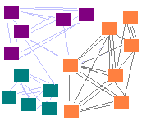
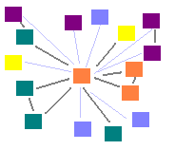
Business Etiquette
Part 6
Understanding the differences in High and Low Context societies and what is expected from people operating within these systems.

Slide 34
High Context Cultures - Japan
High context cultures are more common in Eastern cultures than in Western, and in countries with low racial diversity. Cultures where the group is valued over the individual promote the in-groups and group reliance that favor high context cultures.
High context cultures have a strong sense of tradition and history, and change little over time, such as ‘primitive’ tribal societies and native societies.

Slide 35
High Context Cultures
At differences in direction employees from high-context cultures like China and France adapt to their friends, families and close colleagues (in-group members).
They communicate with them intensively and exchange specific and detailed information about many different topics.
The result is that every in-group member is constantly up-to-date with current relevant facts
HIGH

Slide 36
Low Context Cultures-AUS & USA
A low context culture explains things further, because those in a low context culture have a wide variety of different backgrounds.
Low context cultures change a lot from one generation to the next, like the USA and Australia.

Slide 37
Low Context Cultures
Low-context cultures like Australia, USA and Germany orientate around many people in their daily lives with very little differentiation.
They mostly communicate within everyone in a broad and diffuse way
They mostly only exchange sufficient information to communicate meaning and to ‘get the job done’
Low context cultures are often considered ‘rude’ for not considering that ‘others’ may already know about the issue they are discussing
LOW

Slide 38
High Context Cultures
High Context
Less verbally explicit communication: less written/formal information
More internalized understandings of what is communicated
Multiple cross-cutting ties and intersections with others
Long term relationships
Strong boundaries - who is accepted as belonging V who is considered an "outsider"
Knowledge is situational, relational.
Decisions and activities focus around personal face-to-face relationships, often around a central person who has authority.

Slide 39
Low Context Cultures
Low Context
Rule oriented, people play by external rules
More knowledge is codified, public, external, and accessible.
Sequencing: separation of time, of space, of activities, of relationships
More interpersonal connections of shorter duration
Knowledge is more often transferable
Task-centered - decisions and activities focus around what needs to be done, division of responsibilities.

Slide 40
High & Low Context Cultures
Ways that High and Low Context Differ
The Structure of Relationships
High: Dense, intersecting networks and long-term relationships, strong boundaries, relationship more important than task
Low: Loose, wide networks, shorter term, compartmentalized relationships, task more important than relationship
Main Type of Cultural Knowledge
High: More knowledge is ‘beneath the surface’ - implicit, patterns that are not fully conscious, hard to explain even if you are a member of that culture
Low: More knowledge is ‘above the waterline’ - explicit, consciously organized

Slide 41
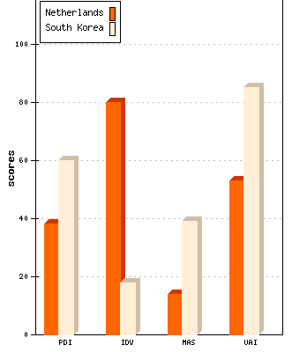
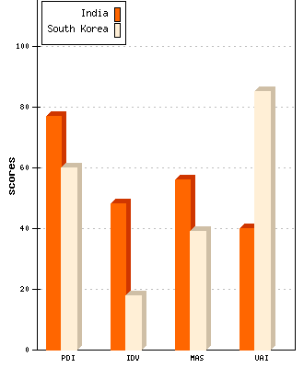
High & Low Context Cultures

Slide 42
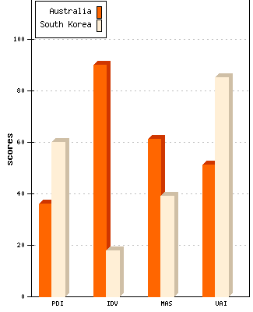
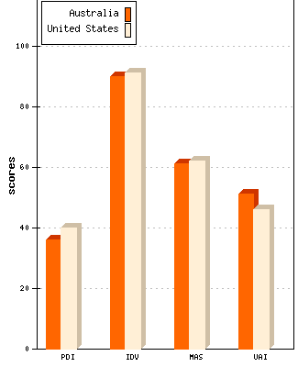
High & Low Context Cultures

Slide 43
High & Low Context Cultures
High Context Cultures
Japan, Korea, China Arab Countries Greece Spain Italy England France North America Scandinavian Countries German-speaking Countries
Australia, USA
Low Context Cultures
Source: Hall, E. and M. Hall
(1990) Understanding Cultural Differences

Slide 44
Consequences of Poor Etiquette
Lack of Business Etiquette may:
Adversely affect relationships
Lead to long-term misunderstanding and mistrust of another culture
Result in lost business opportunities
Cause a complete breakdown in communications

Slide 45
How Business Etiquette is Developed
Skills
Knowledge
Awareness

Slide 46
How It All Happens
How we develop as a mix of nature & nurture
How we’re raised
Personality
Where we’re born
Nurture
Nature

Slide 47


Benefits of Good Business Etiquette
The Ability to Know what to Say .....
.... and how, when, and where to say it.

