Slide 1
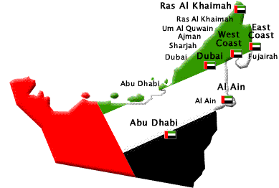
CROSS-CULTURAL BUSINESS IN THE UAE
Ian Kirkwood PhD, MBA, DipMechEng Trainer, Academic, Director

Slide 2


SESSION ONE
GENERAL ISSUES
http://www.youtube.com/watch?v=L4AfPM3aTgI
UAE 9mins
Business skills for harmony, co-operation, & success

Slide 3
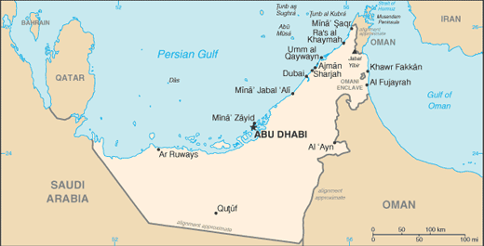
UAE: a Snapshot
Seven Emirates (Principalities)
Islam is the official (and only) religion
Arabic is the official language
Oil – UAE is world’s 6th largest producer
17% Emirates, 23% other Arabs, 60% Foreigners
Total population – about 8.5 million
Dubai 1.8 million, Abu Dhabi 1.0 million
Strong economy ~ GDP/Capita $50,000 (AUS $40k)

Slide 4
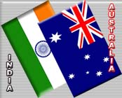
INFLUENCING CONDITIONS
1. From Pearls to Oil to Banking
We want what you have
2. Collectivism (A10 – UAE66)
Think ‘us’ – not ‘me’
3. Power Distance (A35 – UAE80)
Respect, Loyalty, Power, Privilege
4. Uncertainty Avoidance (A48, UAE68)
Reduce risk & avoid problems

Slide 5
PROBLEMS
Problems encountered by Australians visiting UAE - & Arabs visiting Australia
What they found (Abdul, Mohammed, Mishall, bargaining, arguing, expectations, disrespect)
What lessons were learnt

Slide 6
Business in UAE A brief overview
Abu Dhabi & Dubai are fast growing centres of trade and finance in the Middle East
Primarily ‘controlled’ free enterprise with many new Arab billionaires rapidly expanding their empires globally
Two cities with over 66% of the total population
Industrial, commercial & financial clusters
No tax

Slide 7
Basis of 3 different cultures
Eastern culture is based on Confucius
Western culture is based on Socrates
Arab culture is based on Islam & tribal traditions
To many Arabs the world of business is like a game where winning is the order of the day - but without risk and by maintaining religious values

Slide 8
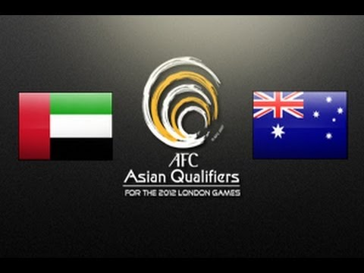
SESSION TWO
SPECIFIC ISSUES

Slide 9
UAE
Population 8.5 million (Abu Dhabi 1.5m, Dubai 1.8m, Sharjah 1m)
Density ~ 100 per Sq Km
Climate: June - August = very hot. Other months are just hot
Business Climate: Fast paced, growing, lots of money
Arab Managers: Directive and paternalistic (father-child)
Arab employees: Do exactly what is asked - but no more
Foreign workers: Always subservient to Emiratis
https://www.cia.gov/library/publications/the-world-factbook/geos/ae.html
UAE – CIA Worldbook

Slide 10
ENTERTAINMENT
Eating
Knowing what to eat – practice at home first
Arabs eat fish and red meat, with rice, humus, tabouleh, dairy foods, grains, vegetables etc
Saffron, Cardamom, Turmeric, Thyme are normal
Wash hands before/after meals – eat with right hand or with a spoon
Socializing & Drinking
Not many Arabs drink – but okay in some major hotels
Giving thanks to Allah
Who ever invites – pays: Work it out in advance
Men & women often separate

Slide 11

TEN DIFFERENT ISSUES
1. Names - A lot of Mohammad's
2. Family names. A lot of Al’s (Amir Al-Zamir)
3. Business Protocol
4. Clothes. Conservative at all times. If in doubt, go formal
5. Many large global corporations
6. Education - International
7. Motivation to succeed in the global market
8. Family/Tribe connections
9. Competitiveness - Keeping up with neighbors
10. Corruption – www.transparency.org,
Receivers: http://cpi.transparency.org/cpi2011/results/, Payers: http://bpi.transparency.org/in_detail/

Slide 12
Six Cultural Differences
Australian |  | Arab
1. Individualism | Vs | Collectivism
2. Short Term | Vs | Short Term
3. Low Power distance | Vs | High Power distance
(REF: Thompson. L (2001) The Mind and Heart of the Negotiator, (2nd Edition) Prentice Hall, NJ.)

Slide 13
Cultural Differences (cont.)
Australian |  | Arab
4. Direct Communication | Vs | Time is their friend
5.Low uncertainty Avoidance | Vs | Higher uncertainty Avoidance
6. Quantity | Vs | Quantity & Quality of life
(REF: Hofstede, G., 1980, Culture’s Consequences: International Differences in Work-related Values, cited in
Kirkbride P, Tang S and Westwood R (1991) Chinese Conflict Preferences and Negotiating
Behaviour: Cultural and Psychological Influences in Organizational Studies, Vol 12, pp 365-386.)

Slide 14
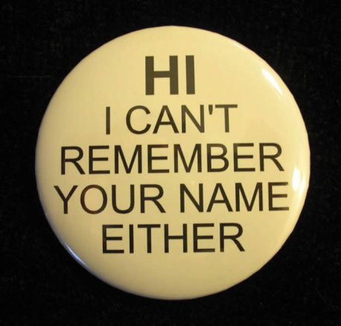
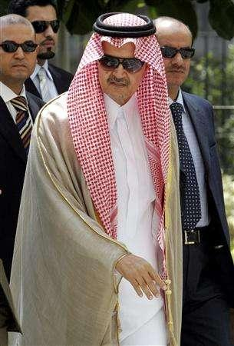
SESSION THREE
WORKING
IN
HARMONY
http://www.emirates247.com/news/emirates/eat-smell-talk-most-annoying-work-habits-in-uae-revealed-2012-06-24-1.464160

Slide 15
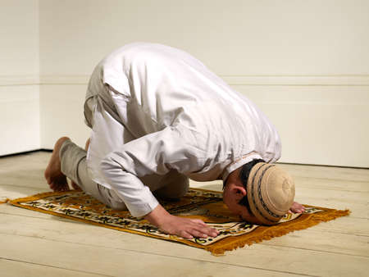
1. Religion
Around 96% of UAE nationals are Muslims (Sunni)
Prayers are held 5 or 6 times daily
Friday is the Sabbath
Allah must be thanked for everything, particularly food and good luck.
People who don’t follow Islam are called Infidels (non-believers)
Muslims don’t eat Pork or drink alcohol
As there are more foreigners than locals in the UAE, there is much tolerance for ‘infidels’
Islam has strict dress codes – so don’t deliberately violate them
Understand Ramadan (July 20 to August 18, 2012)

Slide 16

3. Social Status
Understand the social system
Be respectful of ‘higher’ people & positions
Business dealings - a meeting of equals
No concept of ‘time = money’
Many Arabs understand ‘peak oil’ and what it means to their economy
To avoid social problems, hold meetings in large hotels

Slide 17
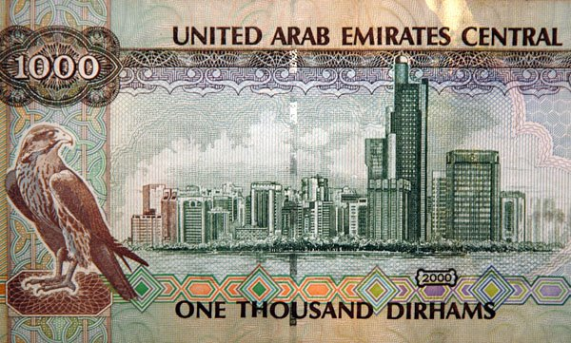
4. Money
. Money, Dirham or AED
Rate of exchange: $AUD 1.00 = AED 3.70
Average expat cost of living: AED 5,000 – 10,000 p/m, or $AUD 1,400 - $AUD 3,000

Slide 18
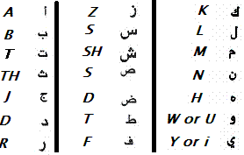

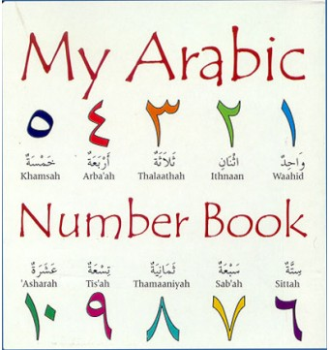
5. The Language of Business
All Arabic business people speak English
English is often the 2nd language after Arabic
Business appointments – generally mid am to around 4:00pm
Personal, leisurely, and almost always based on a personal relationship
Time does not = money

Slide 19
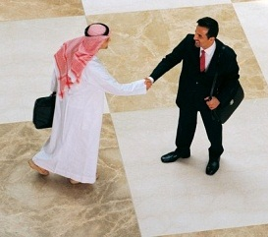
6. Interpersonal Harmony
Friendliness produces results
Initial sizing up can be lengthy
Trust and a relationship are important
Formal contracts are the start, not the end
Try hard to avoid saying ‘no’
Agree quickly, disagree slowly
Shaking hands & forms of greetings
Men/men & Men/women
Use titles & be formal

Slide 20

7. Holistic Thinking
Arabs think in terms of the whole business at one time … A to B to C to M to A to B …
Polychromic
Multi-active – able to do several things simultaneously
Full picture – not the parts
Circular logic
Everything is in Allah’s hands

Slide 21

SESSION FOUR
RELATIONSHIP BUILDING WORKSHOP

Slide 22
Summary
Typical Asian business style is steeped in years of culture, tradition, and Confucianism
Typical Western business style is ‘B.O.B.I.B.’ (the Business Of Business Is Business)
The Arabic style fits between these two styles – with a bias towards Islamic fatalism
Failure to understand the other person’s culture causes problems, mistrust and loss of business

Slide 23
DEVELOPING A CULTURAL BRIDGE
 | ISSUE | ACTION PLAN
1 | What was your initial response to going to the UAE? | .
2 | Have your travel plans been made yet, including hotel?
3 | Do you have any Arab friends or contacts?
4 | Have you been out to eat (and Drink) with Arabs?
5 | Do you have an Emeriti business-buddy?
6 | Are you able to eat Arabic food?
7 | What do you think will be your biggest challenges in the UAE?

Slide 24
DEVELOPING A CULTURAL BRIDGE 2
 | ISSUE | ACTION PLAN
8 | What do you find most difficult in your work when working or negotiating with Arabs? | .
9 | What do you miss most about Australia when you travel abroad?
10 | Are you able to rest and sleep properly?
11 | Do you set daily and weekly goals for yourself to achieve when traveling?
12 | Do you make a deliberate effort to understand Islamic culture, finance, and business ways?
13 | Do you appropriately discuss difficulties and problems you may experience or have experienced?

Slide 25
SUMMARY
CROSS-CULTURAL BUSINESS IN THE UAE

