Slide 1

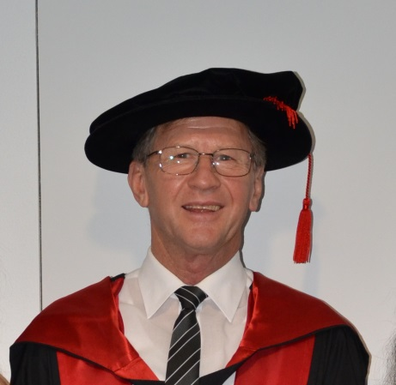
MARKETING & CUSTOMER ENGAGEMENT OVERVIEW
This is a simple overview of marketing and is not designed to conflict with any official subject materials

Slide 2

Managers are not confronted with problems that are independent of each other; they are confronted with dynamic situations that consist of complex systems of changing problems that interact with each other.
I call such situations messes.
Managers do not solve problems, they manage messes.
Russell Ackoff,1 operations theorist

Slide 3
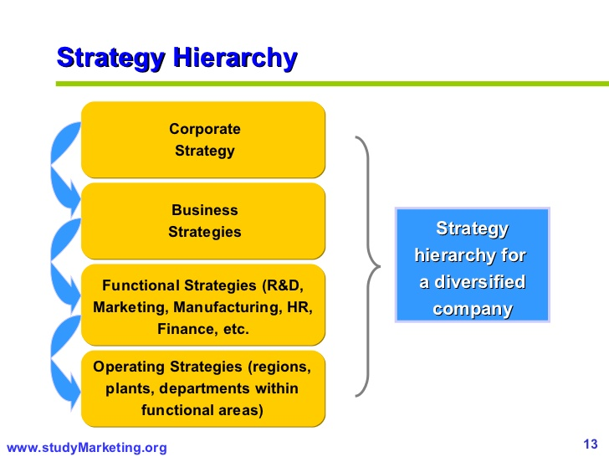

MARKETING FORMULA
M= C+S+O
C S O
corporate strategic operational
(S+F+B) + (CCC+STP+R) + (PPPP+I+C)

Slide 4
CORPORATE MARKETING
C = S+F+B
‘the overall game-plan’
S = Corporate Strategy
F = Financial needs & constraints
B = Brand management & philosophy

Slide 5
STRATEGIC MARKETING
S = CCC+STP+R
‘the planning process’
CCC = Core Competencies, Customers,
Competitors
STP = Segmenting, Targeting,
Positioning
R = Market Research, R&D, C&D, C&D2

Slide 6
OPERATIONAL MARKETING
O = PPPP+I+C
the operational process
PPPP = 4 P’s: Product, Price, Place &
Promotion
I = Implementation
C = Control – the feedback loop

Slide 7

CORPORATE
The Corporate
area of Marketing

Slide 8
Corporate Marketing SP+F+B
Strategic Planning
Business model
Vision
Mission
Value adding or value subtracting
SWOT, TOWS, IFE & EFE, Porters, PESTEL etc
Numbers: What are the numbers?
Sustainability – long term plan
MVA, EVA, VCM
Stakeholders
National, Multi-Domestic, MNC, Σ-Global

Slide 9
Corporate Marketing SP+F+B
Financial Requirements
and Constraints
Annual Ops Plan– Establish & Achieve
Top Line Revenue
Cash Flow – Ops, Fin, Inv.
ROI, ROA, ROE
Growth factors
Market share – Trend analysis
Ongoing Analysis
Fiduciary Governance

Slide 10
Corporate Marketing SP+F+B
Brand Management &
Brand Philosophy
Brand Vision
House of Brands or Branded House (P&G v CC)
Brand accounting: Asset or Expense
Global or Domestic
Brand growth plan
Brand strategy articulation
https://www.youtube.com/watch?v=Zc94oAUXjo8 P&G
https://www.youtube.com/watch?v=bHhCP5ad-zM Coke

Slide 11
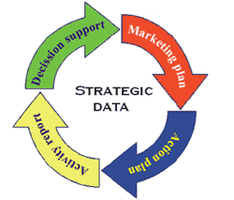
STRATEGIC
The Strategic
area of Marketing

Slide 12
Strategic Marketing CCC+STP+R
Customers, Competitors Core Competencies
Who, what, where are your customers & markets?
Competitive analysis – who, where, why?
What is your competition: now & tomorrow?
Essential (& absolute) core competencies vs non-essential competencies
Elimination of non-essential competencies

Slide 13

Strategic Marketing CCC+STP+R
Segmenting, Targeting,
Positioning
What market segment are you in?
What other segment could you serve?
What customer groups do you target & serve?
Where is your company and product positioned in the marketplace?

Slide 14

Strategic Marketing CCC+STP+R
Research
Formal & informal research (Primary v Secondary)
R&D, C&D¹, C&D²
The ‘NP&SI’ process
Do you have a ‘gate’ process?
The cost of poor research
Do you use a formal, systematic approach?

Slide 15
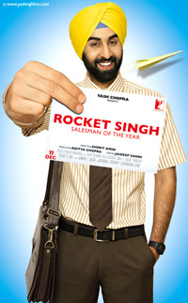
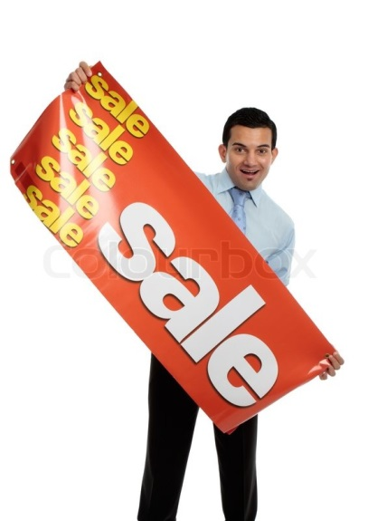
OPERATIONAL
The Operational and/or Tactical area of Marketing

Slide 16
Operational Marketing PPPP+I+C
4Ps: Product, Price, Promotion, Place
Products: Customer solutions
Prices: Customer cost
Promotion: Customer communication
Place: Customer convenience
“Managing customers expectations & experiences”

Slide 17
Operational Marketing P’s+C’s+V’s
P’s C’s V’s
Product Customer solution Value in use
Price Customer cost Value for money
Promotion Customer communications Value proposition
Place Customer convenience Virtual assets
Personal selling Contact & connection Value in relationships
Philosophy Constancy Value creation system
suPPort. Customer retention Value growth
Packaging Constant reminder Value reminders
Politics Crap Value destroyers
Public opinion Consultancy Value identification
Policies & Procedures Consistency Value in orderliness

Slide 18

Operational Marketing PPPP+I+C
Implementation
Who does what, when, why, how
Implementation strategy
Integrated Communications (IMC)
Allocating roles, targets, budgets, territories, functions, accounts
Annual operating plans
Sales territories – Route planning

Slide 19
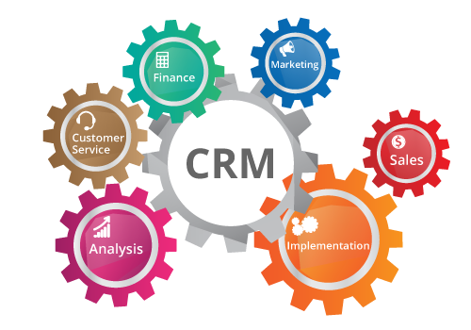
Operational Marketing PPPP+I+C
Control
Formal reporting system
Life cycles: Products, Markets, Technologies, Systems
Feedback: Closed Loop System
Tactical Strategic Corporate Strategic Tactical …… etc

Slide 20

SUMMARY
corporate strategic operational
M = (SP+F+B) + (CCC+STP+R) + (PPPP+I+C)
All three areas are critical for total sustainable success

