Slide 1
DEATHSTATS
Reported By: Team ProblemSolvers
Rajat Jaswal
Srishti Saboo
Karan

Slide 2

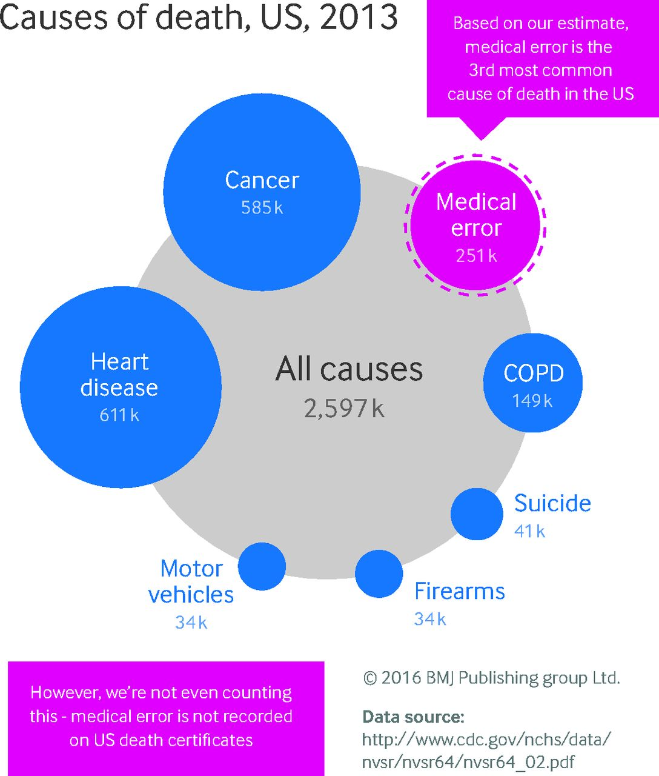
The Problem Statement
Deaths Happen, and goes unchecked.
According to Wikipedia, 6775 people die on an average every day.
Among these 6775, half of them are dead because of carelessness, lack of security or lack of awareness.

Slide 3

The Problem Statement
We choose this topic, So we can dig deeper in the reasons of death.
To provide proper sources, information and protection.
To care about the people who are a victim, or who can be.
To assure them that DeathStats is working for them.

Slide 4
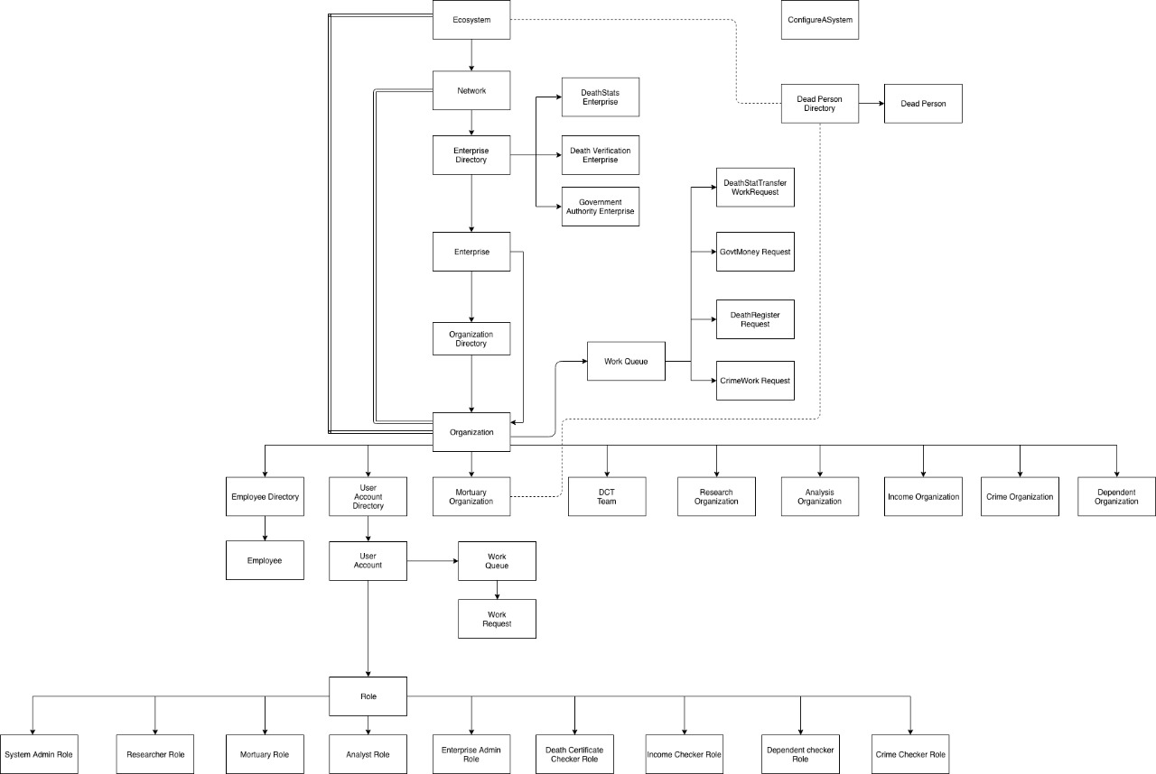
The Object Model

Slide 5

The Approach
The Enterprises
We are having an ecosystem, with different networks and among them we have 3 Enterprises.

Slide 6
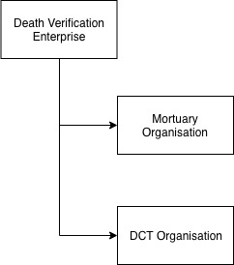
The Approach
The Death Verification Enterprises
The Death Verification Team is responsible for collecting the data of dead People and sending to further Enterprises.
The mortuary organization gets the dead person data, and transfers it to the Death Certification Team.
The Death Certification Team transfer the request to DeathStats. Both Mortuary and DCT team are sharing a DeathRegisterRequest Work Request.

Slide 7
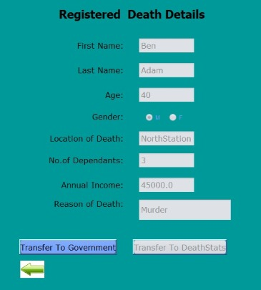
The Approach
The DCT Organisation
The Death Certification sends the data to the DeathStats, but sometimes they send the data to Government Enterprise, Income Checker organization. It depends on the Dependents, If Dependents are more than 2 than send to income Organization to grant some money.

Slide 8
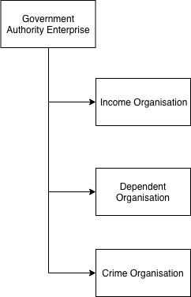
The Approach
The Government Authority Enterprises
The Government Authority Enterprises is responsible to serve the society in all respects.
The income Organisation analyze the income and dependents of the dead person and grant some money to them.
The Dependent Organisation is responsible to check, if the person is died by any contagious Diseases, So the Disease is not spread among his/her dependents.
The Crime Organisation checks where the crime is occurring more and assigns the policemen their for safety.

Slide 9
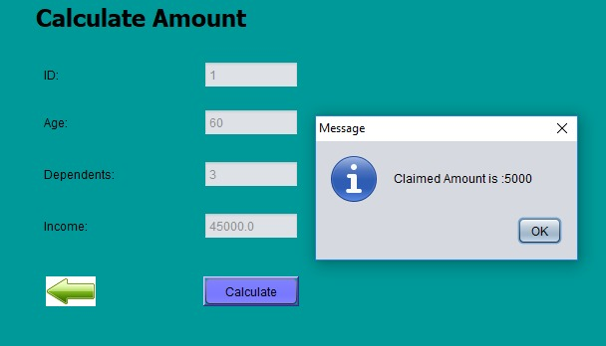
The Approach
The Income Organisation
The Income Organisation grants some money, based on some analysis to the victim’s family.

Slide 10
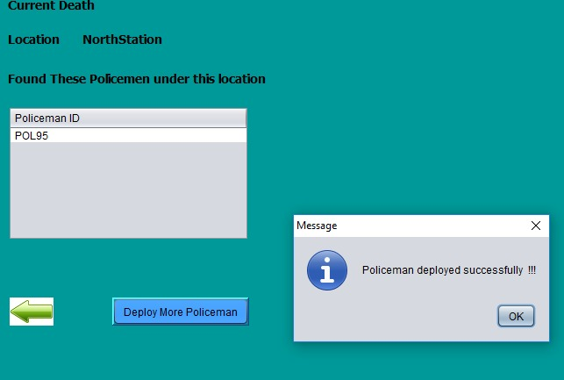
The Approach
The Crime Organisation
Whenever there is an request from the DeathStats Enterprise regarding Crime occurring. The Crime Organization Assigns Police.

Slide 11
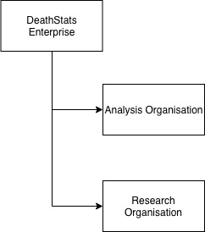
The Approach
The DeathStats Enterprises
DeathStats is the Enterprise which is analyzing and Researching about the data to provide outcomes that will help the society and other organizations in an effective way.
The Analysis Organisation, analyze the type of incident and Assigns the Cause of Death which every Death Request. While analyzing, if there is any death because of crime than Analysis Team also sends the Request to Government Enterprise (Crime Organisation)
The Research Organisation provides the rate of death because of different reasons. They also provides the society, the crime prone and accident prone Areas.

Slide 12
The Approach
The DeathStats Enterprises (The Death Classification)
We have classified the death as shown above.

Slide 13
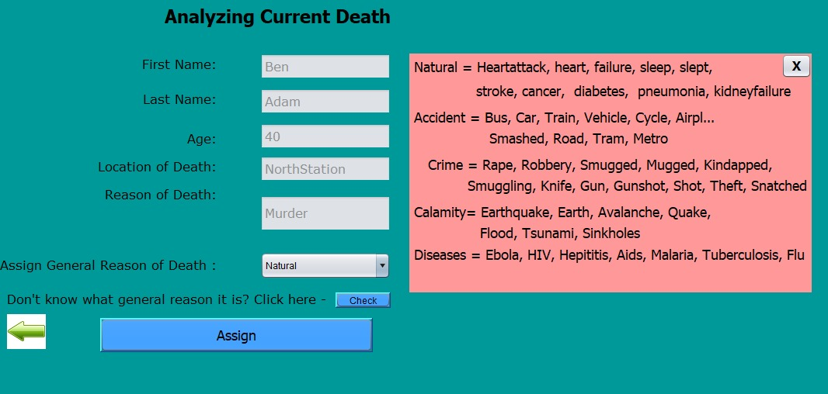
The Approach
The DeathStats Enterprises(The Analysis Organisation)
The Analysis Team classify the Death. While Classifying if they are not sure they can get help from The popup, which have the information regarding classification of death.

Slide 14
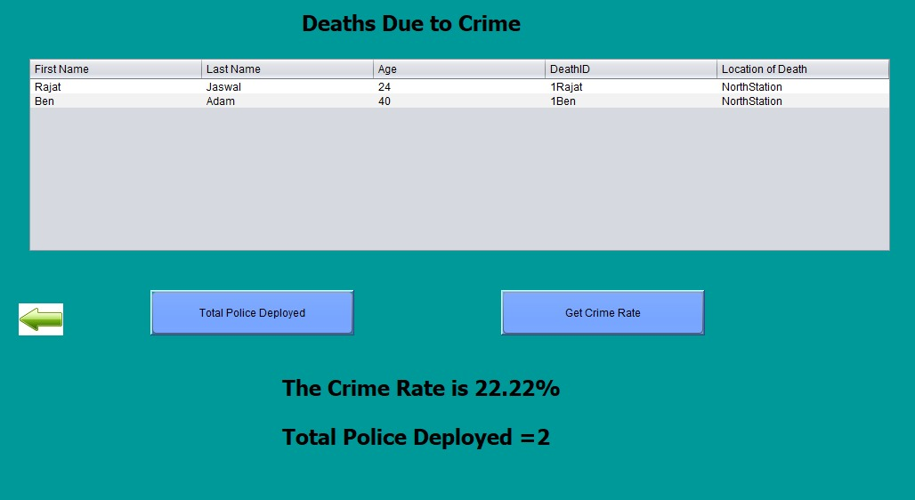
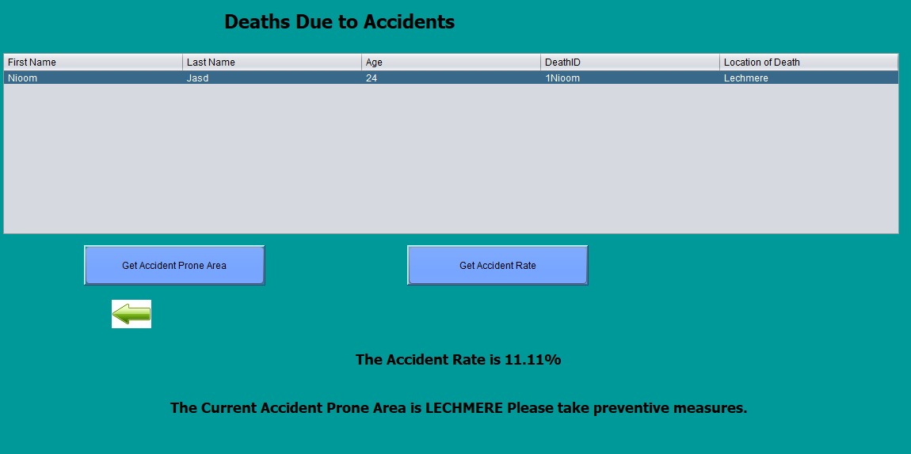
The Approach
The DeathStats Enterprises(The Researcher Organisation)
The Researcher team tells the death rate in the similar order for all kinds of deaths.

Slide 15
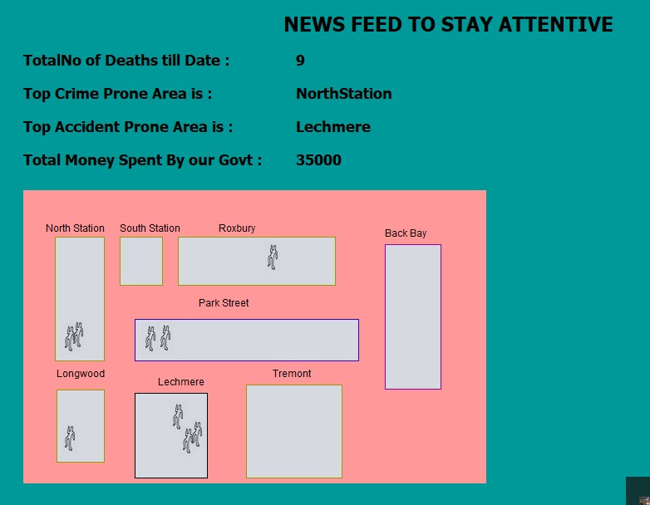
The Way To Present
New Feed
This is the main page of the Application.
It will notify the top crime prone area, top accident prone area, number of deaths till date and money spent by Government.

Slide 16
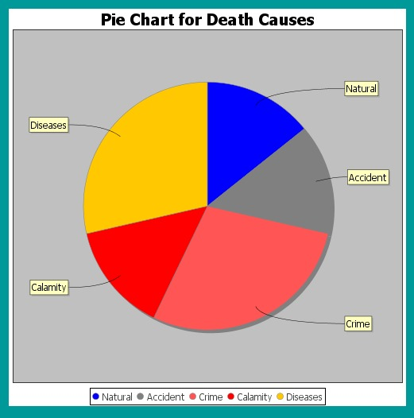
The Way To Present
The Pie Chart Representation
The Pie Chart representation to depict the death reason data.

Slide 17
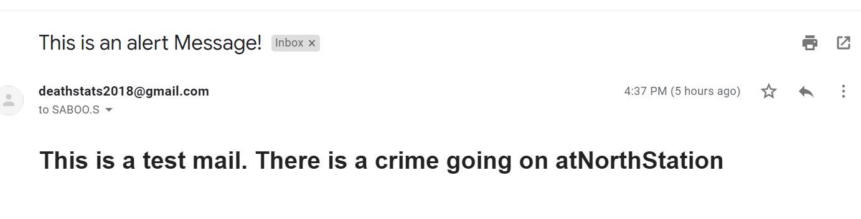
The Way To Present
The Email Alert
Whenever there are a lot of crime happening, the Crime organization can send email alerts to the people registered with them.

Slide 18
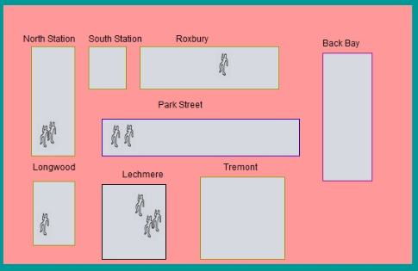
The Way To Present
The Map Representation
It represents how many deaths, happened in that area. It is shared on the news feed, So that people can stay attentive.

Slide 19
Thank You!

