Slide 1
ECE 610 - Paper Presentation
Aggregated Residual Transformations for Deep Neural Networks - Saining Xie; Ross Girshick; Piotr Dollár; Zhuowen Tu; Kaiming He - 2017 IEEE Conference on Computer Vision and Pattern Recognition (CVPR)
Rajat Sharma

Slide 2
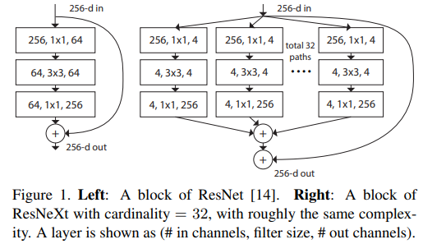
Introduction
Introduces ResNext, a modularized network architecture for image classification.
Adopts VGG/ResNets’ strategy of repeating layers, while exploiting the split-transform-merge strategy in an easy, extensible way.
Improves performance on ImageNet and Cifar datasets with 50% of the complexity of ResNet model.
Notes:
split-transform-merge strategy - It involves breaking down a problem into smaller, manageable subproblems, transforming them independently, and then combining the transformed results to obtain the final solution

Slide 3
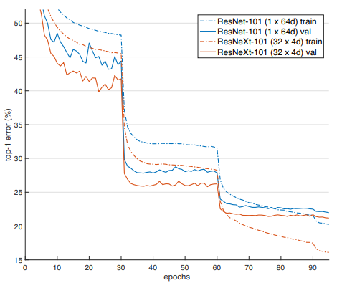
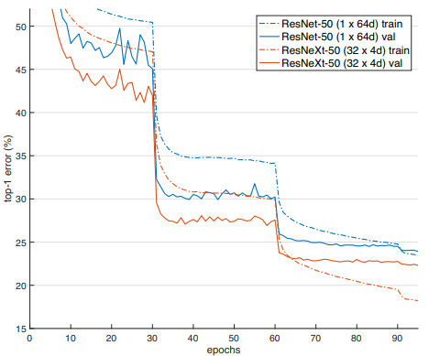
Paper Overview
How to improve performance of deep CNNs without increasing model complexity (deeper/wider)
Adds "cardinality", an additional dimension on top of the width and depth of ResNet, which allows learning of broader features.
Notes:
Depth = more layers, Width = wider layers, Cardinality = more parallel paths

Slide 4
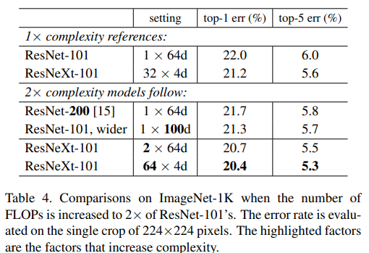
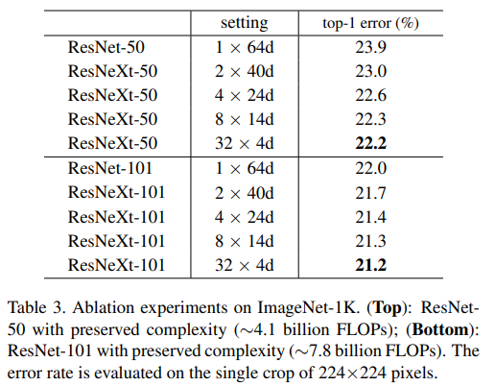
Main Contributions
Increasing Cardinality shows much better results than going deeper or wider
ResNext is the foundation of the entry authors proposed to achieve 2nd place in ILSVRC 2016 classification task.
Generalizes better than existing models to other visual recognition tasks.

Slide 5
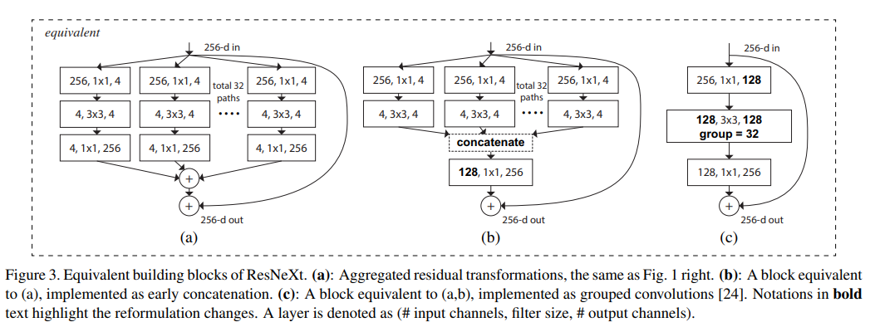
Methodology
Replaces the ResNet block with an aggregated block using multiple parallel groups.
Grouped convolutions emulate 32 paths, where each group acts like an independent path.
Notes:
(a) (Original Idea) This is conceptually similar to inception-style branching but with weight sharing constraints across paths. (b) A single 1×1 convolution (128 in, 256 out) follows to mix across all concatenated paths.
This is computationally more efficient than (a) and easier to implement in practice.
(c) This is how ResNeXt is actually implemented in modern libraries Grouped convolutions emulate the 32 paths, where each group acts like an independent path.

Slide 6
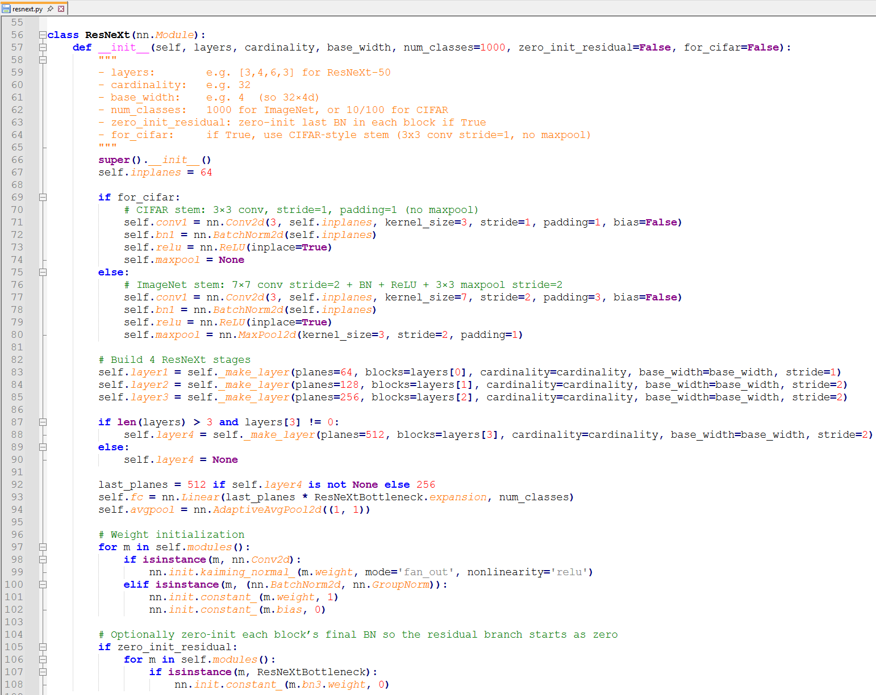
Methodology
Using the methodology proposed by the authors in paper a ResNeXt was implemented in using pytorch libraries.
For ImageNet a model with cardinality 32 and width = 4d is created and is called ResNeXt-50.
For CIFAR a model with cardinality 8 and width 64d is used and is called ResNeXt-29, 8×64d.
Notes:
(a) (Original Idea) This is conceptually similar to inception-style branching but with weight sharing constraints across paths. (b) A single 1×1 convolution (128 in, 256 out) follows to mix across all concatenated paths.
This is computationally more efficient than (a) and easier to implement in practice.
(c) This is how ResNeXt is actually implemented in modern libraries Grouped convolutions emulate the 32 paths, where each group acts like an independent path.

Slide 7
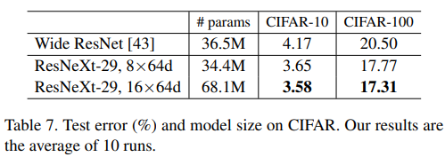
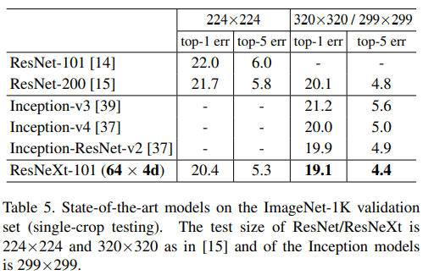
Experimental Results
Trained and evaluated on Imagenet-1k, CIFAR-10 and CIFAR-100 datasets.
Implentation using pytorch
Authors used SGD with a mini-batch size of 256 on 8 GPUs (32 per GPU). Weight decay is 0.0001 and the momentum is 0.9.
Experiment starts with a learning rate of 0.1 and divide it by 10 for three times in scheduled intervals.
Notes:
In addition to testing a 224×224 crop, ResNext was also evaluated on a 320×320 crop following. Results compare favorably with ResNet, Inception-v3/v4, and Inception-ResNet-v2, achieving a single-crop top-5 error rate of 4.4%. ResNext with a similar model size (34.4M) shows results better than Wide ResNet. ResNext's larger method achieves 3.58% test error (average of 10 runs) on CIFAR-10 and 17.31% on CIFAR-100.

Slide 8
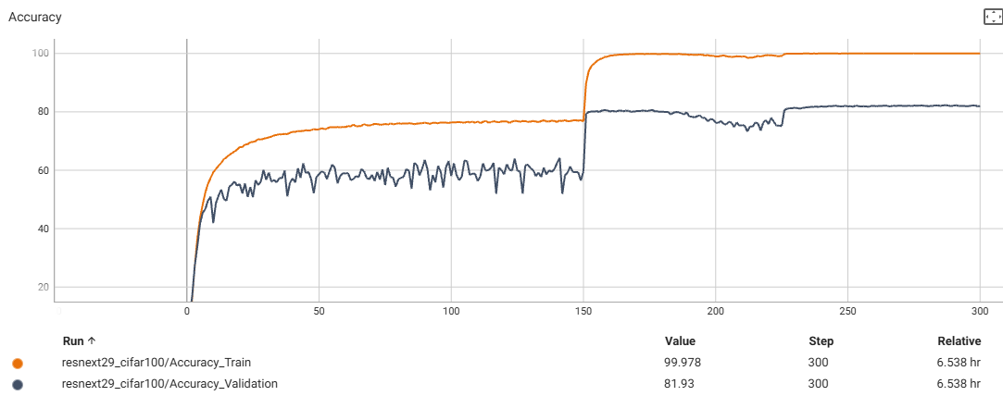
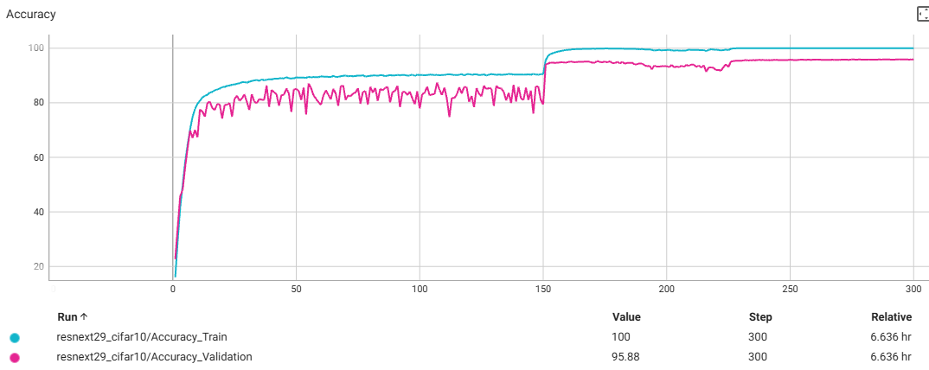
Experimental Results
For my personal setup I used the same hyperparameters, except the training was done on a single GPU due to hardware constraints.
The custom implementation of ResNeXt model achieves performance similar to achieved by authors in the paper.
Model Tested - ResNext29_8x64d
CIFAR10 - 4.12% error (3.65% in paper)
CIFAR100 - 18.07% error (17.77% in paper)
Notes:
(a) (Original Idea) This is conceptually similar to inception-style branching but with weight sharing constraints across paths. (b) A single 1×1 convolution (128 in, 256 out) follows to mix across all concatenated paths.
This is computationally more efficient than (a) and easier to implement in practice.
(c) This is how ResNeXt is actually implemented in modern libraries Grouped convolutions emulate the 32 paths, where each group acts like an independent path.

Slide 9

Discussion
ResNext is a simple yet effective change in deep CNN networks which improves performance with lesser complexity.
Scales with increasing cardinality, easier to tune that depth/width.
Slightly increases memory usage that plain ResNet because of grouped convolutions.
No built-in attention or feature refinement mechanisms.
Residual Attention Network introduces attention modules; which is missing in ResNext model.
ResNest combines attention and cardinality, thus increasing complexity but improves perfromance.

Slide 10

Conclusion
ResNeXt demonstrates the power of aggregated (grouped) transformations.
Maintains the simplicity of ResNet model while achieving better performance.
Future Work:
Combine the new feature cardinality with attention. (ResNest paper follows this path)
Adapt ResNeXt for specific image classification tasks such medical imaging.
ResNeXt's generalized model learning enables better transfer learning as it learns broader features.

