Slide 1

Capstone Project
Piezoelectric Door Safety System
Made by-
Mansi Sharma Rajeshwar Singh
Rajat Batra
Tanya Dora

Slide 2
What is Piezoelectric Transducer?
A piezoelectric transducer (also known as a piezoelectric sensor) is a device that uses the piezoelectric effect to measure changes in acceleration, pressure, strain, temperature or force by converting this energy into an electrical charge.
A transducer can be anything that converts one form of energy to another. When we squeeze this piezoelectric material or apply any force or pressure, the transducer converts this energy into voltage. This voltage is a function of the force or pressure applied to it.
The electric voltage produced by a piezoelectric transducer can be easily measured by the voltage measuring instruments. Since this voltage will be a function of the force or pressure applied to it, we can infer what the force/pressure was by the voltage reading. In this way, physical quantities like mechanical stress or force can be measured directly by using a piezoelectric transducer.

Slide 3
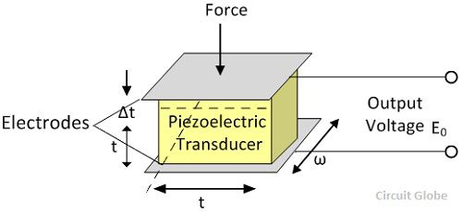

Slide 4
Applications of Piezoelectric Materials
In microphones, the sound pressure is converted into an electric signal and this signal is ultimately amplified to produce a louder sound.
Automobile seat belts lock in response to a rapid deceleration is also done using a piezoelectric material.
It is used in electric lighter used in kitchens. The pressure made on piezoelectric sensor creates an electric signal which ultimately causes the flash to fire up.
They are used for studying high-speed shock waves and blast waves.

Slide 5
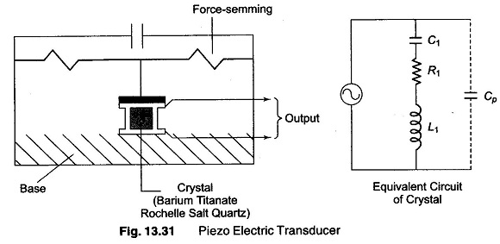
Disadvantages of Piezoelectric Materials
It is not suitable for measurement in static condition
It is affected by temperatures
The output is low so some external circuit is attached to it

Slide 6
Proposed Idea
The proposed idea revolves around the applications of a piezoelectric transducer.
The property that piezoelectric effect can be used to measure changes in pressure and strain tells that the sensor can be used to detect unauthorized access to one’s home via door.
The pressure applied to open door can be detected by piezoelectric and if this pressure increases by a certain amount then relevant steps like informing the owner of the house via GSM technology or several in-house alarms can be made operational to detect unauthorized access.
When a force is applied to a piezoelectric material a electric charge is generated across the face of the crystal. This can be measured as a voltage proportional to the applied pressure.

Slide 7
5. The main advantage of using piezoelectric sensor in this case is that it requires no external voltage or current source, they’re able to generate an output signal from the strain applied. Also they’ve high strength, high voltage output and high mechanical strength.
6. The sensors would be placed along the rod and hinges of the door. Relevant data of the allowed pressure to be applied will be collected beyond which the unauthorized access would be detected.
7. The Piezoelectric Transducer produces a discontinuous or alternating output on applying repeated tapping force over it. Hence it has to be rectified to make it storable or usable DC. Hence for a higher rectifying efficiency of 80% or above, we are going to use full wave rectifier.

Slide 8
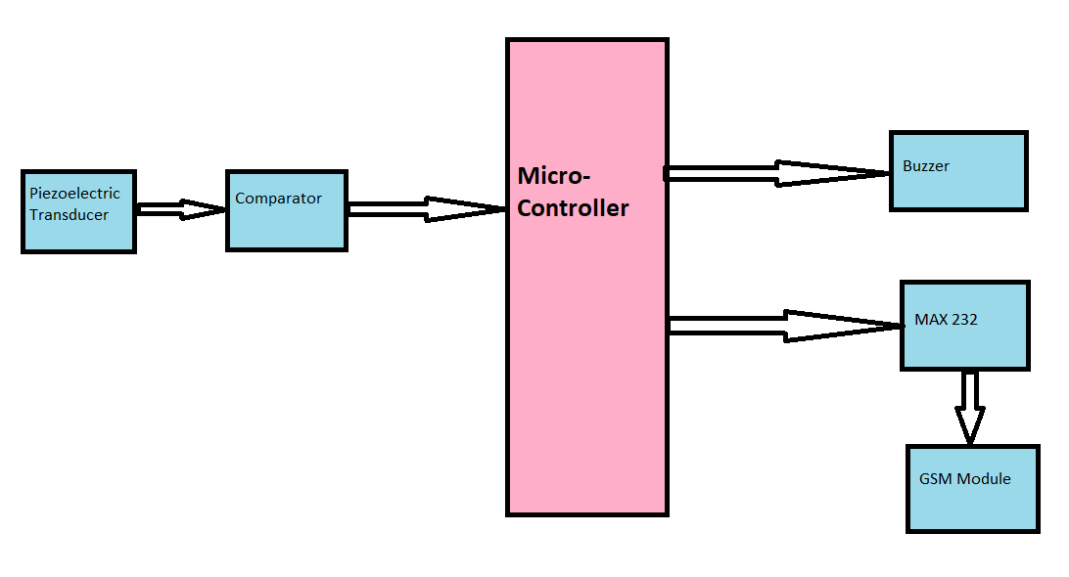
Block Diagram

