Slide 1
Creating Web Api with the existing Database and performed basic api operation with the help of post man tool
Steps:
Install the postman extension in google chrome.
Login to Postman tool.
Copy the url and execute.
Perform basic operation like Get,Post,Delete.

Slide 2
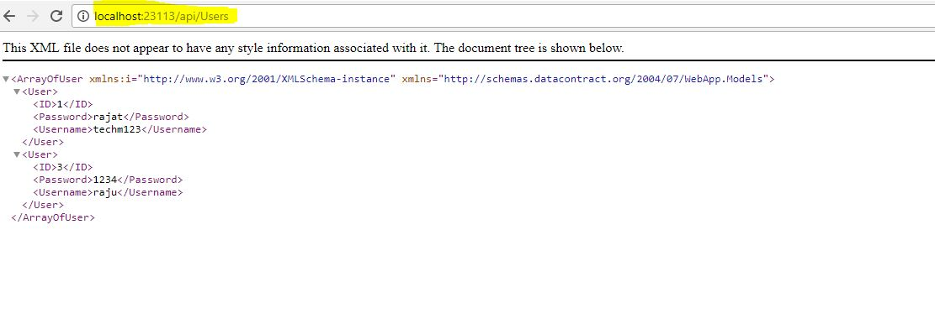
Run the WebApplication and Copy the marked url.

Slide 3
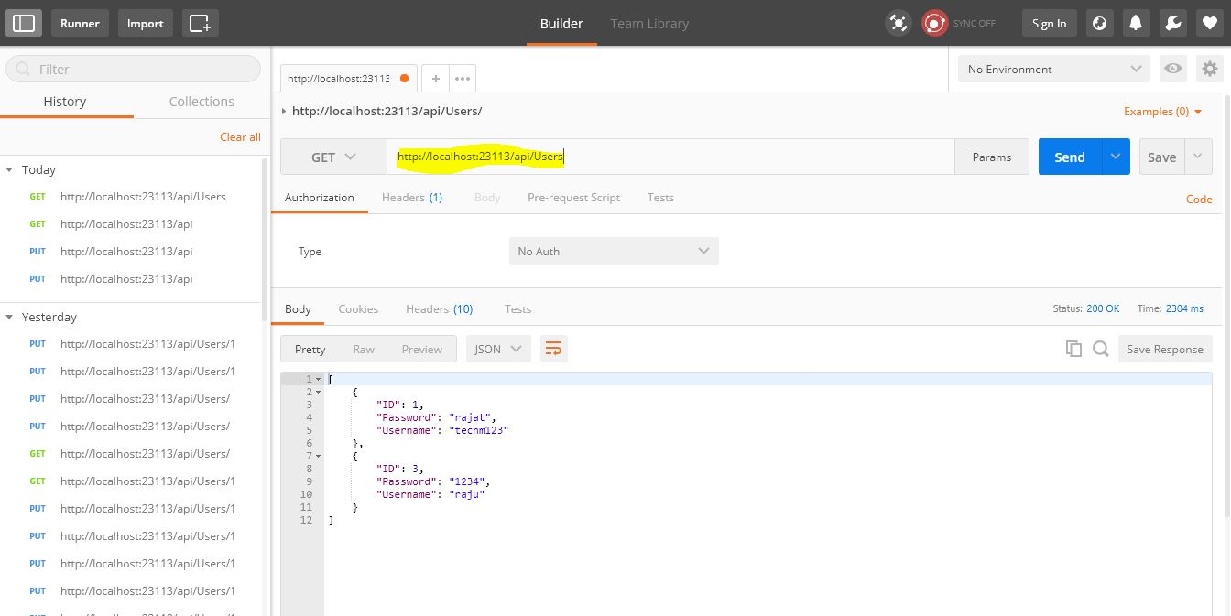
Open postman Application and paste the url. Performing Get Operation selecting from dropdown which displays data from database.

Slide 4
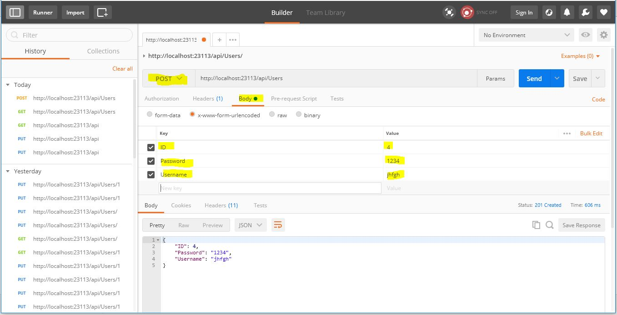
Select Post Operation, And enter the data to be posted inside body and in selected format.

Slide 5
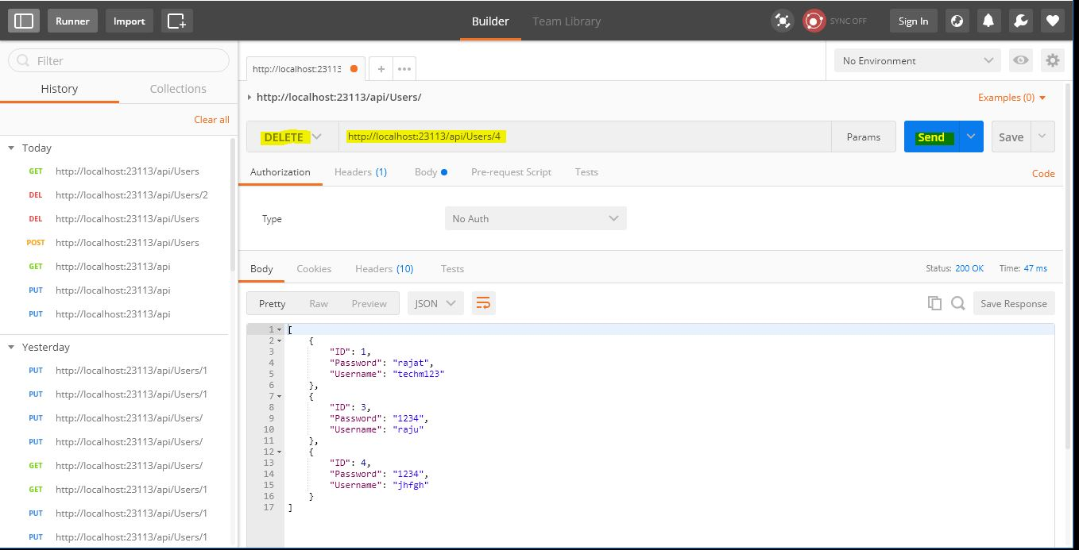
Deleting the record, by selecting delete operation from dropdown.

Slide 6
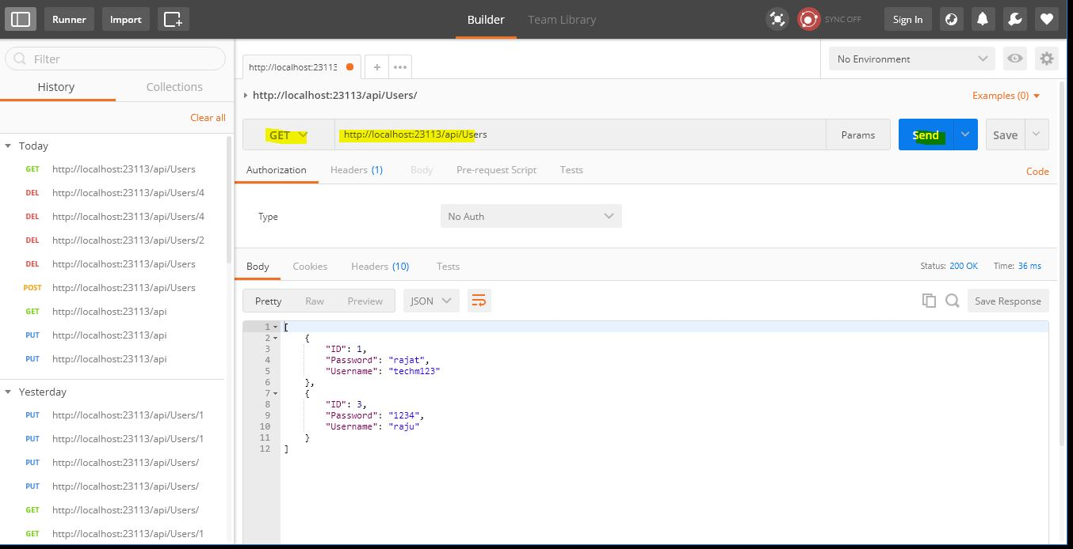
We can see data with id ‘4’ is deleted.

