Slide 1

Visualize Skyscraper Data

Slide 2
What is Skyscraper ?
Skyscraper is any tallest building that consist of many stories.
A building which is usually 15- 20 stories and within 100 – 150 meters.
Worlds first skyscraper was found in Chicago.
World’s tallest building anyone ??

Slide 3
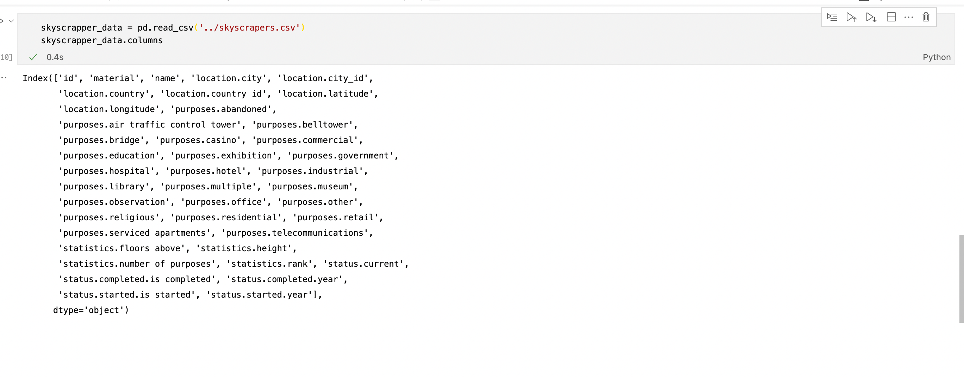
Analyzing the Skyscraper Data
Utilized the Skyscraper Data from
https://www.skyscrapercenter.com/country/united-states

Slide 4
Implementation Technique
Combinations of following : -
HTML
VegaLite
Idyll - js
If needed any other

Slide 5
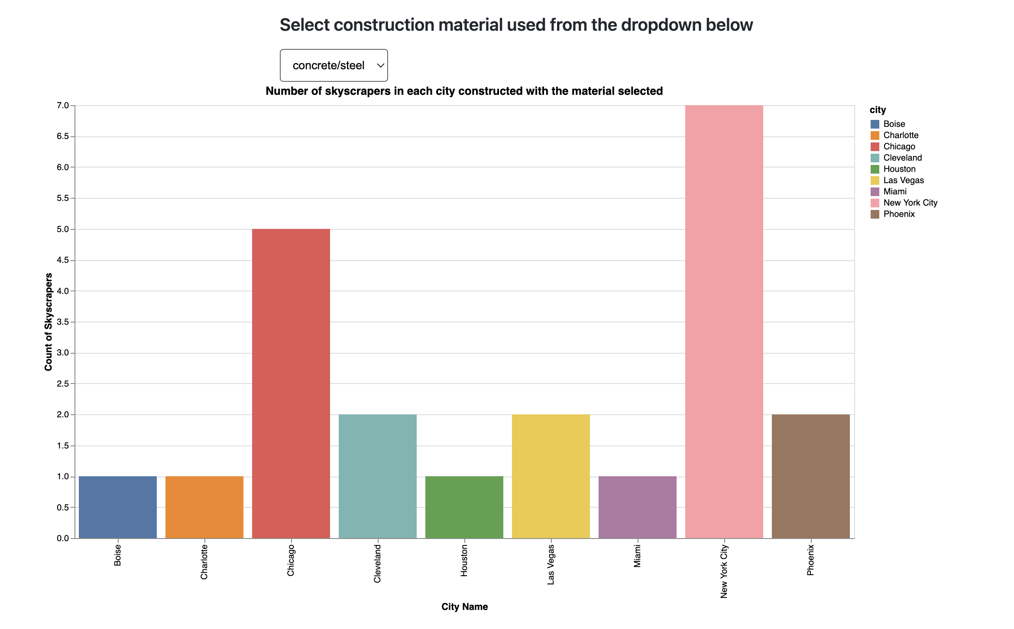
Adding different Plots : -

Slide 6
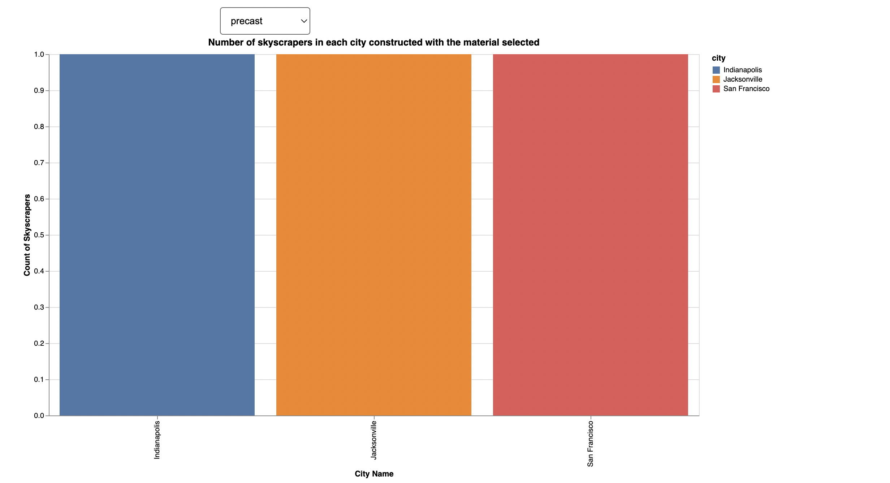

Slide 7
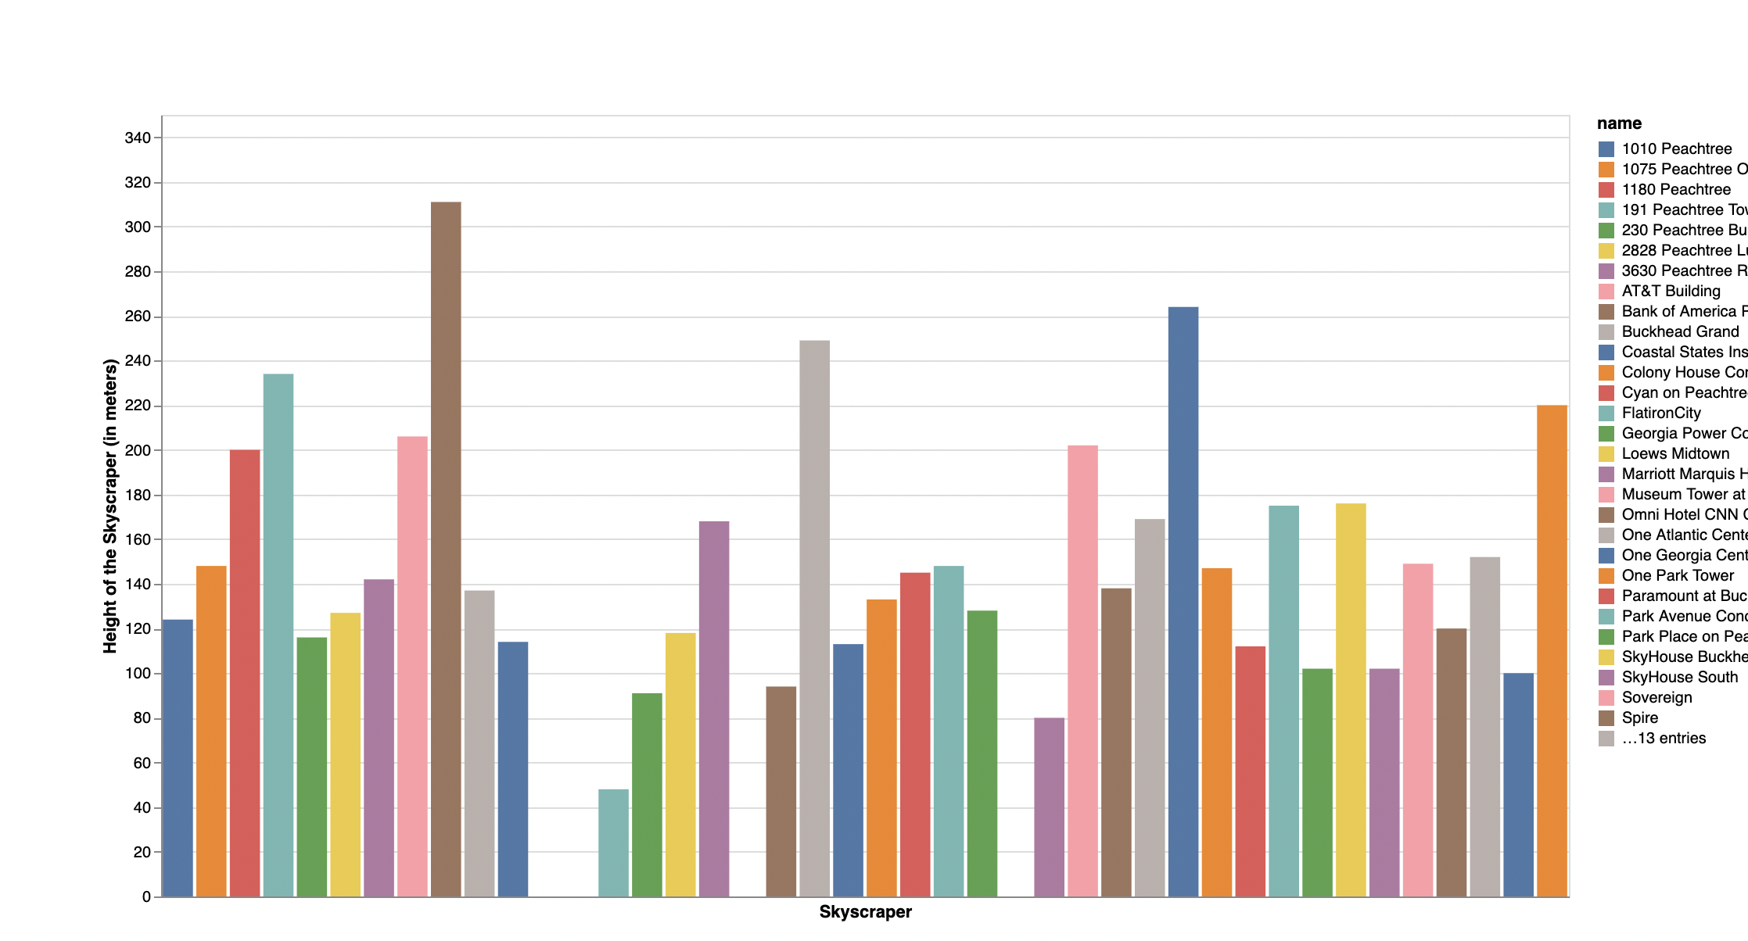

Slide 8
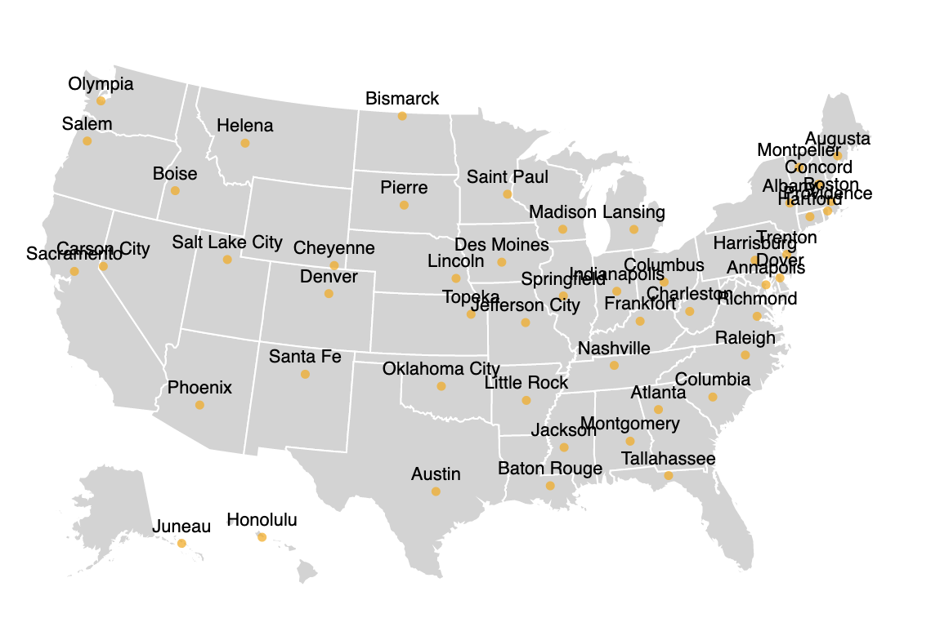

Slide 9
