Slide 1


Presentation Template
Analytics Olympiad
Predicting Sales around Outlets
Rajat Ranjan
Data Scientist
Linked IN - https://www.linkedin.com/in/rajat-ranjan24/
Portfolio - https://rajat5ranjan.github.io

Slide 2
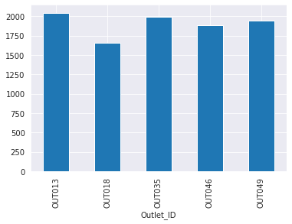
Data Understanding – Outlet ID Sales
The sales in the mega marts are critical to make them sustainable. As a matter of fact, the rise of several marts have created buyers of different categories which are critical about quality of product at the right price.
In the Analytics Olympiad 2021, the data science & machine learning community has been challenged to build an ML model and predict the sales of each product from each outlet. The participants also need to use the model to analyse the properties of the product in the stores and find ways to increase sales.Data Attributes
Mean of Sales for Outlet IDs

Slide 3
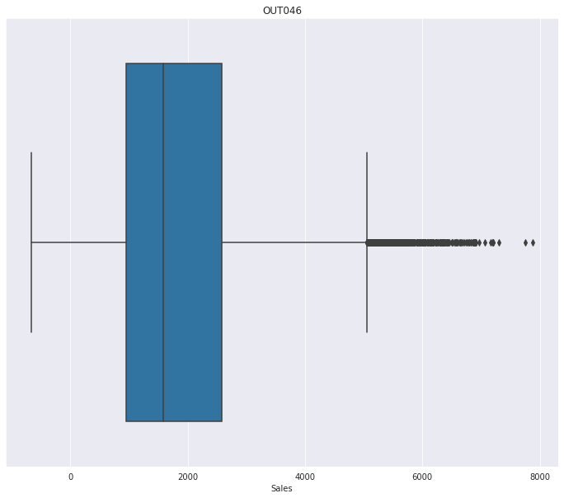
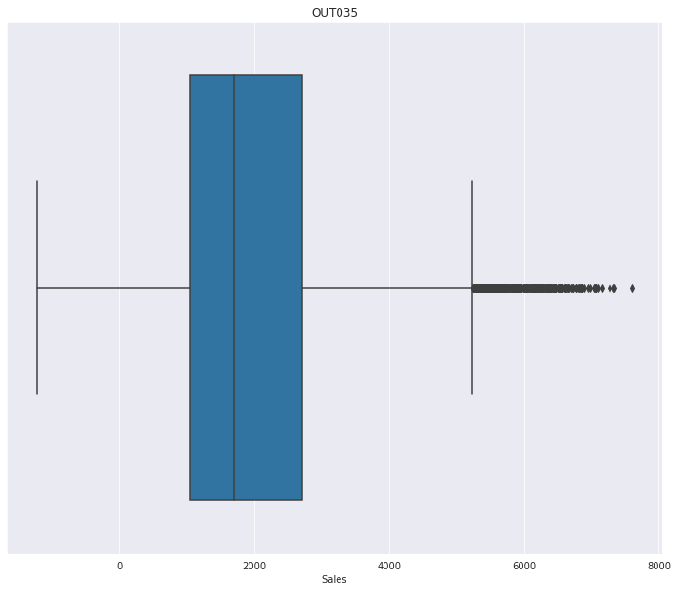
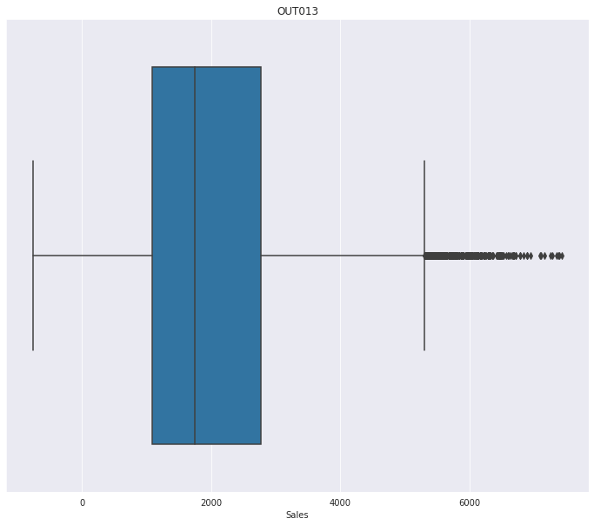
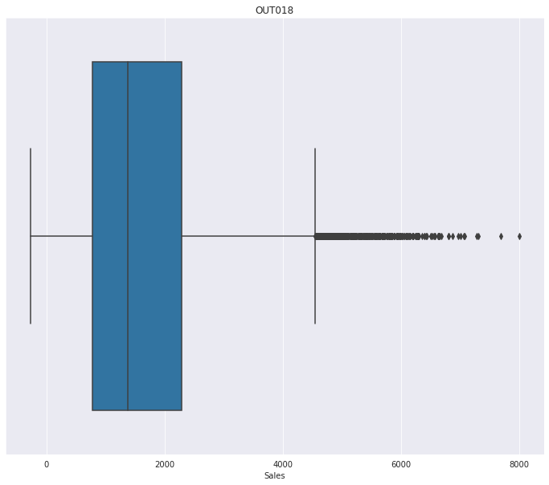

Sales Outliers based on Outlet ID
There are some sales outliers for all outliers ids
The 25-75% IQR is mostly common for all the Outlet Ids

Slide 4
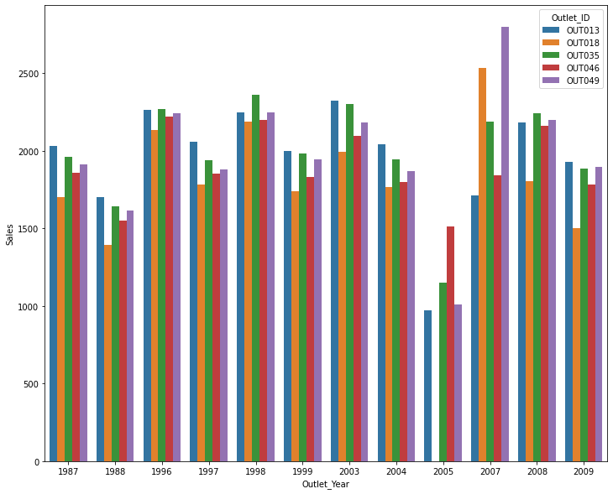
Sales based on Outlet ID
Different EDA are done based on Year and Outlet Features
Insights
In 2005 we do have very minimum sales and no sales for OUT018
2007 amounts the most sales

Slide 5
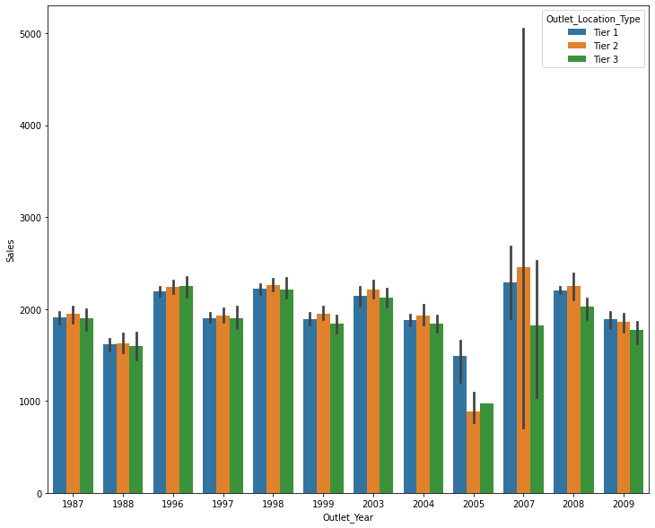
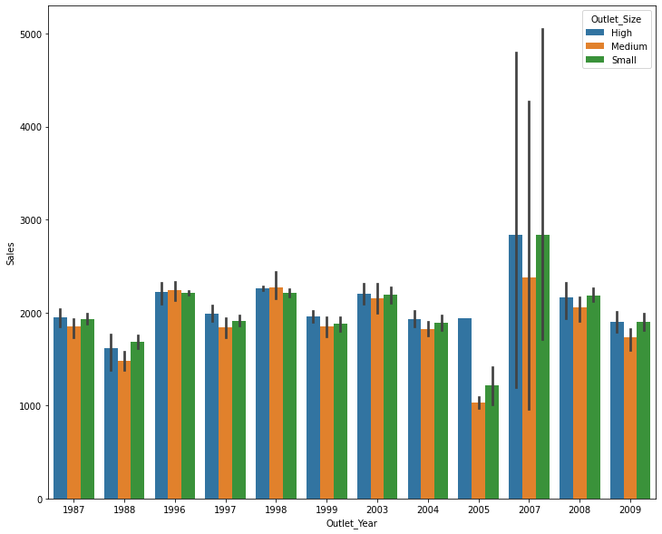
Outlet Features based on Sales
Charts based on the Outlet Location type and Outlier Size among the Years and their Sales
Most variance is seen in Year 2007 for the Sales

Slide 6
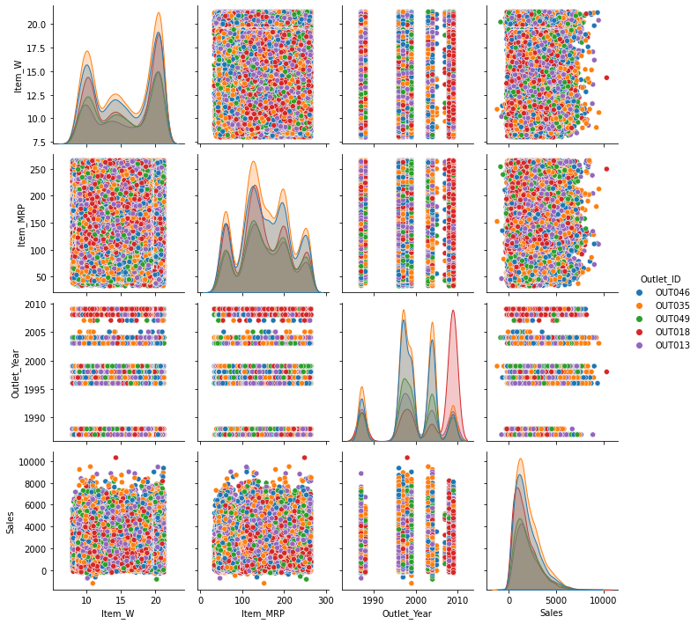
Variance and plots for the Sales, Item Weight and Item MRP for all the different Outlet IDS
In 2010 we have the most Data with OUT018
Sales are maximum for the OUT035 Outlet ID

Slide 7
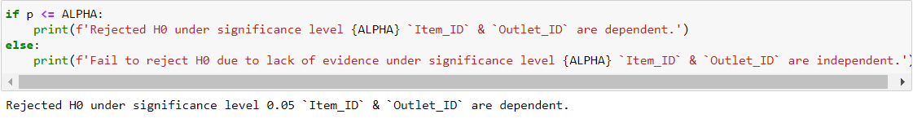
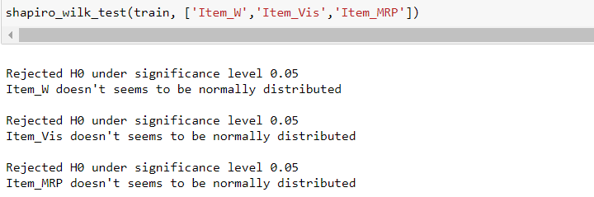
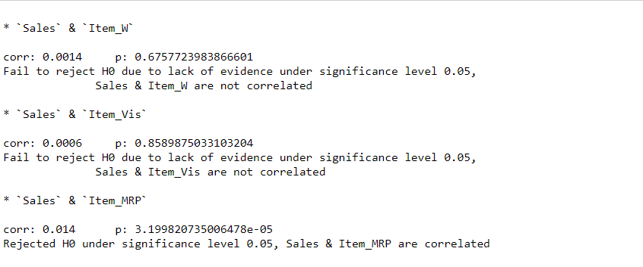
Data Analysis – Statistical Tests
Tests for independence between two categorical variables(Pearson's Chi-square test)
Statistical Tests for Numerical Attributes (Shapiro)
Tests for correlation between two continuous variables (Spearman)

Slide 8
Data Preparation
Outlier is treated for the Target(Sales) based in Outlet ID and Item ID
No Null values present in the data frame
The data is divided such that the for Each Outlet ID we have different Item IDs and their Sales along the Years
Categorical Features – 'Item_ID', 'Item_Type’, ‘Item_FC’, 'Outlet_ID','Outlet_Year', 'Outlet_Size', 'Outlet_Location_Type’, ‘Outlet_Type’
Numerical data - Item_W, Item_Type,’Item_Vis’
Dummy Variables - 'Item_Type','Outlet_Size','Outlet_Location_Type'
Important points:
Outliers are treated based on IQR values
Feature Engineering for now didn’t improve the model performance
Feature selection was pretty simple which was based on the raw data
Model Validation was done using train test splitting

Slide 9
Model Building & Evaluation
Models Tried
RandomForestRegressor – (n_estimators=500,random_state=1994,colsample_bytree=0.6) – 1288.73 RMSE
LightGBM – (n_estimators=5000,random_state=1994,learning_rate=0.05,colsample_bytree=0.6,reg_alpha=2) -1254.61 RMSE
Catboost – (n_estimators=3000,random_state=1994, eval_metric='RMSE',learning_rate=0.05,random_strength=200, bagging_temperature=0.9, l2_leaf_reg=5, one_hot_max_size=10) – 1251.08 RMSE
Insights
Best Model results – Catboost with 10Kfold
Hyperparameter tried few and the best results are recorded
Train RMSE and Test RMSE in sync for public and private LB
Feature Importance recorded
Aggregate Features tried based on Outlet ID, Item ID, didn’t improve the score much
Outlet Year features included which boost the score to an extent.
Simpler Model gave much good score
Ensemble of Catboost with different input data massaging provided much better results.

Slide 10
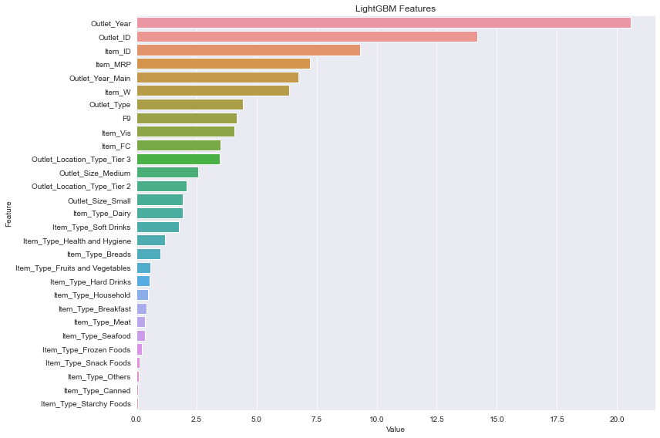
Model Building & Evaluation
Feature Importance of the LightGBM/Catboost features.
Important points:
Outlet ID is the most important feature describing the prescriptive details
Model Validation score for
LighGBM – 1254.61 RMSE
Catboost – 1251.08 RMSE
Using the above features with Kfold Cross validation for both the models, 10 fold score for the above are
LighGBM – 1254.05 RMSE
Catboost – 1252.36 RMSE
Public LB score – 1268.59371 RMSE
Private LB Score - 1269.23393 RMSE

Slide 11
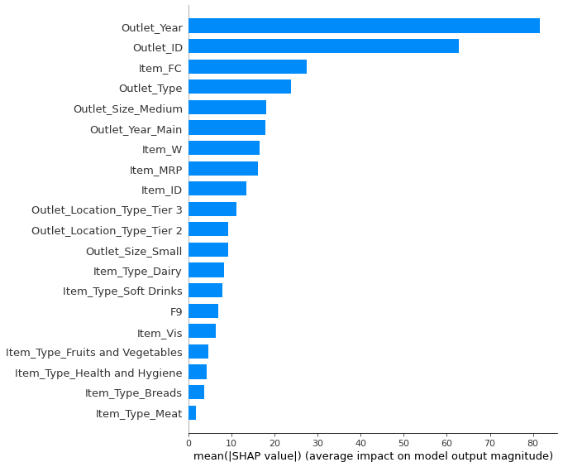
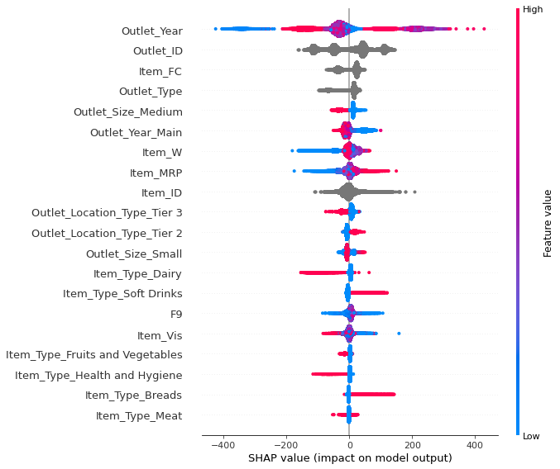
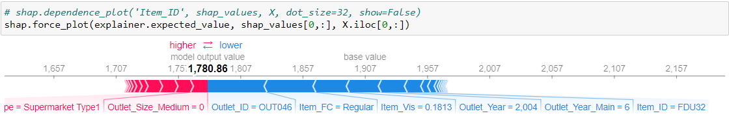
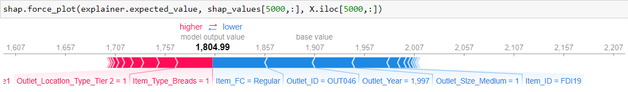
Model Explainability Using SHAP
The main objective here is to understand the model with respect to the input features. We can target certain Outlets and Items in a single Year to explain which features are driving the predictions.

Slide 12
Results and Recommendations
All results are recorded in the notebook along with models which are reproducible and consistent with the hypothesis tests and assumptions taken into consideration.
Important points:
Complex non linear models are best suited for the job along with the perspective of deployment and maintenance.
Tree models gave the best score, which can be further used for the model pipeline deployment and recommendations along with model explainability using SHAP, Lime packages.
Deep dive into the Outlet and Item features along with aggregate features if given time will give the best suitable models which can be further outlined and ease of understanding
Collating more relevant features from either third parties of in house analytics will help in creating more better models.

Slide 13
Recommendations
A summary of the important business outcomes /real life impact
Business Use:
Making models which are better explained with the features in hand will give more understanding to the client for Sales and profitability.
Considering the historical data along with Outlet IDs performance can also be used for prescriptive analysis using Dashboards which will help in making better business decisions.
Using the Item Ids we can also create recommendations systems which will help in proposing more Items in a single outlet to increase sales having in mind the macro economic factors in hand
Specific models can be built around the Outlet Ids to boost the Sales for specific regions using more features.

Slide 14
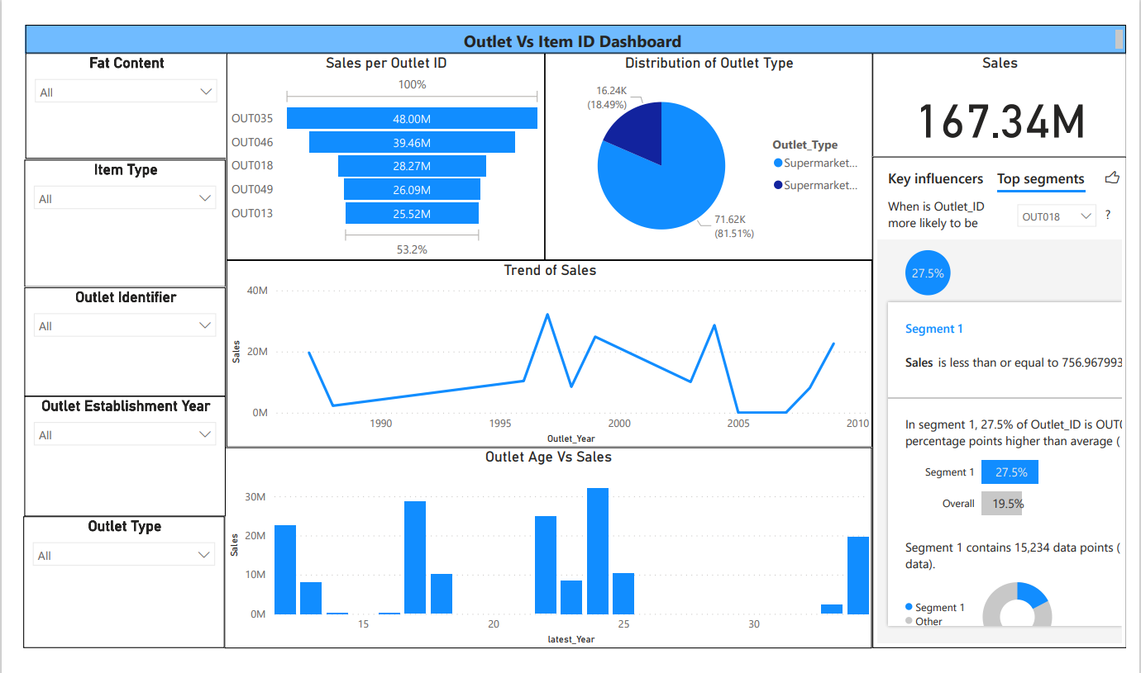
Recommendations – Analytics Dashboard
Dashboards are efficient in analyzing the Sales and keep track of which Outlet or Item in a Certain Year is hampering, therefore focused to boost Sales in that paradigm.
*Power BI pbix attached

Slide 15
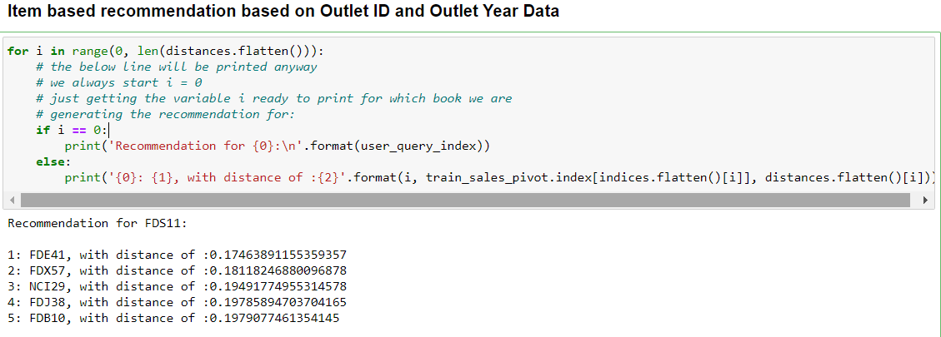
Recommendation – Item Based Recommendations
Item- Item Base recommendations are best suited for this purpose to increase Sales by Inventory management in certain Outlets where there is a demand but not Supply
*The recommendations are based on data provided with Outlet Year and Outlet ID as identifiers using KNN

Slide 16
THANK YOU Questions?

