Slide 1

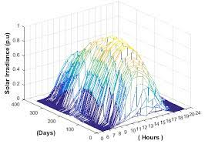


Wipro’s Sustainability Machine Learning Challenge
Rajat Ranjan
Data Scientist

Slide 2
Agenda
Problem Understanding
Data Understanding
Data Pre-Processing
Application of Learnings
Model Building & Evaluation
Introduction
Notes:
Learnings & how their approach can be applied to different use cases

Slide 3
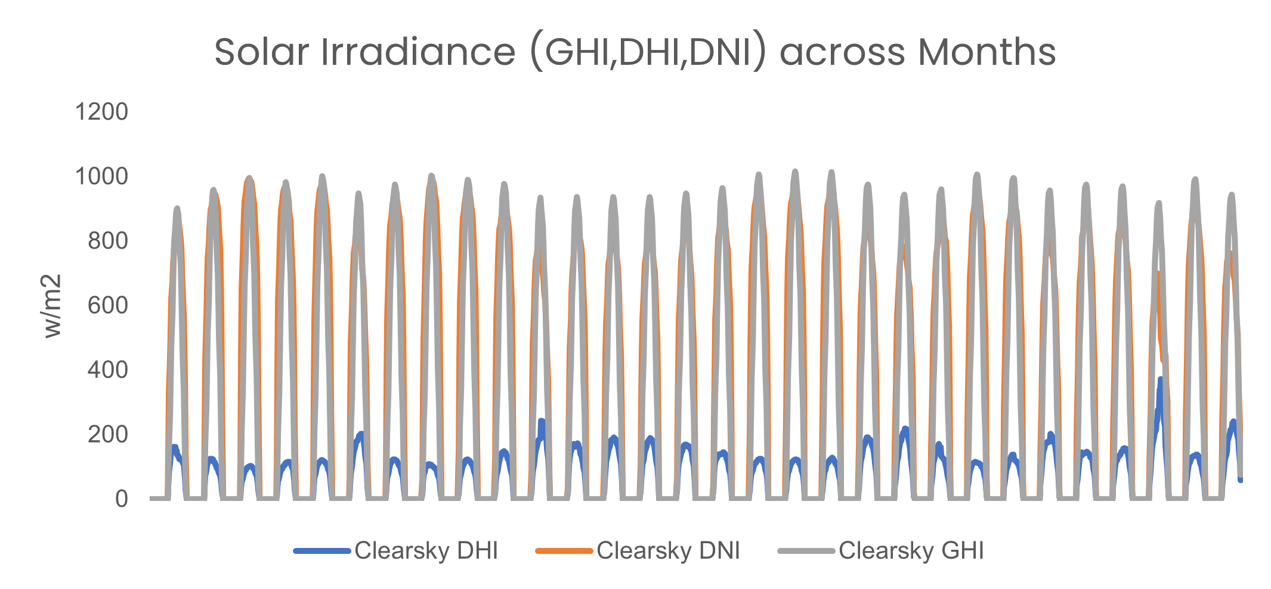
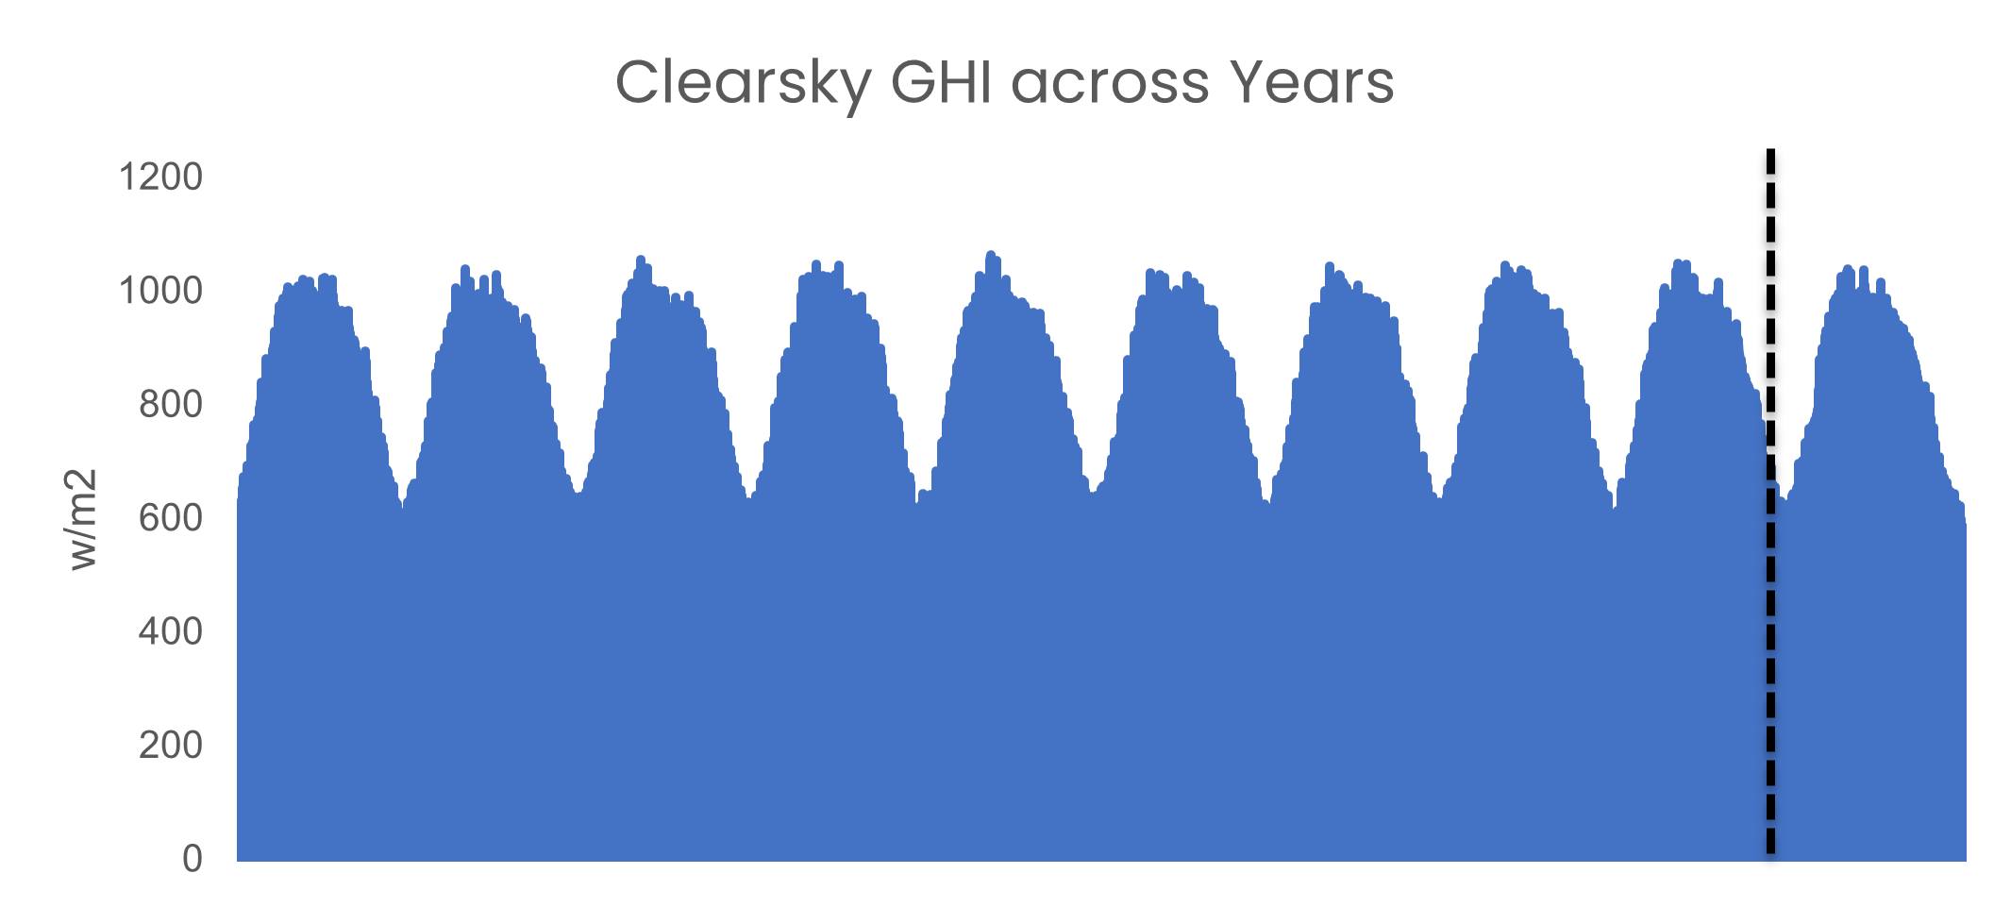
Problem Understanding
Challenge
For Year 2016
Time Series Forecasting challenge to optimize solar power generation using ML models.
A solar power generation company wants to optimize solar power production and needs the prediction model to predict ‘Clearsky DHI’, ‘Clearsky DNI’, ‘Clearsky GHI’.
Forecast the Solar Irradiance for the Test Year (2019) using the past Data from 2009-2018 & other features.
# Train: 1,75,296 rows x 18 columns
# Test: 17,520 rows x 15 columns
Objective
Time Series Forecasting
MSE
Multi Output Regression
Clearsky Data
Train Period from 2009-2018
Feature Engineering
Regression
2009
2015
2019
Notes:
Starting from this slide, explain how you’ve gone about solving this problem

Slide 4
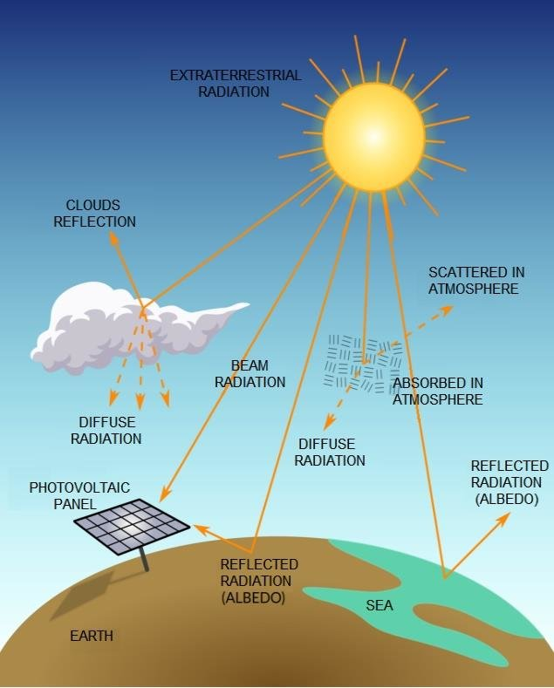
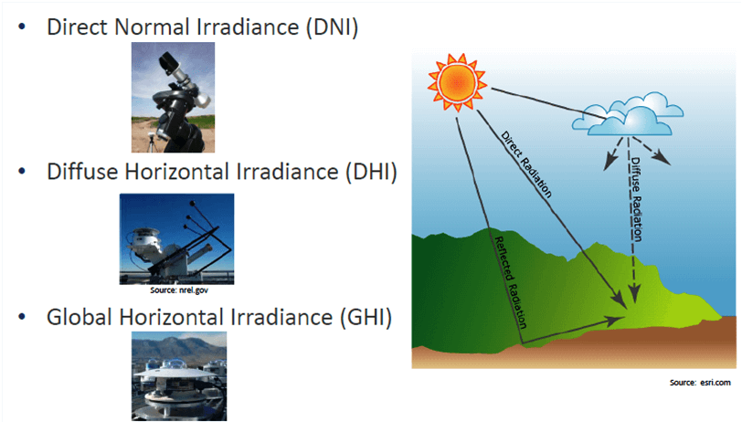
Problem Understanding
Representation of Solar Radiation Components
00:00
11:00
23:00
Some Factors Affecting the Irradiance
Cloud Type
Temperature
Pressure
Diffuse Fraction etc.
https://www.researchgate.net/figure/Representation-of-Solar-Radiation-Components_fig1_337408836
Notes:
Starting from this slide, explain how you’ve gone about solving this problem

Slide 5
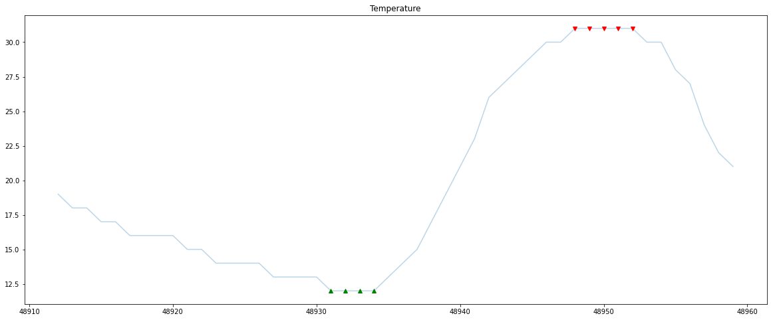
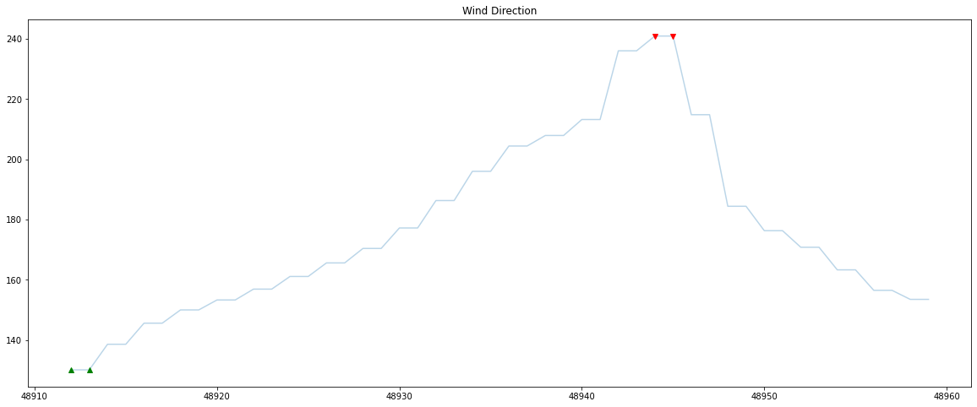
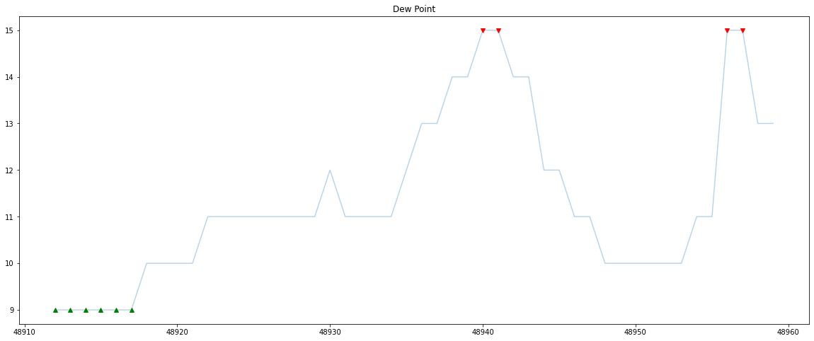
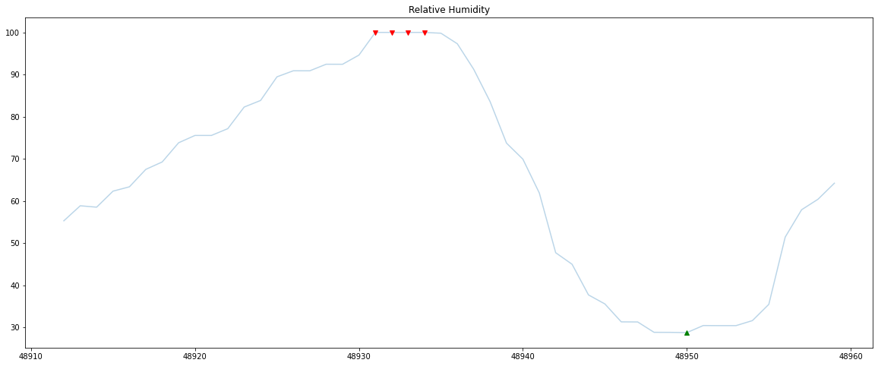
Data Understanding
Temperature in 0C
Wind Direction in Deg
Dew Point in C
Relative Humidity in %
Raw Features & their trends at a Daily Level across time, which shows the peaks & lows during the duration
Notes:
Starting from this slide, explain how you’ve gone about solving this problem

Slide 6
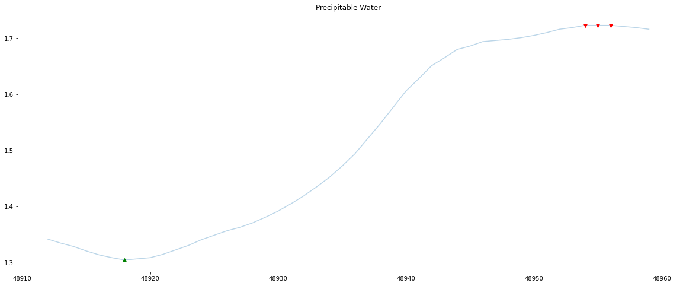
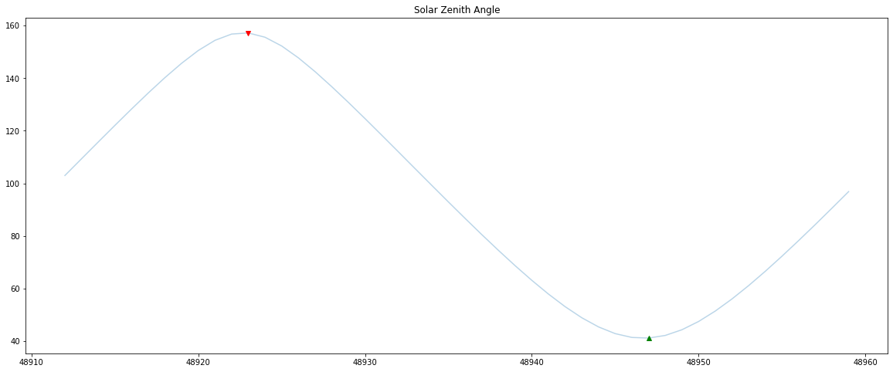
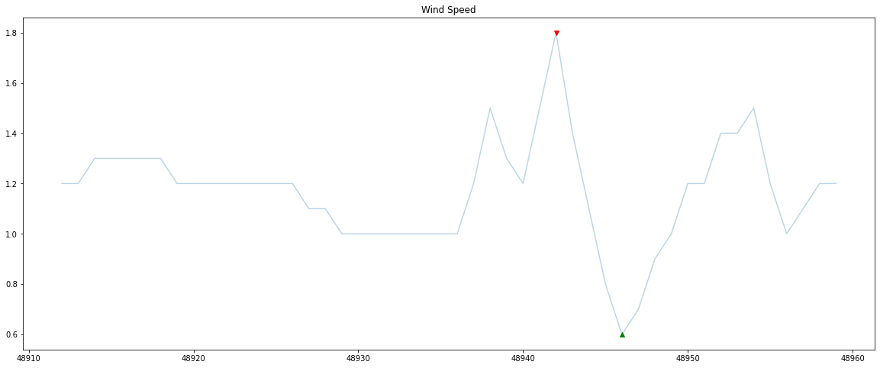
Data Understanding
Precipitable Water in cm
Solar Zenith Angle in Degrees
Wind Speed in m/s
Some Clearsky features engineered using the Raw are
Azimuth Angle
Airmass
Turbidity
Transmittance etc
Feature Understanding taken from pvlib (ref)
Raw Features & their trends at a Daily Level across time, which shows the peaks & lows during the duration
Notes:
Starting from this slide, explain how you’ve gone about solving this problem

Slide 7
Data Pre-Processing
Pre - Processing
Feature Engineering Techniques
Cross Validation
Raw Time Series Data
Data Cleaning
Lag Features
Signal Analysis
Data Pipeline For Stratified Cross Validation
Outlier Detection using Quantiles for Daily Level of Data
Date Time Features
Cloud Type & Time Aggregated Features
Data Pipeline For Kfold Cross Validation
Data Transformation of Raw Features using different techniques
Atmospheric Features
Clear Sky Relevant Features using Data Understanding
Data Processing for Date time Features & creating cyclic features
Data Pipeline For Group Time Series Cross Validation
Interactions between Features
Rolling & Expanding features
Key Understanding of Time Series Related Features & Pre-Processing was done to understand the best Cross Validation strategy which was the trick to climb private leaderboard

Slide 8

Model Building & Evaluation
Raw Data
RANK 1
Vanilla LGBM Regressor Model For Each Clear Sky Target Variable
Weighted Ensemble of Targets for Clearsky GHI, DHI, DNI Based on Mean Local CV gave the best results in private LB
Final Ensemble
Prediction
Group Time Series CV Strategy
261.97 MSE
15 Folds Time Series Splits done based on Non-Overlapping Groups by Days
Main Understanding of the problem to understand the local CV Strategy & Public LB Score
The ensemble of different strategies & using different added features helped to create a balance which gave 251.22 MSE in public LB (Rank 9) & Rank 1 in Private LB
KFold CV Strategy
Target Lags was introduced by a Year with different window to feed to 10 KFold CV with shuffle
267.49 MSE
Stratified KFold CV Strategy
Target Bins was used to equally distribute the Targets across time for 10 Stratified Kfold with shuffle.
279.3 MSE
251.25 MSE
Model Building & Evaluation Based on MSE gave different CV Score due to Cross Validation Strategies & Good score in Public LB (Time Series Folds) which helped to reach Rank 1 in Private LB

Slide 9
Application of Learnings
Business Use Cases revolve around forecasting for Solar Irradiance & Other Time Series forecasting Problem Statements
Data Transformations
Time Series Forecasting using Regression
Different Cross Validation strategies used for Time Series Regression problems
Domain Feature Interactions
Understanding Feature Engineering using Lags, Rolling window, Expanding Window
Outlier Detection in Time series Data
Domain Understanding
Signal Analysis
Notes:
Learnings & how their approach can be applied to different use cases

Slide 10
End Notes
THANK YOU
QUESTIONS?
GitHub Portfolio LinkedIn Kaggle MachineHack
Notes:
Learnings & how their approach can be applied to different use cases

Slide 11

Model Building & Evaluation

Slide 12
Model Building & Evaluation

