Slide 1

B.Tech Project presentation on | Creation of Autocad Plugin to draw Block model of an ore based on Bore hole log data
Submitted by:
Rajat Kumar Khandelwal
Roll no. 17155069, B.Tech (Part -4)
(DEPT. OF MINING ENGINEERING IIT BHU Varanasi)
Under the guidance of:
Dr. Ashok Jaiswal
(Associate Professor)
(DEPT. OF MINING ENGINEERING
IIT BHU Varanasi)

Slide 2
Acknowledgements
In the accomplishment of this project successfully, many people have best owned upon me their blessings and the heart pledged support, this time I am utilizing to thank all the people who have been concerned with this project.
I would like to express my deep gratitude to Dr. Ashok Jaiswal, my research supervisors, for their patient guidance, enthusiastic encouragement and useful critiques of this project work even at the time of global pandemic Covid19 through virtual meetings and telephonic conversations.
My grateful thanks are also extended to my friends of my project group for their help in keeping my progress on schedule.
Finally, I wish to thank my parents for their support and encouragement throughout my study.

Slide 3
Contents
Introduction
Objective
Some basic concepts and Theory
Bore Hole data CSV file format
Procedure and Approach
How to use BlockModel plugin in Autocad
Video Demonstration
Advantage of Block-Model Plugin project
Summary and Result
Example images

Slide 4
Introduction
Open cast mine planning is done by developing the block models and then dividing the deposit into smaller pits which contain both ore and waste blocks which are to be mined in order to reach the pit limit and these operations are done keeping in the mind the overall optimization of the pit and reaching ultimate pit limit design.
Ore body block models are computerized representations of portions of the earth’s crust based on geological and geophysical observations made on and below the earth’s surface. Ore body models are numerical equivalent of a 3-D geological map complemented by description of physical quantities in the domain of interest.
Most operating companies make periodical ore-reserve estimates, usually at least annually, to determine their ore-reserve position as a basis for controlling development and exploration and allocation of funds therefore; for determining deferred, depletion, and depreciation charges per ton; or as a basis for deciding upon operating policy—expansion or contraction of operations, capital expenditures, and the like.

Slide 5
Objective
To prepare Block model Plugin that’s runs in AutoCAD platform and usings single command fetch Bore Hole log datasets from CSV files and generate:-
A Bore hole log depict by a line to particular depth, inclination with their title.
A block model of an ore around bore log that represent estimated grades concentration at different-different regions using colors shapes using inverse square method.
All these computations are dynamic and customized according to the input given by user following very simple dialog box instruction.

Slide 6
Some basic concepts and Theory
BORE HOLE LOG: Borehole logging is the practice of making a detailed record (a well log) of the geologic formations penetrated by a borehole. The log may be based either on visual inspection of samples brought to the surface (geological logs) or on physical measurements made by instruments lowered into the hole (geophysical logs).
BORE HOLE DATA: The interpretations stored in the Borehole Geology database are made from borehole logs that show the geology encountered at depth within each borehole.
Mineral resource estimation: Resource estimation is used to determine and define the ore tonnage and grade of a geological deposit, from the developed block model. There are different estimation methods (see below) used for different scenarios dependent upon the ore boundaries, geological deposit geometry, grade variability and the amount of time and money available

Slide 7
Block Model Estimation: Once the geological modeling is completed, the geological envelopes are divided into block models. Subsequently, the estimation of these blocks is done from "composites" that are point measures of the grade of ore in the rock. Several different mathematical methods can be used to do the estimation depending on the desired degree of precision, quality and quantity of data and of their nature:
Nearest Neighbour Method
Inverse Distance Weighting Method
Kriging Method
In this project we are going to use Inverse Square Distance Weighting Method for ore grade reserve estimation.
Interpolation: Interpolation is the process of estimating unknown values that fall between known values. In this example, a straight line passes through two points of known value. You can estimate the point of unknown value because it appears to be midway between the other two points.

Slide 8
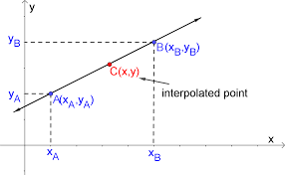
It is widely use in ore grade estimation.
Ore grade estimation using Inverse Distance Weighting Method (IDW):
Inverse distance weighting (IDW) is a type of deterministic method for multivariate interpolation with a known scattered set of points. The assigned values to unknown points are calculated with a weighted average of the values available at the known points.
The name given to this type of methods was motivated by the weighted average applied, since it resorts to the inverse of the distance to each known point ("amount of proximity") when assigning weights.

Slide 9
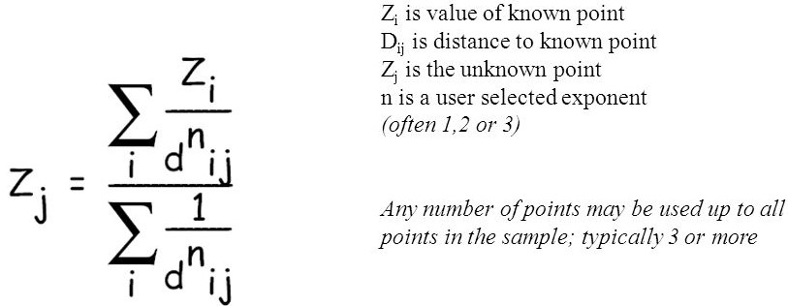
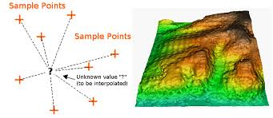
IDW can be applied as:
For inverse square distance method, the value of n = 2 is taken.

Slide 10
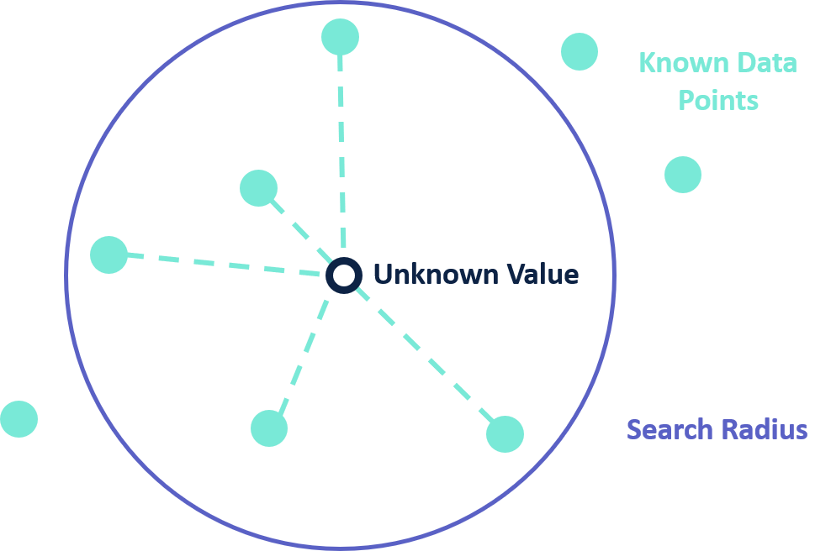
Search Radius: The characteristics of the interpolated surface can also be controlled by applying a search radius (fixed or variable), which limits the number of input points that can be used for calculating each interpolated cell. Generally points far from the cell location where the prediction is being made may have no spatial correlation.

Slide 11
Advantages of Inverse Distance Weight Method:
Computationally simple.
Exponent gives flexibility. The same estimation procedure can be used to create very smooth estimates (like a moving average) or very variable estimates (like nearest neighbor).
Disadvantage:
Preferential sampling makes estimates unreliable.
Requires decision on which sample to use.
Extremes create large halos of great estimates.
Choice of exponent introduces arbitrariness.

Slide 12
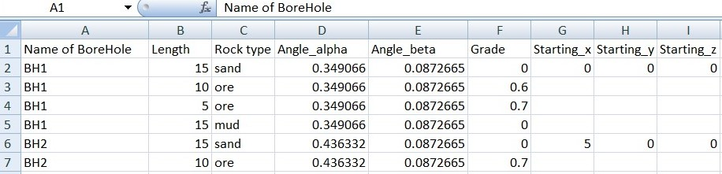
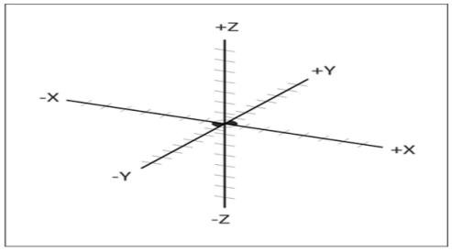
Bore Hole data CSV file format
First column A Bore-Hole log name/code.
B column represent length of log core.
C column the rock typre associated with log core.
D column, here we have to input angle of bore log core with z-axis i.e. vertical depth.
E column, here we have to input angle of bore log core with x-axis i.e. horizontal length along the ground surface.
F represent grade of ore associated with respective log core.
And at last Column G, H, and I represent co-ordinates of collar at ground surface below which we drilled a bore-hole log.

Slide 13
Procedure and Approach
First of all it all started after the brief introduction about the project and concepts to work on with my mentor Dr. Ashok Jaiswal sir.
I started my research work on Bore-Hole, Grade estimation method, and Block model of an ore by bore-hole log data.
After that, I started on software part by getting familiarity with AutoCAD and Microsoft visual studio .Net core platform and learned to write programs to draw simple geometries like lines, circles etc.
After that I started plugin(DLL library file) development coding work in .Net Core platform.
Create a main class file, write standard C# starting codes and gave a AutoCAD plugin command (BlockModel) and attach Autocad api reference files to visual studio IDE. This command is used to load plugin library file in Autocad.

Slide 14
After that I created a window form, designed it by adding two buttons, file dialog setup and gridView window, and attached it with BlockModel command. So that when user run this command, a window form displayed on user screen which ask user to upload Bore hole data.
The provided borehole data must be in .csv format and must be in standardized format.
After upload step, the window form give a preview of bore-log data data so that user can verify it.
After that we started backend coding of this window form. We followed functional programming. Implement methods to two buttons.
The first task of project was designing bore-log according to data taken from csv fille that was given by user earlier. Many lines of C# code was written under Form1.cs file that included user-oriented programming that implement logic consisted of loops and condition statements devised by us.
Now test plugin that it will load bore-hole view or not. After successful testing, I started next phase project i.e. grade calculation at different surrounding points by Inverse Square Distance method and generation of block model around them.

Slide 15
I created another window form, designed it by adding one buttons, and GridView window, that display relevant known grade points with their x, y, z values, when user completed 1st form.
It started by first stored x, y, z co-ordinates of midpoint of ore region of different-different bore-hole logs along with their grade and displaying them in another form. I found min and max values of x, y, and z co-ordinates. Then I setup 3 For loops that draw and store coordinates of random points about 3 units away bounded by min and max values of x, y, and z co-ordinates.
Inside body deepest loop, I declare an array, calculate_relev_distance function, and calculate_grade function.
The calculate_relev_distance function calculate distance of each known points from this unknown point, checked if these points were inside search radius(i.e. was given by user in further development), if yes then store the distance along with known grade in an array.
The calculate_grade function take this array as an argument, calculate distance of unknown point using Inverse Distance Square Method of grade estimation and return it to interpolation (main) function.

Slide 16
If grade calculated is greater than zero then we called another function to draw a solid block having centroid equal to co-ordinates of calculated points having calculated grade value and give color to the block according to magnitude of calculated grade interval.
Finally after successful build and testing our BlockModel plugin file was ready and successfully loaded and implemented in AutoCAD.
In this project future develop involve more systematic UI design and giving all complete user specified features.

Slide 17
How to use BlockModel plugin in Autocad
Collect and Process Bore-Hole log data and save them in CSV format
NETLOAD command on drawing dashboard window
Select BlockModel plugin (DLL file) and click Open
Run AutoCAD software. Click on Start Drawing option

Slide 18
Type and run BlockModel command on drawing dashboard window. A dialog box will display.
Finally click on Generate Block Model button
A 3D block model representation of ore surrounding will display on screen which can be rotated along x , y and z axis.
Also another Dialog box display. The GridView window is showing x, y, z co-ordinates of known relevance ore points with their grade value
Click on Show BHL Button. AutoCAD dashboard is displaying graphical 3D line model of Bore-Log
Click on Load BHL button and select Bore-Hole log data csv file.

Slide 19
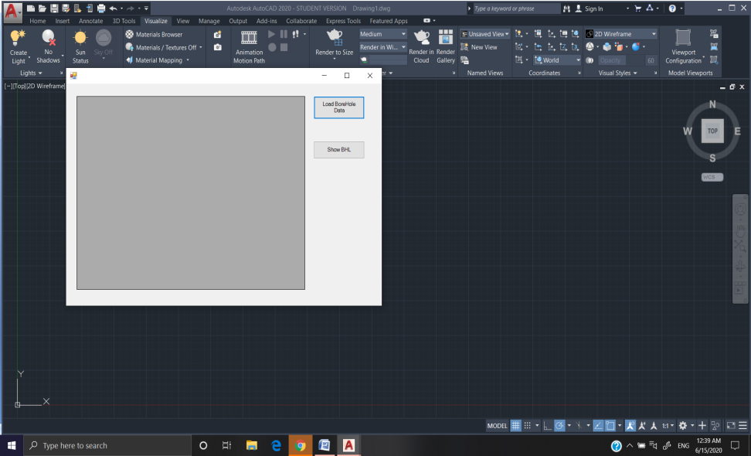
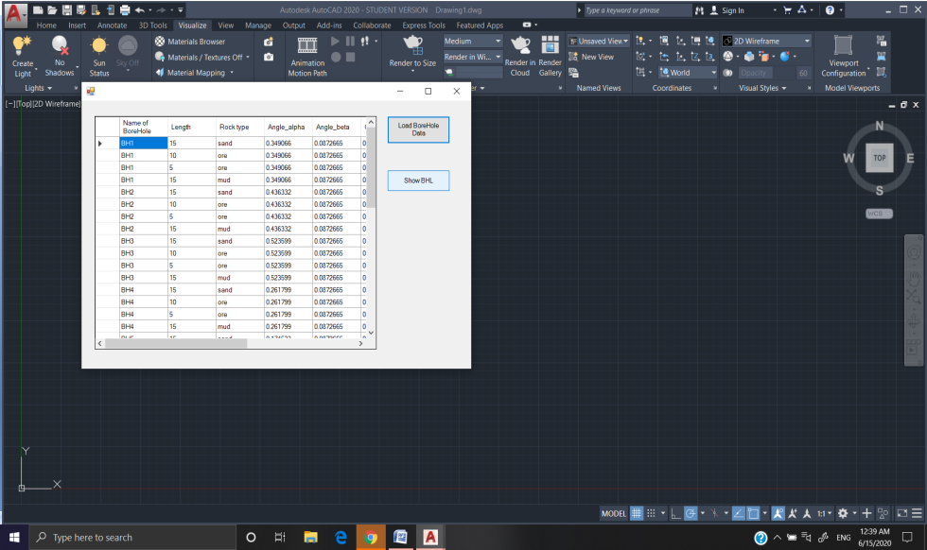
Steps Images

Slide 20
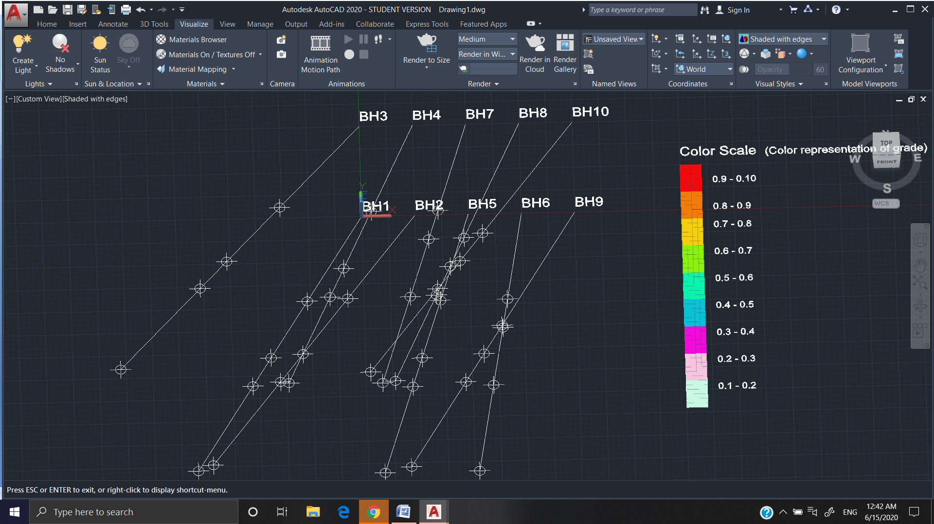
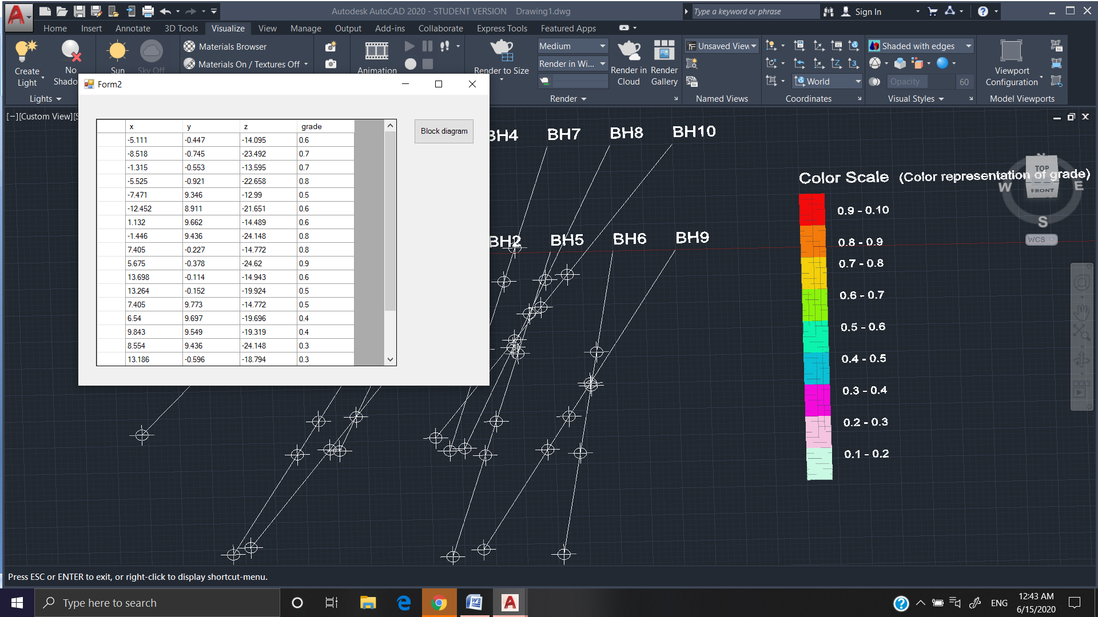

Slide 21
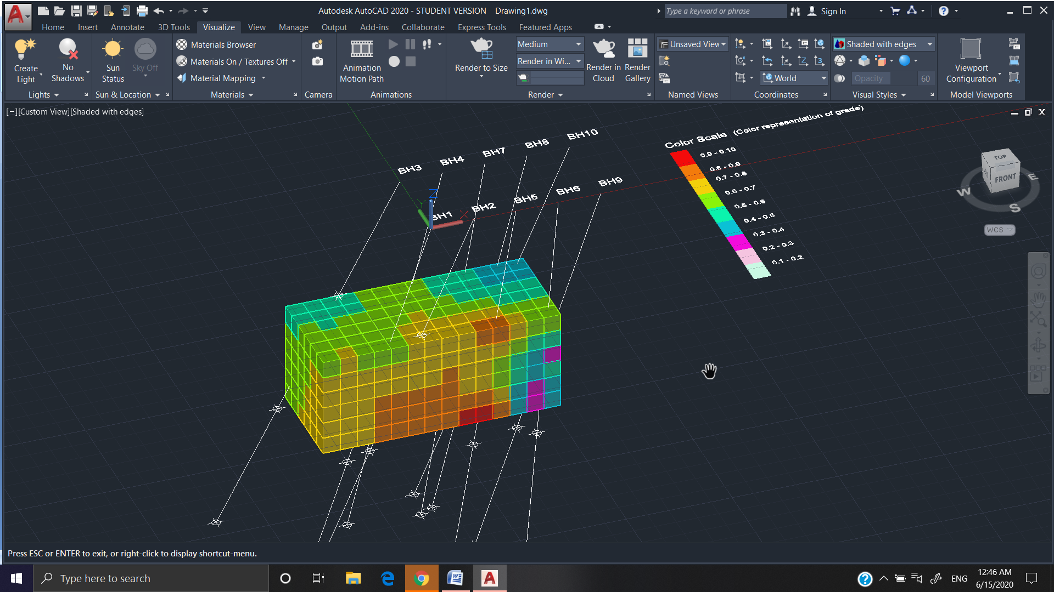

Slide 22
Advantage of Block-Model Plugin project
The main advantage of this plugin is that it is very cost effective and can be used for learning purpose and at small scale modelling because Autocad software easily available on internet free of cost and it is widely popular for modelling purpose but mining software like Surpac are very expensive and not easily free available on internet.

Slide 23
Summary and Result
The Project on “Creation of AutoCAD Plugin to draw Block model of an ore based on Bore Hole log data” is completed successfully.
The final outcome of project is creation of single ClassLibrary2.dll file.
When it run on AutoCad after NETLOAD command, it perform its function as describe above and create 3D Block Grid Model of ore easily.
It ensure complete dynamic and data adaptive programming logic i.e. when you give any Bore-hole log data as per prescribed csv format, it will successfully create block model according to the given data.
For Block Modeling, A high end Personal computer is recommended; otherwise it can take much time to render the graphics on AutoCAD.

Slide 24
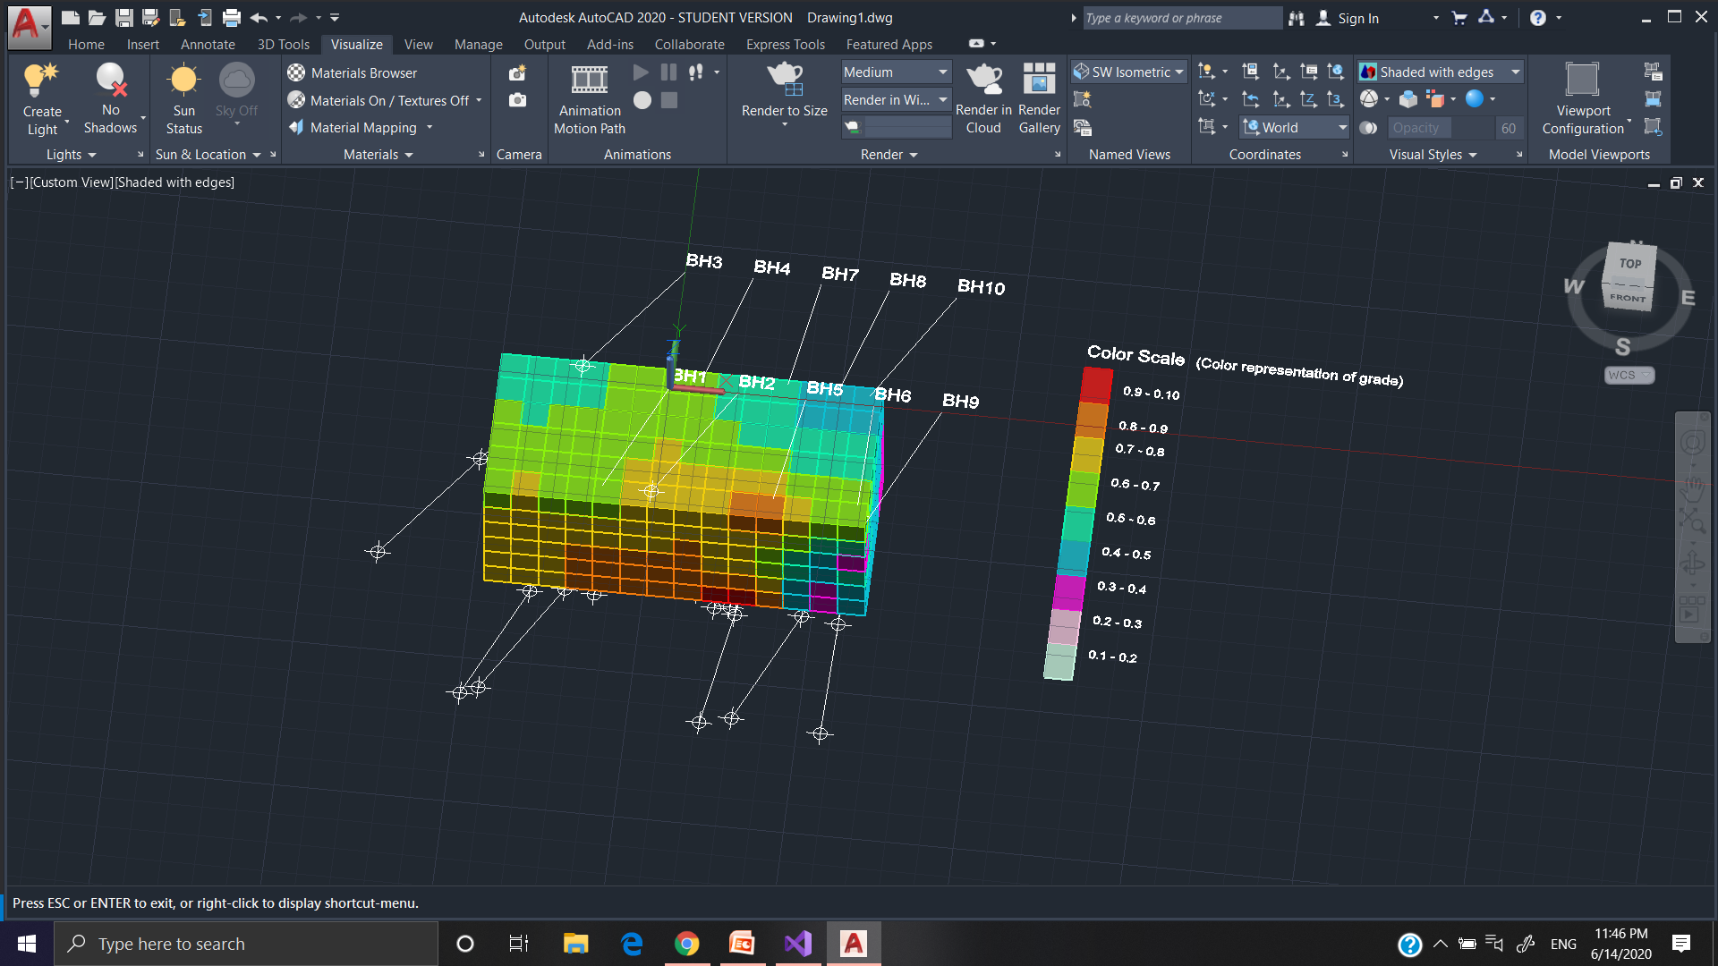
Example Final Block Model images at different views generated by BlockModel Plugin

Slide 25
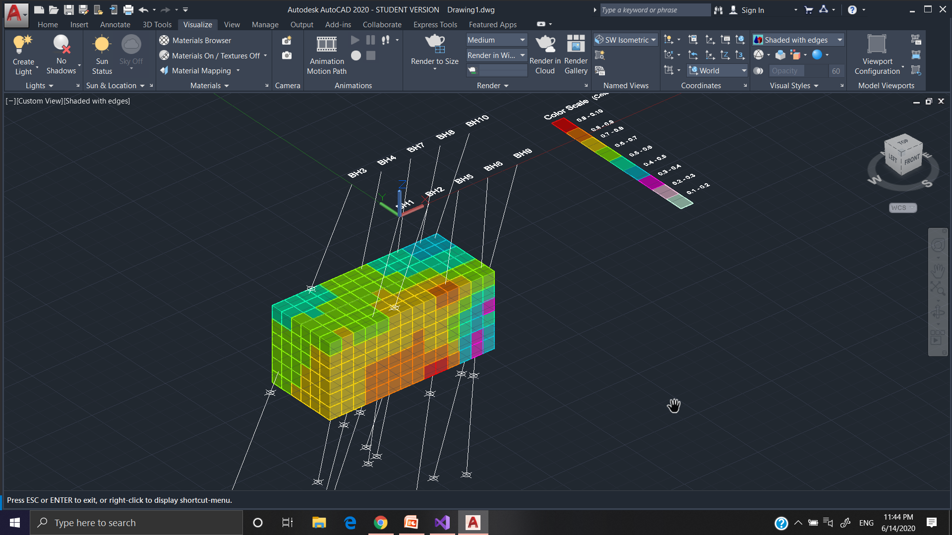

Slide 26
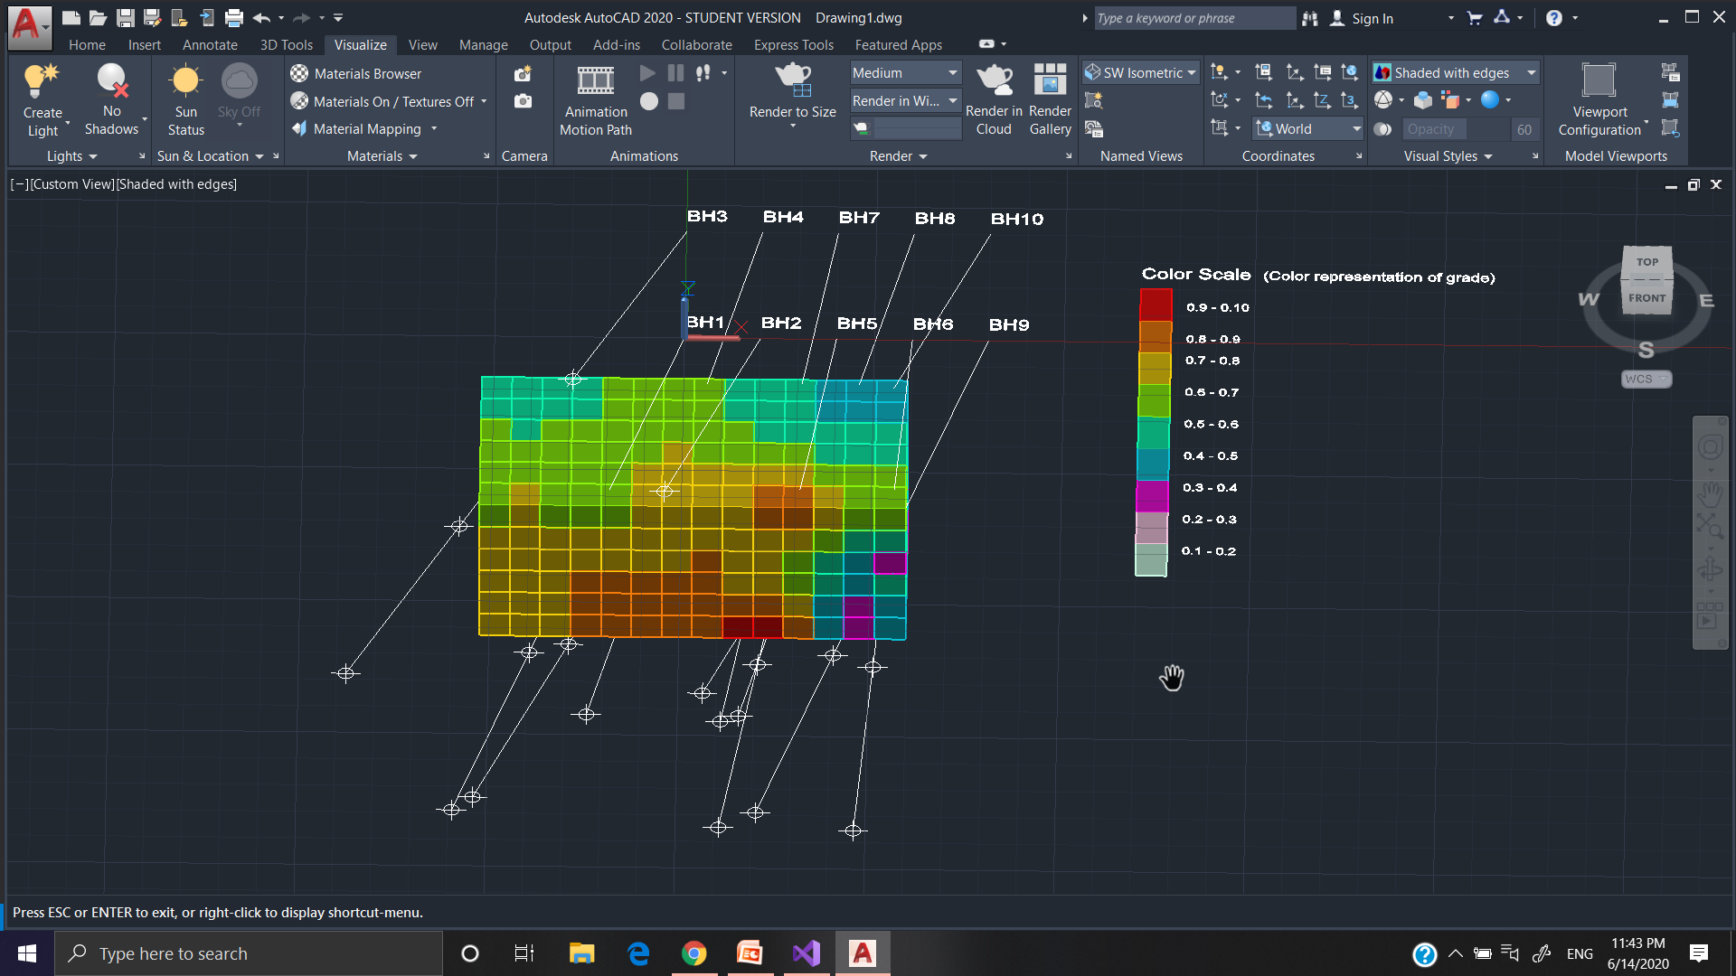

Slide 27
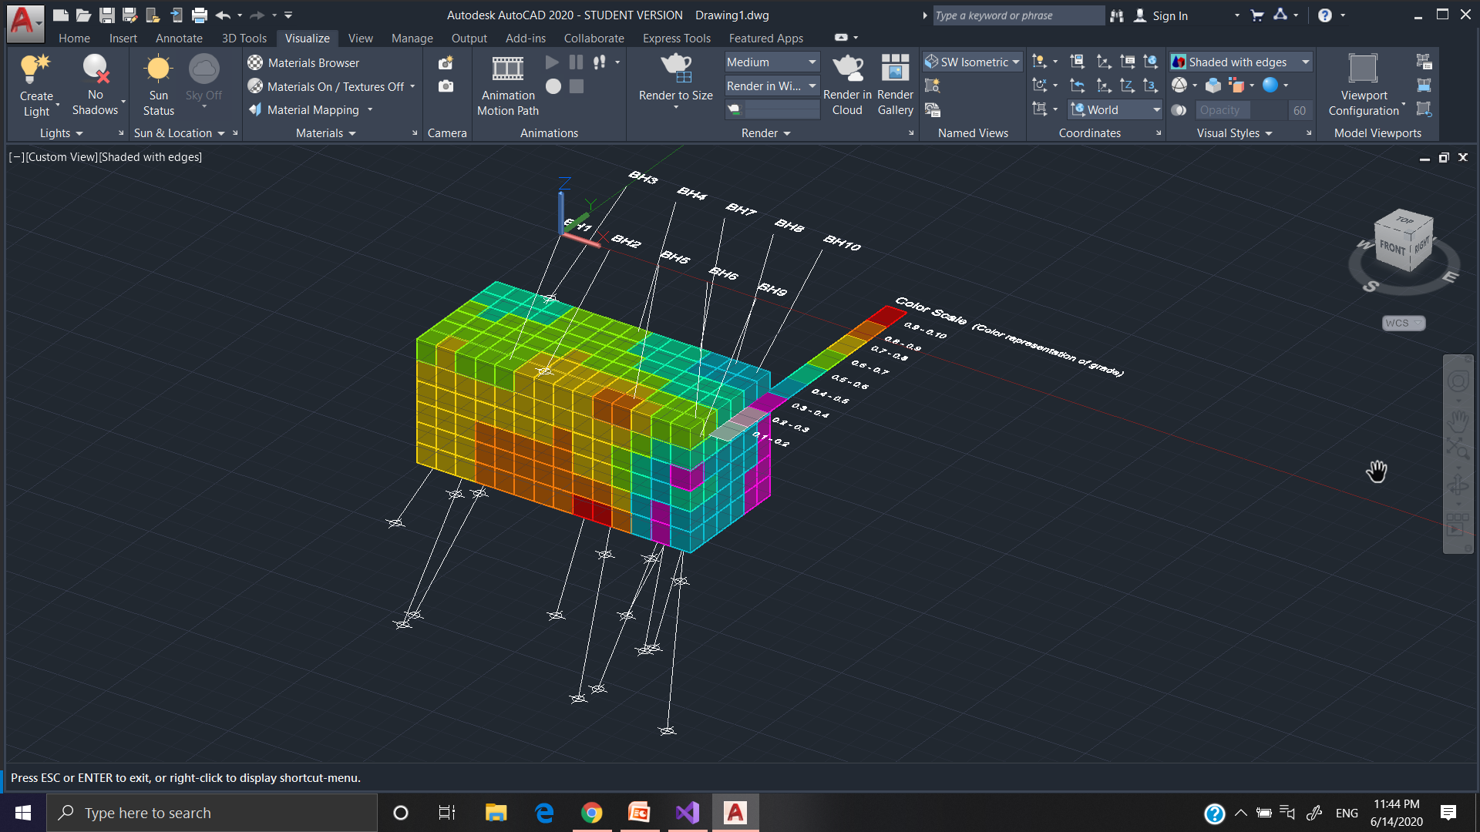

Slide 28
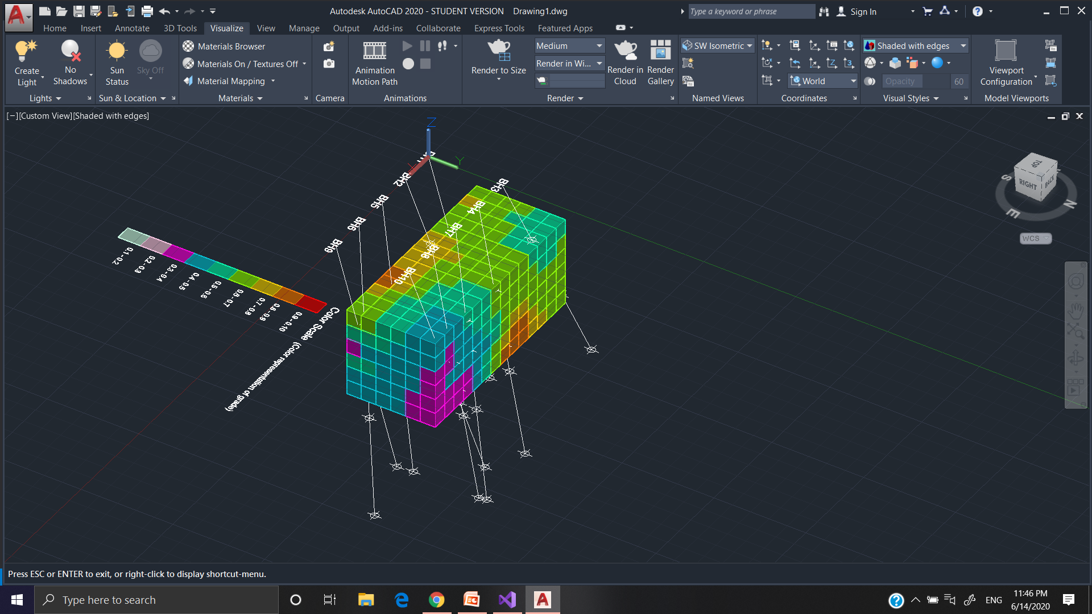

Slide 29
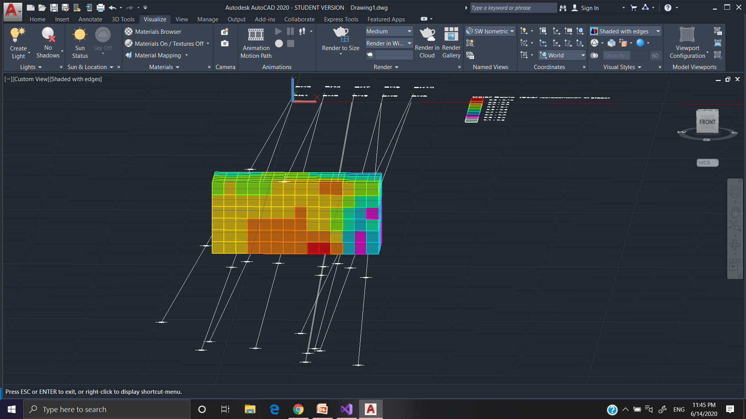

Slide 30
Thank You

