Slide 1
Introduction to
Continuous Integration
Mike Roberts

Slide 2
This session
Some slides
Demonstration
You!
Time at end for Q+A but please shout out if something is unclear
Law of 2 feet!

Slide 3
Introduction to
Continuous Integration
Or…

Slide 4
A tale of Lava Lamps, Homer Simpson, and broken builds

Slide 5
Overview
What?
Why?
How?
Show me!

Slide 6
What?

Slide 7
What is Continuous Integration?
“ Continuous Integration is a software development practice where members of a team integrate their work frequently, usually each person integrates at least daily - leading to multiple integrations per day. Each integration is verified by an automated build (including test) to detect integration errors as quickly as possible.“
http://martinfowler.com/articles/continuousIntegration.html

Slide 8
What is Continuous Integration?
“The Daily Build on Steroids”
or…
“The practice of integrating source code continuously”

Slide 9
What is “integration” ?
At a minimum:
  Gather latest source together
  Compile
  Execute tests
  Verify success

Slide 10
What is “integration” ?
Can include other tasks such as:
  Rebuild the database
  Build release distribution
  Run code analysis and coverage tools
  Generate documentation

Slide 11
How often is continuously?
As frequently as possible
More like once per hour than once per day
Before leaving at the end of the day

Slide 12
When to integrate?
Implement just enough, then integrate
If using Test Driven Development, it forms a natural break in the cycle
Taking small steps
Test
Integrate
Code
Refactor

Slide 13
Why?

Slide 14
Why?
Regular feedback
  For the integrator : “Did that work?”
  For the rest of the team : “Is the build OK?”
  Reduces Risk overall

Slide 15
Why?
Reduce integration pain
  No more ‘merge hell’
  XP Mantra: Do the ‘hard things’ often so they’re not hard any more

Slide 16
Why?
Enables concurrent development
  “We can both work on this today”

Slide 17
Why?
Increased automation
  Don’t repeat yourself - automate to increase speed and to make less mistakes

Slide 18
How?

Slide 19
Technical pre-requisites
Source Code checked into Source Control
Automated (fast) build
  Compile
  Test
  command line without interaction
Dedicated (communal) Integration Machine

Slide 20
Social pre-requisites
Developer discipline
  Continuous means continuous, not ‘once per week’
Shared ownership

Slide 21
Automated CI
Automated Continuous Integration Server
  CruiseControl, CruiseControl.NET, TeamCity, Bamboo, etc.
  Detects changes in source control
  Launches integration build
  Publishes results

Slide 22
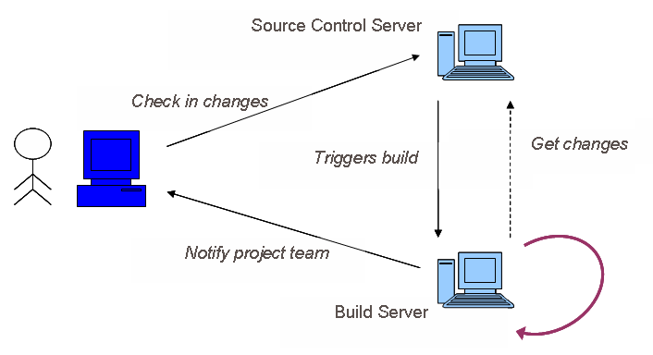
How does Automated CI Work?

Slide 23
Why use Automated CI?
Makes integration easy
Guarantees integration happens
Better feedback options
Encourages test automation
  Through metrics

Slide 24
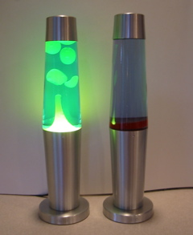
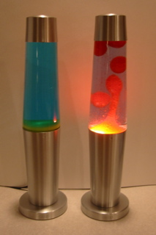
Immediate Feedback is Key

Slide 25

Immediate Feedback is Key

Slide 26
Social Issues - CI Etiquette
Fixing a broken build is the highest priority
“You broke it, you organise fixing it”
Do not check in on a broken build
  It makes fixing it harder
Don’t leave until the integration runs successfully
Keep the build quick

Slide 27
Show me!

Slide 28
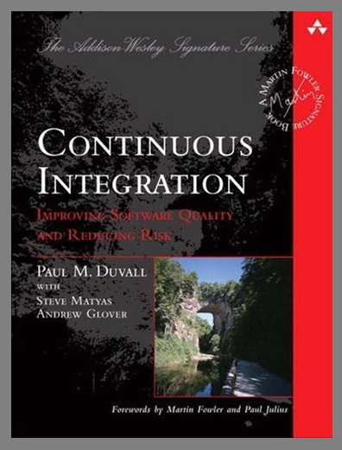
Where next?

Slide 29
Where next?
http://martinfowler.com/articles/continuousIntegration.html
http://cruisecontrol.sourceforge.net/
http://ccnet.thoughtworks.com/
Etc…

Slide 30
Introduction to
Continuous Integration
Mike Roberts
http://www.mikebroberts.com/
mike.b.roberts@gmail.com

