Slide 1

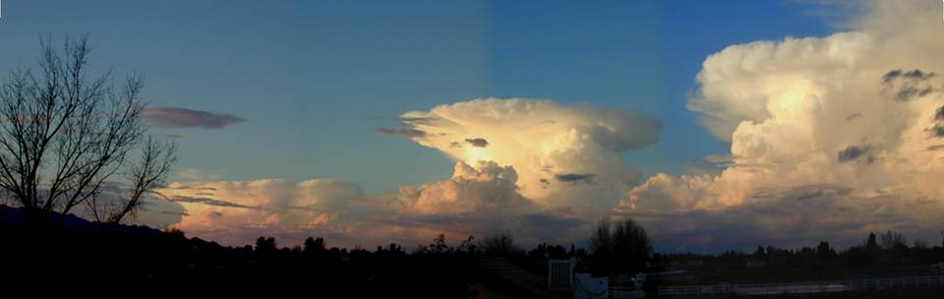
Cloud Formations
Melissa White

Slide 2
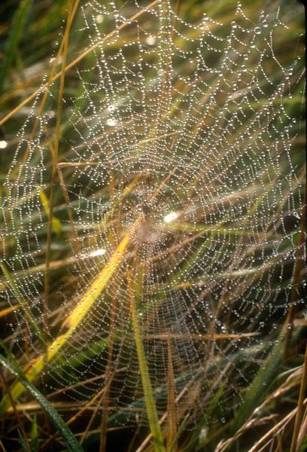
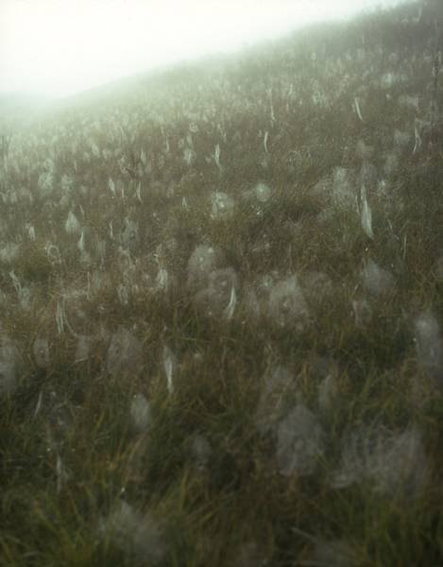
CONDENSATION
Sunlight causes water to evaporate into the atmosphere. This air containing the water vapor is heated at the surface of the earth and rises. As the air rises, it cools and the water vapor condenses on some form of particulate matter such as dust, ash, or smoke to form clouds. The particulate matter are called Condensation Nuclei.
Condensation on spider webs. Views of early morning fog in Indiana

Slide 3
Importance of Clouds
  So, what is a cloud?
    ~ It is a thick mass of suspended water drops or ice crystals.
  What do clouds tell us?
~ The presence of clouds in the sky is one type of signal to meteorologists that there will be changes in the weather. Predicting the weather requires the understanding of the different types of clouds

Slide 4
Identifying Clouds
To better communicate and understand the many cloud forms in the sky, meteorologists identify clouds based on five basic cloud characteristics:
1. The altitude at which they occur
2. Color
3. Density
4. Shape
5. Degree of cover.
From this information, we can identify three basic cloud types and seven other common cloud types.

Slide 5
Cloud Type by Form
Clouds can be classified by some simple, but subjective, criteria that also provides information on the atmospheric conditions
One form of classification is based on appearance or form. Using these characteristics you can identify the three basic cloud types: stratus, cirrus, and cumulus

Slide 6
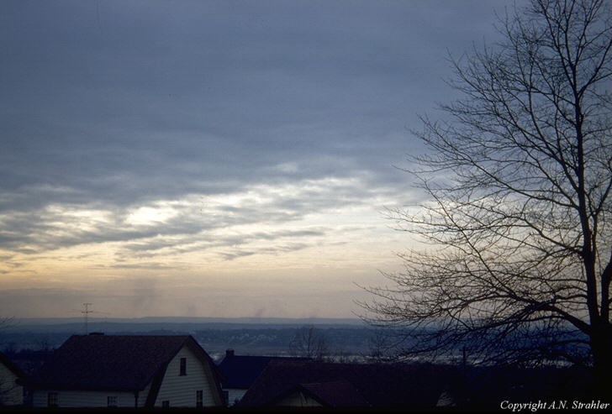
Stratus Clouds
Stratus clouds are thin, sheet-like clouds. They are layered with some rippling, and cover large portions of the sky. They are frequently gray and thick. Stratus clouds are formed when air is forced up slowly.

Slide 7
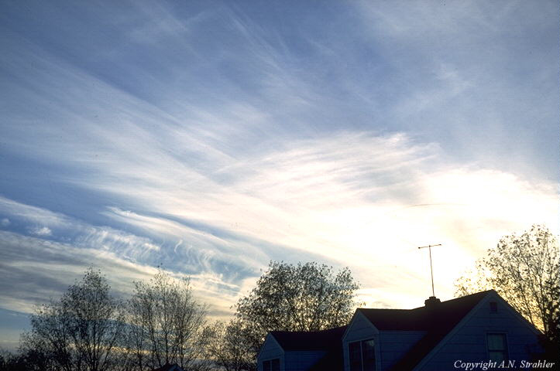
Cirrus Clouds
Cirrus clouds are thin, white clouds with a feathery appearance.
They are the highest of all clouds forming at heights of 30,000 feet or more above the earth's surface.
Cirrus clouds are formed by ice crystals.
They generally occur in fair weather and point in the direction of air movement at their elevation. Cirrus clouds are usually the first sign of an approaching storm.

Slide 8
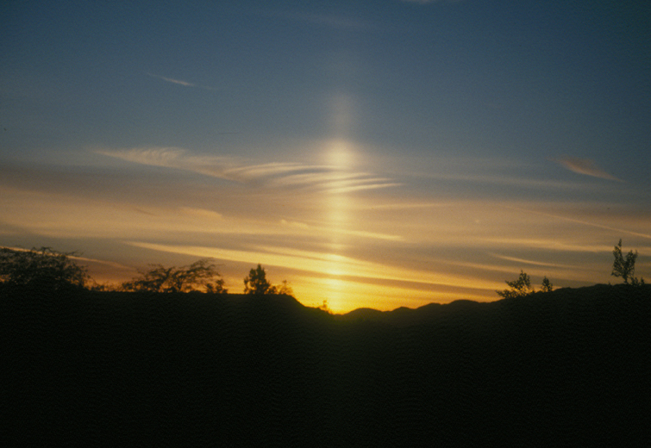
Cirrus Cloud Phenomenon
Sun Pillar
Sometimes, when the sun is just below the horizon, aligned ice crystals reflect light from their crystal faces. We see the cumulative effect of millions of reflections of this sunlight as a sun pillar.

Slide 9
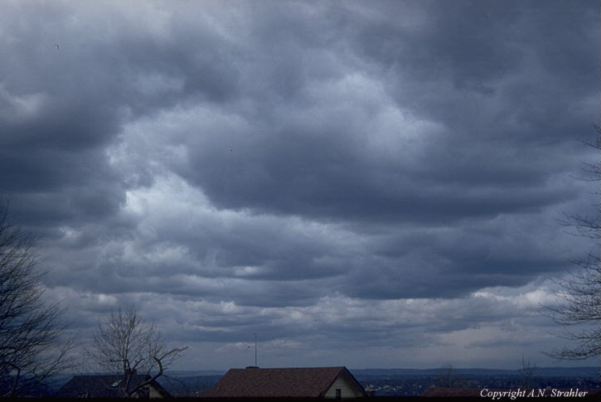
Cumulus Clouds:
Cumulus clouds are flat-based, billowing clouds with vertical doming. Often the top of cumulus clouds have a "cauliflower-like" appearance. Cumulus clouds are most prominent during the summer months.
Cumulus or fluffy clouds form when air is forced up rapidly and therefore rises higher.

Slide 10
Cloud Type by Altitude-01
Clouds can also be classified based on their altitude
There are three categories of cloud heights:
High Clouds = Cirrus
Middle Clouds = Alto
Low Clouds = Stratus

Slide 11
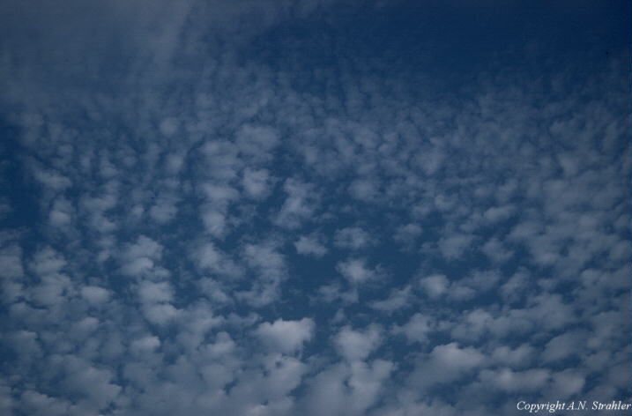
Cirro
  High clouds: 7-18km
    Cold: less than 25ºC & made up of ice crystals
Cirrostratus: high, wispy clouds. They give the sky a milky white appearance.
Cirrocumulus: delicate clouds appearing in bands or ripples across the sky. They are one of the least common of the cloud types.

Slide 12
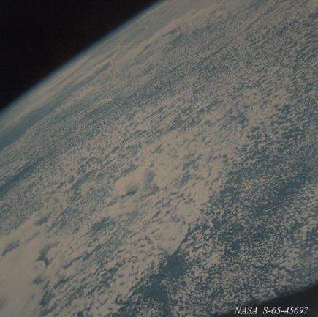
Alto
These clouds usually form from the gradual lifting of air in advance of a cold front.
Middle level clouds: 2-7 km
0-25ºC & composed of both water and ice crystals
The presence of altocumulus clouds on a warm and humid summer morning is commonly followed by thunderstorms later in the day.
Altostratus: thin, layered clouds that are blue-gray or whitish in color and often cover large portions of the sky. They are thinner if formed at higher altitudes but are heavier and more dense if closer to the ground.
* Picture of altocumulus clouds taken by satellite
Altocumulus: oval or eliptical in shape, and can have gray undersides. They often have a "cottonball-like" appearance.

Slide 13
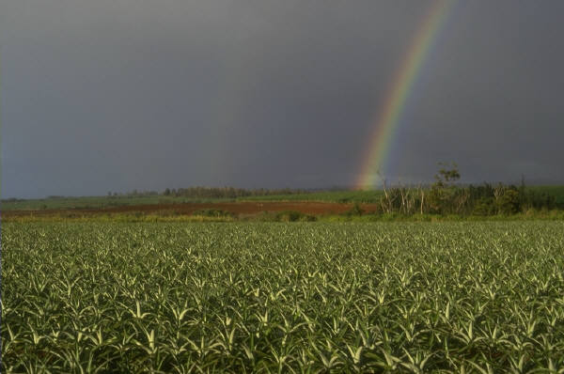
Strato
  Low level clouds: 0 - 4 km
  Greater than 5ºC & composed of water
  Stratus: Dense, uniform dark gray layers.
Stratocumulus: groups of dense, puffy
clouds that cover the sky in dark heavy
masses, long and gray. The often form in
bands across the sky.

Slide 14

Fog
  Fog : Clouds at ground level
  Radiation fog: forms at night when cold ground cools the air above it (in valleys)
  Advection fog: forms when warm, moist air moves over colder surface and cools (in coastal areas)

Slide 15
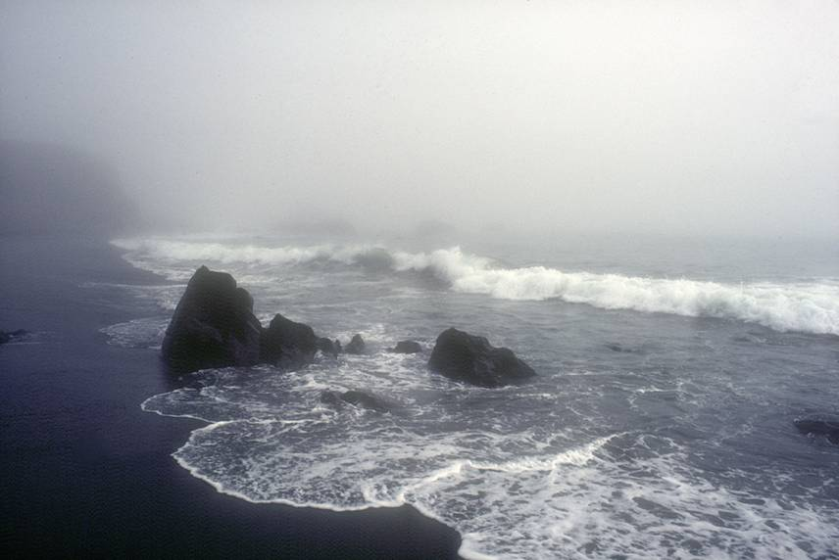
Advection Fog
In this fog, off the coast of Oregon, a cold ocean current cools the air to the air’s dew point temperature. This cooling of the air created the fog. This is called:

Slide 16
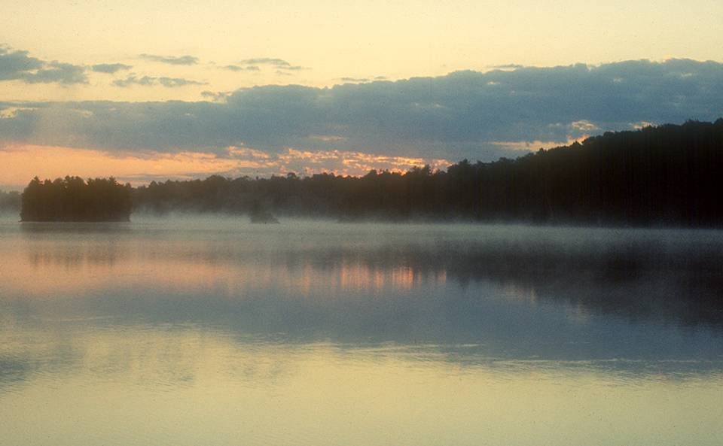
Radiation Fog
For the development of this fog, warm water is evaporating into cool air. The cool air becomes saturated (its relative humidity becomes 100%) and condensation creates the fog. This is called:
Cold Air
Condensation
Evaporation
Warm Water

Slide 17
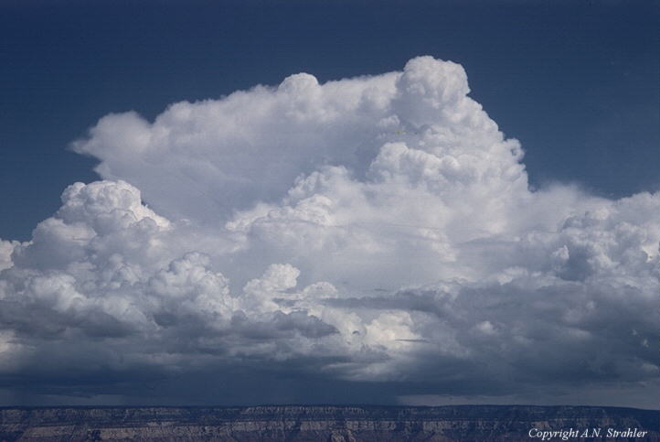
Cloud Type by Rain
Finally, we can classify them based on the presence of rain
Nimbus: any cloud that rains
Cumulonimbus: taller, towering versions of cumulus clouds. Their height can be from two to five miles. These clouds often form thunderstorms.
Nimbostratus: low, flat clouds that are often associated with steady precipitation and occur in thick, continuous layers and are often dark gray in color.

Slide 18
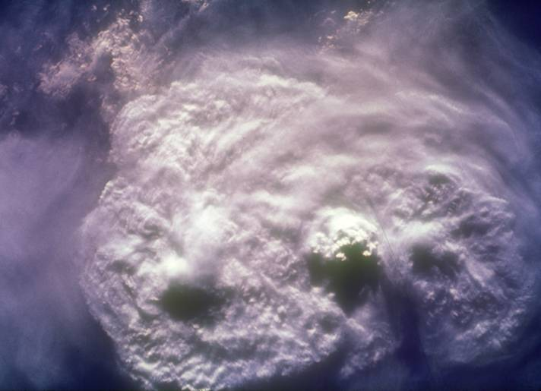
Cumulonimbus Clouds
As seen from Apollo 8

Slide 19
Watch for Cumulus Clouds
Steps:
1. Think "puffy" when you want to identify cumulus clouds.
2. Make a comparison to masses of cotton balls or piles of whipped cream.
3. Remember, cumulus clouds are the clouds we used to look at and imagine they were people, shapes, animals, etc.

Slide 20
Watch for Nimbus Clouds
Steps:
1. Think "rain" when you see nimbus clouds.
2. Remember, nimbus clouds can be stratus or cumulus.
3. Watch for stratus clouds to evolve into nimbostratus formations when low-level clouds shed rain.
4. Look for cumulonimbus clouds when thunderstorms begin to build.

Slide 21
Watch for Stratus and Cirrus Clouds
Steps:
1. Think "flat" when you're identifying stratus clouds.
2. Remember, high altitude cirrostratus clouds appear as thin, wispy sheets.
3. Look for stratus clouds at any altitude.
4. Look high into the sky for cirrus clouds.
5. Remember, cirrus clouds consist of moisture thrown up by distant storms and turned to ice.
6. Watch for thin, hair-like, disconnected wisps of clouds at altitudes above 18,000 feet.
7. Remember, stratus and cumulus clouds can occur at those same altitudes; these clouds are correctly identified as cirrostratus and cirrocumulus clouds.

Slide 22
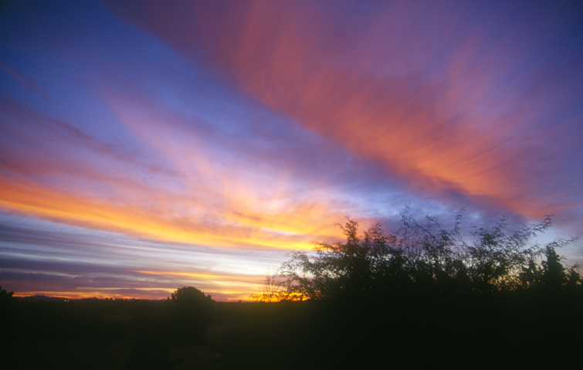
T H E E N D

