Slide 1

data Analytics Project
New deluxe book shop
Product analysis

Slide 2
IMPORTANCE OF DATA ANALYTICS
It helps in providing meaningful information for making better business decisions.
It helps in arriving at conclusions and proving the hypothesis.
It helps in organizing , representing,describing,evaluating and interpreting big data.
The main purpose of data analytics is to help a company or organization to give them a clear picture of their work progress.
Analytics relies on the simultaneous application of statistics, computer programming and operations research to quantify performance.

Slide 3
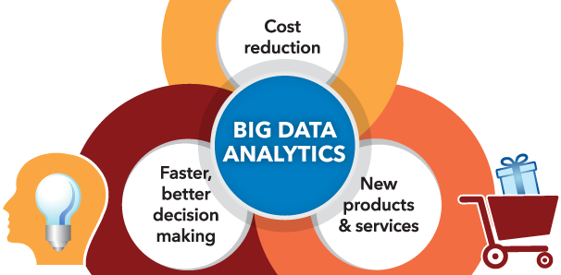
It helps to describe, predict, and improve business
performance.
It helps in exploring data in meaningful ways.

Slide 4
ABOUT THE PROJECT
This Project is based upon my own Bussiness.
In this Project firstly the data of my own shop and another shop has been collected.
Then the Wholesale rate, Retail rate and Net Profit of Every Product is being calculated.
After this the result has been shown on the basis of profit that whether a given shop has Excellent working skills or Average working skills.
Then the analysis is being done on the basis of profit earned by two shops in different products.
At the end for better understanding of Project different types of charts has been made i.e. bar chart, column chart etc.

Slide 5
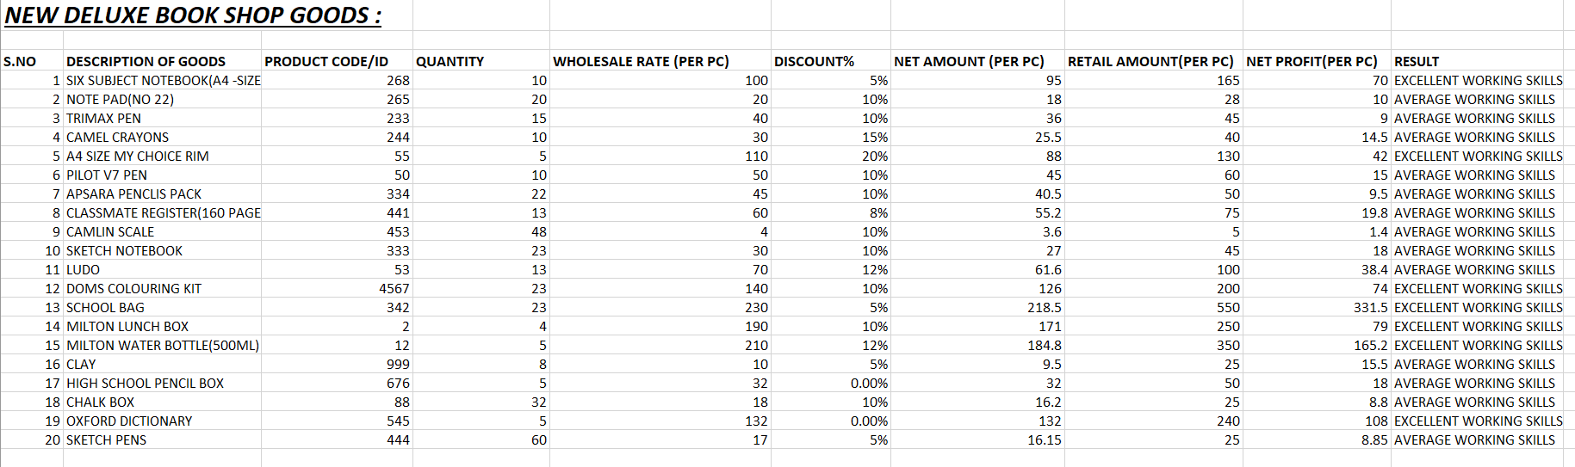
PREVIEW OF PROJECT Tables:

Slide 6
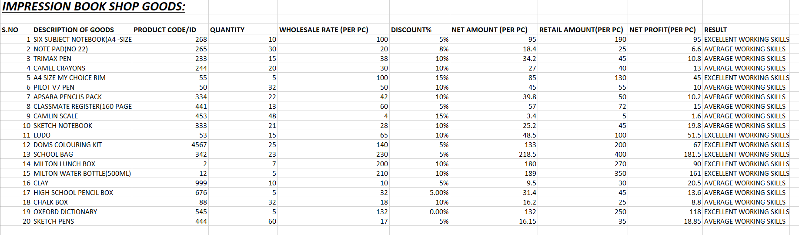

Slide 7
CHARTS Column Chart:

Slide 8
Pie chart:

Slide 9
Bar chart:

Slide 10
Line chart:
So with the analysis of data and help of charts ,it is easily identifiable that in some products New deluxe book shop has more profit and in some Impression book shop has more profit..

Slide 11
IMPORTANCE OF BOOKS
From my point of view, Books are very important because they show pathways in life . Books teaches people about society. Learning to Read is important it helps to develop the mind before computers were around many many decades ago.
For the majority of people, books are part of their everyday life. A book is like a best friend who will never walk away from you. Books are packed with knowledge, insights into a happy life, life lessons, love, fear, prayer and helpful advice.
Reading is important because it develops the mind. ... Understanding the written word is one way the mind grows in its ability. Teaching young children to read helps them develop their language skills. It also helps them learn to listen.

Slide 12

The main important feature of books is that they
help us not only in increasing our knowledge but
also plays a vital role in making our future more
bright and successful
“Padega India Tabhi Toh Badega India”

Slide 13

CONCLUSION:
Data analytics helps us in better understanding of the
business and helps us in getting best results for any problem
regarding any field .
At the end I want to say that with the help of data analytics we
can easily large amount of data and the growth of any company
or organization.
Hence, Data analytics
can be a “good future career”..
“THANK YOU”

