Slide 1
DATA ANALYTICS CASE STUDY
IPL Team
Performance
Analysis
A Data-Driven Approach to Understanding Batting, Bowling, and Winning Performance
[Your Name] · [Team member 2] · [Team member 3]
Python
Pandas
Matplotlib
Seaborn
SciPy
Notes:
OPENING (about 30 seconds). Introduce yourself and your team. Say: 'Our project asks a simple question: can ball-by-ball IPL data tell us why teams win, beyond just counting wins?' Mention the tools: Python with Pandas for data work, Matplotlib and Seaborn for charts, SciPy for hypothesis tests. Edit the names on this slide before presenting.

Slide 2
Business Problem and Objectives
01 · BUSINESS PROBLEM
The problem
1
How do franchises compare in batting and bowling?
2
Which innings phase is each team's strongest or weakest?
IPL franchises invest heavily in building squads. Wins and losses alone do not explain why a team succeeds or fails.
3
Do teams perform differently batting first versus chasing?
4
Which indicators separate winning from losing innings?
The objective
Use ball-by-ball data to find strengths, weaknesses and the indicators associated with winning.
5
How has scoring performance changed across seasons?
6
Can a transparent Team Performance Index evaluate franchises?
Notes:
ABOUT 60 SECONDS. Franchises spend crores at the auction, but wins and losses alone do not explain why a team succeeds or fails. A team can lose after a great batting display or win with an average one. Our objective: use ball-by-ball data to find strengths, weaknesses and the indicators linked with winning. Walk quickly through the six research questions; the rest of the talk answers them in order: comparison (Q1-3), hypothesis tests (Q4), seasons (Q5), and the Performance Index (Q6).

Slide 3
Dataset Understanding
02 · DATA UNDERSTANDING
deliveries.csv
matches.csv
PRIMARY SOURCE · ~260,000 rows × 17 columns
CONTEXT ONLY · ~1,100 rows × 20 columns
Match and innings identifiers
Batting and bowling teams
Over and ball-level run information
Extras (wides, no-balls, byes…)
Wickets and dismissal types
Match date and season
Winning team
Venue information
Used to label every innings as a win or a loss
match_id = id
Merged working table: every ball + season, winner and venue
Ball-by-ball data is the primary source for team metrics; match data supplies outcomes and context.
Notes:
ABOUT 45 SECONDS. Two files from the Kaggle IPL Complete Dataset by Patrick B. deliveries.csv is the main dataset: one row per ball, roughly 260,000 rows and 17 columns. Every team metric comes from it. matches.csv has about 1,100 rows and 20 columns and gives context only: season, winner, venue. They are joined on match_id in deliveries equal to id in matches, which gives one working ball-by-ball table. Key message: the ball-by-ball file tells us HOW teams played; the matches file tells us whether they WON.

Slide 4
Data Cleaning and Feature Engineering
02 · DATA PREPARATION
POWERPLAY
overs 1–6
MIDDLE OVERS
overs 7–16
DEATH
overs 17–20
Cleaning
Feature engineering
Standardise franchise names across seasons
Convert match dates into season years
Remove duplicate delivery rows
Standardise over numbering to 0–19
Exclude super overs and matches with no winner
Merge match context into every delivery
Legal ball (excludes wides and no-balls)
Bowler runs (excludes byes, leg-byes, penalty)
Dot-ball and boundary flags
Bowler-credited wickets (excludes run-outs, retirements)
Innings phase: powerplay, middle, death
Notes:
ABOUT 75 SECONDS. Start with the timeline: we split every innings into three phases because cricket is not played at an even pace. Powerplay is overs 1 to 6, middle overs are 7 to 16, death overs are 17 to 20. Then the cleaning: franchises renamed over the years are unified (for example Delhi Daredevils to Delhi Capitals), dates become season years, duplicate rows are removed, overs are standardised to 0-19, super overs and no-result matches are excluded so every innings can be labelled win or loss. Finally the features: a legal-ball flag because wides and no-balls are not counted in the six balls of an over; bowler-runs because byes and leg-byes are not charged to the bowler; dot-ball and boundary flags; and bowler-credited wickets, which exclude run-outs and retirements.

Slide 5
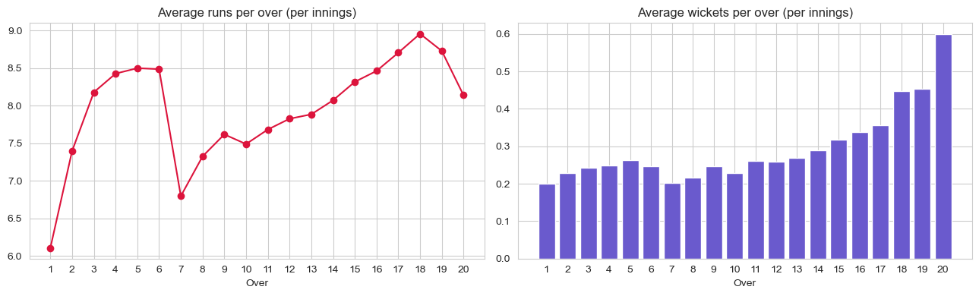
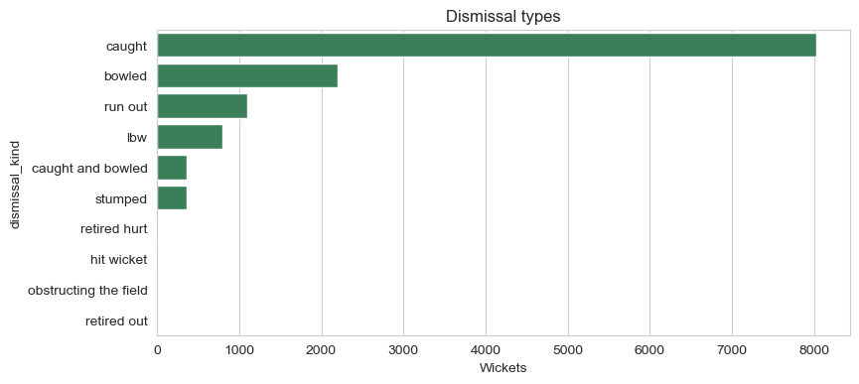
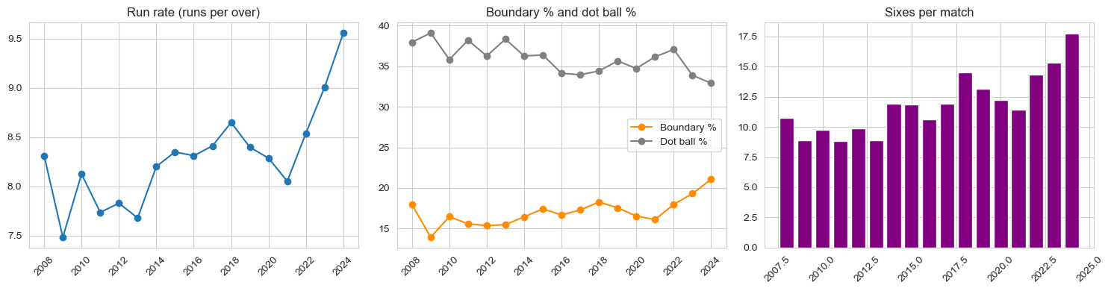
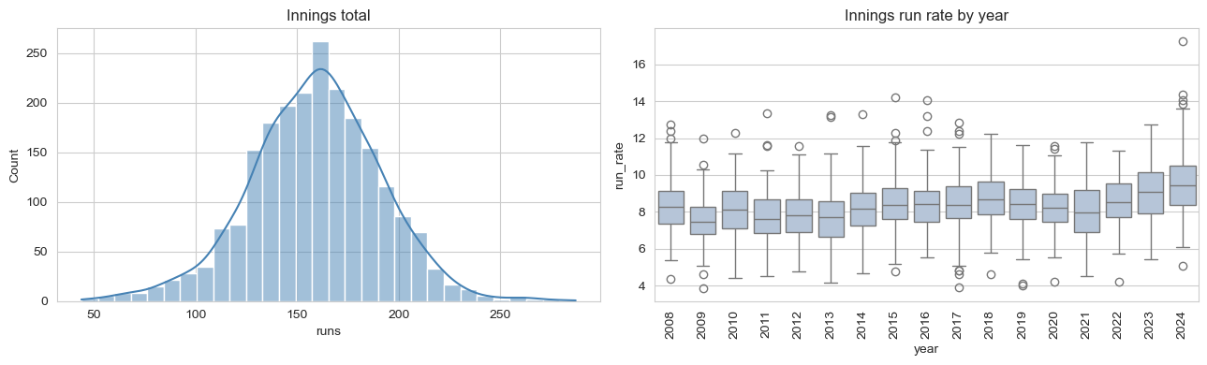
Exploratory Data Analysis
03 · EXPLORATORY ANALYSIS
Runs per over rise through the powerplay and peak near over 18; wickets are most frequent in over 20. Phase run rates: 7.85 / 7.90 / 10.23.
Caught is by far the most common dismissal (about 8,000 of 12,893 wickets), then bowled and run out.
Run rate rose from 8.31 (2008) to 9.56 (2024); sixes per match from 10.74 to 17.76.
Innings totals centre near 160 runs; run-rate medians are higher in 2023 and 2024.
Notes:
ABOUT 75 SECONDS. Four views of the 260,269 balls (250,845 legal) in the cleaned data: 346,797 runs, 12,893 wickets, 29,770 fours, 13,009 sixes, an overall run rate of 8.30 and 36.0% dot balls. Top left: runs per over start low (about 6.1 in over 1), climb through the powerplay, dip at over 7, then rise to a peak around over 18; wickets per over are highest in over 20. By phase, the run rate is 7.85 in the powerplay, 7.90 in the middle and 10.23 in the death overs, and a wicket falls every 10.9 balls in the death versus 22 to 25 balls earlier. Top right: caught is by far the most common dismissal (about 8,000 of 12,893), then bowled and run out. Bottom left: run rate rose from 8.31 in 2008 to 9.56 in 2024 and sixes per match from 10.74 to 17.76. Bottom right: innings totals centre around 160 and the run-rate box plots rise in the latest seasons.

Slide 6
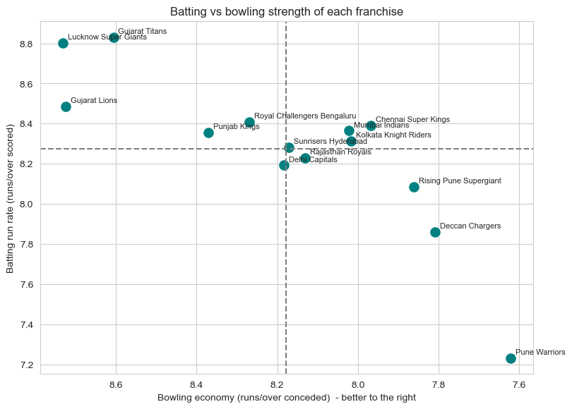
Comparing IPL Teams
04 · TEAM COMPARISON
Batting metrics
Batting run rate
Runs per wicket
Boundary %
Dot-ball %
Run rate by phase
Bowling metrics
Economy
Strike rate (balls per wicket)
Dot-ball % bowled
Wides + no-balls per over
Economy by phase
Higher run rate = faster scoring
Lower economy = fewer runs conceded
Best profile: high scoring + low economy (top-right, x-axis reversed)
Notes:
ABOUT 60 SECONDS. We compare franchises on two sides. Batting: run rate, runs per wicket, boundary percentage, dot-ball percentage and run rate by phase. Bowling: economy, strike rate (balls per bowler-credited wicket), dot-ball percentage bowled, wides plus no-balls per over, and economy by phase. Only franchises with at least 30 matches are included. The scatter plot is from notebook section 4.1, with 14 franchises that played at least 30 matches. How to read it: the x-axis is flipped, so teams further RIGHT have lower (better) economy and teams higher UP score faster. The best profile is high scoring AND low economy, which is the top-right corner once the axis is flipped. Point to the teams in that corner and to teams that are strong in only one discipline, using the chart on screen.

Slide 7
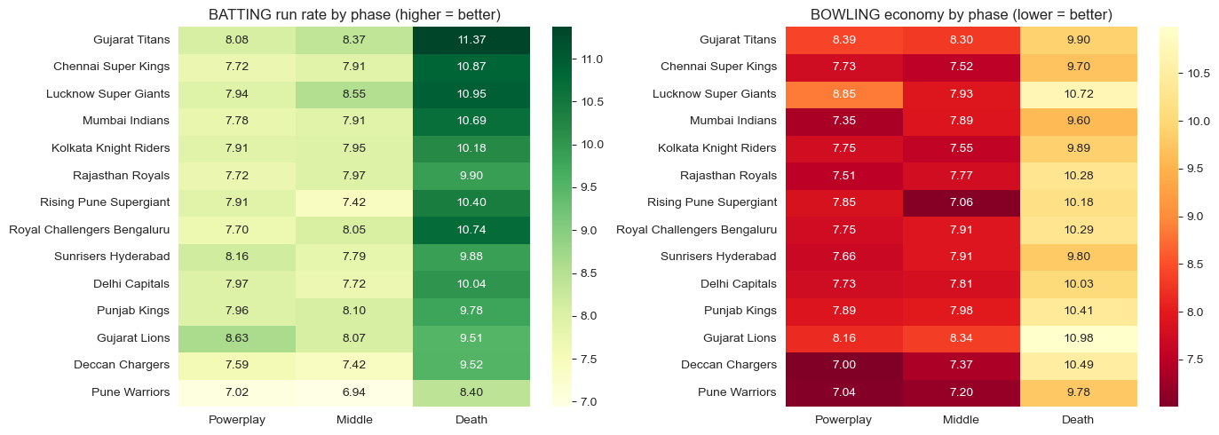
Phase-Wise Performance Analysis
04 · TEAM COMPARISON
Scores fast
Restricts runs
Why death overs
Tactical use
Powerplay: Gujarat Lions 8.63
Death: Gujarat Titans 11.37
Powerplay: Deccan Chargers 7.00
Death: Mumbai Indians 9.60
League run rate 10.23 vs 7.85–7.90 earlier; a wicket every 10.9 balls
Match bowlers and finishers to the phase where a rival is weakest
Notes:
ABOUT 75 SECONDS. Left heatmap: batting run rate by phase, higher is better. Right heatmap: bowling economy by phase, lower is better. Fourteen franchises with at least 30 matches. Batting: Gujarat Lions have the highest powerplay run rate (8.63, from only 30 matches) and Gujarat Titans the highest death-over run rate (11.37). Bowling: Deccan Chargers have the lowest powerplay economy (7.00) and Mumbai Indians the lowest death-over economy (9.60). Why death overs matter: the league-wide run rate is 10.23 in the death versus 7.85 and 7.90 earlier, and a wicket falls every 10.9 balls, so batting and bowling skill there swings results. Tactical point: match bowlers and finishers to the phase where a rival is weakest. Mention that Gujarat Lions, Rising Pune Supergiant (30 matches each) are small samples.

Slide 8
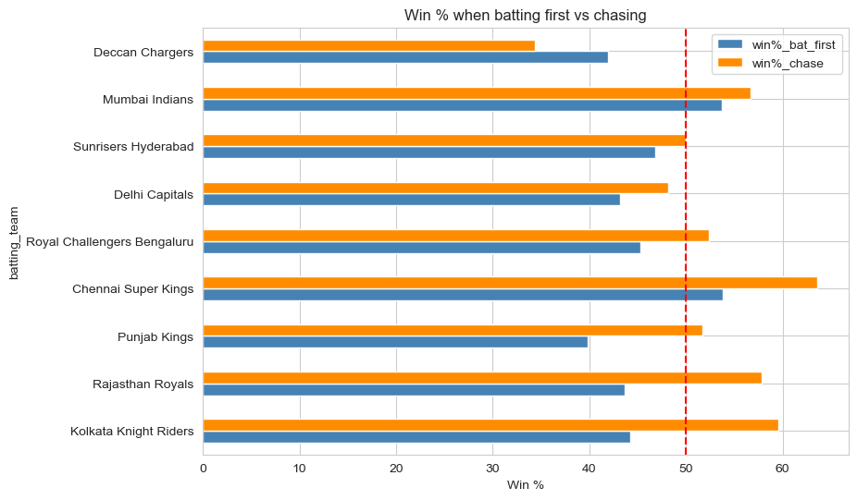
Batting First Versus Chasing
04 · TEAM COMPARISON
Biggest chasing edge
Kolkata Knight Riders: 59.5% chasing vs 44.2% batting first (+15.4 pts)
Biggest defending edge
Deccan Chargers: 41.9% batting first vs 34.4% chasing (+7.5 pts)
Preparation
A large gap flags a role-specific weakness: practise defending totals and chasing targets separately
Gap = win % chasing − win % batting first. Teams with ≥30 batting-first innings.
Notes:
ABOUT 60 SECONDS. Win percentage when batting first versus chasing for the nine franchises with at least 30 batting-first innings; the red dashed line marks 50 percent. The gap is chase win percentage minus bat-first win percentage. Kolkata Knight Riders have the largest chasing edge: 59.5 percent when chasing versus 44.2 batting first, a gap of 15.4 points. Rajasthan Royals (+14.1) and Punjab Kings (+11.9) follow. Deccan Chargers are the only team better at defending: 41.9 batting first versus 34.4 chasing, a gap of minus 7.5. Chennai Super Kings are strong in both roles (53.8 and 63.6). Statistically, the average run rate does not differ between the two innings (H3, p = 0.23), so the gaps are about winning, not scoring pace. Practical message: prepare separately for defending and chasing.

Slide 9
Statistical Hypothesis Testing
05 · HYPOTHESIS TESTING
H1
Winning and losing innings differ in mean run rate
Welch t-test
Reading the tests
H0: no real difference. H1: there is one.
p-value: how likely a gap this large is if H0 were true.
α = 0.05: p below it → reject H0.
Cohen's d: how big the gap is, not just whether it exists.
H2
Winning and losing innings differ in dot-ball %
Welch t-test
H3
Mean run rate differs between 1st and 2nd innings
Welch t-test
H4
Losing 3+ powerplay wickets is associated with the match result
Chi-square
H5
Mean run rate differs: 2008–2015 vs 2016 onwards
Welch t-test
H6
Mean run rate differs across franchises (≥100 innings)
One-way ANOVA
H7
Winner–loser run-rate gap by phase (PP / middle / death)
Welch t + Cohen's d
Notes:
ABOUT 75 SECONDS. Why test? A chart can show a difference, but only a test tells us whether it is bigger than chance. We use alpha = 0.05 and the innings as the unit of analysis, each labelled win or loss. Read the seven hypotheses on the left. Welch's t-test compares two means without assuming equal variances (H1, H2, H3, H5). Chi-square tests whether two categories are linked, here powerplay collapse versus result (H4). ANOVA compares many group means at once, here franchises with at least 100 innings (H6). H7 repeats the winner-versus-loser comparison in each phase with Cohen's d. On the right: the null hypothesis says no real difference; the p-value is the chance of a gap this large if the null were true; below 0.05 we reject the null; and Cohen's d tells us how BIG the gap is, because with 2,180 innings even tiny gaps can be significant.

Slide 10
Hypothesis Testing Results
05 · HYPOTHESIS TESTING
Hypothesis | Test | Statistic | P-value | Decision (α = 0.05) | Business interpretation
H1 Run rate: win vs loss | Welch t-test | t = 18.87; d = 0.81 | < 0.001 | Reject H0 | Winners: 8.89 vs 7.74 runs/over
H2 Dot-ball %: win vs loss | Welch t-test | t = −12.81; d = −0.55 | < 0.001 | Reject H0 | Winners: 34.1% dots vs 38.0%
H3 Run rate: 1st vs 2nd inns | Welch t-test | t = 1.19; d = 0.05 | 0.233 | Fail to reject H0 | No clear pace gap: 8.36 vs 8.28
H4 3+ PP wickets vs result | Chi-square | χ² = 107.57; dof = 1 | < 0.001 | Reject H0 | 3+ PP wkts: 24.7% wins vs 54.9%
H5 Run rate: 2008–15 vs 2016+ | Welch t-test | t = −10.03; d = −0.43 | < 0.001 | Reject H0 | Pace rose: 7.97 → 8.62 runs/over
H6 Run rate across franchises | One-way ANOVA | F = 0.62 | 0.739 | Fail to reject H0 | Franchises within normal variation
H7 Gap by phase (PP/Mid/Death) | Welch t + d | d = 0.47 / 0.58 / 0.73 | < 0.001 ×3 | Reject H0 (all 3) | Death overs gap largest: +2.49
Decision rule: p < 0.05 → evidence supports rejecting H0. p ≥ 0.05 → fail to reject H0.
Significant ≠ important: with 2,180 innings, read Cohen's d. H1 d = 0.81 is large; H5 d = −0.43 is small to medium.
d = Cohen's d. Notebook p-values printed as 0.000000 are shown as < 0.001. H7 p-values: powerplay, middle, death.
Notes:
ABOUT 75 SECONDS. These are the notebook's printed results (alpha = 0.05; 2,180 innings, 1,090 wins and 1,090 losses). H1: winning innings score 8.89 runs per over versus 7.74 in losses, t = 18.87, Cohen's d = 0.81, a large effect; reject H0. H2: dot-ball share is 34.1 percent in wins versus 38.0 in losses, t = minus 12.81, d = minus 0.55, a medium effect; reject H0. H3: first innings 8.36 versus second 8.28, t = 1.19, p = 0.233; we fail to reject H0, so there is no evidence of a pace difference. H4: chi-square = 107.57, p below 0.001; teams that lost 3 or more powerplay wickets won 24.7 percent versus 54.9 percent otherwise. H5: 7.97 in 2008 to 2015 versus 8.62 from 2016, t = minus 10.03, d = minus 0.43, small to medium; reject H0. H6: ANOVA across 8 franchises, F = 0.62, p = 0.739; fail to reject, franchise batting run rates are within normal variation. H7: winner-versus-loser gaps are 0.96 in the powerplay, 1.03 in the middle and 2.49 runs per over in the death; Cohen's d is 0.47, 0.58 and 0.73, so the death overs separate winners most. The notebook prints p-values below 0.000001 as 0.000000, shown here as less than 0.001. Rule: p below 0.05 means the evidence supports rejecting H0; p of 0.05 or more means we fail to reject it. Remind the audience that the two innings of a match are not independent, so p-values are approximate.

Slide 11
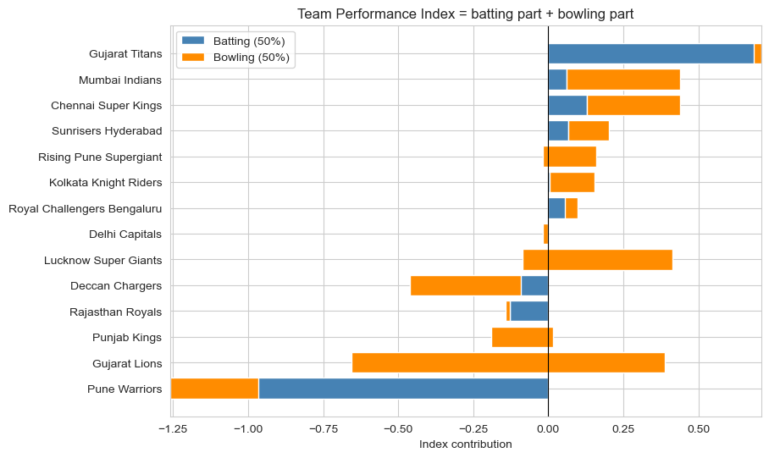
Team Performance Index
06 · TEAM PERFORMANCE INDEX
1 Standardise: convert metrics to z-scores; reverse lower-is-better metrics so + always means stronger.
2 Batting Index
2 Bowling Index
Batting run rate
Powerplay run rate
Death run rate
Boundary %
Dot-ball % (reversed)
Economy (reversed)
Strike rate (reversed)
Powerplay econ. (reversed)
Death econ. (reversed)
Dot-ball % bowled
Performance Index = 50% Batting + 50% Bowling · rule-based, no ML
Gujarat Titans · Elite, Batting-led · Index +0.68
Strengths: avoiding dot balls (+2.11), death-over batting (+1.65)
Weaknesses: powerplay bowling (−1.33), overall economy (−1.32)
3 Tier | Performance Index
Elite | ≥ 0.50
Strong | 0.15 to < 0.50
Average | −0.15 to < 0.15
Struggling | < −0.15
Profile: batting − bowling > 0.3 → batting-led; < −0.3 → bowling-led; else balanced.
Notes:
ABOUT 90 SECONDS. This is the centrepiece. It is a transparent, rule-based index, NOT a trained machine-learning model, so every number can be explained to a coach. Step 1: convert each metric to a z-score, meaning how many standard deviations a team is above or below the average team, and flip the metrics where lower is better so that positive always means stronger. Step 2: Batting Index is the equal-weight average of five components, Bowling Index likewise, and the Performance Index is 50 percent batting plus 50 percent bowling. Step 3: tiers by fixed cut-offs: Elite at 0.50 or above, Strong 0.15 to 0.50, Average between minus 0.15 and 0.15, Struggling below minus 0.15. Profiles: if batting minus bowling is above 0.3 the team is batting-led, below minus 0.3 bowling-led, otherwise balanced. On the right: the contribution chart from the notebook and one real report card. Results for the 14 franchises with at least 30 matches: Gujarat Titans are the only Elite team (index 0.68, batting-led); Mumbai Indians and Chennai Super Kings (both 0.44), Sunrisers Hyderabad, Rising Pune Supergiant and Kolkata Knight Riders are Strong; Punjab Kings, Gujarat Lions and Pune Warriors are Struggling. Gujarat Titans' report card shows strong dot-ball avoidance and death-over batting but weak powerplay and overall bowling. Note that the chart draws the bowling part as a bar stacked after the batting part, exactly as in the notebook.

Slide 12
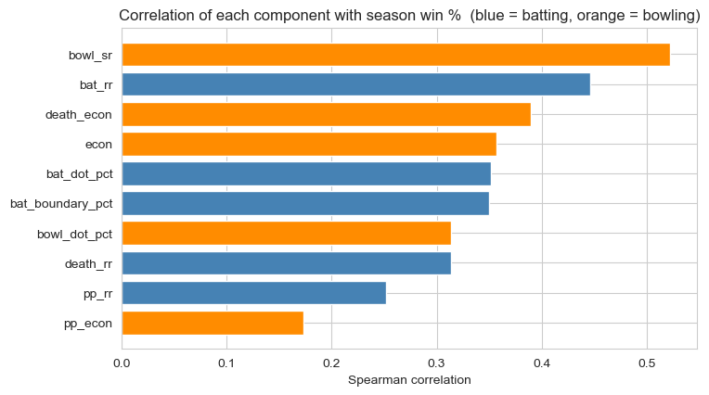
Does the Index Agree With Winning?
06 · TEAM PERFORMANCE INDEX
0.73
0.47
0.48
0.56
ρ Performance Index vs win %
ρ Batting Index vs win %
ρ Bowling Index vs win %
R² win % ~ batting + bowling
Tier | Avg win % | Team-seasons
Elite | 64.7 | 20
Strong | 56.1 | 40
Average | 48.9 | 32
Struggling | 38.8 | 54
Index is standardised within each season and never uses the win/loss column. Win % rises with tier, but correlation ≠ causation.
Component vs season win % · blue = batting, orange = bowling
Notes:
ABOUT 75 SECONDS. Validation logic: the index is built only from ball-by-ball statistics and never sees the win-loss column, so agreement with win percentage is real evidence it measures performance. We built it for 146 team-seasons with at least eight matches, standardised within each season, and compared with that season's win percentage. Spearman rho is 0.73 for the Performance Index, 0.47 for the Batting Index and 0.48 for the Bowling Index; a regression of win percentage on the two sub-indices gives R-squared 0.56 (win % = 49.3 + 9.7 x batting + 11.2 x bowling), so bowling carries slightly more weight than batting. Tier check: Elite team-seasons averaged 64.7 percent wins (20 team-seasons), Strong 56.1 (40), Average 48.9 (32) and Struggling 38.8 (54). The chart shows the Spearman correlation of each component with win percentage: bowling strike rate (0.52) and overall batting run rate (0.45) are highest, powerplay economy (0.17) lowest. Caution: correlation does not prove causation, and individual team-seasons are small samples.

Slide 13
Key Business Insights
07 · BUSINESS INSIGHTS
1
2
3
Winning innings tend to score faster, with fewer dot balls (H1, H2)
Powerplay collapses can be associated with worse results (H4)
Scoring and boundary patterns change across seasons (H5)
Evidence: Run rate: wins 8.89 vs losses 7.74; dot %: 34.1 vs 38.0
Evidence: Win % with 3+ PP wickets lost: 24.7% vs 54.9% otherwise
Evidence: Run rate 2008–15: 7.97 vs 2016+: 8.62; sixes per match 10.74 (2008) → 17.76 (2024)
4
5
6
Teams have different batting and bowling strengths
Performance differs across innings phases and roles
The Index gives an interpretable team-season comparison
Evidence: 4 batting-led, 5 bowling-led, 5 balanced; but H6 franchise run rates are not significantly different (p = 0.739)
Evidence: Largest chase edge: Kolkata Knight Riders (+15.4 pts); best death batting: Gujarat Titans (11.37)
Evidence: Spearman ρ = 0.73; Elite avg win % 64.7 vs Struggling 38.8
Notes:
ABOUT 75 SECONDS. Six insights, each tied to a number. Every evidence line comes from the notebook's printed output. Note insight 4: teams show different batting and bowling profiles, but the ANOVA found no significant difference in batting run rate across the 8 largest franchises, so say 'profiles differ' rather than 'run rates differ'. Cover insights 1 and 2 quickly (winners and powerplay collapses), then 3 to 5 as 'how teams and seasons differ', and spend the most time on insight 6, the Performance Index, since it is the project's main contribution.

Slide 14
Recommendations and Limitations
08 · RECOMMENDATIONS
Recommendations
Limitations
Future scope
Use report cards to find the weakest metrics
Aim auction spend at identified gaps
Protect the powerplay; cut dot balls
Strengthen death-over batting or bowling
Prepare separately for defending and chasing
Track the index every season
Equal weights are a judgement call
Small team-season samples
Squads change every auction
Innings of one match are not independent, so p-values are approximate
Venue, pitch, toss and opposition not adjusted
Batter- and bowler-level analysis
Adjust for venue and pitch
Ball-by-ball win-probability model
Test alternative index weights
Notes:
ABOUT 60 SECONDS. Left: what franchises should do. Use the team report cards to find the weakest metric, aim auction spend at it, protect the powerplay and reduce dot balls, strengthen death-over batting or bowling where needed, prepare separately for defending and chasing, and track the index every season. Middle: be upfront about limitations. Equal weights are a judgement call, team-season samples are small, squads change at every auction, the two innings of a match are not independent so p-values are approximate, and venue, pitch, toss and opposition are not fully adjusted. Right: future scope: player-level analysis, venue and pitch adjustment, a ball-by-ball win-probability model, and alternative index weightings. Recommendations are interpretations of the findings, not proven causal effects.

Slide 15
Conclusion and Q&A
09 · CONCLUSION
Ball-by-ball IPL data can be converted into actionable team performance metrics.
Comprehensive comparisons
Thank You
1
Batting and bowling metrics by franchise and innings phase
Questions?
Statistical investigation
2
Seven hypothesis tests on what differs in winning innings
Transparent Performance Index
3
A rule-based score that reveals each team's strengths and gaps
Notes:
ABOUT 45 SECONDS, THEN QUESTIONS. Close the loop: we started with 'win and loss alone do not explain performance' and showed that ball-by-ball data can be converted into actionable team metrics. Three contributions: first, comprehensive batting and bowling comparisons by franchise and phase; second, a statistical investigation of what differs between winning and losing innings; third, a transparent Team Performance Index that shows each team's strengths and weaknesses. Say thank you and invite questions. Likely questions: why equal weights; why Welch's test; why not machine learning; are p-values reliable given non-independent innings; what would you add next (venue adjustment, player-level analysis).

