Slide 1
AIRLINE RESERVATION SYSTEM
Ayush Agrawal, Rajat Agarwal, Pavan Bykampadi

Slide 2
Introduction
The Airline Reservation System (AIRS) is an interface for users and airlines to interact and connect to each other.
Convenient for both airlines and consumers to discover each other, providing a single platform for users to book flights across airlines.
Program for a consumers who wish to book air travel tickets to and from their favorite destinations.
Helps airlines manage their flight logistics and schedules across destinations.

Slide 3
Functionality:
Users can search for their required flights, getting complete information about them
They can further view their bookings, and cancel if required
Airlines can add new, delete old and view all information about current flights.

Slide 4
Concepts Used:
Pre-Processor Directives
Structures
Functions
Arrays
Loops

Slide 5
Functions Defined In The Program
front_page()
preset_vals()
password()
drawline()
header()
table_header()
table_line()
display_flights()
add_flight()
del_flight()
bookings()
status()
pay()
confirmation()
search()
userf()
admin()
main()

Slide 6
Header Files Used
iostream
stdio.h
stdlib.h
iomanip
conio.h
process.h
string.h

Slide 7
Structures Defined
Date
Flight
User

Slide 8
Flow Chart
User menu and functions
User
START
Enter log in credentials
User or Admin
Log out?
STOP
Admin
Admin menu and functions

Slide 9
User:
Input menu option:
Book
View Bookings
Exit
Logout?
Login
Yes
STOP
No
Menu option:
2
1
Input Search Criterion
Display Bookings
Display results
Exit/
Cancel
Exit
Cancel
Confirm, Book and Pay
Cancel Booking

Slide 10
Admin:
Input menu option:
Add flight
Delete flight
Display all flights
Exit
Login
Logout?
Yes
STOP
No
Menu option:
1
2
Input Flight Details
3
Display All flights
Display All flights
Create Flight
Input flight to be deleted
Delete Flight

Slide 11
Key Takeaways
Teamwork
Effective time management
Patiently correcting errors

Slide 12
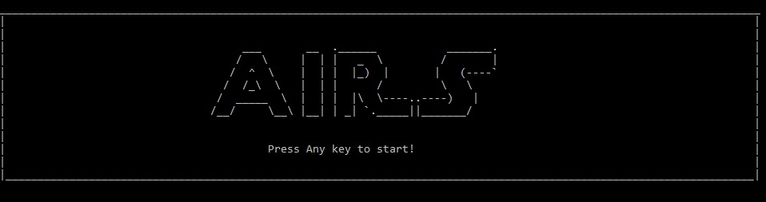
Screenshots

Slide 13
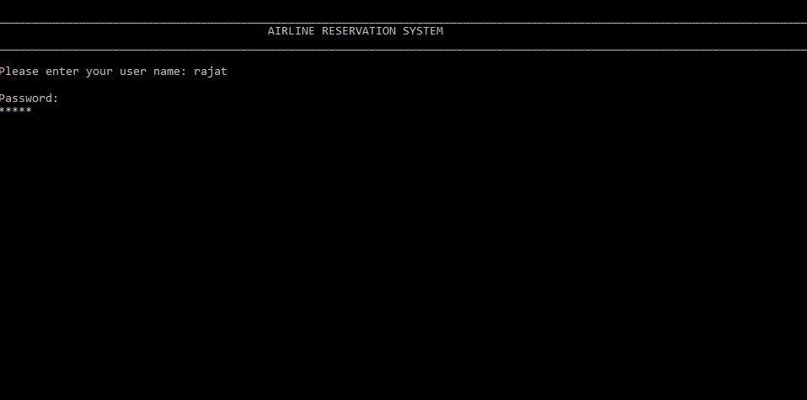

Slide 14
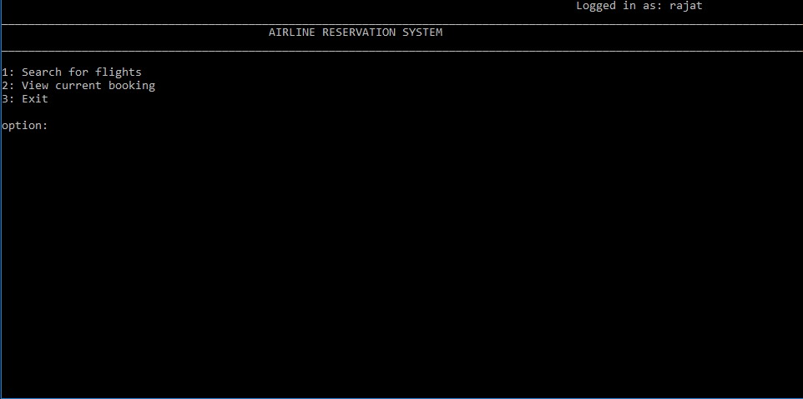

Slide 15
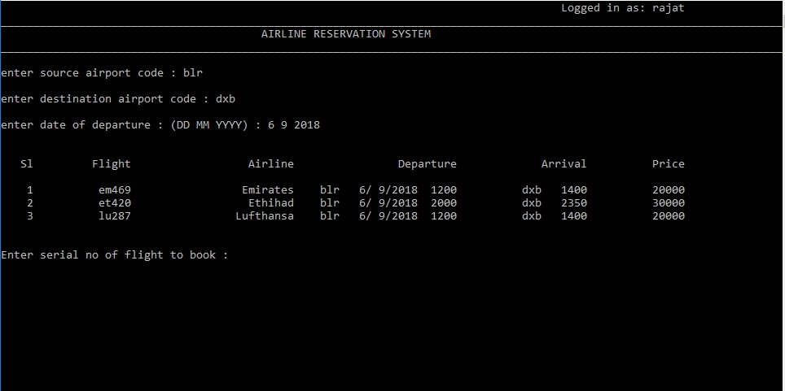

Slide 16
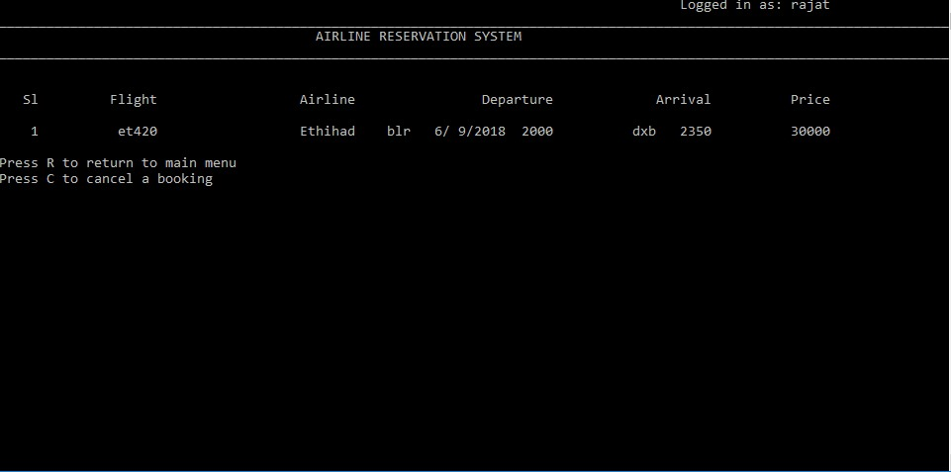

Slide 17
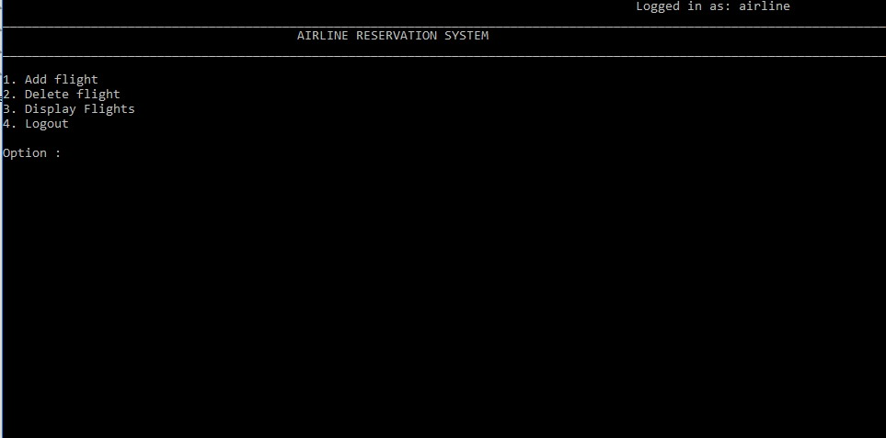

Slide 18
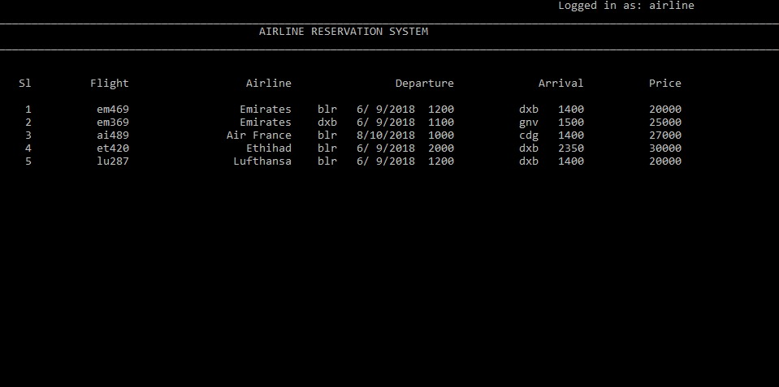

Slide 19
Thank You

