Slide 1
INTELLIGENT INSURANCE PLATFORM
Underwriting, Claims, Fraud & Risk—Unified by AI
A single real-time platform for premium estimation, claims triage, fraud detection
and policy churn prediction — powered by Snowflake Cortex AI Agents.
H
A
L
Ho
Health
Auto
Life
Home
Snowflake Cortex Analyst • Cortex Agents • Semantic Views

Slide 2
THE CHALLENGE
Insurers Are Flying Blind Across the Policy Lifecycle
Premium pricing, claims handling, fraud review and retention are run as separate, manual, backward-looking processes — across Health, Auto, Life and Home lines alike.
!
Inconsistent Underwriting
Premiums are estimated with manual, rule-of-thumb judgment instead of consistent, data-driven multi-factor pricing.
!
Reactive Claims Handling
Claims and fraud signals are reviewed after the fact, slowing approvals and letting fraud losses slip through.
!
Undetected Policy Churn
At-risk customers aren't flagged until they've already cancelled — retention offers come too late, if at all.
!
Decisions on Stale Data
Leadership works from periodic reports, not real-time portfolio, loss-ratio and revenue visibility.
The fix: one platform that unifies pricing, claims, fraud and retention — with real-time analytics and predictive AI built in.
2

Slide 3
THE SOLUTION
One Platform, Four Connected Modules
A Streamlit app running on Snowflake, reading live data from a single governed database. Each module pairs its own workflow with an AI agent grounded in a shared semantic layer — so every answer, chart and quote comes from the same source of truth.
A
$
C
R
Executive Analytics
Premium Calculator
Claims Processing
Churn & Risk Engine
Real-time portfolio KPIs, revenue & loss-ratio trends
Multi-factor, risk-adjusted pricing in seconds
Fraud-aware triage with a full audit trail
At-risk policies with recommended retention actions
Underpinned by: INSURANCE_MGMT_SYSTEM database • 2 semantic views • 3 Cortex AI agents
3

Slide 4
THE DATA FOUNDATION
INSURANCE_MGMT_SYSTEM Database
4
14
2,235+
4
SCHEMAS
TABLES
ROWS
PRODUCT LINES
Schema | Purpose | Tables | Rows
CORE | Master data — customers, policies, claims, agents | 4 | 975
ANALYTICS | KPIs, trends, loss ratios, fraud alerts | 4 | 158
RISK | Churn predictions, at-risk policies, risk factors | 3 | 505
PREMIUM | Premium calculations, rating factors, plan tiers | 3 | 597
KEY TABLES
• CUSTOMERS (250) — demographics, income, credit score, BMI, smoking status
• POLICIES (300) — type, tier, premium, coverage, deductible, loss ratio
• CLAIMS (400) — amount, status, fraud score, priority, resolution time
• CHURN_PREDICTIONS (300) — churn probability, confidence, top risk factors
• AT_RISK_POLICIES (165) — risk score, revenue at risk, retention actions
• FRAUD_ALERTS (50) — fraud type, confidence score, amount saved
Relationships: CLAIMS → CUSTOMERS (via CUSTOMER_ID) • AT_RISK_POLICIES → POLICIES (via POLICY_ID)
4

Slide 5
SEMANTIC LAYER
INSURANCE_ANALYTICS_SV
INSURANCE_MGMT_SYSTEM.CORE • Extensions: Cortex Analyst, AI
Full insurance portfolio analytics — customers, policies, claims, financial trends, loss ratios and fraud detection across Health, Auto, Life and Home.
7
18
48
5
TABLES
FACTS
DIMENSIONS
VERIFIED QUERIES
KEY METRICS (FACTS)
PRE-BUILT VERIFIED QUERIES
Revenue:
PREMIUM_AMOUNT, COVERAGE_AMOUNT, TOTAL_PREMIUM_REVENUE, TOTAL_PAYOUT
• Total revenue and retention rate by policy type
Claims:
CLAIM_AMOUNT, APPROVED_AMOUNT, AVG_CLAIM_AMOUNT, APPROVAL_RATE
• Top 10 customers by total claims amount
Risk:
FRAUD_SCORE, LOSS_RATIO, COMBINED_RATIO, EXPENSE_RATIO
• Loss ratio trend by policy type over time
• Claims count and amount by status
Customer:
ANNUAL_INCOME, BMI, CUSTOMER_SATISFACTION, CONFIDENCE_SCORE
• Most common fraud types and money saved
Used by: Executive Insights Agent • Claims Triage Agent
Source tables: CUSTOMERS • POLICIES • CLAIMS • POLICY_TRENDS • CLAIMS_KPI • LOSS_RATIO_HISTORY • FRAUD_ALERTS
5

Slide 6
SEMANTIC LAYER
CHURN_RISK_SV
INSURANCE_MGMT_SYSTEM.RISK • Extensions: Cortex Analyst, AI
Churn risk analytics for policy retention — at-risk policy identification, churn predictions with confidence scores, risk-factor analysis and recommended retention actions.
4
11
30
3
TABLES
FACTS
DIMENSIONS
VERIFIED QUERIES
KEY METRICS (FACTS)
PRE-BUILT VERIFIED QUERIES
Churn:
CHURN_PROBABILITY, CONFIDENCE_SCORE, RISK_SCORE
• Churn risk breakdown by policy type and risk category
Financial:
REVENUE_AT_RISK, PREMIUM_AMOUNT, COVERAGE_AMOUNT
• Most common risk factors driving churn
Thresholds:
WEIGHT, THRESHOLD_LOW, THRESHOLD_MEDIUM, THRESHOLD_HIGH
• Policies with churn probability above 70%
Used by: Retention Agent
Source tables: AT_RISK_POLICIES • CHURN_PREDICTIONS • RISK_FACTORS • POLICIES
6

Slide 7
A
Executive Analytics
MODULE 1 / 4
WHAT IT DOES
Real-time portfolio KPIs — GWP, loss ratio, combined ratio, retention & growth
UNDER THE HOOD
DATA USED
ANALYTICS schema: POLICY_TRENDS, CLAIMS_KPI, FRAUD_ALERTS, LOSS_RATIO_HISTORY
CORE.CUSTOMERS (for demographics)
Revenue vs. claims trend, product mix, loss-ratio and policy-growth charts
SEMANTIC VIEW
Customer demographic and income breakdowns by age bracket
INSURANCE_ANALYTICS_SV
AI AGENT
One-click CSV, full-data CSV and PDF report export
Executive Insights Agent — answers portfolio questions in plain English
7

Slide 8
$
Premium Calculator
MODULE 2 / 4
WHAT IT DOES
Collects policy & underwriting inputs for Health, Auto, Life or Home
UNDER THE HOOD
DATA USED
CORE.CUSTOMERS (validation)
PREMIUM.PLAN_TIERS (base rates)
PREMIUM.PREMIUM_CALCULATIONS (audit log)
Validates the customer, then pulls the base rate for that product & tier
SEMANTIC VIEW
Applies a multi-factor formula — age, location, health, lifestyle, claims history
— not used (deterministic rules engine)
AI AGENT
Logs every quote to an audit trail, with a searchable quote history
— none — rules-based pricing, not agent-driven
8

Slide 9
C
Claims Processing & AI Triage
MODULE 3 / 4
WHAT IT DOES
Paginated claims queue, filterable by status
UNDER THE HOOD
DATA USED
CORE.CLAIMS (read on load, updated on every decision)
Surfaces fraud score, priority and claim amount at a glance
SEMANTIC VIEW
Approve, deny or escalate with a confirmation step and full audit trail
INSURANCE_ANALYTICS_SV
AI AGENT
Escalated claims are auto-flagged to the fraud unit
Claims Triage Agent — surfaces fraud patterns & high-priority claims
9

Slide 10
R
Churn & Risk Prediction Engine
MODULE 4 / 4
WHAT IT DOES
Flags at-risk policies with revenue-at-risk and churn probability
UNDER THE HOOD
DATA USED
RISK.AT_RISK_POLICIES, RISK.CHURN_PREDICTIONS
Breaks down risk by policy type, category and top contributing factors
SEMANTIC VIEW
Surfaces the highest-risk policies with a recommended retention action
CHURN_RISK_SV
AI AGENT
Tracks which retention offers actually worked
Retention Agent — recommends and explains retention actions
10

Slide 11
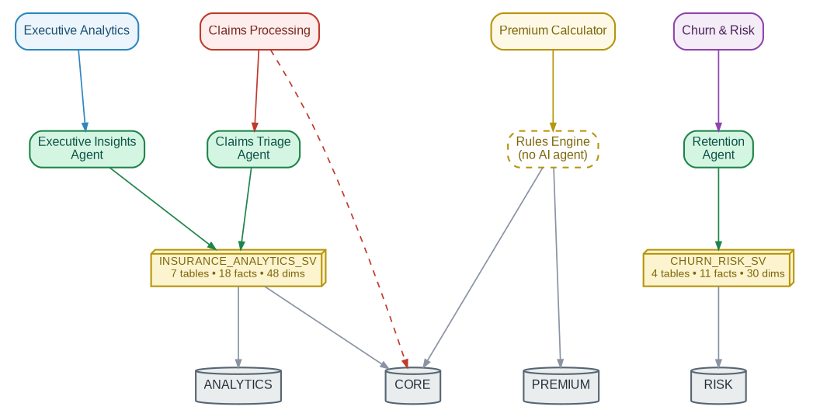
ARCHITECTURE
How It All Connects
Every module reads live data from one database. Three of the four also hand off to a Cortex AI agent — each grounded in a shared, governed semantic view, so the app and the AI never give different answers.
11

Slide 12
WHAT'S NEXT
Future Scope & Roadmap
01
02
Straight-Through Underwriting
New Product Lines
Auto-decision low-risk quotes instantly, no manual review needed.
Extend the same platform to Commercial, Travel and Pet insurance.
03
04
Real-Time Fraud Alerts
Usage-Based Pricing
Push notifications the moment a high-risk claim is filed, not after.
Fold in telematics and wearable data for dynamic, personalized premiums.
05
06
One Unified AI Assistant
Model Monitoring & Retraining
A single agent that orchestrates all four modules, not four separate ones.
Ongoing accuracy tracking for the churn and fraud models over time.
Thank you — Questions?
12

