Slide 1

URLNet
Learning a URL Representation with Deep Learning for Malicious URL Detection
Hung Le, Quang Pham, Doyen Sahoo, Steven C.H. Hoi
Presented By :
Rajat Singh (2020CSZ8507)
Purushottam Bairwa (2020MCS2464)

Slide 2


Overview
Problem in Nutshell
Malicious URL & harm
Goal
Current Malicious url Det. techniques
Disadvantage of current techniques
Proposed Approach and how it works
Features of url

Slide 3
Problem in nutshell
URL features to identify malicious Websites and links
  Without using context and content inside the link.
Different classes of URLs
  Benign, Spam, Phishing, Scam etc.
  For now, distinguish between Benign vs Malicious.

Slide 4
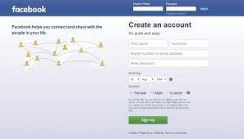
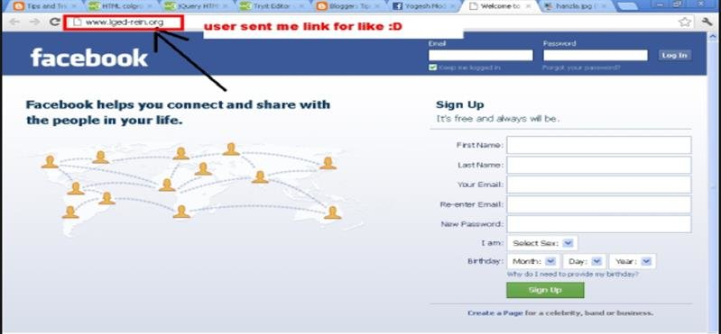
Malicious
Image Source : www.google.com

Slide 5

Malicious url and what they can do?
Malicious URL is a clickable link that leads users to a malicious or fraudulent webpage .
By clicking on such type of URL user can expose their system to various threats such as virus, trojans, ransomware and many other types of malwares.
The potential harm is so big that malicious links are considered one of the biggest threats to the digital world.

Slide 6
Goal:
Recently several efforts to perform malicious url detection mechanism based on the machine learning algorithm.
Most of the approaches used lexical properties of URL string by extracting bag of words features but these approaches suffer from several limitations.
To address these challenges, this paper introduced URLNet.

Slide 7
Malicious url techniques:
Traditionally detection of malicious url done through usage of blacklists which can not be exhaustive.
Recently, several efforts to perform malicious url detection using machine learning.
Most popular and scalable approaches use lexical properties of url string by extracting bag of words like features followed by applying SVM.

Slide 8
Disadvantages of current techniques:
Current techniques are not able to capture semantic meaning and sequential patterns in url.
Not able to handle unseen features
Requiring substantial manual feature engineering

Slide 9
Proposed approach:
-Deep learning based solution for malicious url detection.
-Character level and word level CNN’s used to detect the pattern
-Both character and word CNN’s together to remove some challenges
-This approach allow us to alleviate the shortcomings of traditional approaches.

Slide 10
Features:
-Lexical features
-Blacklist features
-Host-based features
-Content features
-context & popularity features

Slide 11
URLNet
Two major components of URLNet include:
Character-level CNN for Malicious URL Detection.
Word-level CNN for Malicious URL Detection

Slide 12

URLNet
Two major components of URLNet include:
Character-level CNN for Malicious URL Detection.
Word-level CNN for Malicious URL Detection
What is CNN ?
This Photo by Unknown Author is licensed under CC BY

Slide 13
CNN

Slide 14
CNN
CNN stands for Convolutional Neural Network.
CNN is most commonly applied to analyze visual images.
They have applications in following domain:
  Image and Video Recognition
  Recommender Systems
  Image Classification
  Image Segmentation
  Medical Image Analysis
  Natural Language Processing
  Brain-computer interfaces
  Financial Time series

