Slide 1
NKI MICCAI TASK 3
SURPRISINGLY SIMPLE APPROACH FOR CROSS MODAL CLASSIFICATION
TEAM DSIRE :
RAJAT SINGH, KUNAL DARGAN, SHIVANGI BITHEL

Slide 2
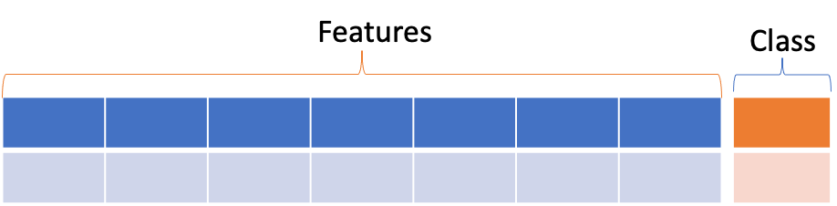
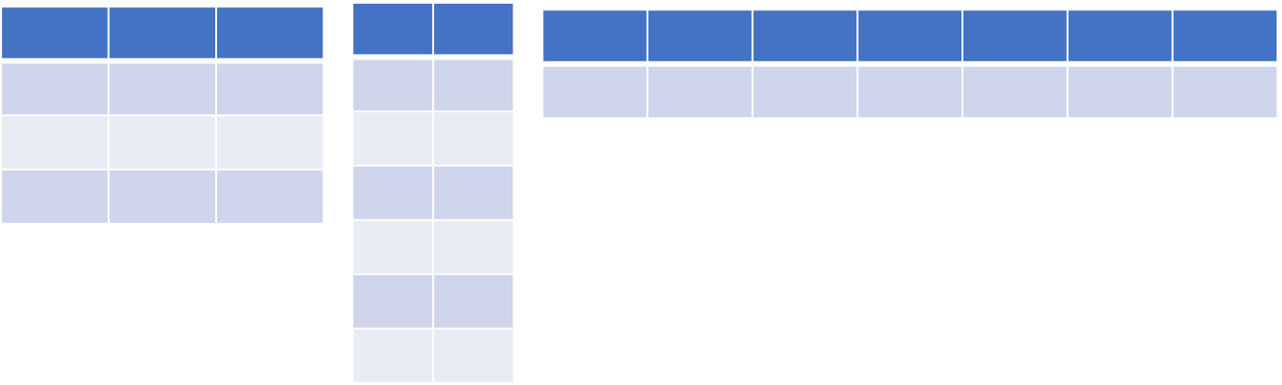
What ?
PROBLEM SETTING - INTEGRATED DIAGNOSTICS
In medical domain, AI models are trained using multimodal diagnostic datasets coming from longitudinal observations. In order to solve downstream tasks the most recent data integration methods/ frameworks are classified into five different integration strategies: early, mixed, intermediate, late and hierarchical.
TABLE1
TABLE2
TABLE3

Slide 3
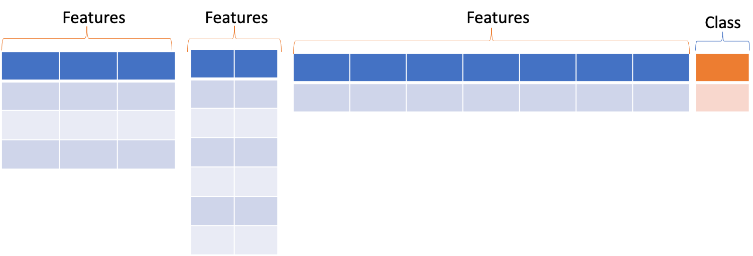
What ?
CLASSIFICATION TASK :
Outcome of the risks is independent class Risk1, Risk2, Risk3
Whereas Tables T1,T2,T3 represent a common underlying medical phenomenon ie, readings of multiple tests which can be correlated.
 | risk_1 | risk_2 | risk_3
PT00003 | True | False | True

Slide 4
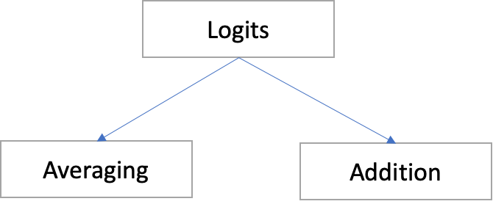
ISSUES :Simple Integration Strategies
Logits
Feature Vector Concatenation

Slide 5
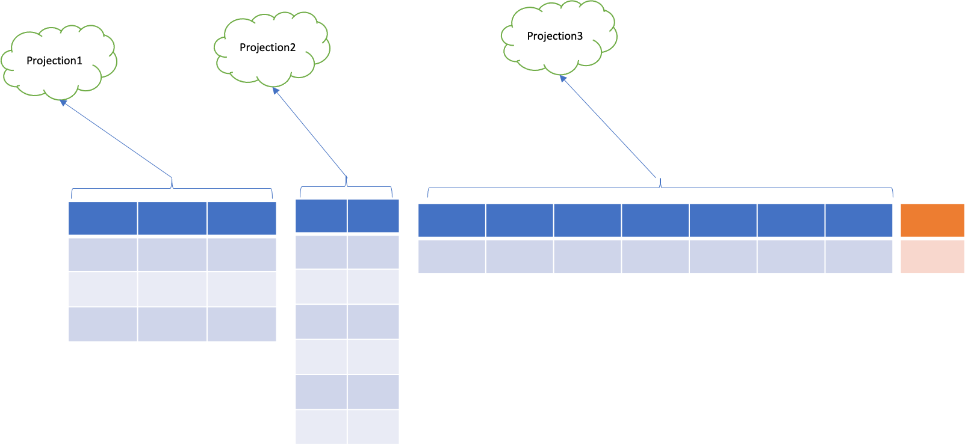
Our Proposal
Intermediate Representation
USING LSTM EXTRACT INTERMEDIATE REPRENTATIONS

Slide 6
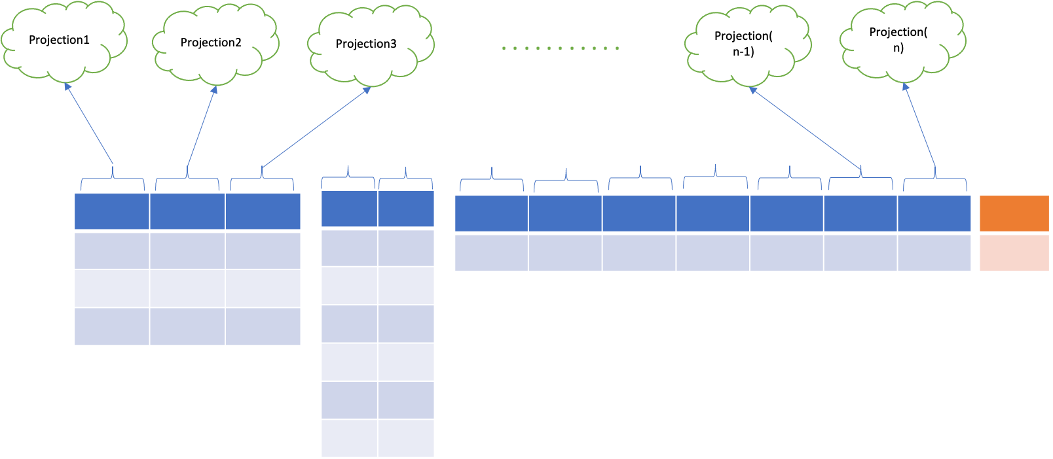
Our Proposal
Hierarchical Representation
Since we can have features that have similar value but different semantics.
E.g. 80.0 in column1 and 80.0 in column2 represent two different semantics.
Thus we need to project each column to different embedding space.

Slide 7
Our Proposal
Two different columns can be related to each other.
Initially we will learn embedding for each column using attention based models (BERT).

Slide 8
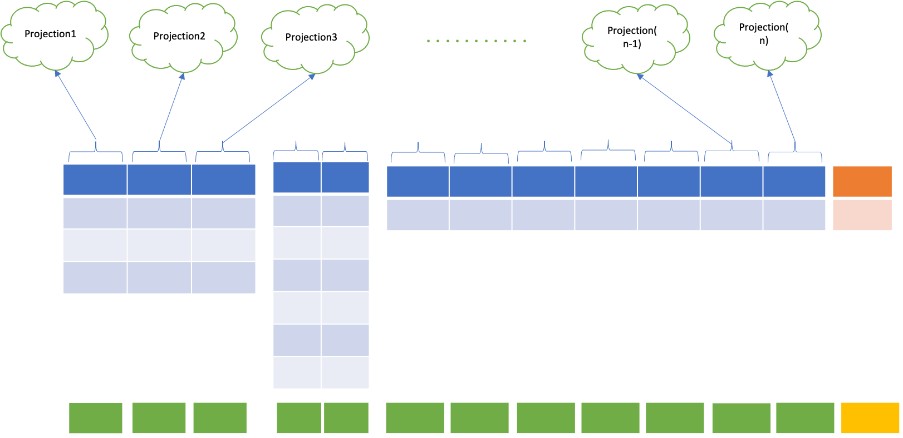
Our Proposal

Slide 9
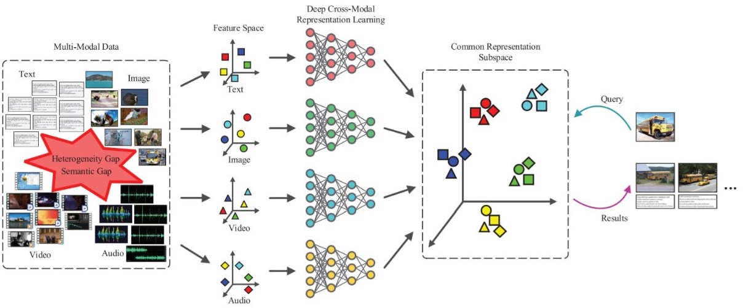
Framework for Cross-modal Retrieval

Slide 10
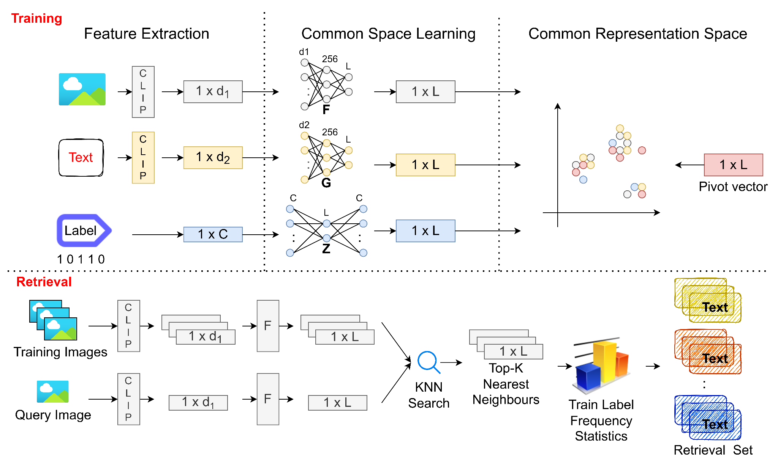

Slide 11
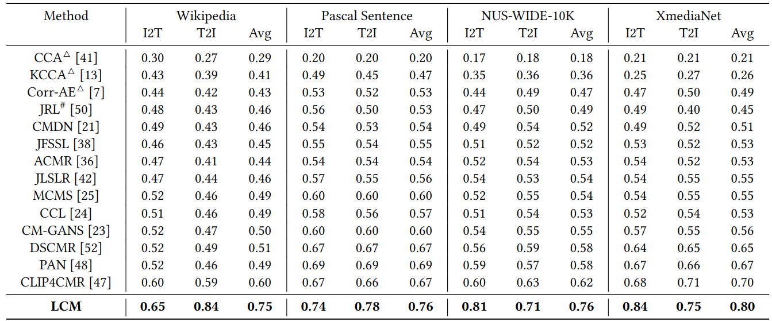
Comparison with Baseline Methods

Slide 12
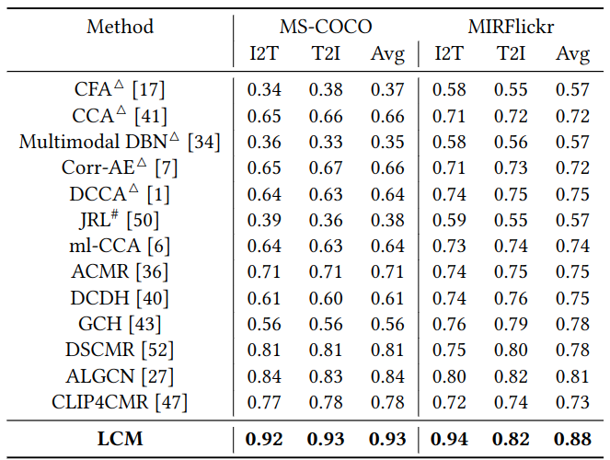

Slide 13
KNN Classifier
We have the projections of each table and now we can learn a common representation space through pivot training.

