Slide 1
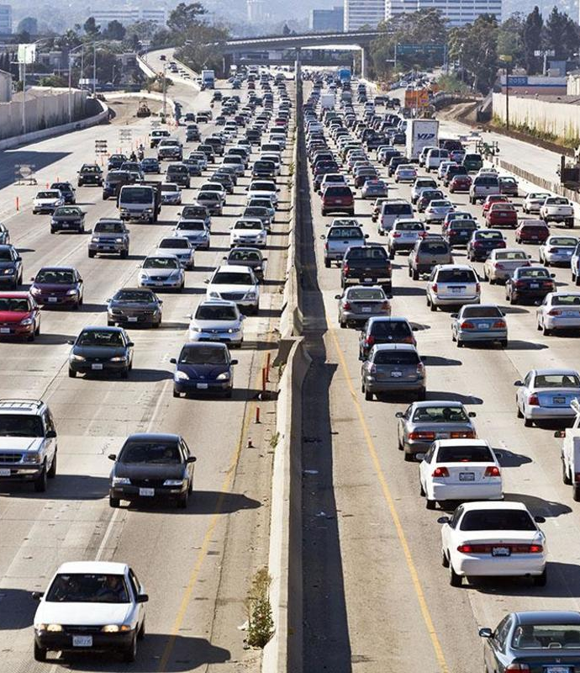
Automatic Number Plate Recognition
Convenience and Security by One Technology

Slide 2
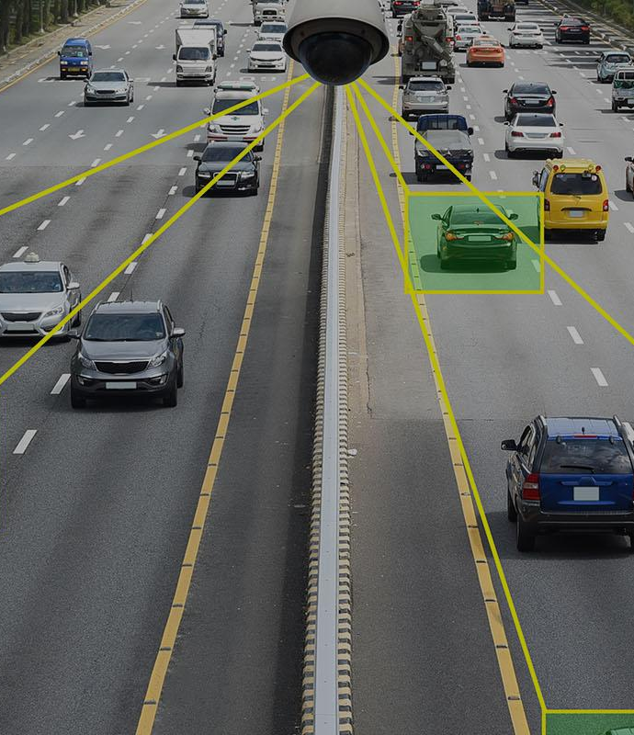
Contents:
Introduction
Problem Statement
How did we develop Idea
Our Approach towards Idea
Innovation or Feature we can add
Brief Development Plan
Business Idea
Applications Of Our Project
Conclusion and Further Scope
Team Members

Slide 3
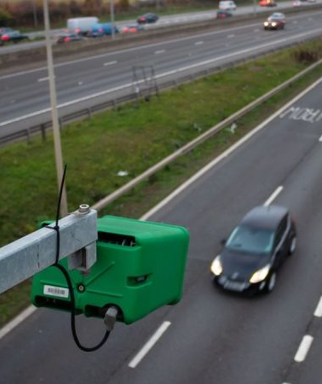
Introduction
ANPR(Automatic Number Plate Recognition):
Automatic Number Plate Recognition (ANPR) is a highly accurate system capable of reading vehicle number plates without human intervention.

Slide 4
Traffic control and vehicle owner identification has become a major problem in every country. Sometimes it becomes difficult to identify the vehicle owner who may have violated traffic rules or drove too fast.
It is also not possible to catch and punish these kind of people because the traffic personnel may not be able to retrieve license plate number of the vehicle due to high speed.
As such, there is a need to develop ANPR(Automatic Number Plate Recognition) system as one of the solutions to this problem. There are numerous ANPR systems already available today.
These systems are based on different methodologies but it is still a challenging task as some of the factors like high speed of vehicle, non-uniform number plate and different lighting conditions can affect a lot in the overall accuracy of recognition. Most systems work under these limitations.

Slide 5
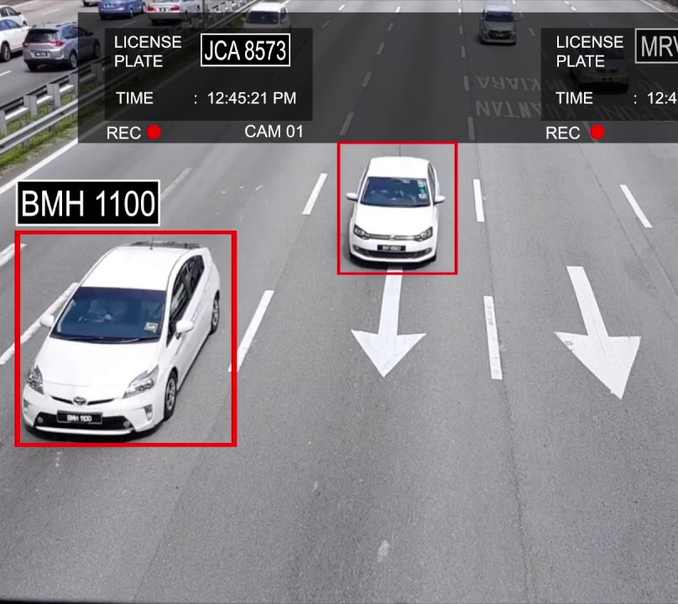
Problem Statement
Cameras fitted at Steep Angle:
Cameras are typically fitted at a certain height above the ground, and not at the same level as passing vehicles. This means that footage is captured at a steep angle.
High Speeding:
Some cameras may be unable to clearly capture the number plate of vehicles moving at a high speed, especially on highways.
High Traffic Density Area:
The presence of other vehicles, pedestrians, animals and objects which intermittently obstruct the camera’s field of view. This means that the camera is unable to view the complete number plate in a single shot.

Slide 6
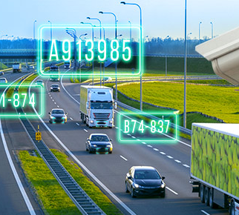
How did we Develop Idea?
Quantity of Vehicles on road is growing in modern age, so numerous crimes are also increasing day by day. Almost every day the news of missing vehicles and accidents are perceived. As per the Road Accident Report for 2019, a total number of 449,002 accidents took place in the country leading to 151,113 deaths and 451,361 injuries.
Vehicles tracking is often required to investigate all these illegal activities. So, vehicle number plate identification, as well as recognition, is an active field of study.

Slide 7
Our Approach Towards Idea
The image is processed through object detection model such that resultant output is the image of the number plate.
The image of the number plate is processed to segment the characters of number plate.
The character segmented in the previous step are recognized. The fetched registration number is passed to API to get the details of vehicle.

Slide 8
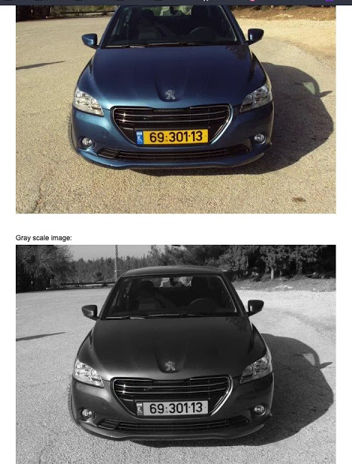
Innovative Features We Can Add
We are trying to incorporate features like
Detecting the age of vehicles as per orders issued by the National Green Tribunal (NGT) in 2015 the Supreme Court in 2018, any registered diesel vehicle over 10 years old and petrol vehicle over 15 years old cannot operate in the National Capital Region. Thus it will help in regulating the vehicles which should be allowed and which shouldn't be without much hassle.
We are also trying to add feature that will help us in distinguishing a private / commercial/ electric vehicle. We are planning to do so by recognizing the color of the license plate. it will also help us in identifying whether a vehicle is of any foreign delegates or any government official.
We are also trying to identify different types of fonts that are used in license plates.
And if the vehicle is registered we can also find it's model along with the color of the vehicle.

Slide 9
Brief Development Plan
Video Feed from camera -> Frames (using opencv)
Frames passed to Object Detection Model.
That image passed to OCR model and extract the registration number of vehicle.
Get the cropped images of number plate and apply image optimisation for good OCR
Data is stored to a database and then this number can be used to extract info of vehicle by passing to parivahan API.

Slide 10
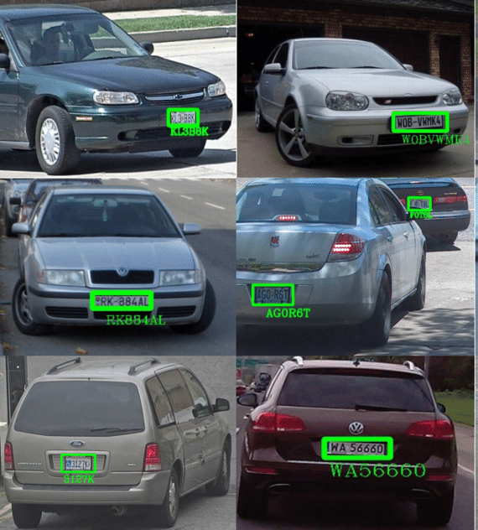
Business Idea
ANPR Systems are used by the Police, Government Agencies, and commercial companies. It provides a tactical option to disrupt, deter and detect criminal activity and, by doing so, helps to increase public confidence in the police. Using the ANPR information, authorities can take steps forward to ensure the well-being of the public. It helps in maintaining traffic accidents and congestions, Locating unwarranted vehicles, Opening barriers for white-listed vehicles Thus reducing the inconvenience while simultaneously ensuring safety of the public.

Slide 11
Applications Of Our Project
In Access Control :
Parking Management
Tolling At Toll Plaza
Getting Statistics On Visitors
In Managing Traffic And Road Safety :
Traffic Jam Information to decongest the area
Penalize High Speeding Vehicles
Detection Of Vehicles In Wrong Direction
Providing Support to law Enforcement :
Search for stolen Vehicles
Checking Border Crossings

Slide 12
Conclusion and Further Scope
Digitization and ANPR have grown alongside each other and it has been natural for clients to include ANPR when upgrading, mainly because by the time digitization reached traffic enforcement clients had a more open mind towards computers. A smart city with an ANPR System is a safe place to live. While there is still room for improvement, there is no denying that soon smart cities will take over. Until then, ANPR System is doing the job of connecting law enforcement, toll stations, and parking zones via its number plate recognition system, creating the foundation of smart cities worldwide.

