Slide 1

Department of MCA
MC4PT209- Minor Project
Synopsis Presentation
on
Employee PayRoll Management
Guide: Prof. Neeraj Kumar Jha
Name of Students
Rajat Rameshwar Bhendarkar,
Roll No :B52 , Sec: B
2.Roshan Ramesh Deshpande
Roll No: B:60, sec :B
MCA First Year, Semester-II
Session Summer-26

Slide 2

Contents
Introduction
Motivation
Problem Statement
Objective of the Project
System Analysis
Survey of Technology
Data Flow Diagrams
Modules of the Project
Data Modelling
Purpose & Scope
Expected Result & Discussion
Chapter Plan
Month Wise Work Plan
References
Nagpur | Pune | Jalgaon | Amravati | Pandhurna | Bhandara

Slide 3
Introduction
Employee Payroll Management System is a web-based application.
It helps manage employee data, attendance, leave, and salary.
It reduces manual work and calculation errors.
Developed using Node.js, Supabase, html and Tailwind Css.
It has two roles: Admin and Employee.
Nagpur | Pune | Jalgaon | Amravati | Pandhurna | Bhandara

Slide 4
Motivation
Manual payroll systems take too much time.
There are chances of mistakes in salary calculation.
Attendance and leave records are hard to manage manually.
Need for a secure and digital system.
To make payroll process faster and easier.
Nagpur | Pune | Jalgaon | Amravati | Pandhurna | Bhandara

Slide 5
Problem Statements
Manual payroll leads to errors and confusion.
Paper records can be lost or damaged.
No proper tracking of attendance and leaves.
Difficult to generate salary reports and payslips.
No centralized system for managing employees.
Nagpur | Pune | Jalgaon | Amravati | Pandhurna | Bhandara

Slide 6
Objective Of Project
Manual payroll leads to errors and confusion.
Paper records can be lost or damaged.
No proper tracking of attendance and leaves.
Difficult to generate salary reports and payslips.
No centralized system for managing employees.
Nagpur | Pune | Jalgaon | Amravati | Pandhurna | Bhandara

Slide 7
System Analysis
Identified system requirements.
Defined Admin and Employee roles.
Designed system structure (Frontend + Backend + Database).
Ensured system security.
Checked technical and operational feasibility.
Nagpur | Pune | Jalgaon | Amravati | Pandhurna | Bhandara

Slide 8
Survey of Technology
Backend: Node.js
Database: SupaBase (PostgreSql)
Authentication: JWT
Frontend: HTML, Taiwind Css and JavaScript
REST API used for communication
Nagpur | Pune | Jalgaon | Amravati | Pandhurna | Bhandara

Slide 9
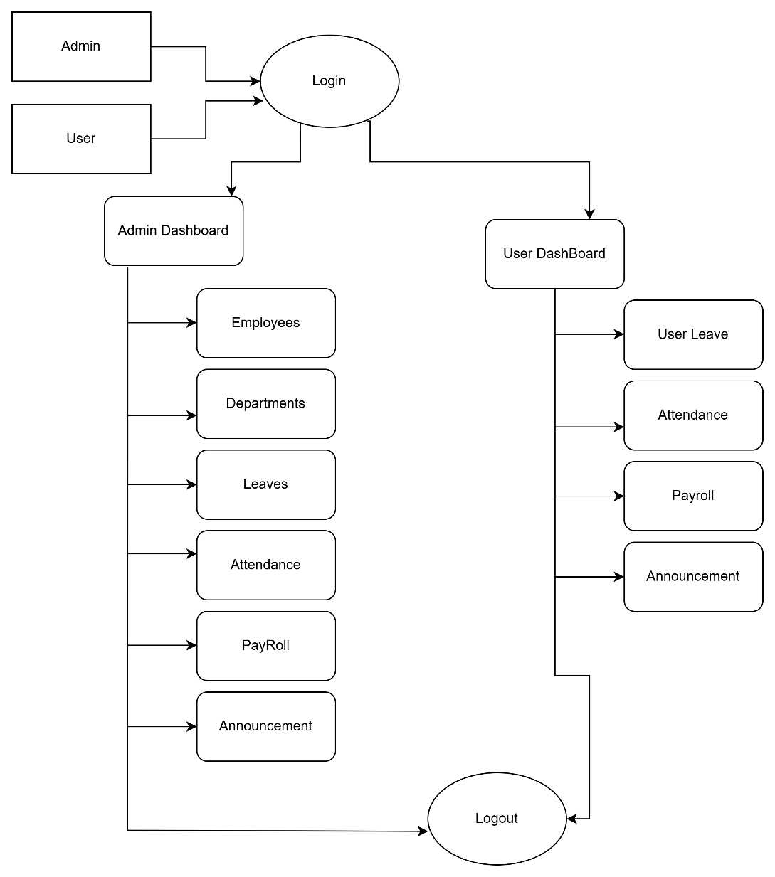
Data Flow Diagram
Nagpur | Pune | Jalgaon | Amravati | Pandhurna | Bhandara

Slide 10
Modules of Project
Login & Authentication
Employee Management
Department Management
Attendance Management
Leave Management
Payroll Management
Announcement Module
Nagpur | Pune | Jalgaon | Amravati | Pandhurna | Bhandara

Slide 11
Data Modelling
Employee data model
Department model
Attendance model
Leave model
Payroll model
Announcement model
Nagpur | Pune | Jalgaon | Amravati | Pandhurna | Bhandara

Slide 12
Purpose and Scope
Purpose:
To automate payroll process.
To reduce errors and save time.
Scope:
Suitable for small and medium companies.
Can be upgraded with more features in future.
Nagpur | Pune | Jalgaon | Amravati | Pandhurna | Bhandara

Slide 13
Expected Result And Discussion
Accurate salary calculation.
Easy attendance and leave tracking.
Secure login system.
Modern and easy-to-use dashboard.
Better management and productivity.
Nagpur | Pune | Jalgaon | Amravati | Pandhurna | Bhandara

Slide 14
Chapter Plan
Introduction
System Analysis
System Design
Implementation
Testing
Conclusion
Nagpur | Pune | Jalgaon | Amravati | Pandhurna | Bhandara

Slide 15
Work – Plan
Months Activities | JAN’26 | FEB’26 | MAR’26 | APR’26 | MAY’26
Literature Reviews | √ | √
System Analysis |  | √
System Designing
Coding
System Testing
Testing and Debugging
Preparation of Project Report
Thesis and Poster Submission

Slide 16
References
Books
Silberschatz, A., Galvin, P. B., & Gagne, G. (2018). Operating system concepts (10th ed.). Wiley.
Pressman, R. S., & Maxim, B. R. (2019). Software engineering: A practitioner’s approach (9th ed.). McGraw-Hill Education.
Sommerville, I. (2016). Software engineering (10th ed.). Pearson Education.
Official Documentation & Websites
Node.js Foundation. (2024). Node.js documentation. Retrieved from https://nodejs.org
Supabase Inc. (2024). Supabase documentation. Retrieved from https://supabase.com/docs
W3Schools. (2024). Web development tutorials. Retrieved from https://www.w3schools.com

Slide 17

Department of MCA
Thank You
G H Raisoni College of Engineering & Management
(Formerly Known as G H Raisoni Institute of Engineering & Technology)
An Autonomous Institute Affiliated to Rashtrasant Tukadoji Maharaj Nagpur University, Nagpur
Accredited by NAAC with “A+” Grade
Shraddha Park, B-37-39/1, MIDC, Hingna-Wadi Link Road, Nagpur-440016 (INDIA)
T: +91-07104-236102 | E: ghrcemn@raisoni.net | W: www.ghrcemn.raisoni.net
Nagpur | Pune | Jalgaon | Amravati | Pandhurna | Bhandara

