Slide 1
Flu.G ✈️
GPU Accelerated CFD Solver
CFD Lab Project Presentation: 21/07/2022
by Group F - Vaishali, Rajat and Sumukha

Slide 2
What’s New?
Motivation/Benefits of GPU
Availability of massive number of threads
Faster performing threads compared to CPUs
To execute high performance algorithms accelerated by thousands of parallel threads running on GPUs
High Data Throughput
Project Idea : FluG
GPU Acceleration of Fluidchen Solver with CUDA interface intended for huge geometries and computationally intensive cases.

Slide 3
CUDA Programming Model
CUDA provides C/C++ language extension and APIs for programming and managing GPUs. Both CPUs and GPUs are used for computing.
Typically, we run serial workload on CPU and offload parallel computation to GPUs.
__global__ - Runs on the GPU, called from the CPU or the GPU.
__device__ - Runs on the GPU, called from the GPU.
__host__ - Runs on the CPU, called from the CPU.
A function to be run on the GPU is a kernel, called with an execution configuration using the
<<< ... >>> syntax

Slide 4
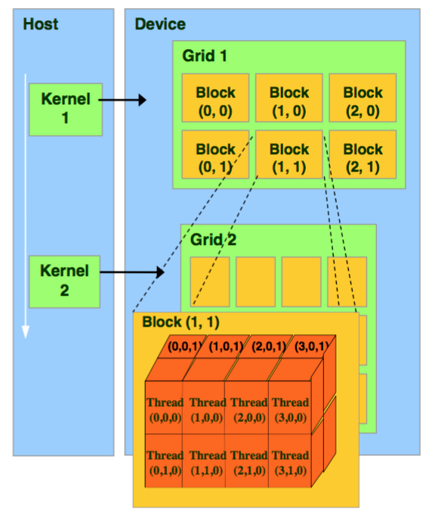
CUDA Thread Hierarchy
A kernel is executed in parallel by an array of threads.
Threads are arranged as a thread blocks, which can be 1D,
2D or 3D arrays of threads.
A ‘grid’ is a collection of thread blocks of the same thread
dimensionality which all execute the same kernel.
The execution configuration specifies the thread hierarchy
for a kernel launch, which defines the number of thread blocks,
as well as how many threads to execute in each block.
Exectution Syntax:
kernel<<< NUMBER_OF_BLOCKS, NUMBER_OF_THREADS_PER_BLOCK>>>()

Slide 5
Overview
GPU Acceleration of Fluidchen solver using CUDA API.
Major Functions such as calculating velocities, timesteps offloaded to GPU.
Pressure SOR parallel implementation done through Red-Black scheme.
Performance Analysis of scaled up versions of classic test cases.
Tested on Cluster – NVIDIA GeForce RTX3080.

Slide 6
CUDA class on CUDA_Solver.cuh
Source File
CUDA_Solver.cu
Declare GPU Variables
Memory Allocation on GPU
Initialize()
Data Transfer : Host to Device
Pre_Process()
Declare Methods
initialize();
pre_process();
post_process();
calc_T();
apply_boundary();
calc_fluxes();
calc_rs();
calc_pressure();
calc_velocities();
calc_dt();
get_num_blocks();
get_num_blocks_2d();
~CUDA_solver();
Define __device__ methods
All Discretization functions
Define kernels
Kernels – Temp(), dt() Boundaries(), Fluxes(), RS(), SOR_black(), SOR_red()
Reduction Functions
Max_Abs_Element(), Residuals()
Code Structure
Memory De-Allocation
~CUDA_solver();

Slide 7
GO
cuda_solver.pre_process()
No
t<t_{end}
Yes
cuda_solver.calc_dt()
cuda_solver.calc_T()
cuda_solver.calc_fluxes()
Case::Simulate Flowchart
cuda_solver.calc_rs()
cuda_solver.calc_pressure()
cuda_solver.calc_velocity()
output_vtk()
END

Slide 8
Code Development Stages
CPU
Case::simulate()
CPU:
Calc_Fluxes
CPU:
Boundaries
CPU:
Calc_RS
CPU:
Pressure_SOR
CPU:
Calc_Velocities
Output_vtk()
Define GPU
Calc_T
Define GPU
Calc_Fluxes
Define GPU
Boundaries
Define GPU
Calc_RS
Define GPU
Pressure_SOR
Define GPU
Calc_Velocities
GPU
Declare GPU class with required members
and methods
Define Initialize, Pre_process, post_process and destructor

Slide 9
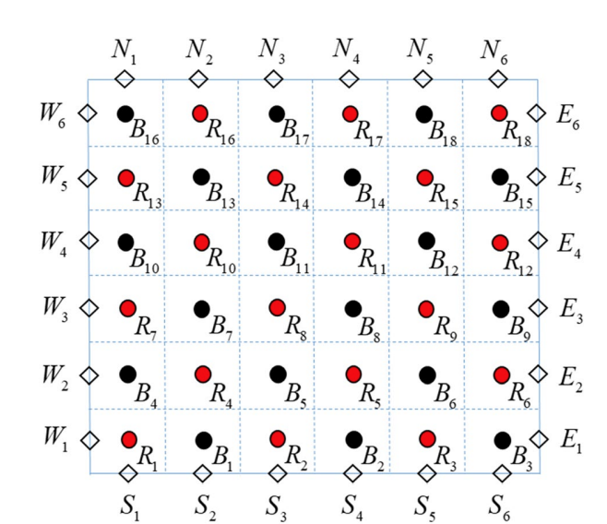
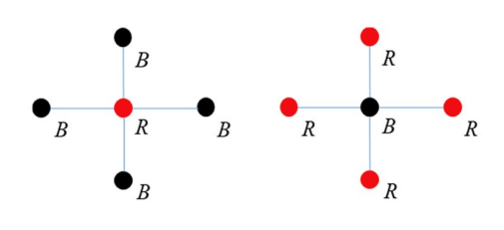
Pressure Solver - Red Black Scheme
Implementation of SOR in parallel

Slide 10
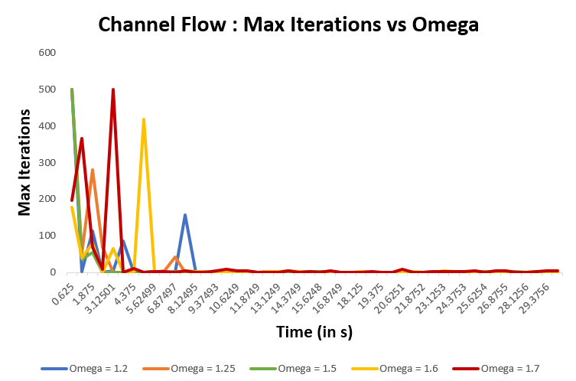
Convergence of Red Black Scheme with ω
We observe that Red Black scheme works well for smaller values of Omega ( = 1.2)

Slide 11
Efficiency – CUDA vs Serial
We could observe an average speedup of 6-7x on CUDA compared to the Serial case. For the Worksheet 3 using MPI, the speedup observed was around 2x compared to the Serial case.
Case | Serial Runtime (in s) | CUDA Runtime (in s) | Speedup
Lid Driven Cavity | 70.739 | 5.405 | 13.0876
Channel Flow | 24.304 | 3.894 | 6.241
ChannelwithBFS | 12.940 | 2.340 | 5.53
ChannelwithObstacle | 37.073 | 6.326 | 5.86
Fluid Trap | 54.752 | 8.198 | 6.68
Natural Convection | 119.04 | 23.375 | 5.0926

Slide 12
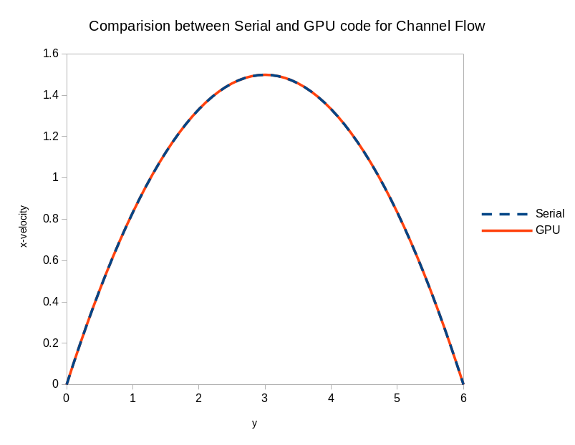
Validation of Channel Flow case

Slide 13
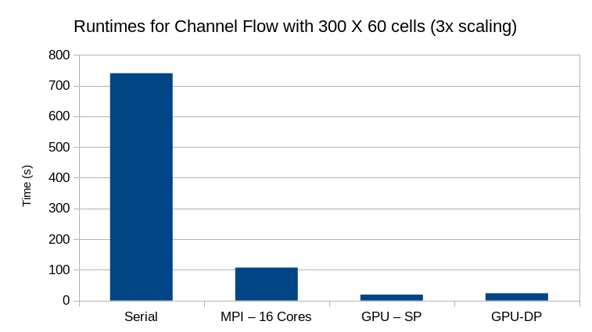
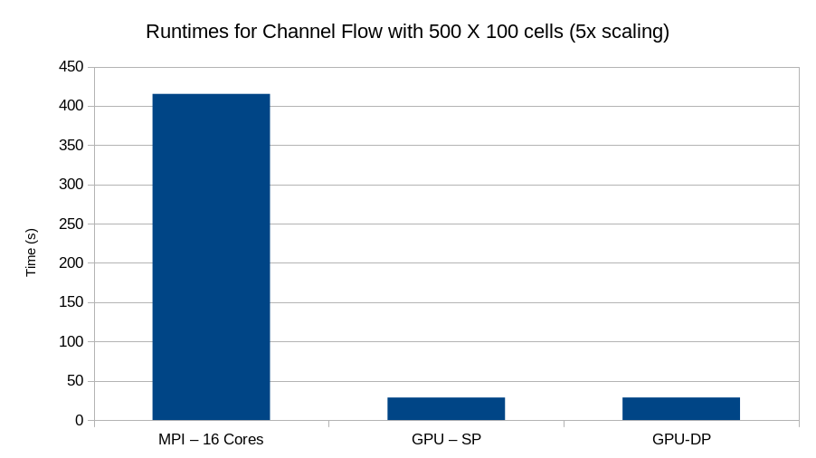
Performance Analysis : Channel Flow
Speedup observed by GPU wrt Serial
(3x Scaling) = 37x
Speedup observed by GPU wrt MPI
(5x Scaling) = 8x

Slide 14
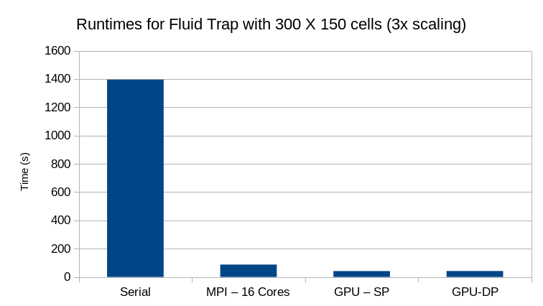
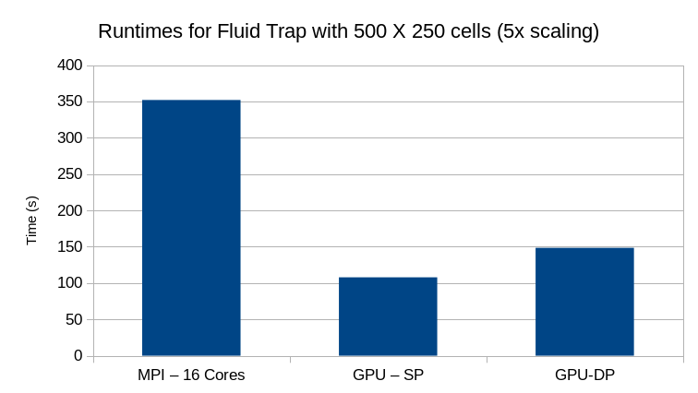
Performance Analysis : Fluid Trap
Speedup observed by GPU wrt Serial
(3x Scaling) = 35x
Speedup observed by GPU wrt MPI
(5x Scaling) = 3x

Slide 15
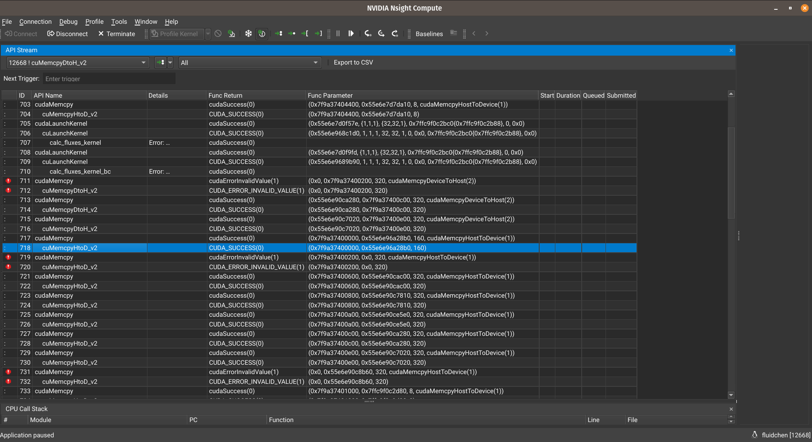
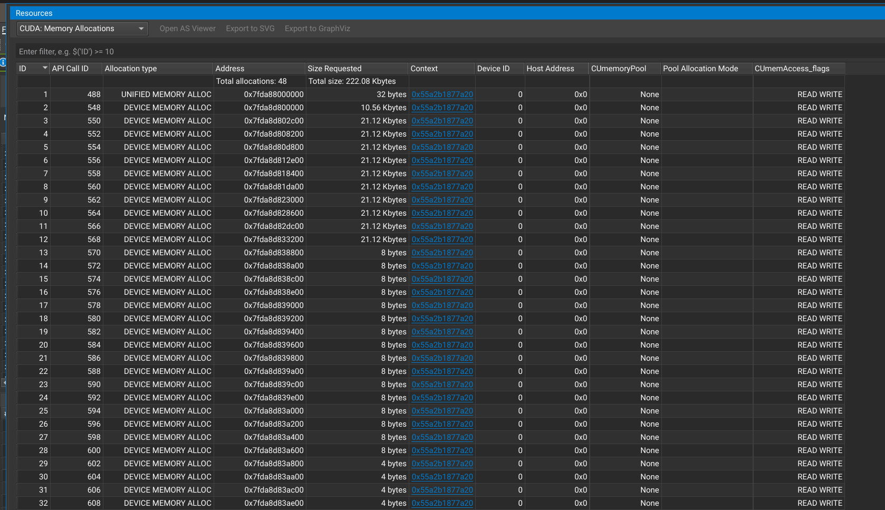
Profiling and Debugging Tools
NVIDIA Nsights

Slide 16
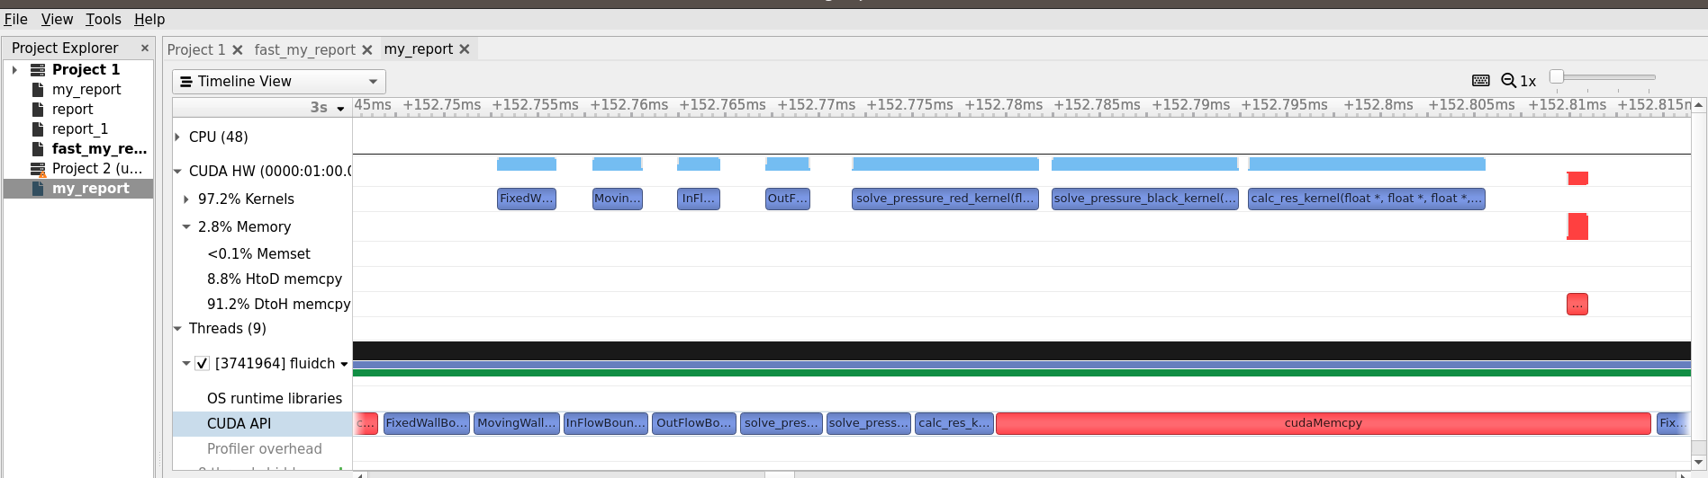
Profiling and Debugging Tools
NVIDIA Systems
CUDA-gdb, gdb

Slide 17
Tasks for Next Week
Detailed performance study
Possible optimizations in code
Fix Rayleigh Benard cases (Max iterations reached every time)
Parallelization of Domain Creation (Grid.cpp)
Add heat conduction equations into the solver (possibly)
Comments
Readme file and Documentation, Project Report
Suggestions?

Slide 18
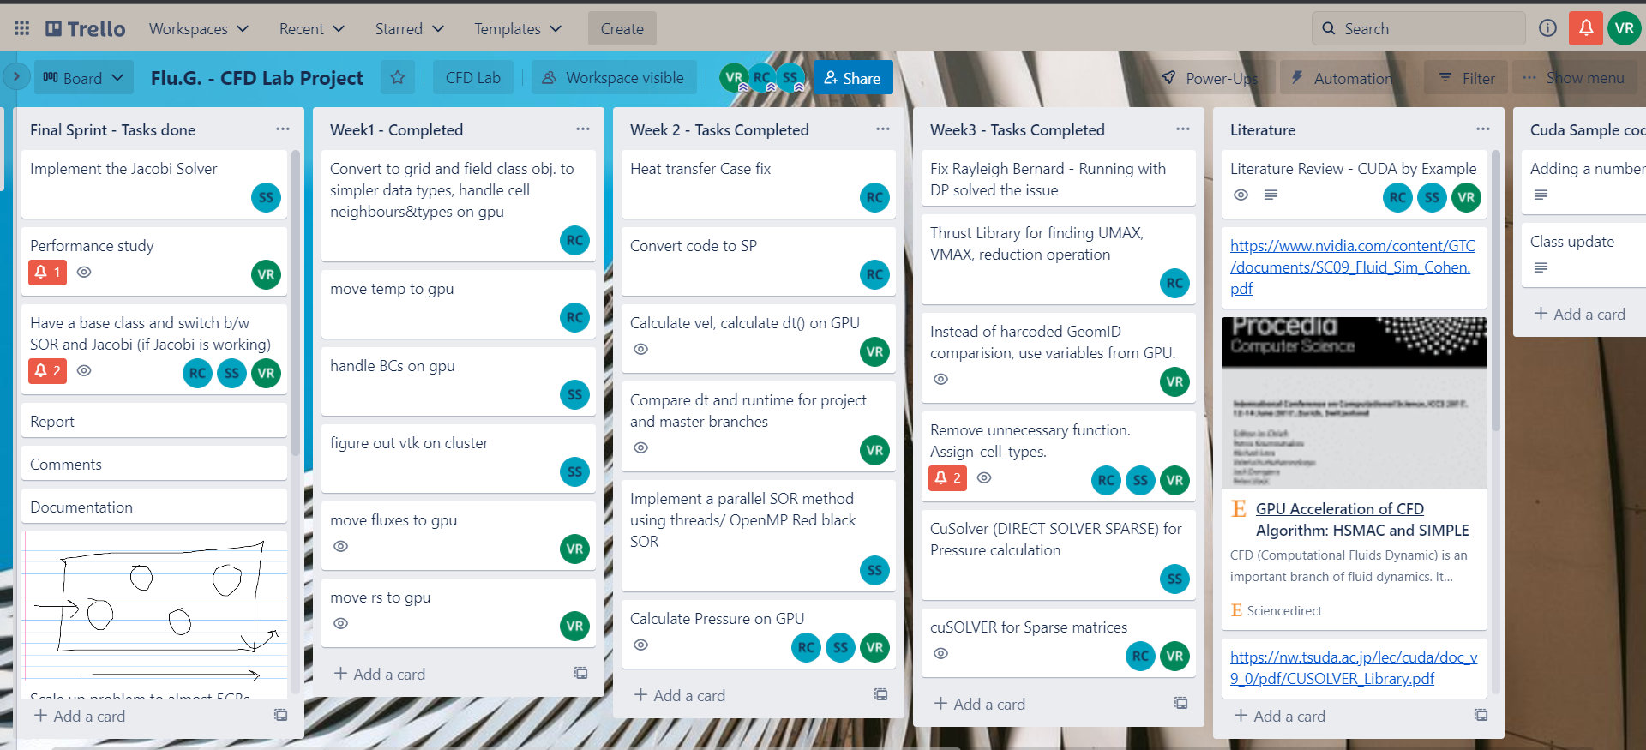
Project Management - (1)
Tasks assignment and tracking using Trello
Collaborative Work with GitLab, offline and online meetings

Slide 19
THANK YOU.

