Slide 1
Azure Data Engineering & Agentic AI
(Ernst & Young Consultants)
Rajat Garg
B. Tech. (IIT Roorkee),
Masters of Science (University of Minnesota)
Software Engineer

Slide 2
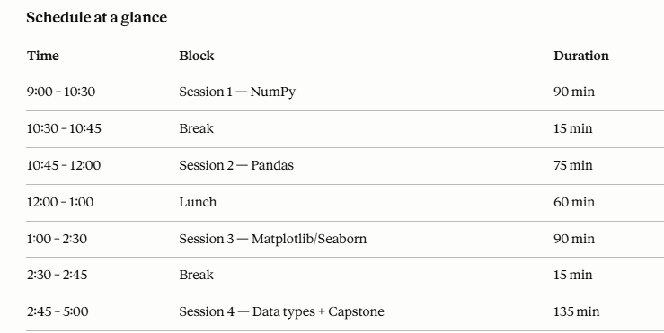

Slide 3
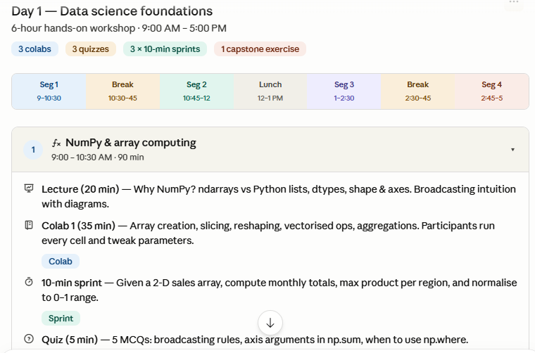

Slide 4
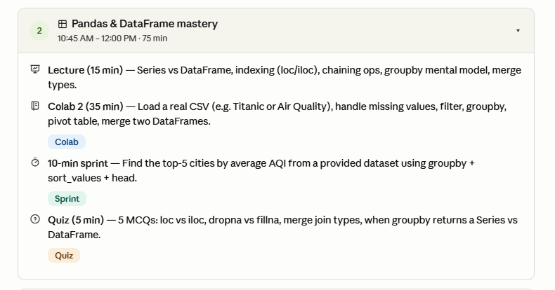

Slide 5
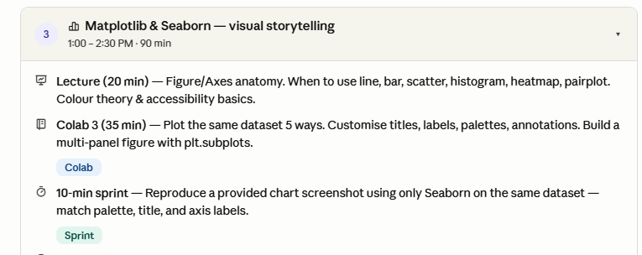

Slide 6
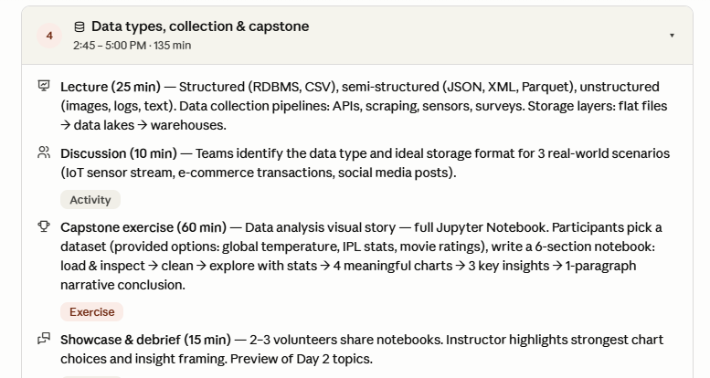

Slide 7
Day 2
Git
Azure
ML Fundamentals

Slide 8
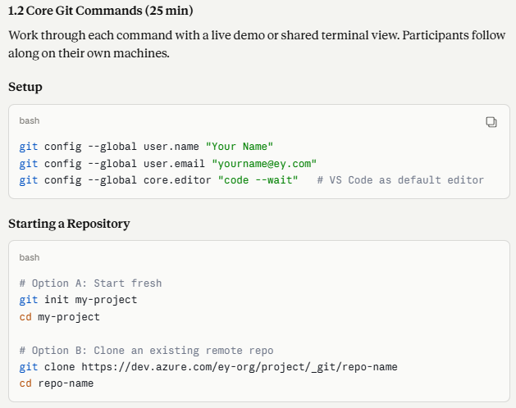

Slide 9
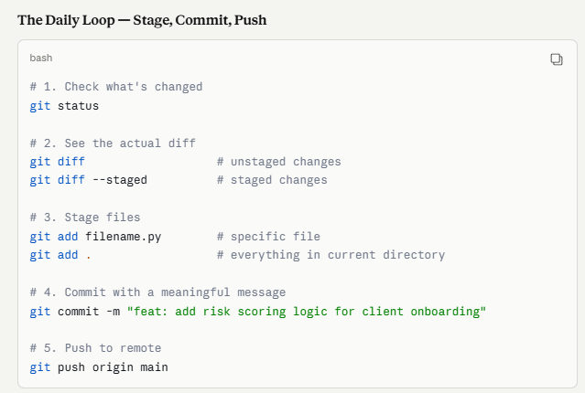

Slide 10
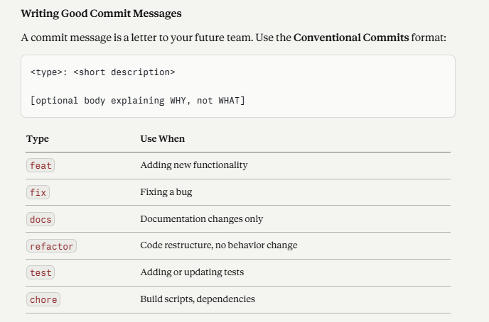

Slide 11
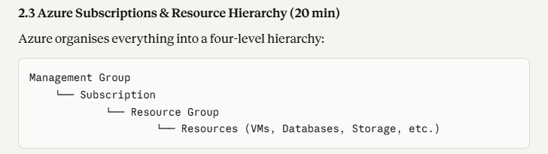

Slide 12
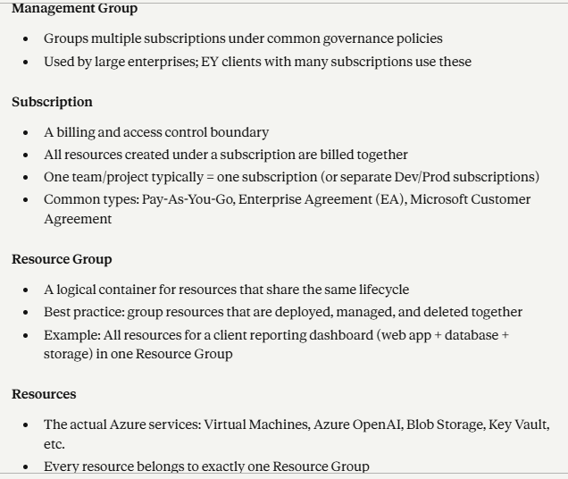

Slide 13
Day 3 exercise

Slide 14
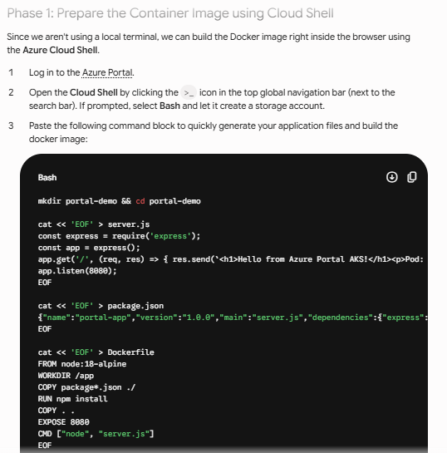

Slide 15
docker build -t portal-web-app:v1

Slide 16
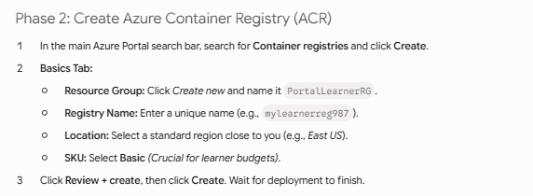

Slide 17
az acr build --registry mylearnerreg987 --image portal-web-app:v1
What happens behind the scenes?
Zips the code: Cloud Shell bundles your current directory (.) into a temporary file.
Sends to Azure: It uploads the bundle to your Azure Container Registry.
Remote Build: Azure spins up an ephemeral, fully-managed environment to execute your Dockerfile instructions.
Auto-Push: The finished image is automatically saved straight into your registry repositories.
.

Slide 18
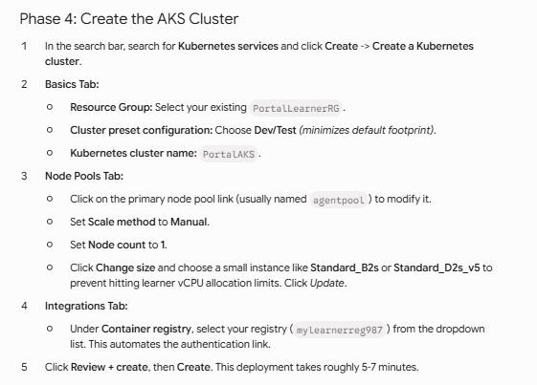

Slide 19
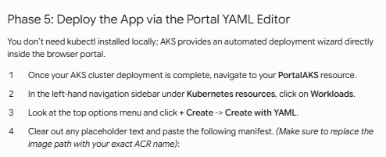

Slide 20
Day 4 exercise
Since the first part requires designing an Entity-Relationship Diagram (ERD) and implementing it in PostgreSQL, we will spin up an Azure Database for PostgreSQL flexible server, followed by an Azure Data Factory (ADF) pipeline to handle the data processing into Azure SQL.

Slide 21
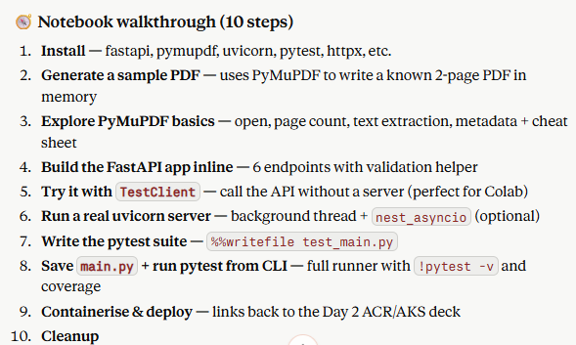

Slide 22
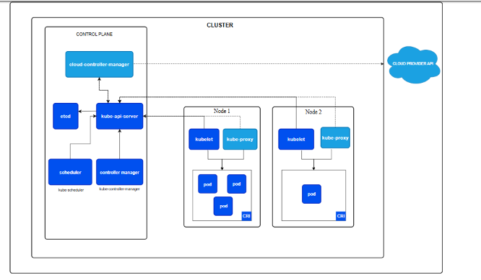

Slide 23
Day 8

Slide 24
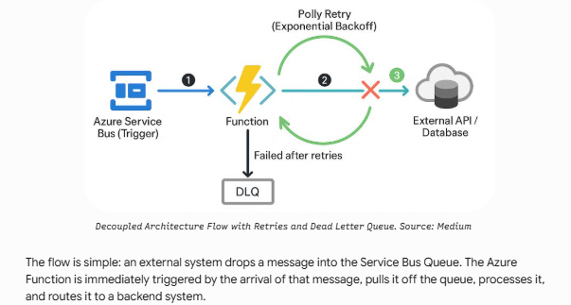

Slide 25
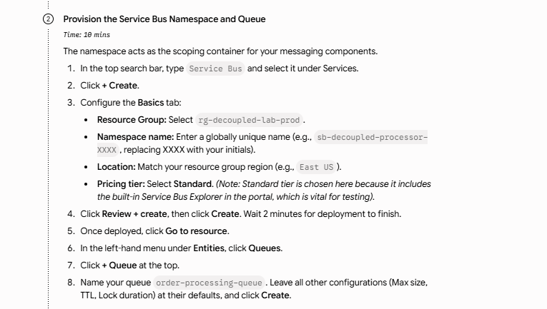

Slide 26
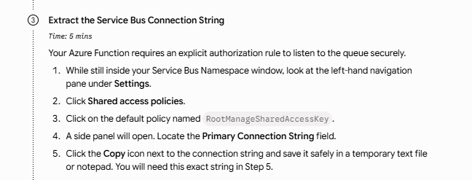

Slide 27
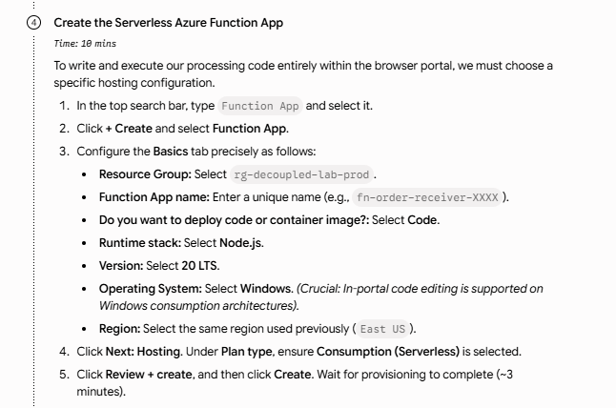

Slide 28
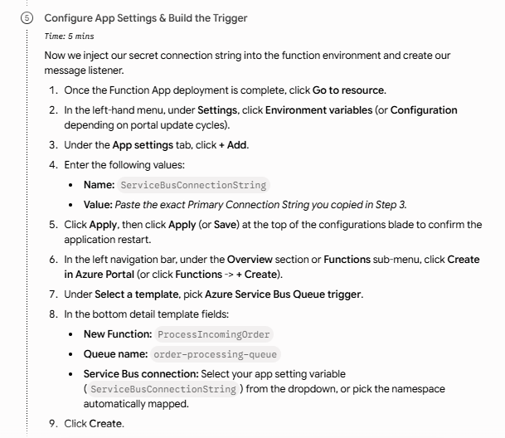

Slide 29
