Slide 1
Streaming SIMD Extension (SSE)

Slide 2
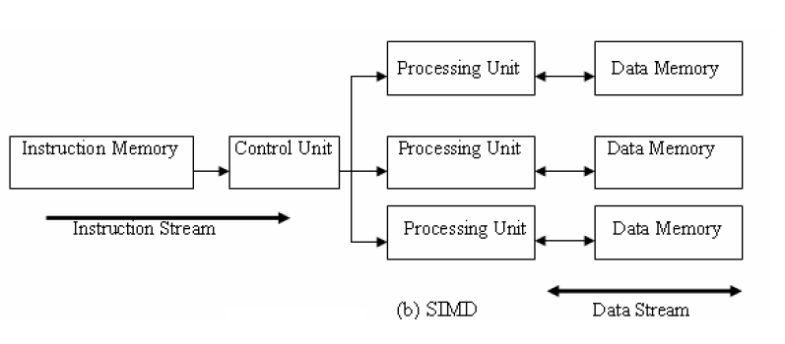
SIMD architectures
A data parallel architecture
Applying the same instruction to many data
Save control logic
A related architecture is the vector architecture
SIMD and vector architectures offer high performance for vector operations.

Slide 3
Vector operations
Vector addition Z = X + Y
for (i=0; i<n; i++) z[i] = x[i] + y[i];
Vector scaling Y = a * X
for(i=0; i<n; i++) y[i] = a*x[i];
Dot product
for(i=0; i<n; i++) r += x[i]*y[i];

Slide 4
SISD and SIMD vector operations
C = A + B
For (i=0;i<n; i++) c[i] = a[i] + b[i]
C
A
9.0 8.0 7.0 6.0 5.0 4.0 3.0 2.0 1.0
SISD
+
10 9.0 8.0 7.0 6.0 5.0 4.0 3.0 2.0
B
1.0 1.0 1.0 1.0 1.0 1.0 1.0 1.0 1.0
A
7.0 5.0 3.0 1.0
8.0 6.0 4.0 2.0
SIMD
+
+
8.0 6.0 4.0 2.0
9.0 7.0 5.0 3.0
C
1.0 1.0 1.0 1.0
1.0 1.0 1.0 1.0
B

Slide 5
x86 architecture SIMD support
Both current AMD and Intel’s x86 processors have ISA and microarchitecture support SIMD operations.
ISA SIMD support
MMX, 3DNow!, SSE, SSE2, SSE3, SSE4, AVX
See the flag field in /proc/cpuinfo
SSE (Streaming SIMD extensions): a SIMD instruction set extension to the x86 architecture
Instructions for operating on multiple data simultaneously (vector operations).
Micro architecture support
Many functional units
8 128-bit vector registers, XMM0, XMM1, …, XMM7

Slide 6
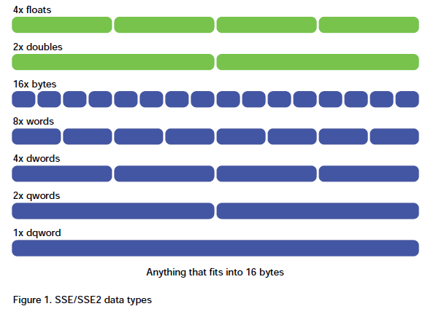
SSE programming
Vector registers support three data types:
Integer (16 bytes, 8 shorts, 4 int, 2 long long int, 1 dqword)
single precision floating point (4 floats)
double precision float point (2 doubles).
[Klimovitski 2001]

Slide 7
SSE instructions
Assembly instructions
Data movement instructions
moving data in and out of vector registers
Arithmetic instructions
Arithmetic operation on multiple data (2 doubles, 4 floats, 16 bytes, etc)
Logical instructions
Logical operation on multiple data
Comparison instructions
Comparing multiple data
Shuffle instructions
move data around SIMD registers
Miscellaneous
Data conversion: between x86 and SIMD registers
Cache control: vector may pollute the caches
State management:

Slide 8
SSE instructions
Data Movement Instructions:
MOVUPS - Move 128bits of data to an SIMD register from memory or SIMD register. Unaligned. MOVAPS - Move 128bits of data to an SIMD register from memory or SIMD register. Aligned. MOVHPS - Move 64bits to upper bits of an SIMD register (high). MOVLPS - Move 64bits to lower bits of an SIMD register (low). MOVHLPS - Move upper 64bits of source register to the lower 64bits of destination register. MOVLHPS - Move lower 64bits of source register to the upper 64bits of destination register. MOVMSKPS = Move sign bits of each of the 4 packed scalars to an x86 integer register. MOVSS - Move 32bits to an SIMD register from memory or SIMD register.

Slide 9
SSE instructions
Arithmetic instructions
pd: two doubles, ps: 4 floats, ss: scalar
ADD, SUB, MUL, DIV, SQRT, MAX, MIN, RCP, etc
ADDPS – add four floats, ADDSS: scalar add
Logical instructions
AND, OR, XOR, ANDN, etc
ANDPS – bitwise AND of operands
ANDNPS – bitwise AND NOT of operands
Comparison instruction:
CMPPS, CMPSS – compare operands and return all 1’s or 0’s

Slide 10
SSE instructions
Shuffle instructions
SHUFPS: shuffle number from one operand to another
UNPCKHPS - Unpack high order numbers to an SIMD register. Unpckhps [x4,x3,x2,x1][y4,y3,y2,y1] = [y4, x4, y3, x3]
UNPCKLPS
Other
Data conversion: CVTPS2PI mm,xmm/mem64
Cache control
MOVNTPS stores data from a SIMD floating-point register to memory, bypass cache.
State management: LDMXCSR load MXCSR status register.

Slide 11
SEE programming in C/C++
Map to intrinsics
An intrinsic is a function known by the compiler that directly maps to a sequence of one or more assembly language instructions. Intrinsic functions are inherently more efficient than called functions because no calling linkage is required.
Intrinsics provides a C/C++ interface to use processor-specific enhancements
Supported by major compilers such as gcc

Slide 12
SSE intrinsics
Header files to access SEE intrinsics
#include <mmintrin.h> // MMX
#include <xmmintrin.h> // SSE
#include <emmintrin.h> //SSE2
#include <pmmintrin.h> //SSE3
#include <tmmintrin.h> //SSSE3
#include <smmintrin.h> // SSE4
MMX/SSE/SSE2 are mostly supported
SSE4 are not well supported.
When compile, use –msse, -mmmx, -msse2 (machine dependent code)
Some are default for gcc.
A side note:
Gcc default include path can be seen by ‘cpp –v’
On linprog, the SSE header files are in
/usr/local/lib/gcc/x86_64-unknown-linux-gnu/4.3.2/include/

Slide 13
SSE intrinsics
Data types (mapped to an xmm register)
__m128: float
__m128d: double
__m128i: integer
Data movement and initialization
_mm_load_ps, _mm_loadu_ps, _mm_load_pd, _mm_loadu_pd, etc
_mm_store_ps, …
_mm_setzero_ps

Slide 14
SSE intrinsics
Data types (mapped to an xmm register)
__m128: float
__m128d: double
__m128i: integer
Data movement and initialization
_mm_load_ps, _mm_loadu_ps, _mm_load_pd, _mm_loadu_pd, etc
_mm_store_ps, …
_mm_setzero_ps
_mm_loadl_pd, _mm_loadh_pd
_mm_storel_pd, _mm_storeh_pd

Slide 15
SSE intrinsics
Arithemetic intrinsics:
_mm_add_ss, _mm_add_ps, …
_mm_add_pd, _mm_mul_pd
More details in the MSDN library at
http://msdn.microsoft.com/en-us/library/y0dh78ez(v=VS.80).aspx
See ex1.c, and sapxy.c

Slide 16
SSE intrinsics
Data alignment issue
Some intrinsics may require memory to be aligned to 16 bytes.
May not work when memory is not aligned.
See sapxy1.c
Writing more generic SSE routine
Check memory alignment
Slow path may not have any performance benefit with SSE
See sapxy2.c

Slide 17
Summary
Contemporary CPUs have SIMD support for vector operations
SSE is its programming interface
SSE can be accessed at high level languages through intrinsic functions.
SSE Programming needs to be very careful about memory alignments
Both for correctness and for performance.

Slide 18
References
Intel® 64 and IA-32 Architectures Software Developer's Manuals (volumes 2A and 2B). http://www.intel.com/products/processor/manuals/
SSE Performance Programming, http://developer.apple.com/hardwaredrivers/ve/sse.html
Alex Klimovitski, “Using SSE and SSE2: Misconcepts and Reality.” Intel Developer update magazine, March 2001.
Intel SSE Tutorial : An Introduction to the SSE Instruction Set, http://neilkemp.us/src/sse_tutorial/sse_tutorial.html#D
SSE intrinsics tutorial, http://www.formboss.net/blog/2010/10/sse-intrinsics-tutorial/
MSDN library, MMX, SSE, and SSE2 intrinsics: http://msdn.microsoft.com/en-us/library/y0dh78ez(v=VS.80).aspx

