Slide 1
Streaming SIMD Extensions
CSE 820
Dr. Richard Enbody

Slide 2
Why SSE?
3D multimedia
Floating-point (FP) computation is the heart of 3D geometry
An increase of 1.5 - 2x was required in order to have a visually perceptible difference in performance
Accelerate single-precision FP

Slide 3
Other issues
Feedback on MMX
Cache instructions to improve memory accesses

Slide 4
New
70 new instructions
1 new state

Slide 5
2-Wide vs. 4-Wide SIMD-FP
4-wide single-precision FP per clock could be done without significant cost
double-cycle existing 64-bit hardware to get 1.5 - 2x improvements

Slide 6
More functional units?
much larger area and timing cost,
by increasing busses,
register file ports,
execution hardware, and
scheduling complexity.

Slide 7
Data Path Width?
Current was 80-bits
256-bits is way too expensive
Too much requires extra bandwidth
128-bits is reasonable compromise

Slide 8
Registers
Couldn’t overlap with existing registers:
only 8 original 80-bit registers yields
  four 4-wide 128-bit registers, or
  eight 2-wide 64-bit registers (no gain)
do not want to share with MMX
  complexity
  structural hazard

Slide 9
New Register Set (State)
New registers allow concurrency
Problem of adding a new state was resolved by implementing it earlier to allow O/S to support it before needed.

Slide 10
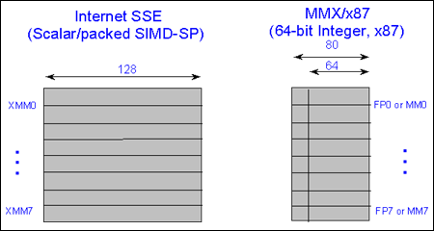
SSE Registers

Slide 11
Pentium III
Issues 2 64-bit micro-instructions which can hold a 4-wide SIMD operation
so if instructions alternate between functional units, 4x speed is achievable
Scalar instructions were included so combined scalar & SIMD could be done together

Slide 12
Memory
Streaming data may not stay in cache, but you cannot go to memory on each access
Solution: HINTS with no state change
  prefetch next data cache instruction
  (can specify memory hierarchy level)
  noncached stores

Slide 13
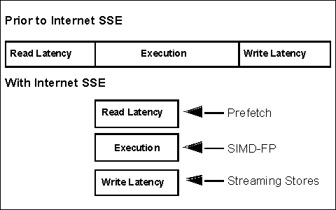
Concurrency

Slide 14
Alignment
Data must be aligned
Fixing alignment costs time
so raise an exception

Slide 15
IEEE compliance
Two modes
  IEEE Compliant (slower)
  Flush-To-Zero (FTZ) (faster)

Slide 16
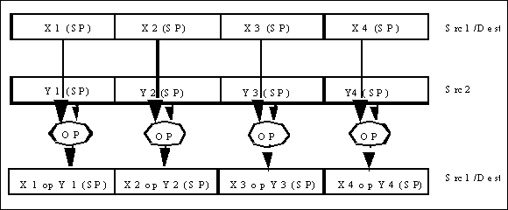
Packed Operation

Slide 17
Barrier (Fence)
New light-weight fence (SFENCE) instruction ensures that all stores that precede the fence are observed on the front-side bus before any subsequent stores are completed.
SFENCE is targeted for uses such as writing commands from the processor to the graphics accelerator

Slide 18
Conditional
The basic single precision FP comparison instruction (CMP) is similar to existing MMX instruction variants (PCMPEQ, PCMPGT) in that it produces a redundant mask per float of all 1's or all 0's depending upon the result of the comparison.
Used for masking for conditional move

Slide 19
MIN/MAX CMOV
the MAX/MIN instructions perform conditional move in only one instruction by directly using the carry-out from the comparison subtraction to select which source to forward as a result.
Within 3D geometry and rasterization, color clamping is an example that benefits from the use of MINPS/PMIN.

Slide 20
MIN/MAX CMOV
A fundamental component in many speech recognition engines is the evaluation of a Hidden-Markov Model (HMM); this function comprises upwards of 80% of execution time. The PMIN instruction improves this kernel performance by 33%, giving a 19% application gain.

Slide 21
Data Manipulation
Organizing the display list for an ideal SIMD format is called Structure-of-Arrays (SOA) since the structure contains separate x, y, z, and w arrays
Instructions which support conversion from AOS are supplied
Converting to fit SIMD is better overall than executing AOS code inefficiently

Slide 22
Reciprocal and
Reciprocal Square Root
Uses:
  transformation
  specular lighting
  geometric normalization
For a basic geometry pipeline, these instructions can improve overall performance on the order of 15%.

Slide 23
New MMX
3D Rasterization is greatly improved by unsigned MMX multiply: application-level performance gain of 8%-10%.
byte-masked write instruction selectively writes directly to memory bypassing the cache

Slide 24
Packed Average
Motion compensation is a key component of the MPEG-2 decode pipeline: reconstituting each frame of the output picture stream by interpolating between key frames.
This interpolation primarily consists of averaging operations between pixels from different macroblocks (16x16 pixel unit).

Slide 25
Packed Average Speedup
The PAVG instruction enabled a 25% kernel speedup on motion Compensation of a DVD player.
At the application level: 4%-6% speedup
The application level gain can increase to 10% for higher resolution HDTV digital television formats.

Slide 26
Packed Sum of
Absolute Differences
Video encode:
40%-70% in motion-estimation
This single instruction replaces on the order of seven MMX instructions in the motion-estimation inner loop so PSADBW has been found to increase motion-estimation performance by a factor of two.

Slide 27
Improvements
real-time rendering of complex worlds
real-time video encoding (MPEG-1 & 2)
DVD decode at 30 frames per second
1M-pixel HDTV format decode
home video editing
reduced speech error rates

Slide 28
Cost
10% increase in die
similar to MMX cost

