Slide 1


Lending Club Case Study
Submission By
Group Facilitator : Rajat Goel
Group Member. : Shashank Narhari Borsutkar

Slide 2

Contents
1. The objective of analysis is to use the information about past loan applicants and find whether they ‘defaulted’ or not.
2. Borrowers can easily access lower interest rate loans through a fast online interface.
3. Lending club is the largest online loan marketplace, facilitating personal loans, business loans, and financing of medical procedures.

Slide 3
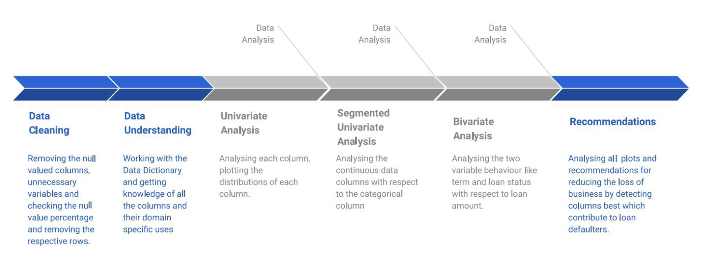
PROBLEM SOLVING STARTEGY

Slide 4
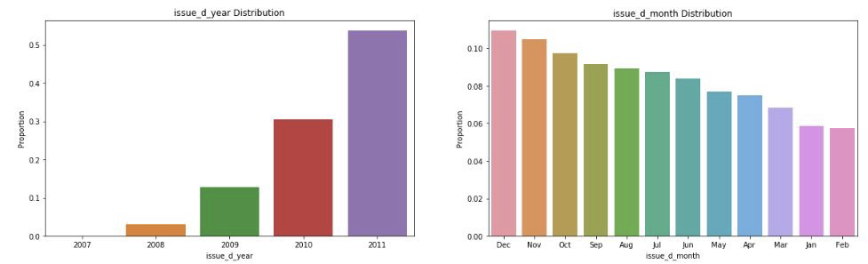
ANALYSIS
Lending club has really expanded year by year, the number of loan issued are doubled every year.
In the final quarter of year there are more loans issued this could be because of vacation and Christmas.

Slide 5
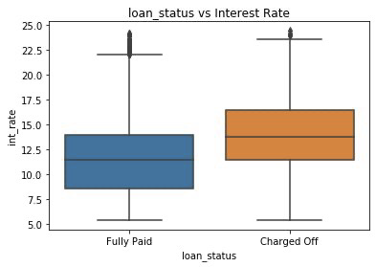
ANALYSIS
When the loan interest rate is
high there is high chance of loan
getting defaulted.

Slide 6
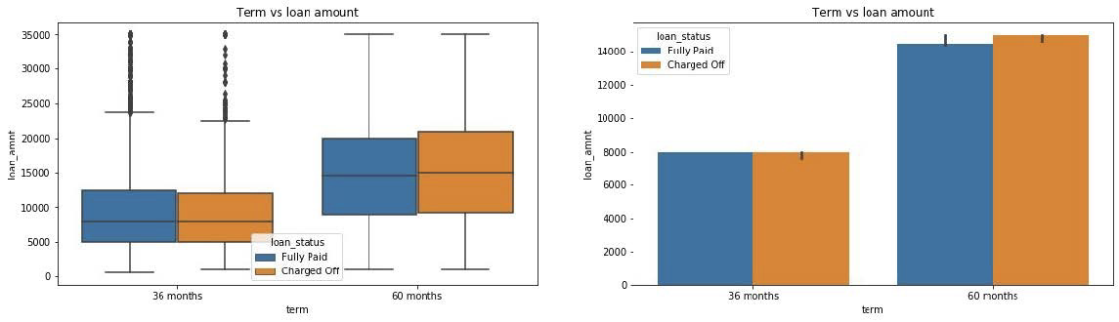
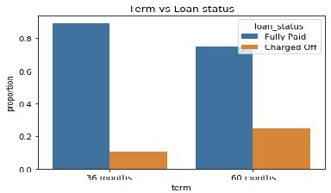
The default rate is high in 60
months tenure because most
people took high loan amount with
high interest rate in it and they
faced difficulties in returning the
sum to bank.

Slide 7
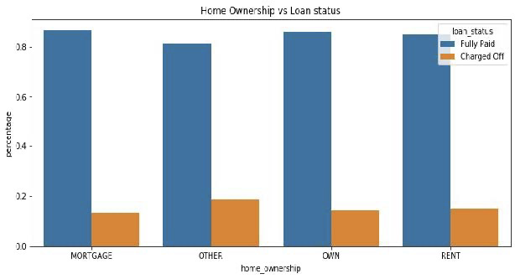
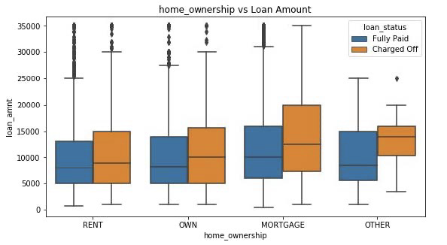
There is around 20% chance of loan default in each home ownership category.
From the 2nd plot we can see the people with higher loan amounts in
mortgage home ownership has high default rate than others.

Slide 8
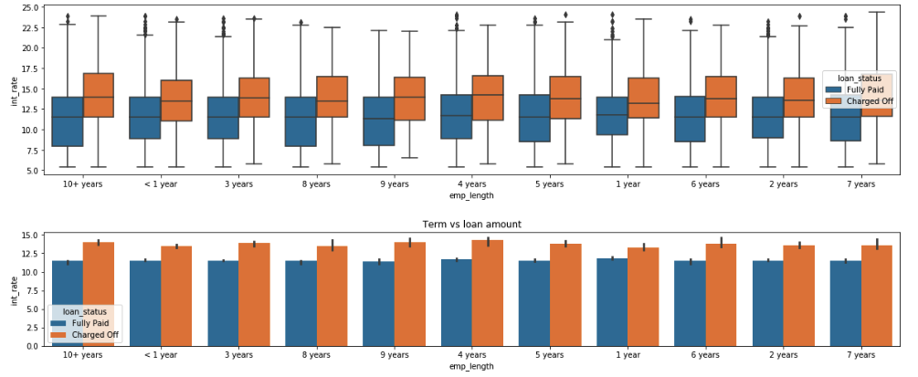
Loans with more interest rates got defaulted more irrespective of employment length

Slide 9
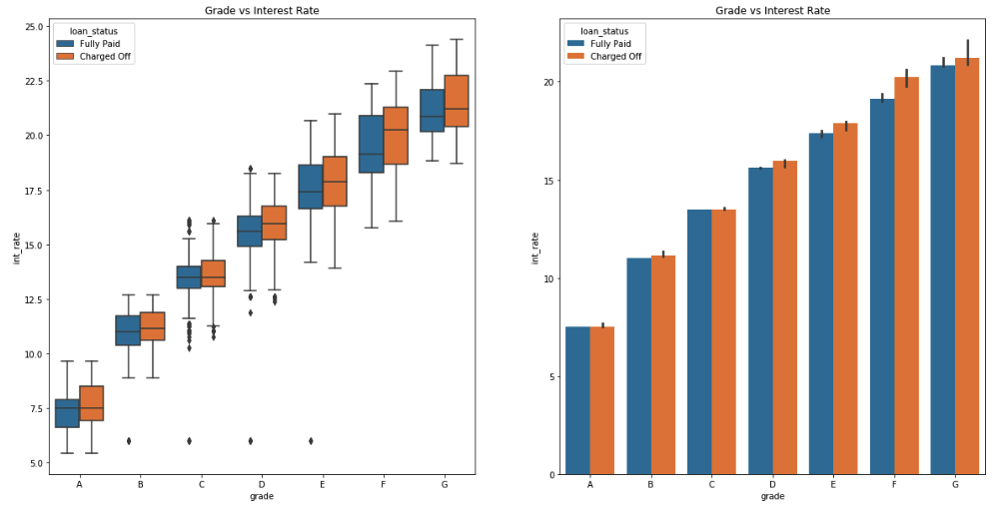
As grade decreases the interest rate gradually increases. and they are more and more prone to default the loan.
1

Slide 10
DESCRIPTIVE STATISTICS
In a sample of 39717 observations the minimum loan amount was $500.00, and the maximum loan amount was $35000.00 with a mean of $11837.43 and standard deviation 7972.01 in the case where the loan was Charged Off. In contrast, the minimum and maximum loan amount was same in case where the loan was Fully Paid but the mean and standard deviation of the loan amount in this status was lower compared to the Charged Off status.
The minimum and maximum funded amounts by the investors are same in both charged off status and fully paid status. However, the mean and the standard deviation of the funded amount is higher for charged off status ($10307.15 & 7636.38) compared to fully paid status ($10110.15 & 7037.58)
The average interest rate seems higher for charged off status, 14% versus 12%.
All primary statistics such as mean, standard deviation, minimum, and maximum for instalment variable was higher for charged off status versus fully paid status.

Slide 11
The mean annual income for fully paid status is $70164.39 with standard deviation 66283.92 whereas the mean annual income for charged off status was $63366.87 with standard deviation 49684.10. The same rule applies for maximum limit. Fully paid status group has the higher value for annual income ($6000000.00) compared to charged off status ($1250000.00).
The mean debt to income ration (dti) is higher for charged off status (14.05) compared to fully paid status (13.25). This is reasonable because, fully paid group has higher average income.
The mean and standard deviation of total credit revolving balance for the charged off status are $15194.46 and 27942.81 respectively which is higher compared to the mean and standard deviation of the fully paid status ( $14138.15 and 20783.18)
The mean and standard deviation of the total payments by the investors ($12239.24 & 9102.21) are higher for the fully paid status compared to the charged off status ($6112.44 & 6585.14)
More precise descriptive statistics of the continuous variables have been represented by the table below. ared to charged off status ($1250000.00).

Slide 12
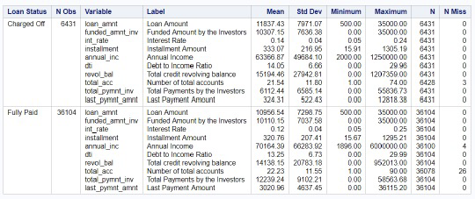
Table1: Summary Statistics of the continuous predictive variables grouped by Loan Status

Slide 13
CONCLUSIONS
People with more number of public derogatory records are having more chance of filing a bankruptcy. Lending club should make sure there are no public derogatory records for borrower.
The variables that we considered in this analysis are not good predictors for loan status prediction. Because there is a significant difference in the parameter estimates when we split the original data into training data and validation data. Also, there is collinearity problem among the variables that we selected. So, further investigation is required along with the selection of other significant predictors.
Small business loans are defaulted more. Lending club should stop/reduce issuing the loans to them.
Borrowers with mortgage home ownership are taking higher loans and defaulting the approved loans. Lending club should stop giving loans to this category.

