Slide 1
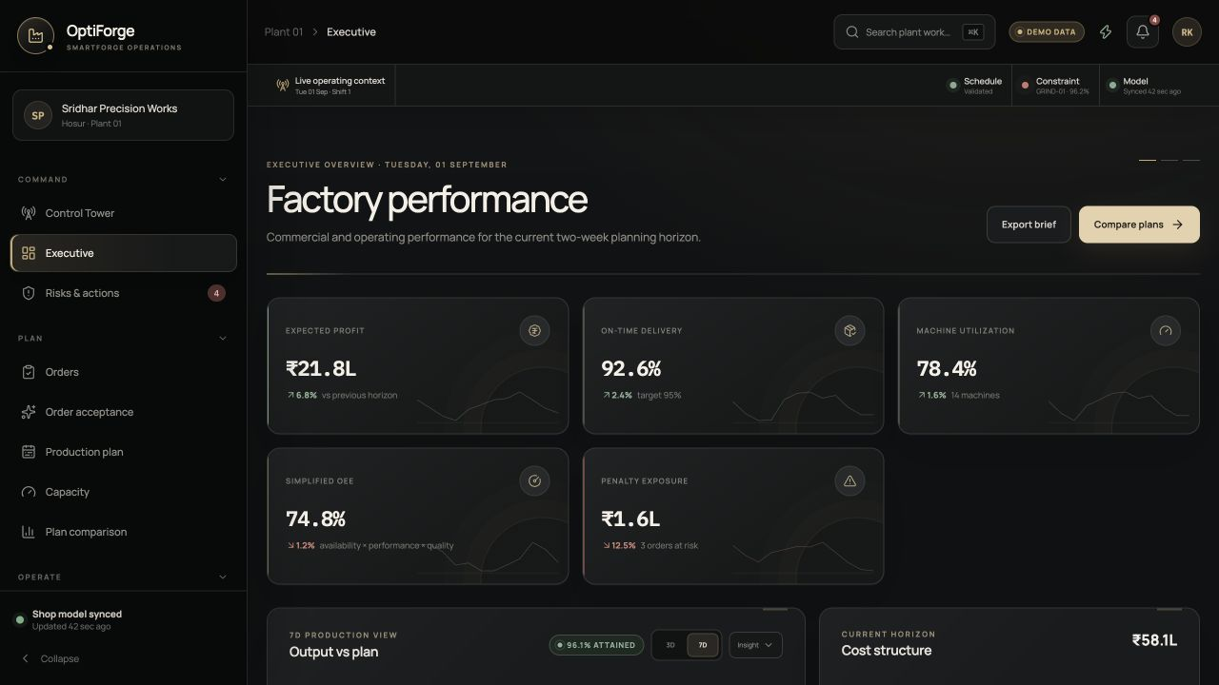
SMARTFORGE / OPTIFORGE
SmartForge
A factory decision control tower
Finite-capacity scheduling, capable-to-promise, disruption recovery and risk-adjusted profitability in one auditable workflow.
14 machines · 40 operators · 96 routed operations
TECHNICAL ASSESSMENT PRESENTATION
Notes:
Open with the decision problem: SmartForge turns one constrained machine-shop state into a feasible two-week schedule and explains the delivery, capacity, risk and profit impact. Emphasize that optimization and transparent rules—not an unexplained AI score—drive the core decisions.
[Sources]
- README.md — project overview and seeded demo data
- Local SmartForge /dashboard capture — deterministic demo data

Slide 2
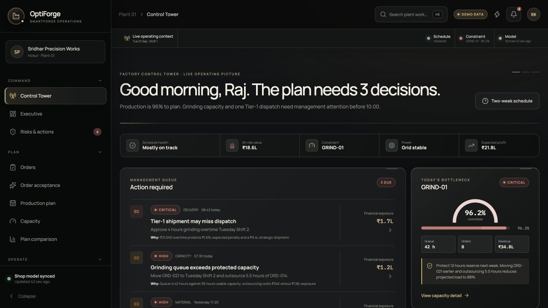
THE OPERATING PROBLEM
02
Factory capacity only exists when constraints align
14
Machine
FINITE-CAPACITY RESOURCES
+ operator
40
+ material
+ power
SKILL-CONSTRAINED OPERATORS
+ sequence
96
+ time
PRECEDENCE-LINKED OPERATIONS
= a promise the factory can defend
GRIND-01 at 96.2% turns one bottleneck into a delivery and profit decision.
SMARTFORGE · FINITE-CAPACITY MANUFACTURING DECISIONS
Notes:
Explain why aggregate available hours are insufficient. A machine slot only becomes usable capacity when a qualified operator, released material, allowed calendar, valid predecessor sequence and power source exist at the same time. Use GRIND-01 as the concrete bottleneck example.
[Sources]
- README.md — business problem and factory scenario
- Local SmartForge /control-tower capture

Slide 3
ARCHITECTURE
03
One factory model drives every operational decision
React + Vite
FastAPI
Planning domain
CP-SAT
Validator
Services
Decision interface
Typed REST contract
Immutable factory state
Assignments + intervals
Independent feasibility
RFQ · risk · replan
SQLAlchemy
SQLite locally
PostgreSQL-ready
The same state powers scheduling, capacity, order acceptance, risk, profitability, simulation and recovery.
SMARTFORGE · FINITE-CAPACITY MANUFACTURING DECISIONS
Notes:
The key architecture choice is consistency. SQLAlchemy records are adapted into immutable planning-domain objects. The optimizer remains independent of HTTP and persistence, while RFQ, risk, financial, capacity and replanning services reuse the same domain and validator.
[Sources]
- docs/architecture.md
- README.md — system architecture
- backend/app/optimizer/domain.py and backend/app/services/

Slide 4
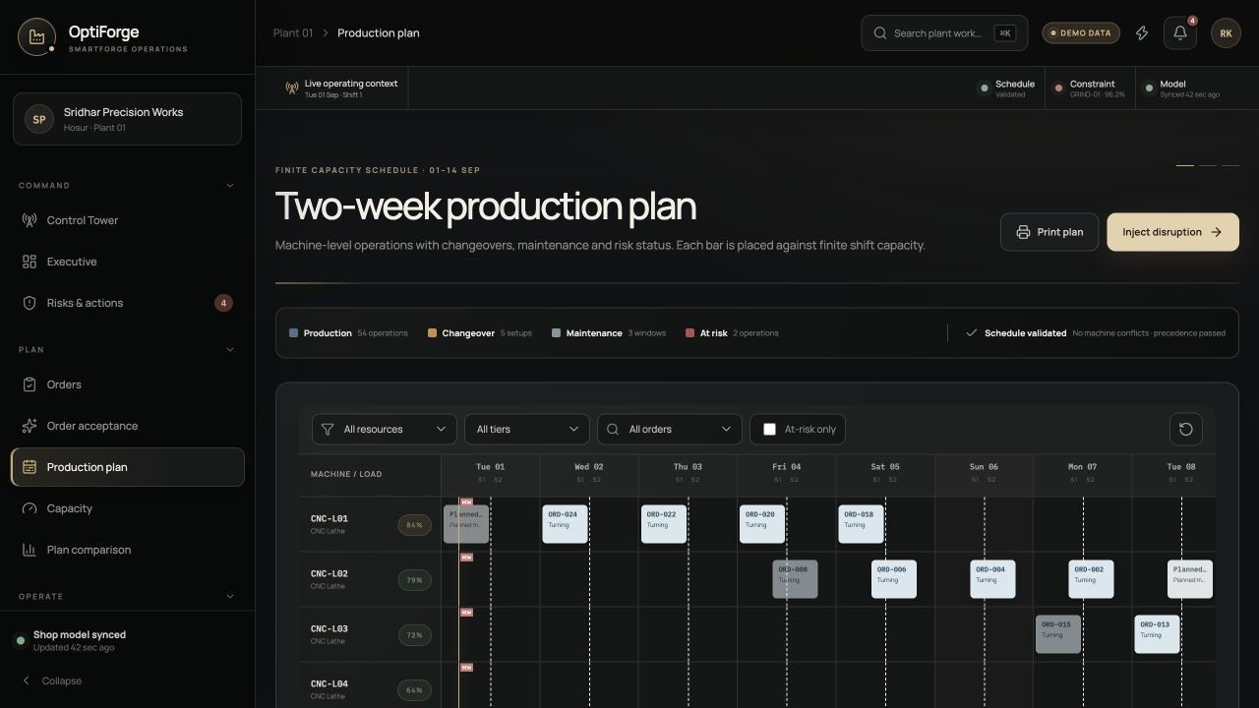
FINITE-CAPACITY SCHEDULING
04
The Gantt is a validated plan—not a decorative timeline
EVERY PUBLISHED TASK PASSES
✓
No overlap
Machine and operator intervals cannot collide.
✓
Precedence
Routing order and material release remain intact.
✓
Eligibility
Capabilities, skills, shifts and power are enforced.
✓
Sequence
Part-family changeovers consume real capacity.
SMARTFORGE · FINITE-CAPACITY MANUFACTURING DECISIONS
Notes:
Describe the conceptual decision variables: select one compatible machine/operator alternative and one start/end interval for each unfinished operation. CP-SAT enforces no-overlap, precedence, capability, skills, shifts, maintenance, breakdowns, material, power, generator capacity and sequence-dependent changes. A deterministic heuristic is the interactive fallback, and both outputs pass the independent validator.
[Sources]
- docs/scheduling-model.md
- backend/app/optimizer/scheduler.py
- backend/app/optimizer/validator.py
- Local SmartForge /schedule capture

Slide 5
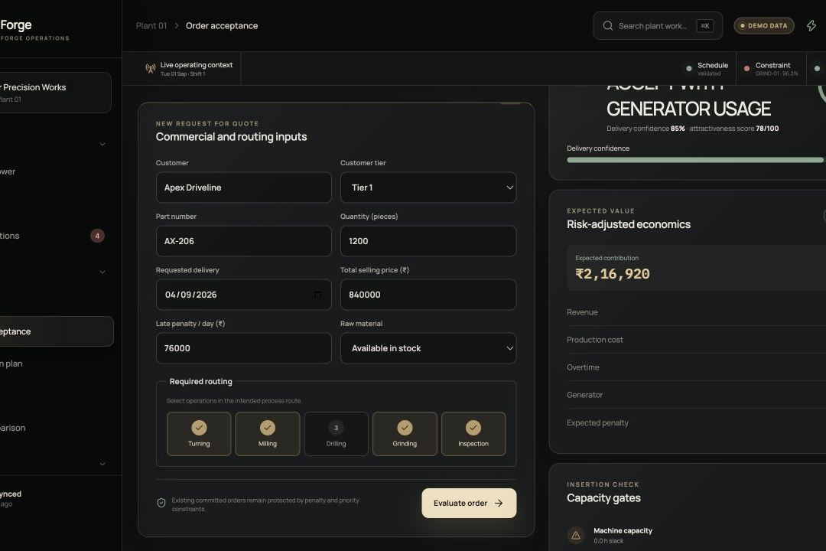
CAPABLE-TO-PROMISE
05
New RFQs are tested against the work already promised
ACCEPT WITH
GENERATOR USAGE
Apex Driveline · Tier 1 · 1,200 pieces
85%
₹2.17L
DELIVERY CONFIDENCE
RISK-ADJUSTED CONTRIBUTION
The engine checks
Machine hours · qualified labour · material timing · power economics · penalty displacement
SMARTFORGE · FINITE-CAPACITY MANUFACTURING DECISIONS
Notes:
Use the seeded Apex Driveline RFQ. The request is temporarily inserted into the current constrained state, not an empty factory. Explain that the decision combines feasibility, delivery confidence, recovery costs, contribution and displacement penalties. The displayed result is generated locally when the API is unavailable and is reproducible from the seeded demo inputs.
[Sources]
- backend/app/services/rfq.py
- frontend/src/services/api.ts — deterministic RFQ fallback
- Local SmartForge /acceptance capture after evaluation

Slide 6
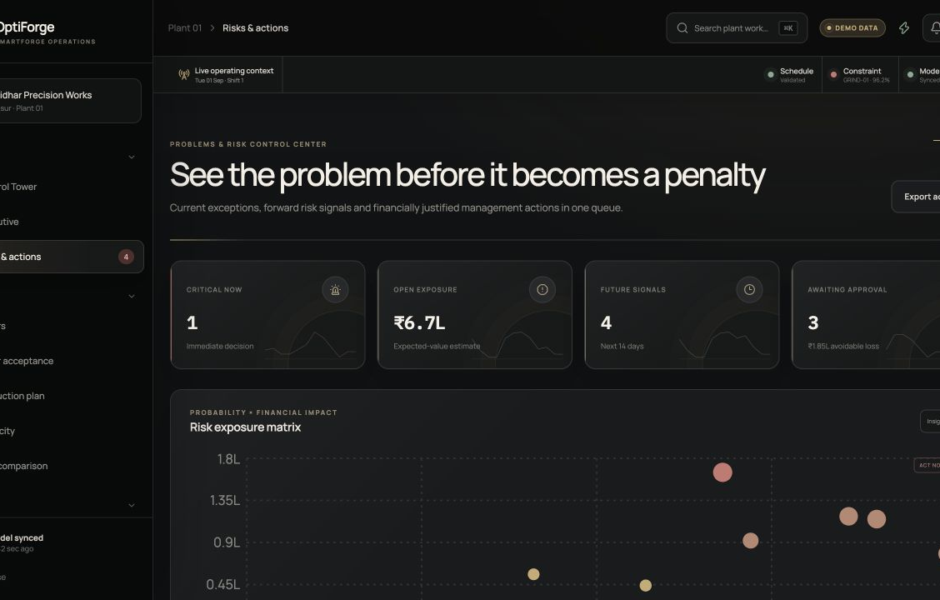
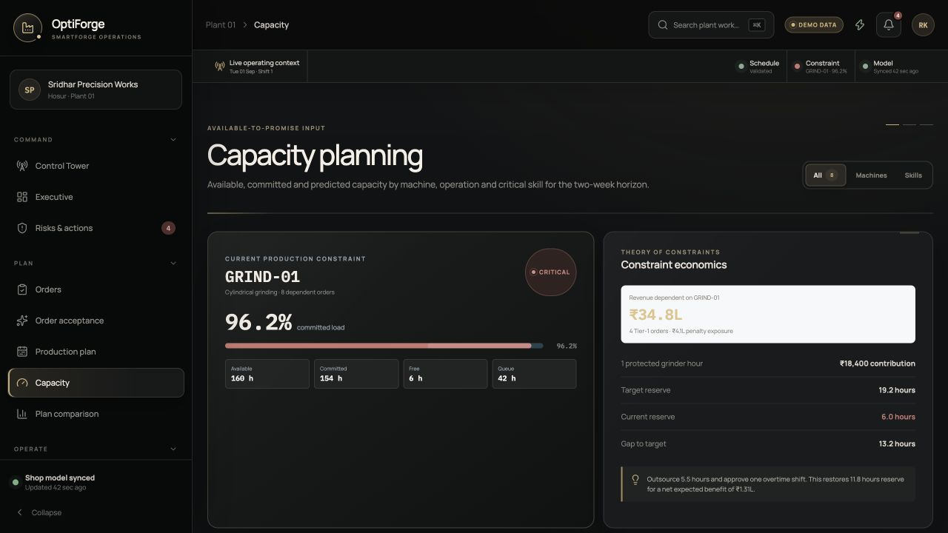
RISK + CAPACITY
06
Risk becomes actionable when capacity meets ₹ exposure
Expected-loss view
Constraint view
Probability × impact identifies the risks worth acting on before they become penalties.
Machine hours and skill-constrained hours reveal whether equipment capacity is truly usable.
SMARTFORGE · FINITE-CAPACITY MANUFACTURING DECISIONS
Notes:
Risk is not only a severity label. SmartForge combines probability, financial impact, affected orders and timing. Capacity is calculated at both resource and qualified-skill level; a free grinder is not usable capacity when all grinder-qualified operators are unavailable.
[Sources]
- README.md — risk analysis and capacity planning
- backend/app/services/capacity.py
- Local SmartForge /risks and /capacity captures

Slide 7
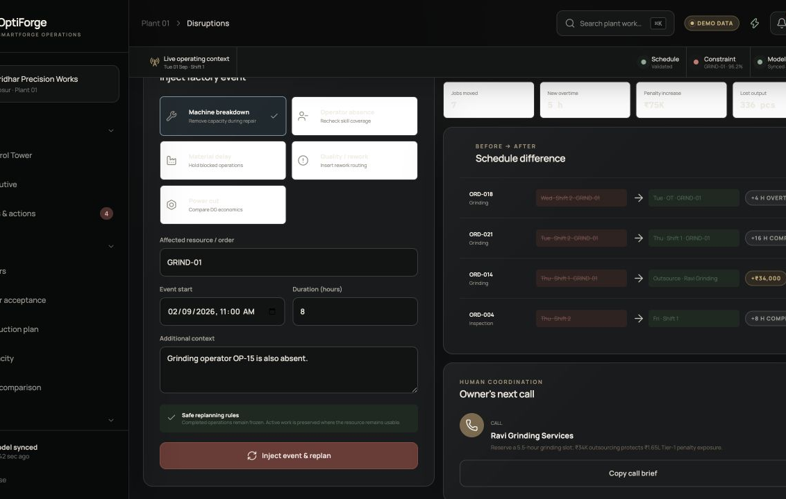
DYNAMIC RECOVERY
07
Recovery preserves history and prices every move
7
JOBS MOVED
+5h
NEW OVERTIME
₹75K
PENALTY INCREASE
OWNER'S NEXT CALL
Ravi Grinding Services
Reserve an outsourced grinding slot to protect the Tier-1 commitment.
SMARTFORGE · FINITE-CAPACITY MANUFACTURING DECISIONS
Notes:
Demonstrate the eight-hour GRIND-01 failure with OP-15 absent. Completed and unaffected in-progress work remain frozen. The revised plan blocks lost capacity, regenerates only unfinished work, validates the result and reports moved jobs, resource changes, overtime, penalties and lost output. The Owner's Next Call converts the result into a coordination action.
[Sources]
- backend/app/services/replanning.py
- frontend/src/services/api.ts — deterministic disruption fallback
- Local SmartForge /disruptions capture after replanning

Slide 8
POLICY TRADE-OFFS
08
The cheapest plan is not automatically the best plan
SERVICE + RECOVERY RESERVE
MANAGEMENT RECOMMENDATION
Most Robust
₹22.9L
95%
expected profit
on-time delivery
14% reserve around constrained and fragile resources absorbs disruption for only ₹20K less expected profit than the nominally cheapest plan.
Demo policy metrics; live API values replace the fallback when available.
SMARTFORGE · FINITE-CAPACITY MANUFACTURING DECISIONS
Notes:
Compare the three explicit policies. Cheapest returns ₹23.1L expected profit but only 84% on-time delivery and 3% reserve. Most On-Time reaches 98% service with more cost. Most Robust preserves 95% service and 14% reserve at ₹22.9L expected profit. The recommendation makes the trade-off visible rather than collapsing it into one unexplained score.
[Sources]
- frontend/src/data/demo.ts — plans array
- backend/app/services/comparison.py
- Local SmartForge /plan-comparison capture used for verification

Slide 9
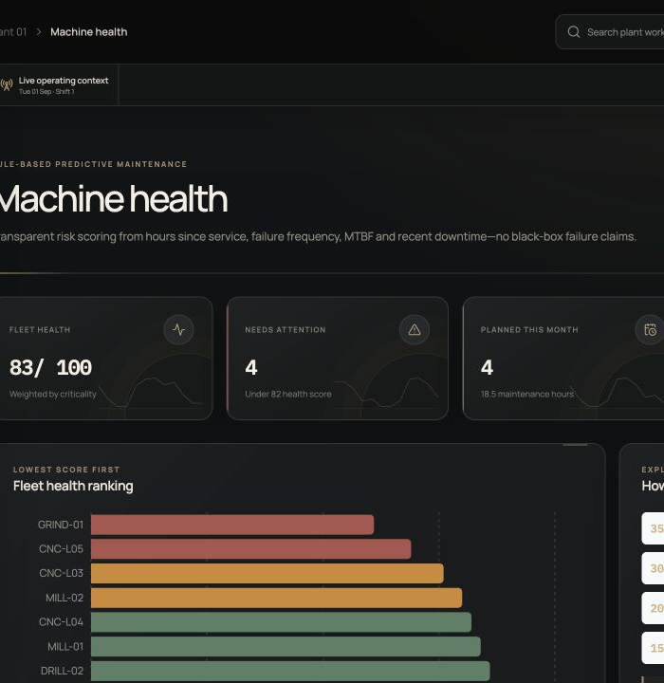
INDUSTRIAL SAAS EXPERIENCE
09
Role-based views turn factory data into decisions
Management
Planning
Maintenance
Profit, delivery, utilization and penalty exposure
Constraint load, remaining hours and recovery options
Health ranking, failure basis and intervention priority
SMARTFORGE · FINITE-CAPACITY MANUFACTURING DECISIONS
Notes:
The frontend is workflow-oriented. Managers see service and financial exposure, planners see capacity and schedules, maintenance sees health priorities, and supervisors receive an execution board. The shared design system uses typed API adapters, responsive layouts and deterministic demo fallbacks without changing backend contracts.
[Sources]
- README.md — application pages and design/UI
- frontend/src/pages/ and frontend/src/components/
- Local SmartForge dashboard, capacity and machine-health captures

Slide 10
THE TECHNICAL CONTRIBUTION
Feasibility becomes a business action
01
02
03
04
Factory state
Valid schedule
Priced trade-off
Auditable action
Orders · machines · people · material · power
Assignments · intervals · independent checks
Profit · penalties · risk · reserve
Accept · recover · call · invest
Production path
ERP / MES / CMMS integration · PostgreSQL + queued solve workers · RBAC and audit · calibrated costs and uncertainty · shadow-mode validation
SmartForge is decision support—not autonomous machine control.
Notes:
Close by returning to the engineering contribution: not a dashboard or solver in isolation, but the connection between a validated finite-capacity plan and an explainable action—accepting an order, protecting a promise, authorizing overtime or generator use, recovering from a failure or investing in constrained capacity. State the limits clearly: generated data, deterministic risk rules and no live factory control.
[Sources]
- docs/project-presentation-and-approach.md — suggested closing statement
- docs/assumptions.md
- README.md — limitations and future enhancements

