Slide 1
LLM Course: Session 1

Slide 2
Course goal
A hands on introduction to LLMs ( LLM inference with open AI and open source Hugging Face models,Function calling LLMs, RAG, LLM fine tuning,very basic Langchain)
Expects you to know what vectors are and what a dot product is.
Past deep learning, NLP exposure is obviously helpful.
Will not cover MCPs, Agents , Langgraph, Crew.ai , autogen, GRPO

Slide 3
What will we cover ?
Session 1: Quick review of ML, Neural networks, Text Processing , environment setup
Session 2: LLM inference using Open AI and Ollama, basic Langchain
Session 3: Gradio, Function calling LLMs
Session 4: HuggingFace pipelines, Open source LLMs
Session 5: RAG
Session 6: LLM fine tuning

Slide 4
Environment and account setup
Follow instructions here: https://github.com/prizmaweb/llm_course/blob/main/install.txt
Above includes step to pip install a list of needed packages given here:
https://github.com/prizmaweb/llm_course/blob/main/requirements.txt
Download Ollama on your mac/PC.
Create an Open AI account ( optional)

Slide 5
Basic ML, Neural Networks

Slide 6
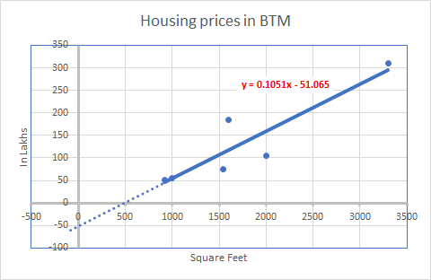
How much would you pay for 1300 sq Ft in BTM ?
Housing prices in BTM
Size ( square Feet) | Price (Lakhs)
2000 | 105
1600 | 185
3300 | 310
1000 | 55
920 | 52
1540 | 75
1300 | ?

Slide 7
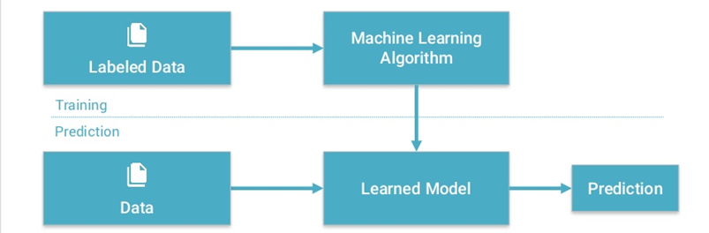
A Basic Machine learning workflow

Slide 8
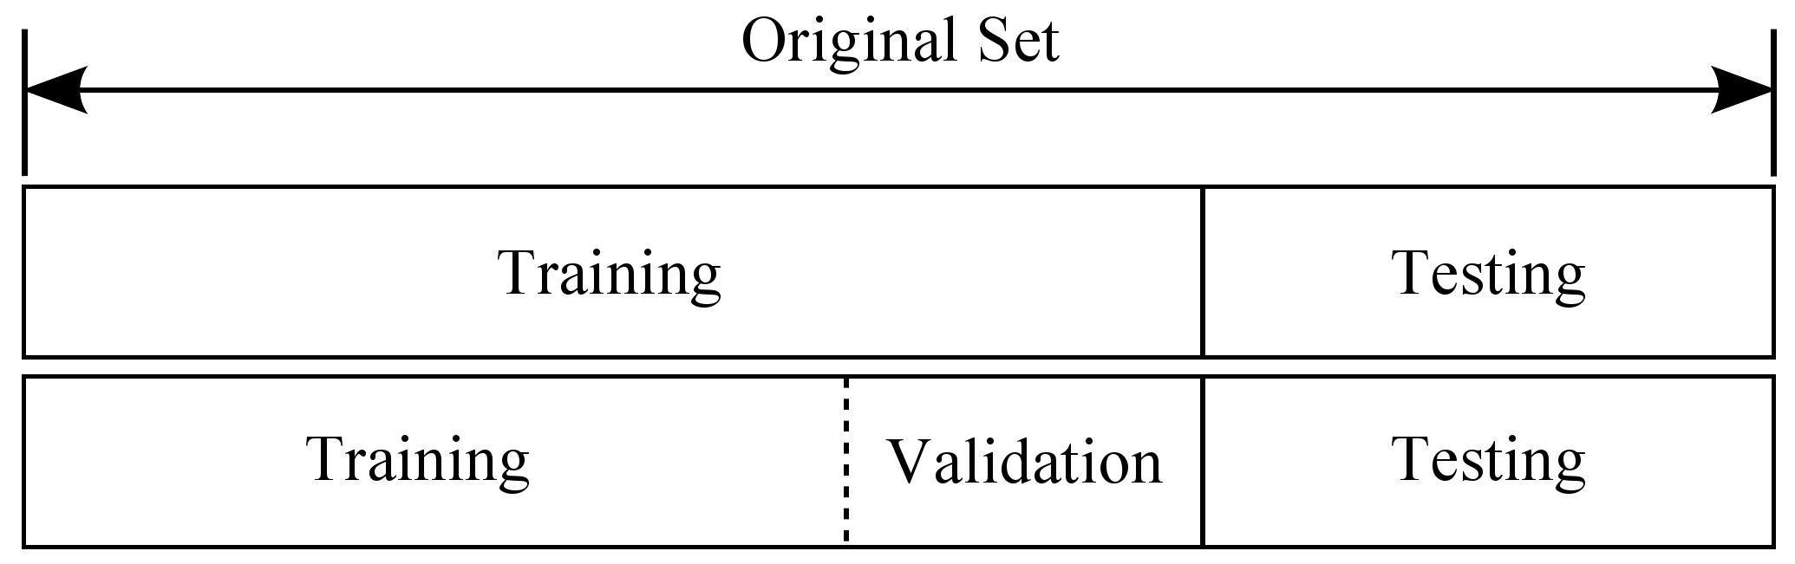
Data is split into training, validation, test sets

Slide 9

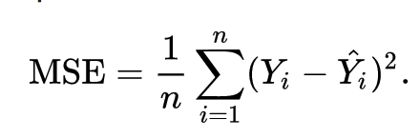
The Model: Linear regression example
A model is a function that approximates the observed phenomena. It has some (initially) unknown parameters ( called ‘weights’)
Y = 0.1051*X - 51.06
Cost Function
A function that tracks the model output’s deviation from the actual values. Needed to learn the optimal model parameters.

Slide 10
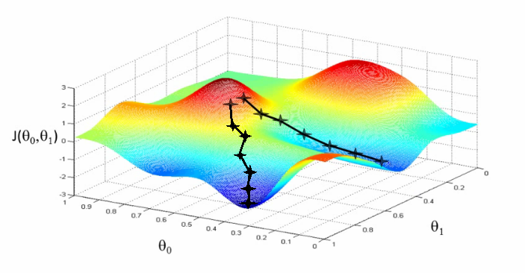
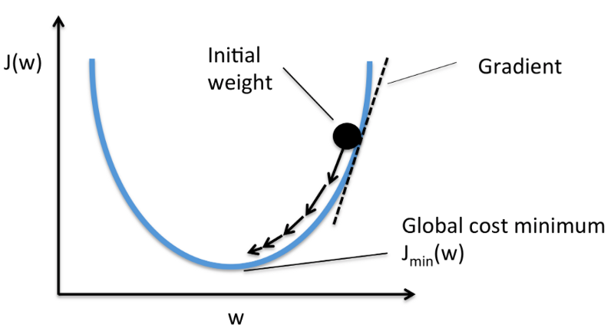
Gradient Descent: The best solution lies where cost function is lowest
Cost function plot with respect to input variables
Cost function plot with respect to input variables
Moving in the opposite direction to gradient should lead us to the lowest point(s)!

Slide 11
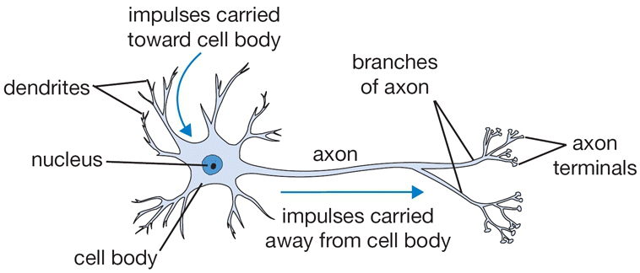
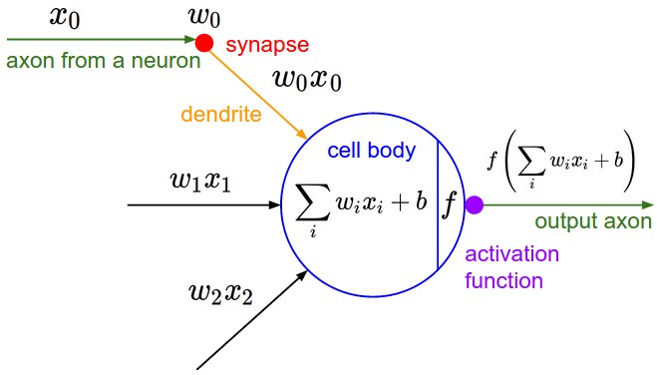
A mathematical model of a single neuron
A drawing of a biological neuron (left) and its mathematical model (right).

Slide 12
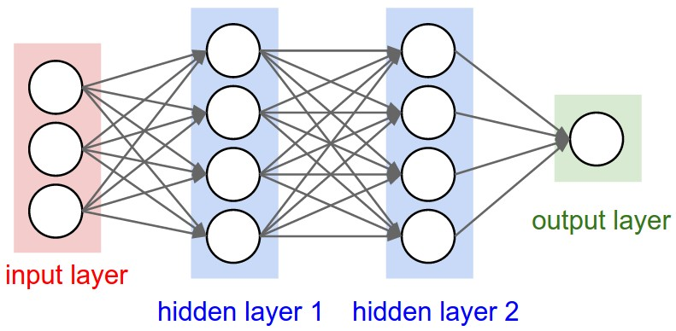
A neural net : many layers of connected neurons
weights go here
Notes:
If we create layers of neurons and connect them to subsequent layers, what we end up with is a neural network. This is a powerful concept- each of these neurons is a non linear function, and taken together, this network can model any function in the world. The process of discovering the optimal weights of these networks for a given problem is called backpropagation.

Slide 13
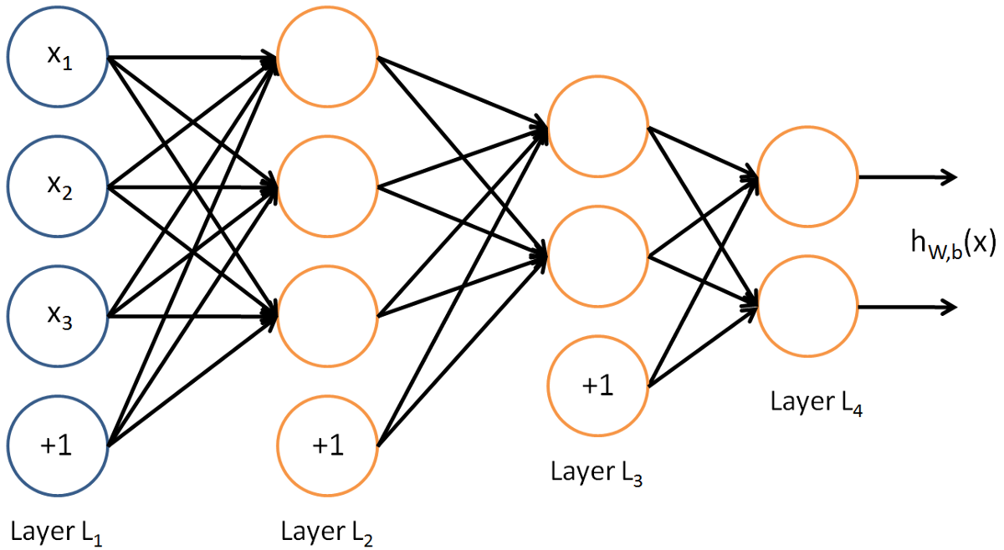
Neural networks are like management hierarchies
Notes:
Each layer processes information and outputs a summarized data, which is further processed till a final output layer

Slide 14
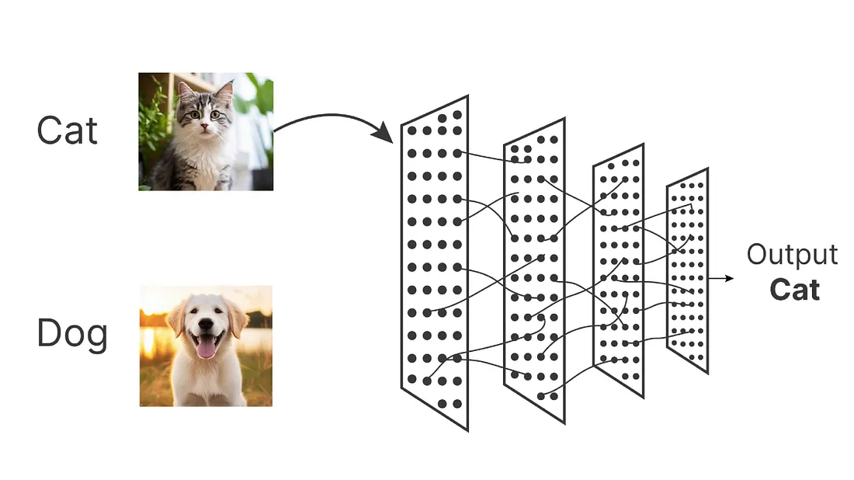
Neural networks can solve classification Problems

Slide 15
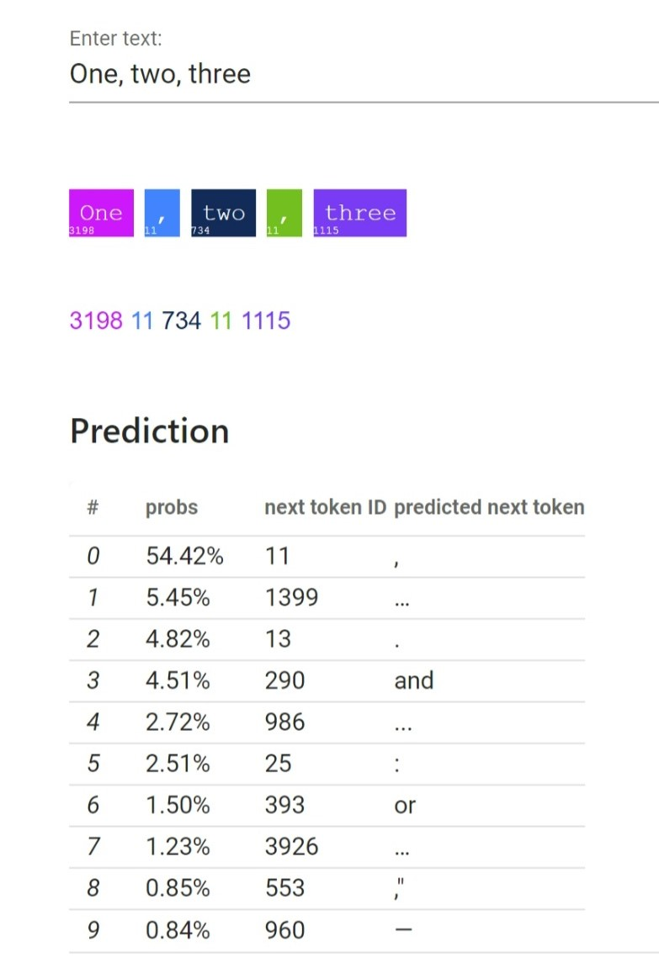
Next token prediction given some text
Notes:
Now we can frame the next token given a current phrase as a classification problem.

Slide 16
Text Processing

Slide 17
How to represent text for a Neural network?
We can represent words as discrete symbols
Example: One hot vectors where one bit is 1, rest are 0:
hotel = [0 0 0 0 0 0 0 0 0 0 0 1 0 0 0 0]
motel = [0 0 0 1 0 0 0 0 0 0 0 0 0 0 0 0]
But:
The vector dimension is the total # of words in the vocabulary - a problem for large vocabularies
The mapping approach ignores word similarity completely.

Slide 18
# One Hot Encoding Categoricals
books = ["War and Peace", "Anna Karenina",
"The Hitchhiker's Guide to the Galaxy"]
books_encoded = [[1, 0, 0],
[0, 1, 0],
[0, 0, 1]]
Similarity (dot product) between First and Second = 0
Similarity (dot product) between Second and Third = 0
Similarity (dot product) between First and Third = 0

Slide 19
Word Embeddings
Words as dense, not one hot vectors where similar meanings words occur nearby:
books = ["War and Peace", "Anna Karenina",
"The Hitchhiker's Guide to the Galaxy"]
books_encoded_ideal = [[0.53, 0.85],
[0.60, 0.80],
[-0.78, -0.62]]
Similarity (dot product) between First and Second = 0.99
Similarity (dot product) between Second and Third = -0.94
Similarity (dot product) between First and Third = -0.97

Slide 20
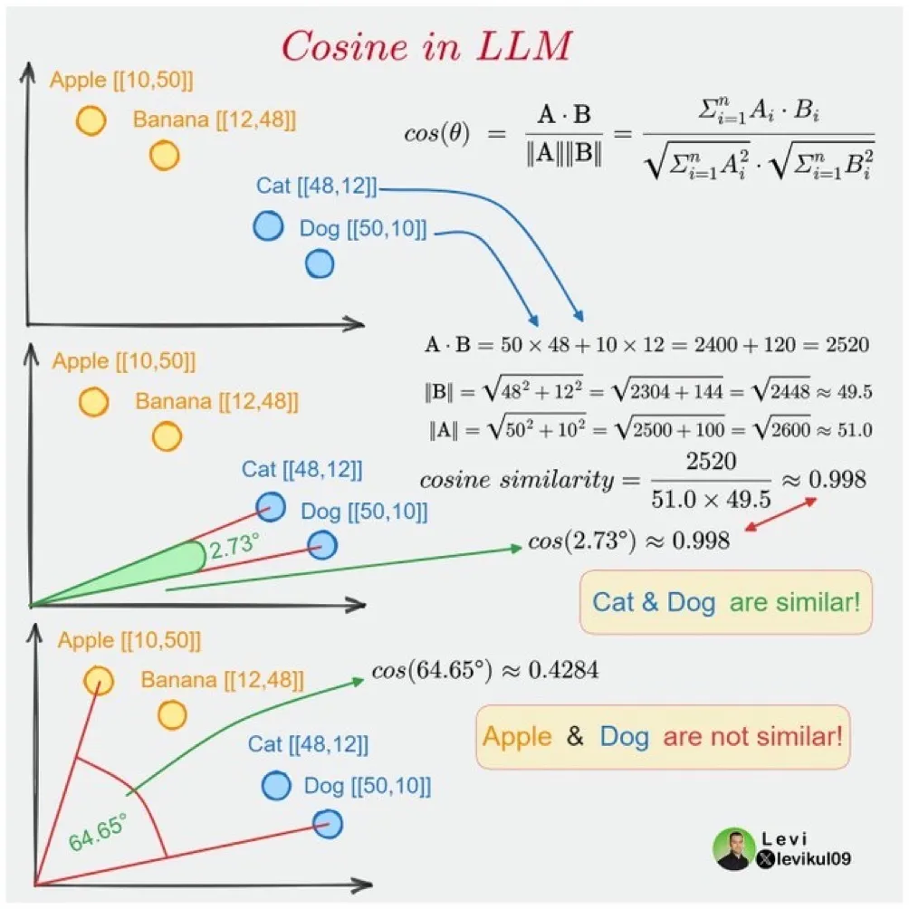

Slide 21
Tokenizing text inputs
Tokenizing a text is splitting it into words or subwords, which then are converted to ids through a look-up table
The tokenizer does this compression by constructing a one-to-one map of token strings (combinations of characters) to token IDs (a number).
A pretrained language model’s subword vocabulary cannot be altered: any downstream application of these models must tokenize input or generate output using the original subword vocabulary,

Slide 22
Tokenizing Options
Word Tokenization: Splitting text along word spaces and punctuation characters
(-) very large vocabulary size
Character tokenization: Simple and would greatly reduce memory and time complexity.
(-) But makes it hard for the model to learn meaningful input representations. ‘T’ in itself means nothing compared to ‘Today’ .
(-) Very long sequences
Subword tokenization Frequently used words should not be split into smaller subwords but rare words should be decomposed into meaningful subwords
Unigram Lang Model Tokenization : Begin with a superset of the final vocabulary, pruning it to desired size: (+) Semantically relevant affixes

Slide 23
Transformer Architecture

Slide 24
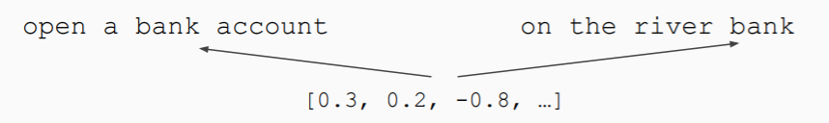
word2vec style word embeddings are not enough...
Words are not discrete symbols
There are some new faces in the office
He had to save face
Face the problem.
Consider the wider context (interactions between words) for disambiguation.
Important interactions can be non local
“How meanings combine depends on those meanings” (Eg:under the weather)
Sources: talk by Felix Hill, Deepmind & Stanford NLP seminar slides
Notes:
Words are not discrete symbols, the meaning changes based on how words combine, and also with context .
The interactions between the individual tokens matter, and we need to pay attention to the other words in the sentence when arriving at the meaning of a word
A model that just treats words as discrete symbols will fail to capture the full meaning

Slide 25
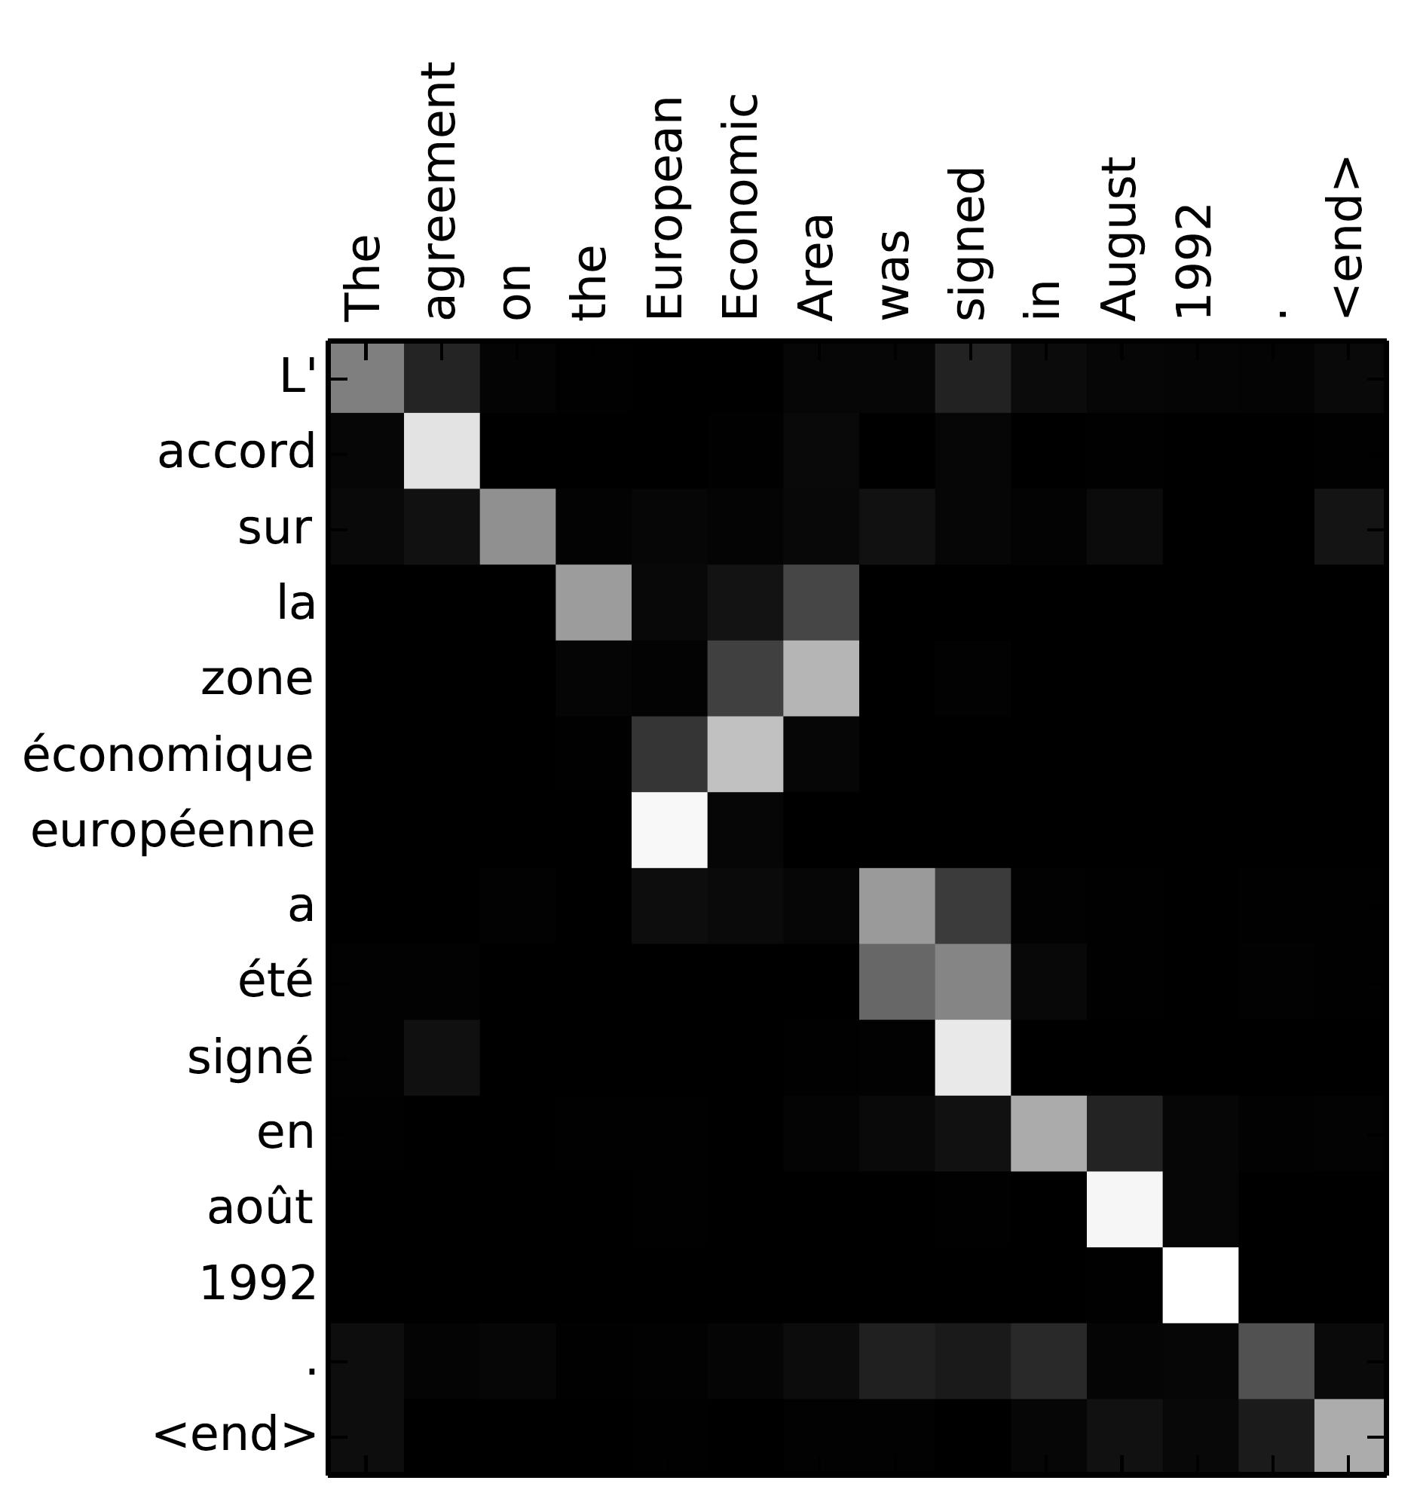
Attention during a translation task
Notes:
Each word in the target translated text might depend more on one or more input words- and thus when generating translated text, each target word must pay more attention to some specific input words rather than weigh all of them equally

Slide 26
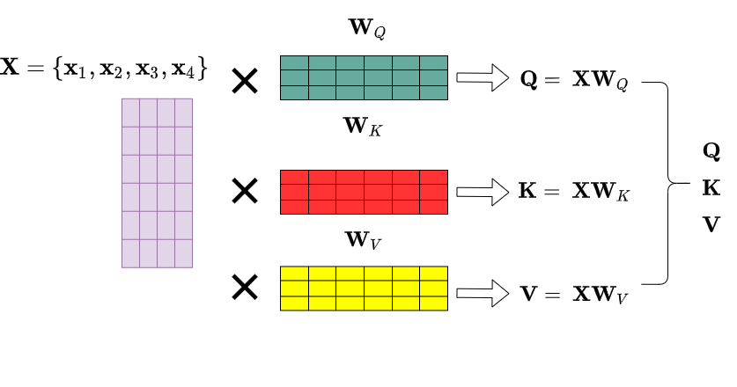
Add layers to generate 3 new activations: Q,K,V

Slide 27
Self attention
Q
Q
Q
Q
K
K
K
K
V
V
V
V
The
Sun
also
rises
Notes:
We convert our tokens to embeddings, and multiply them with 3 matrices ( whose weights are to be learnt), to learn 3 vectors - a query Q, a key K and a value V

Slide 28
Self attention : compute dot product of Q,K
Q1
Q1
Q1
Q1
K1
K2
K3
K4
Q
Q
Q
Q
K
K
K
K
V
V
V
V
The
Sun
also
rises
Notes:
For each token, we compare the query vector for it with the key vectors of other tokens using a scaled dot product

Slide 29
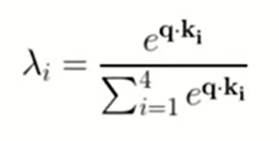
Self attention: Learn a weighted avg representation for each token w.r.t other tokens
Attention vector
Attention vector
Attention vector
λ₁
Q
Q
Q
Q
λ₂
λ₃
λ₄
K
K
K
K
V
V
V
V
The
Sun
also
rises
Notes:
That gives us a score for each token with respect to every other token. This score is converted to a probability using the softmax function giving attention weights between each token and every other token in the sentence.
We use this to calculate a weighted average of the value vector

Slide 30
Self attention :A single transformer block
Feed fwd layer
Feed fwd layer
Feed fwd layer
Feed fwd layer
Q
Q
Q
Q
K
K
K
K
V
V
V
V
The
Sun
also
rises
Notes:
That gives us a score for each token with respect to every other token. This core is converted to a probability using the softmax function giving attention weights between each token and every other token in the sentence.
We use this to calculate a weighted average of the value vector

Slide 31
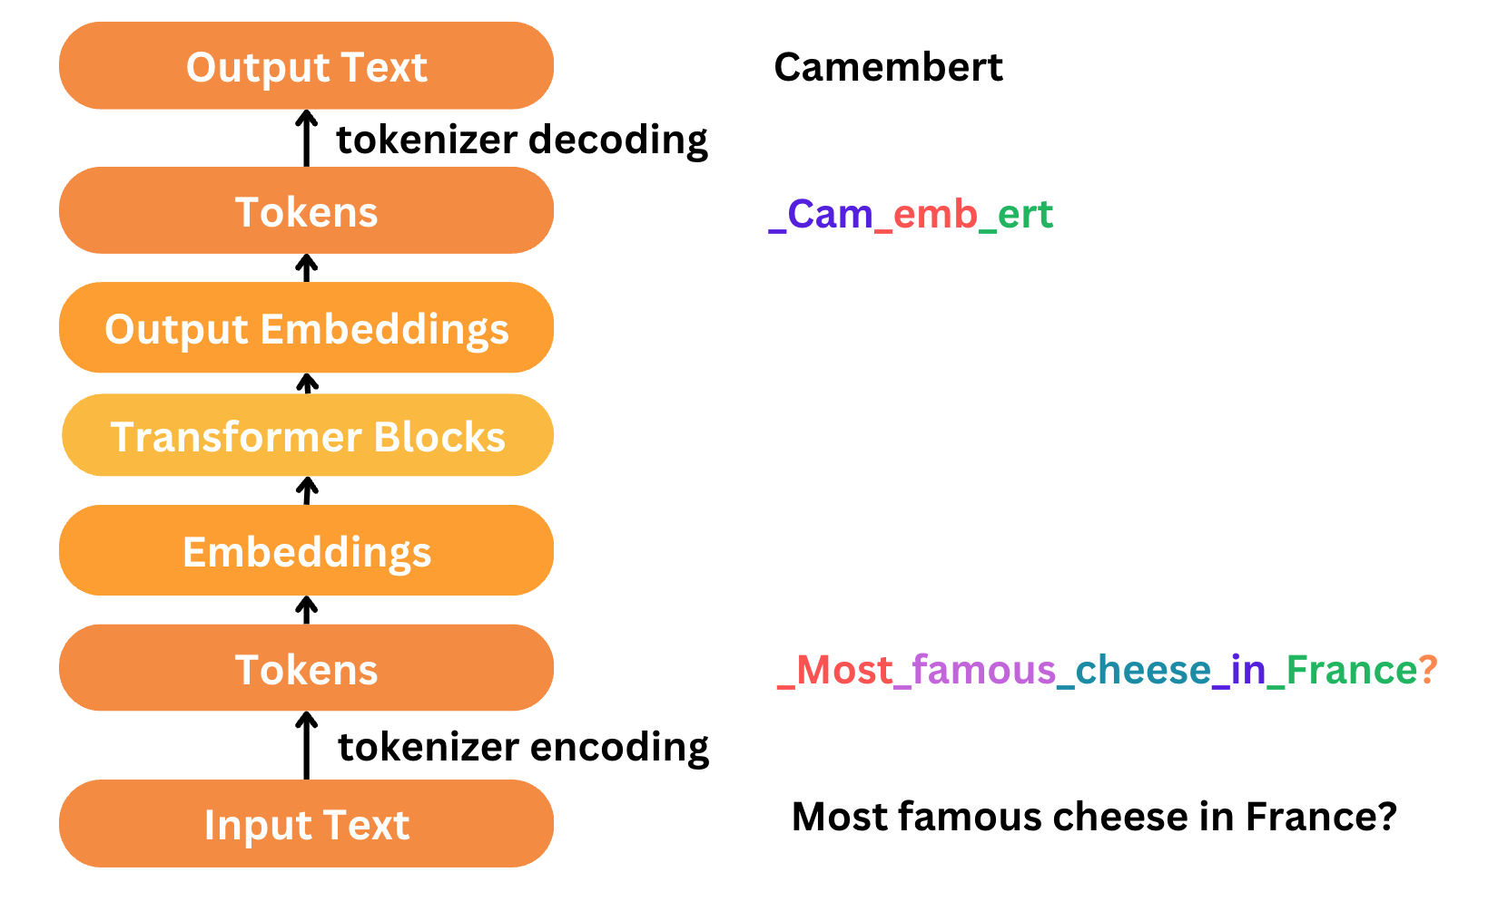
Text processing steps in a Large language Model

