Slide 2
What is HuggingFace
A leading platform for machine learning and natural language processing (NLP).
Hosts thousands of pre‑trained models (LLMs, vision, audio, etc.).
Provides tools like Transformers library, Datasets, and Spaces for deploying ML apps.
Community‑driven: researchers, developers, and companies share models openly.

Slide 3
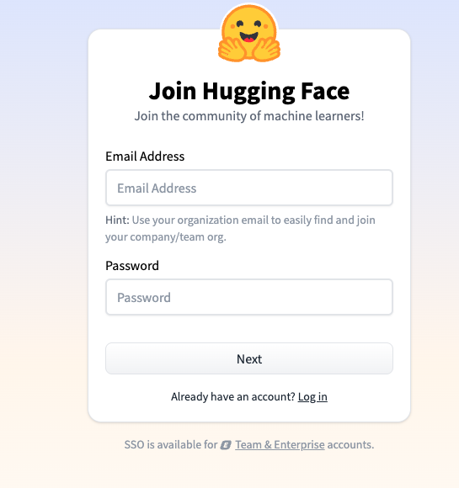
Getting Started
Go to huggingface.co.
Click Sign Up (top right).
Enter your email, username, and password.
Verify your email address.
Log in to access your profile and models.

Slide 4
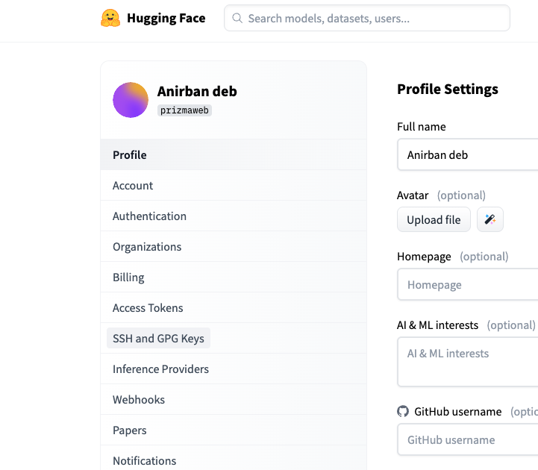
Generate an access token
While logged in, click your profile picture → Settings.
Navigate to Access Tokens.
Click New Token.
Choose the name (HF_TOKEN).
Select write for token type
Copy the generated token — keep it private!

Slide 5
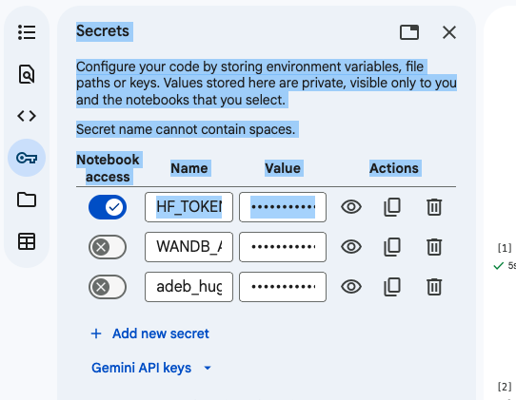
Add the token in your Google Colab notebooks

Slide 6
LLM Hello World Program
from transformers import AutoTokenizer, AutoModelForCausalLM
# Load tokenizer and model automatically
tokenizer = AutoTokenizer.from_pretrained("gpt2")
model = AutoModelForCausalLM.from_pretrained("gpt2")
# Encode and generate
inputs = tokenizer("Hello world, How are you", return_tensors="pt")
outputs = model.generate(**inputs, max_length=30)
print(tokenizer.decode(outputs[0]))

Slide 7
Pipelines
High‑level API in Hugging Face’s transformers library.
Simplifies using pre‑trained models for common tasks.
The pipeline() abstraction handles tokenization, model inference, and decoding automatically.
Consistency: Same interface across tasks (text, vision, audio).
Flexibility: Swap models easily by changing the model name.
A pipeline consists of:
One or more components for pre-processing model inputs, such as a tokenizer, image_processor, feature_extractor, or processor.
A model that generates predictions from the inputs.
Optional post-processing steps to refine the model’s output, which can also be handled by processors.

Slide 8
Trask Specific Pipelines
Dedicated classes for specific tasks (e.g., TextClassificationPipeline, QuestionAnsweringPipeline).
Provide fine‑grained control and customization beyond the general pipeline().
Useful when you need to tweak preprocessing, postprocessing, or integrate into larger systems.

Slide 9
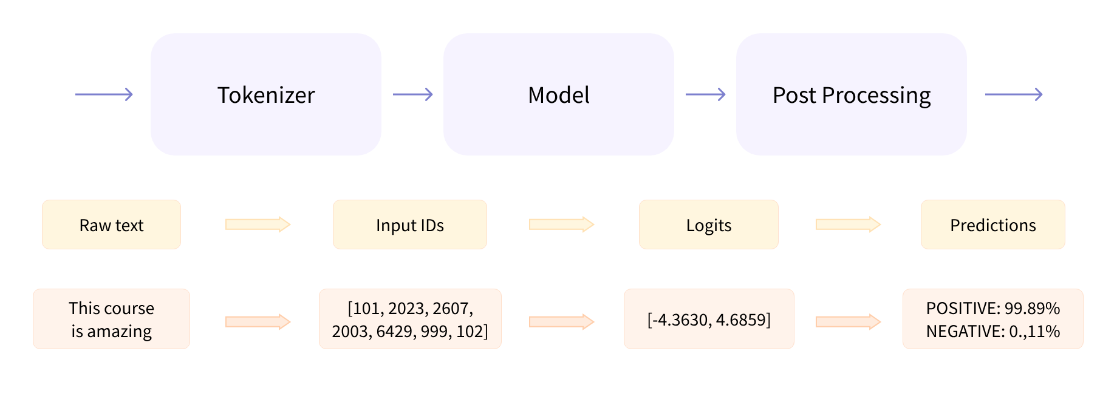
Three steps inside the pipeline function

Slide 10
Supported Tasks
Text classification (sentiment analysis, topic detection)
Text generation (LLMs, chatbots)
Named entity recognition (NER)
Question answering
Translation
Summarization
Image classification, object detection
Audio tasks (speech recognition, text‑to‑speech)

Slide 11
Using Pipelines
from transformers import pipeline
classifier = pipeline("sentiment-analysis")
classifier("Hello World! Have a wonderful day today")

