Slide 1
Function Calling LLMs

Slide 2
What we have covered

Slide 3
How to Process Natural Language
Passages have to be first split into individual tokens using a tokenizer
We explored a way to represent words and tokens using vectors such that semantically similar tokens are nearby
Language is not about individual words. Words combine to form meanings (River bank, vs bank deposit) .Context matters.
Solution : Let each token in a sentence combine with others to form a mixed output representation. We use a neural network +dot products to learn the weighted proportion of how they should combine

Slide 4
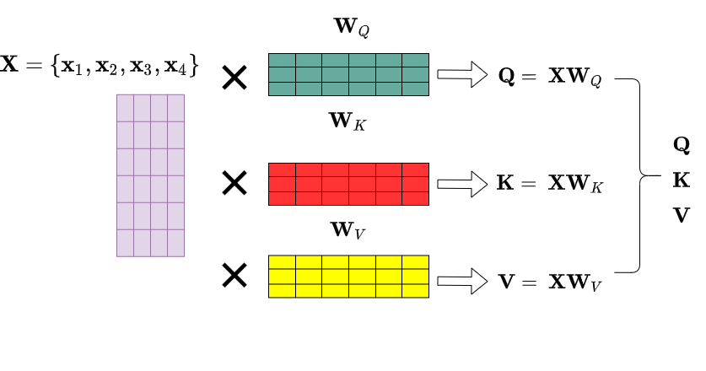
Learn3 output vectors Q,K,V and do dot products

Slide 5
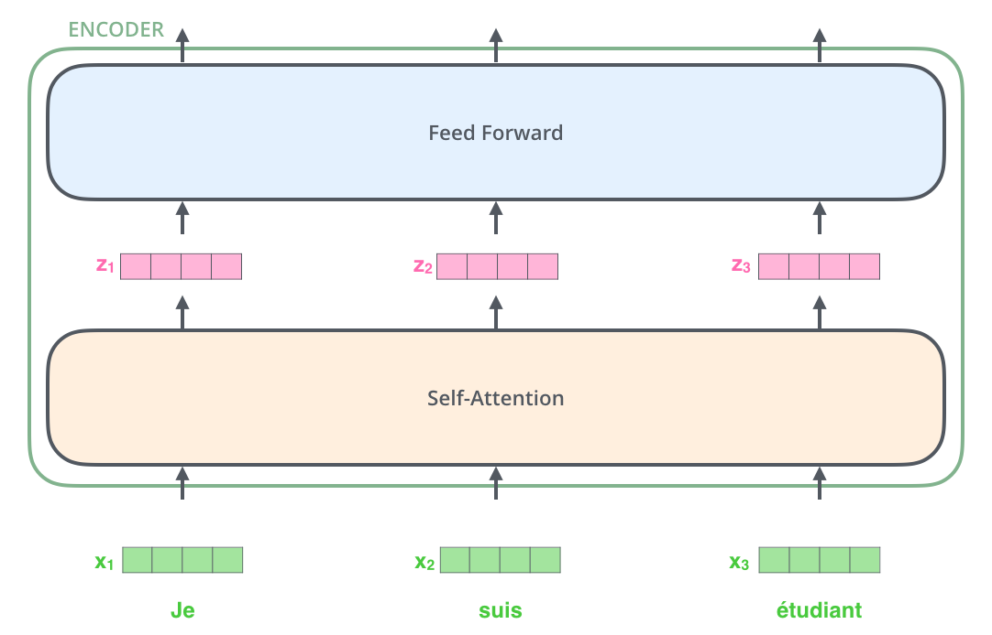
The Transformer architecture

Slide 6
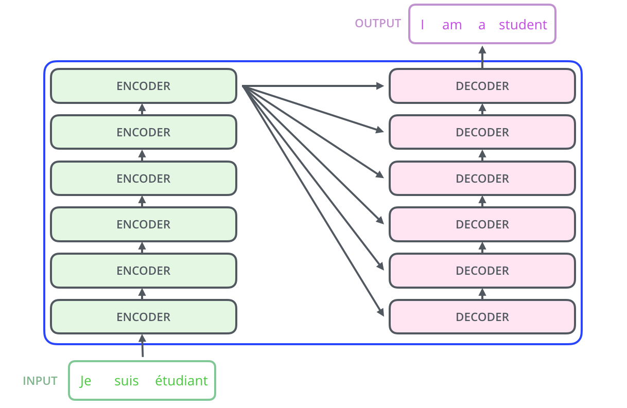
The Transformer architecture

Slide 7
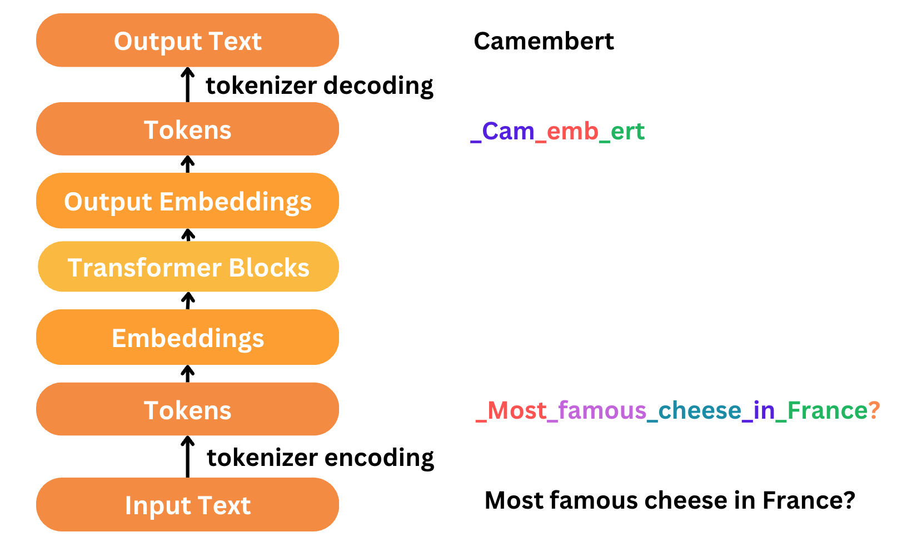
Text processing steps in a Large language Model

Slide 8
OPEN AI and Ollama
We learnt that the Transformer based models are exposed using REST APIs, like Open AI.
Ollama is a free on prem alternative which can use the same Open API format.
We learnt about a system prompt, about user prompts and the chat completion API
We need to chain multiple prompts to get something done , so frameworks like Langchain can make this easy with an expression language
But LLMs can only answer based on what they were trained on. We have to empower them with Tools to do additional tasks

Slide 9
Tool Use /Function calling

Slide 10
Tool Use/Function calling
Tool use allows LLMs to go beyond text generation by invoking external functions, APIs, or services.
Instead of answering only from their internal knowledge, models can decide: “I need to call a tool to get this information or perform this action.”
Common tools: search APIs, vector databases, calculators, custom business logic.

Slide 11
How Tool use works
Tool definition: Developers register tools with names, descriptions, and parameter schemas.
Model reasoning: The LLM interprets the user’s request and decides if a tool is relevant.
Tool call: The model outputs a structured request (often JSON) instead of plain text.
Execution: The external tool runs and returns results.
Integration: The LLM incorporates the tool’s output into its final response.

Slide 12
Example: Open AI tool calling
OpenAI lets you define tools in the tools parameter.
The model decides when to call them (tool_choice="auto").
Example: a get_weather function is invoked when the user asks “What’s the weather in Paris?”
response = client.chat.completions.create(
model="gpt-4o-mini",
messages=[{"role": "user", "content": "What's the weather in Paris?"}],
tools=[...],
tool_choice="auto"
)

Slide 13
Open AI response
{
"role": "assistant",
"content": null,
"tool_calls": [
{
"id": "call_abc123",
"type": "function",
"function": {
"name": "get_weather",
"arguments": {
"location": "Paris"
}
}
}
]
}
role: "assistant" → the model is responding.
content: null → no natural language output yet, because it’s calling a tool.
tool_calls → structured JSON telling you which tool to invoke.
function.name → the tool name (get_weather).
arguments → the parameters extracted from the user’s request ("Paris").

Slide 14
Call tool and send response to model
response = client.chat.completions.create(
model="gpt-4o-mini",
messages=[
{"role": "user", "content": "What's the weather in Paris?"},
{"role": "assistant", "tool_calls": [...]}, # model’s tool call
{"role": "tool", "tool_call_id": "call_abc123", "content": result}
]
)

Slide 15
Gradio
An open-source Python package that allows you to quickly build a demo or web application for your AI models.
Gradio includes more than 30 built-in components (such as the gr.Textbox(), gr.Image(), and gr.HTML() components)

Slide 16
Gradio Interface class
The Interface class has three core arguments:
fn: the function to wrap a user interface (UI) around
inputs: the Gradio component(s) to use for the input. The number of components should match the number of arguments in your function.
outputs: the Gradio component(s) to use for the output. The number of components should match the number of return values from your function.

Slide 17
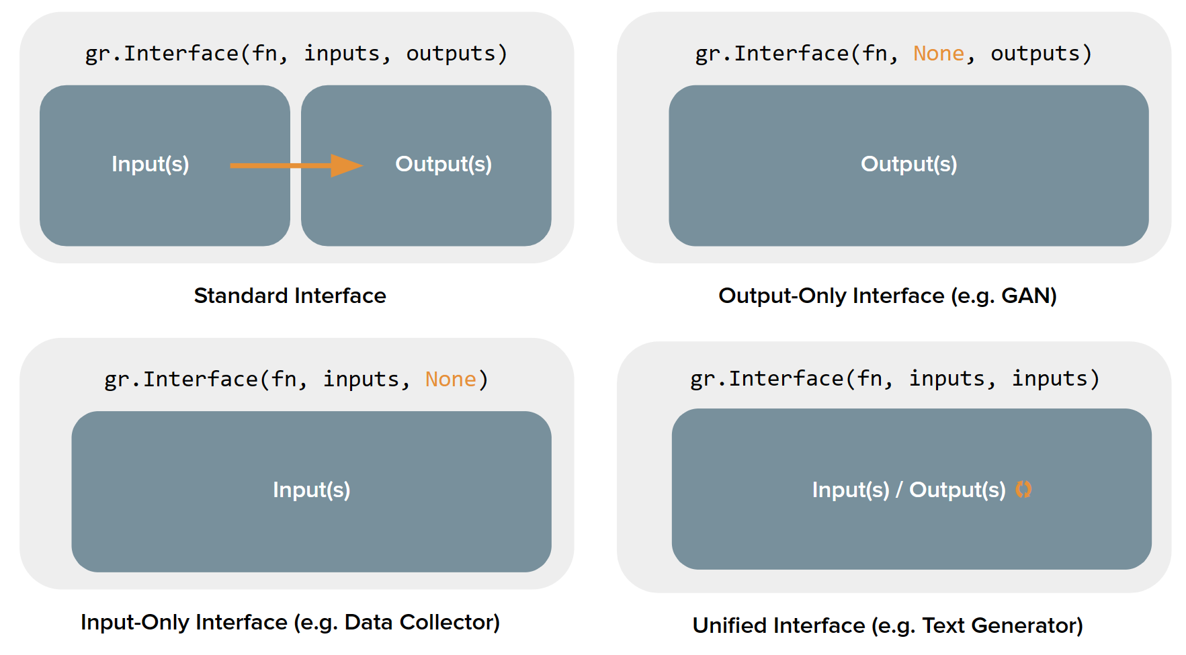
The four kinds of Interfaces

Slide 18
Other Gradio classes
gr.ChatInterface: Gradio includes a high-level class, gr.ChatInterface, which is specifically designed to create Chatbot UIs. With openAI compatible endpoint:
gr.load_chat("http://localhost:11434/v1/", model="llama3.2", token="***").launch()
The Gradio Chatbot exposes several events, such as .retry, .undo, .like, and .clear, to let you build this functionality into your application
gr.Blocks class: low-level approach for designing web apps with more customizable layouts and data flows. Blocks supports things like controlling where components appear on the page, handling multiple data flows and more complex interactions (e.g. outputs can serve as inputs to other functions),

Slide 19
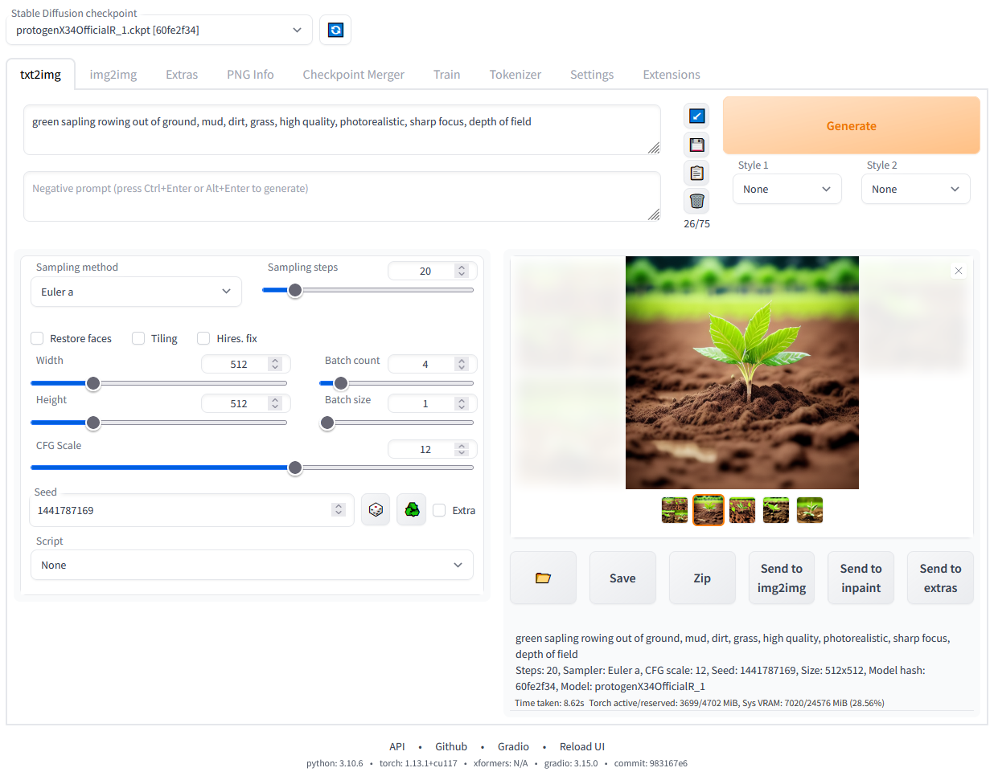
Stable Diffusion web UI using Gradio Blocks

