Slide 1
LLM Course: Session 1

Slide 2
What will we cover ?
Session 1: Quick review of ML, Neural networks, Text Processing hands on Ollama Jupyter notebook
Session 2: Gradio, Function calling LLMs
Session 4: HuggingFace Open source LLMs
Session 5: RAG
Session 6: LLM fine tuning

Slide 3
Basic ML, Neural Networks

Slide 4
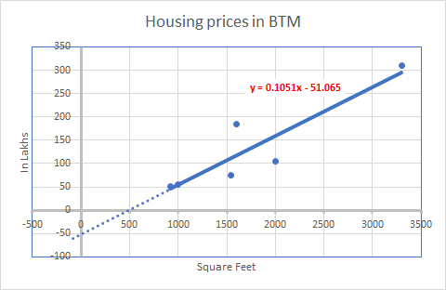
How much would you pay for 1300 sq Ft in BTM ?
Housing prices in BTM
Size ( square Feet) | Price (Lakhs)
2000 | 105
1600 | 185
3300 | 310
1000 | 55
920 | 52
1540 | 75
1300 | ?

Slide 5
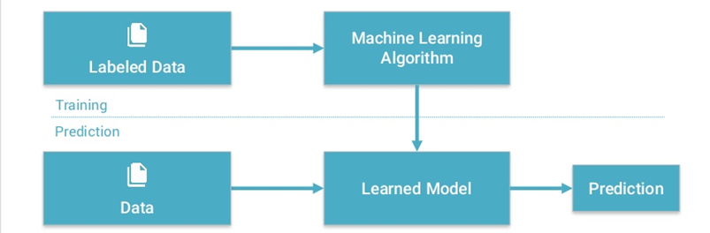
A Basic Machine learning workflow

Slide 6
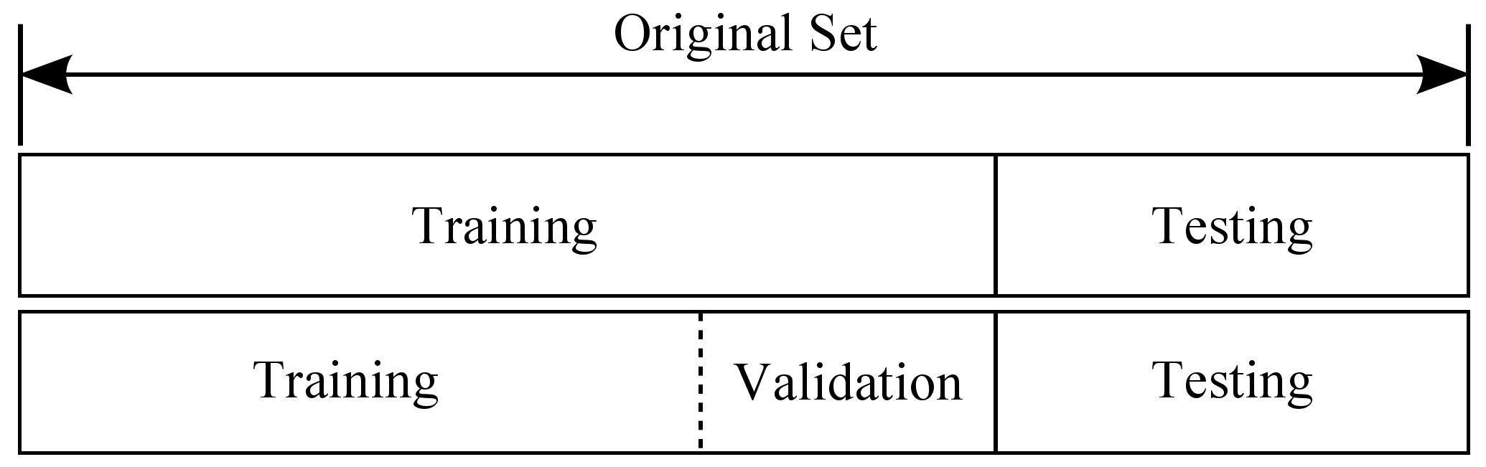
Data is split into training, validation, test sets

Slide 7

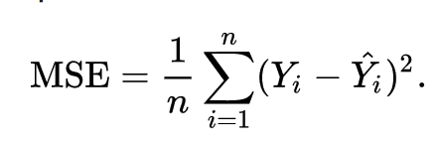
The Model: Linear regression example
A model is a function that approximates the observed phenomena. It has some (initially) unknown parameters ( called ‘weights’)
Y = 0.1051*X - 51.06
Cost Function
A function that tracks the model output’s deviation from the actual values. Needed to learn the optimal model parameters.

Slide 8
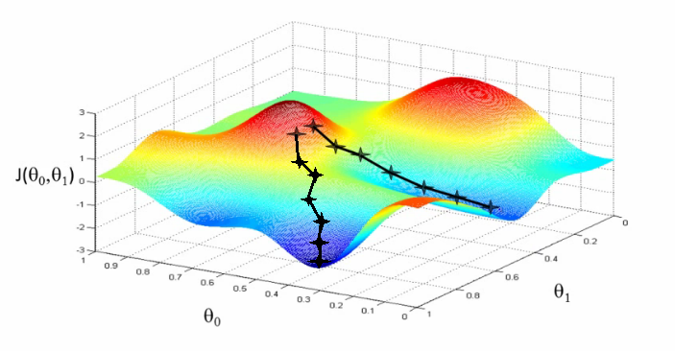
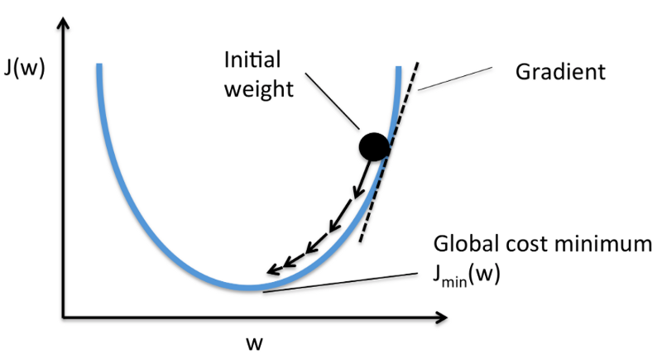
Gradient Descent: The best solution lies where cost function is lowest
Cost function plot with respect to input variables
Cost function plot with respect to input variables
Moving in the opposite direction to gradient should lead us to the lowest point(s)!

Slide 9
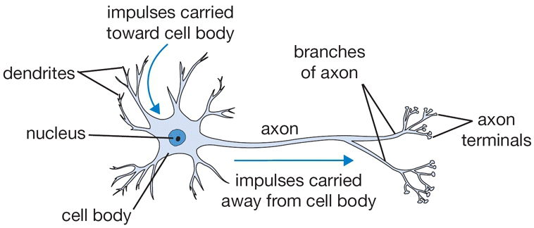
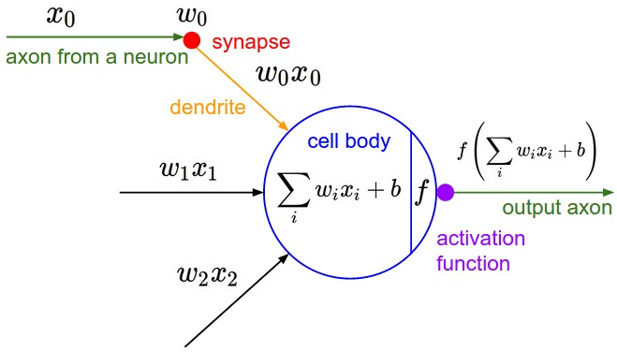
A mathematical model of a single neuron
A drawing of a biological neuron (left) and its mathematical model (right).

Slide 10
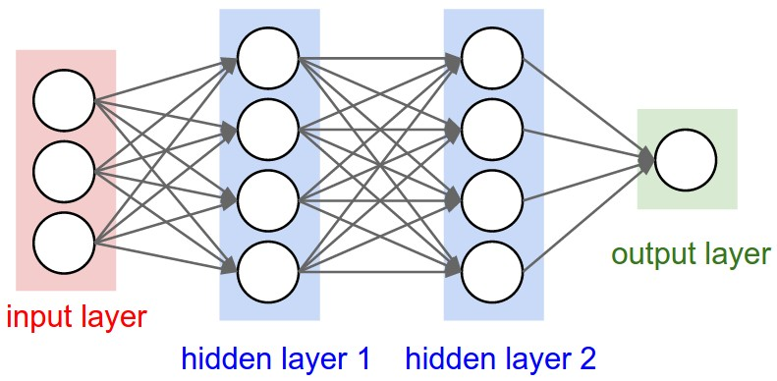
A neural net : many layers of connected neurons
weights go here
Notes:
If we create layers of neurons and connect them to subsequent layers, what we end up with is a neural network. This is a powerful concept- each of these neurons is a non linear function, and taken together, this network can model any function in the world. The process of discovering the optimal weights of these networks for a given problem is called backpropagation.

Slide 11
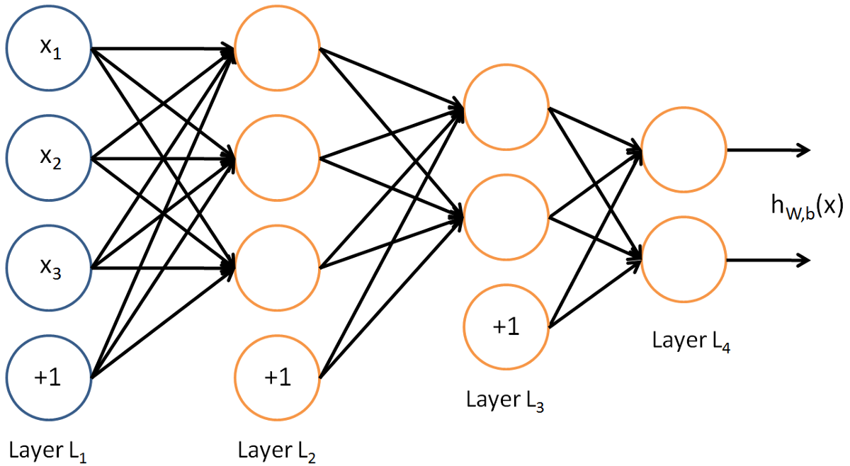
Neural networks are like management hierarchies
Notes:
Each layer processes information and outputs a summarized data, which is further processed till a final output layer

Slide 12
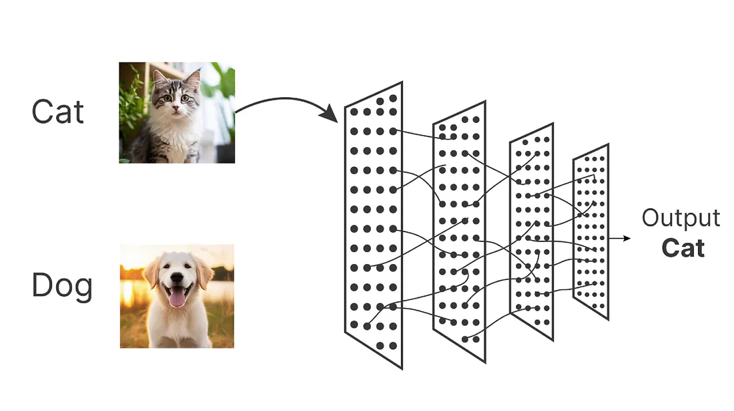
Neural networks can solve classification Problems

Slide 13
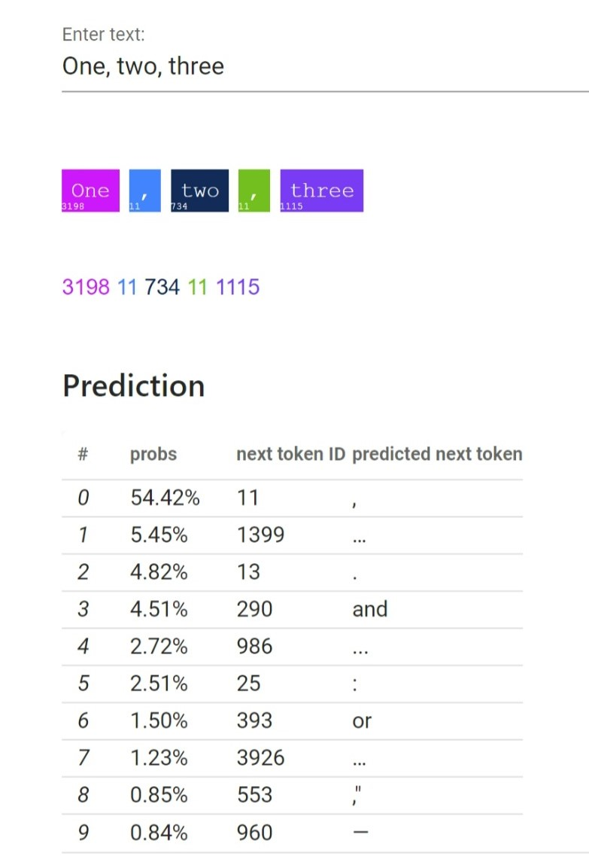
Next token prediction given some text
Notes:
Now we can frame the next token given a current phrase as a classification problem.

Slide 14
Text Processing

Slide 15
How to represent text for a Neural network?
We can represent words as discrete symbols
Example: One hot vectors where one bit is 1, rest are 0:
hotel = [0 0 0 0 0 0 0 0 0 0 0 1 0 0 0 0]
motel = [0 0 0 1 0 0 0 0 0 0 0 0 0 0 0 0]
But:
The vector dimension is the total # of words in the vocabulary - a problem for large vocabularies
The mapping approach ignores word similarity completely.

Slide 16
# One Hot Encoding Categoricals
books = ["War and Peace", "Anna Karenina",
"The Hitchhiker's Guide to the Galaxy"]
books_encoded = [[1, 0, 0],
[0, 1, 0],
[0, 0, 1]]
Similarity (dot product) between First and Second = 0
Similarity (dot product) between Second and Third = 0
Similarity (dot product) between First and Third = 0

Slide 17
Word Embeddings
Words as dense, not one hot vectors where similar meanings words occur nearby:
books = ["War and Peace", "Anna Karenina",
"The Hitchhiker's Guide to the Galaxy"]
books_encoded_ideal = [[0.53, 0.85],
[0.60, 0.80],
[-0.78, -0.62]]
Similarity (dot product) between First and Second = 0.99
Similarity (dot product) between Second and Third = -0.94
Similarity (dot product) between First and Third = -0.97

Slide 18
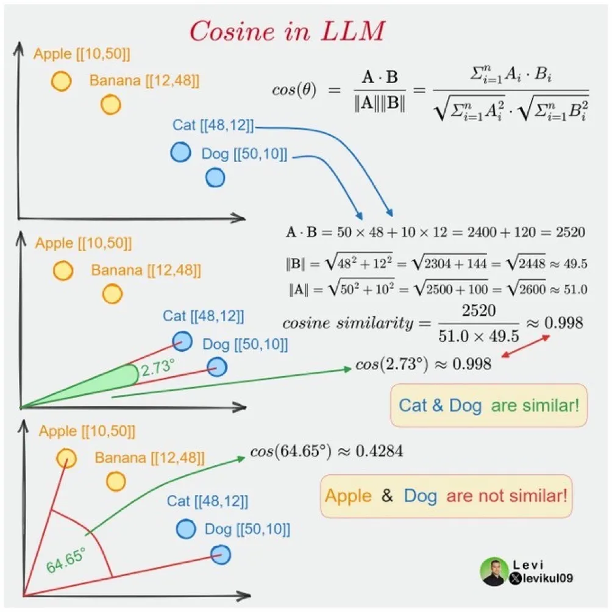

Slide 19
Tokenizing Text input
Tokenizing a text is splitting it into words or subwords, which then are converted to ids through a look-up table
The tokenizer does this compression by constructing a one-to-one map of token strings (combinations of characters) to token IDs (a number).
A pretrained language model’s subword vocabulary cannot be altered: any downstream application of these models must tokenize input or generate output using the original subword vocabulary,

Slide 20
Tokenizing Options
Word Tokenization: Splitting text along word spaces and punctuation characters
(-) very large vocabulary size
Character tokenization: Simple and would greatly reduce memory and time complexity.
(-) But makes it hard for the model to learn meaningful input representations. ‘T’ in itself means nothing compared to ‘Today’ .
(-) Very long sequences
Subword tokenization Frequently used words should not be split into smaller subwords but rare words should be decomposed into meaningful subwords
Unigram Lang Model Tokenization : Begin with a superset of the final vocabulary, pruning it to desired size: (+) Semantically relevant affixes

Slide 21
What are Large language Models?
Language Models are models that are trained without supervision on sentence completion tasks, where a partial string is fed as input and it predicts the output:
“A stitch in time _____________”
This is called ‘pre training’., and typically uses data consisting of Wikipedia or other internet pages.
The introduction of Transformers (Vaswani in 2017), allowed these models to understand a word in context of the whole sentence,, allowing for more accurate completions.
Large Language Models are neural nets that use the transformer architecture and have billions of parameters

Slide 22
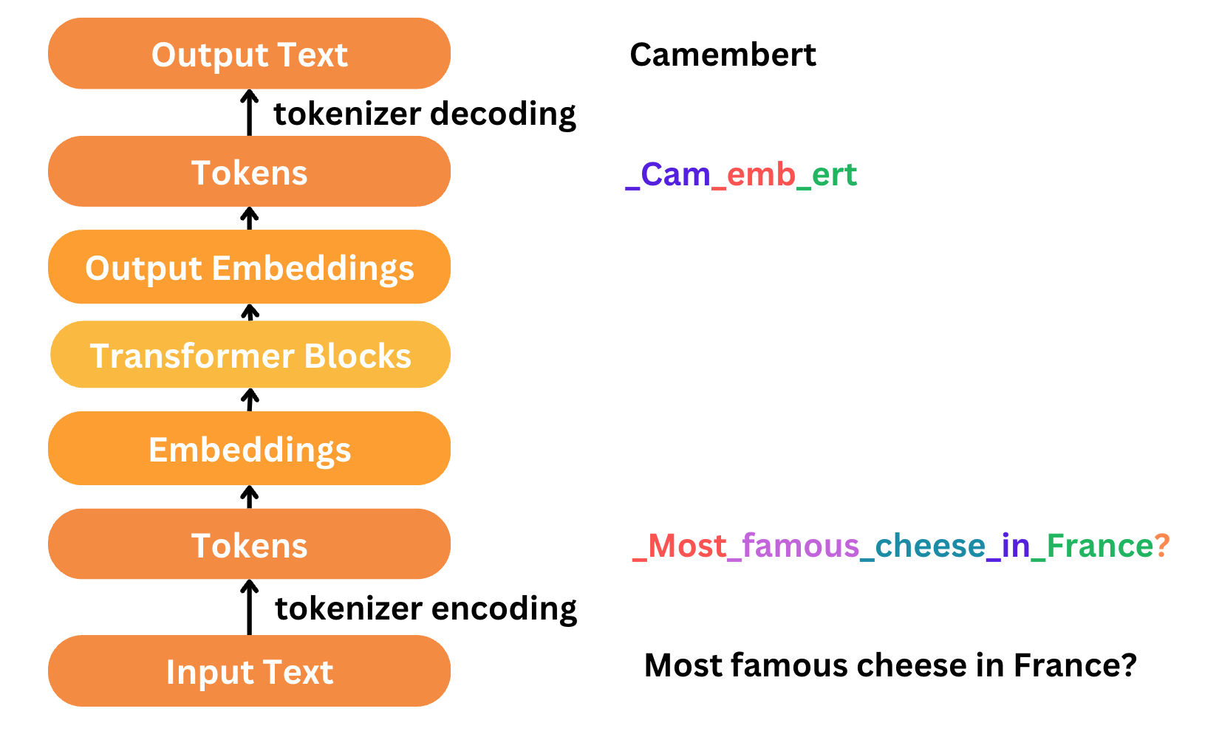
Text processing steps in a Large language Model

Slide 23
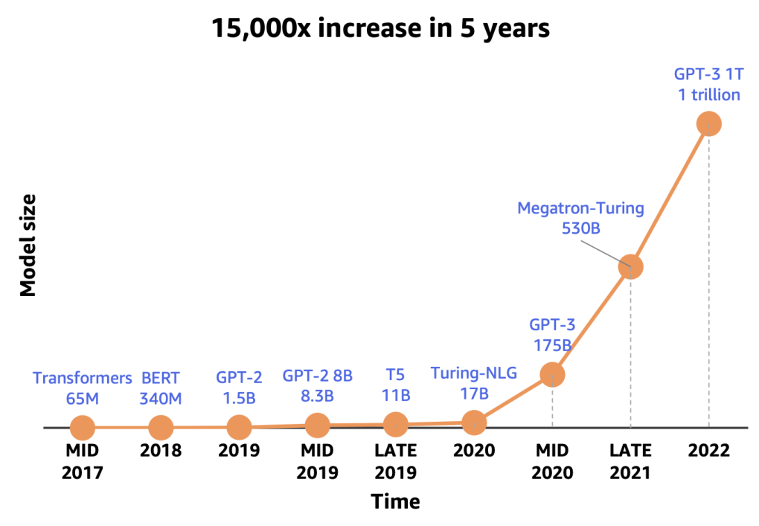
Larger and Larger Models

Slide 24
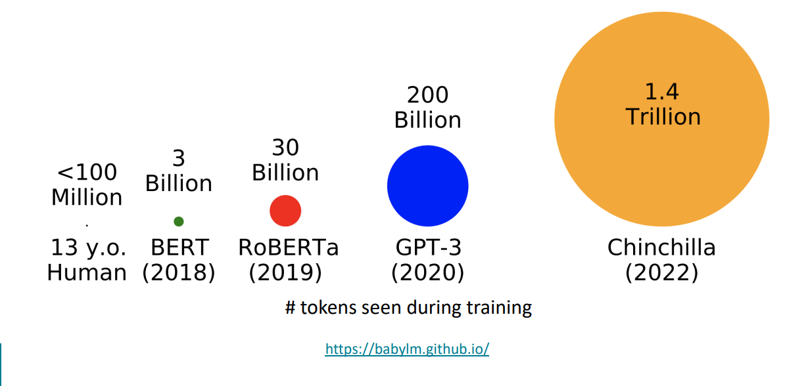
Trained on more and more data

