Slide 1
HIVE Fundamentals

Slide 2
Agenda
Introduction to Hive
Hive architecture
Features of Hive
Getting started with HIVE
Hive Query Language
Hive - JDBC connectivity
Hive metastore Using MySql as a metastore
User Defined Functions (UDF)
Integrating Hive and Pentaho
Partitioning in Hive
Performance Tuning
Notes:
2

Slide 3
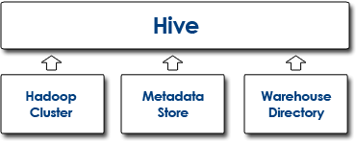
Introduction to Hive
Hive is a data warehouse infrastructure that is built on top of Hadoop
Hive provides a mechanism to project structure onto the data and query the data using SQL-like language called HiveQL

Slide 4
Introduction to Hive cont..
Components of HIVE
Hive is the foundation on which Hive queries are executed.
It is comprised of three components, which must be setup before defining Hive.
Advantages of using HIVE
It can be used as an ETL
Provides capability of querying and analysis
Can handle large data sets
SQL(filters, joins, group by) on top of Map and Reduce

Slide 5
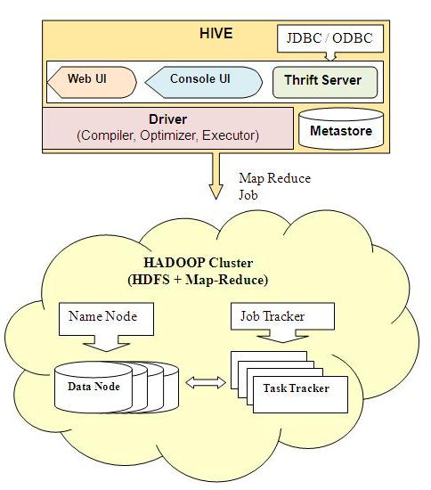
Hive architecture
Notes:
UI: The user interface for users to submit queries(CLI ,Web interface)
Driver: The component which receives the queries. It also provides execute and fetch APIs modelled on jdbc/odbc interface.
Metastore: Stores all the structure information of tables and partitions in the warehouse including column and column type information.
Compiler: It is a component that parses the query. It generates execution plan with the help of table and partition metadata looked up from the metastore.
Execution Engine: Executes the execution plan created by the compiler. This plan is a DAG of stages

Slide 6
Features of Hive
How is it Different from SQL
The major difference is that a Hive query executes on a Hadoop infrastructure rather than a traditional database.
This allows Hive to scale to handle huge data sets - data sets so large that high-end, expensive, traditional databases would fail.
The internal execution of a Hive query is via a series of automatically generated Map Reduce jobs
Hive Usage Scenario
Text mining
Log Processing
Document indexing
Customer-facing business intelligence (e.g., Web Analytics)

Slide 7
Getting started with Hive
Install Hive
Initialize environment variable
Configure Hive to run in different modes
Data types

Slide 8
Install Hive
To install hive, we need to simply untar the .gz file.
tar -xzvf hive-0.7.0.tar.gz
Hive configurations
Hive default configuration is stored in hive-default.xml file in the conf directory
Hive comes configured to use derby as the metastore
export HADOOP_HOME=/home/usr/hadoop-0.20.2
(Specifies the location of the installation directory of hadoop.)
export HIVE_HOME=/home/usr/hive-0.7.0-bin
(Specifies the location of the hive to the environment variable.)
export PATH=$HIVE_HOME/bin:$PATH
Initialize the environment variable

Slide 9
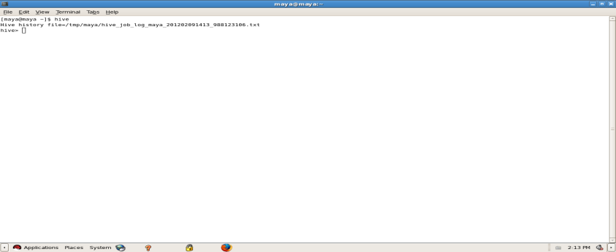
Running Hive in different modes
To start the hive shell, type hive and press enter
Two modes of execution
Local Mode
hive> SET mapred.job.tracker=local
Map Reduce Mode
hive> SET mapred.job.tracker=master:9001;

Slide 10
Hive Data types
The primitive data types in hive include Integers, Boolean, Floating point
numbers and Strings.
The below table lists the size of each data type:
Type Size ---------------------- --------- TINYINT 1 byte SMALLINT 2 byte INT 4 byte BIGINT 8 byte FLOAT 4 byte (single precision floating point numbers) DOUBLE 8 byte (double precision floating point numbers) BOOLEAN TRUE/FALSE value STRING Max size is 2GB.
Notes:
Hive also supports complex data types
The complex data types include Arrays, Maps and Structs. These data types are built on using the primitive data types. Arrays: Contain a list of elements of the same data type. These elements are accessed by using an index. For example an array, “fruits”, containing a list of elements [‘apple’, ’mango’, ‘orange’], the element “apple” in the array can be accessed by specifying fruits[1]. Maps: Contains key, value pairs. The elements are accessed by using the keys. For example a map, “pass_list” containing the “user name” as key and “password” as value, the password of the user can be accessed by specifying pass_list[‘username’] Structs: Contains elements of different data types. The elements can be accessed by using the dot notation. For example in a stuct, ”car”, the color of the car can be retrieved as specifying car.color The create table statement containing the complex type is shown below. CREATE TABLE complex_data_types ( Fruits ARRAY<string>, Pass_list MAP<STRING, STRING>, Car STRUCT<color: STRING, wheel_size: FLOAT> );

Slide 11
Hive Query Language
Hive query Language is very similar to SQL.
By default, hive uses the 'default' durby database.
Hive does not have SQL statements such as:
INSERT
UPDATE
DELETE
The underlying reason why these fundamental SQL statements are not available in Hive is that Hive (and Hadoop) technologies are designed for Data Warehousing applications (that is, write once, read many times).
But, most of the functionality of SQL statements INSERT, UPDATE and DELETE can be replicated through the use of the INSERT OVERWRITE TABLE

Slide 12
Hive Queries
Creating a table
hive> CREATE TABLE <table-name>
( <column name> <data-type>,
<column name> <data type>);
hive> CREATE TABLE <table-name>
( <column name> <data-type>,
<column name> <data type> )
row format delimited fields terminated by ‘\t’;
hive> create table events(a int, b string);
Loading data in a table
hive> LOAD DATA LOCAL INPATH ‘<input-path>' INTO TABLE events;
hive> LOAD DATA LOCAL INPATH ‘<input-path>' OVERWRITE INTO TABLE events;
Viewing the list of tables
hive> show tables;

Slide 13
Hive Queries
Displaying contents of the table
hive> select * from <table-name>;
Dropping tables
hive> drop table <table-name>;
Altering tables
Table names can be changed and additional columns can be dropped:
hive> ALTER TABLE events ADD COLUMNS (new_col INT);
hive> ALTER TABLE events RENAME TO pokes;
Using WHERE Clause
The where condition is a boolean expression. Hive does not support IN, EXISTS or sub queries in the WHERE clause.
hive> SELECT * FROM <table-name> WHERE <condition>

Slide 14
Hive Queries
Using Group by
hive> SELECT deptid, count(*) FROM department GROUP BY deptid;
Using Join
ATTENTION Hive users:
Only equality joins, outer joins, and left semi joins are supported in Hive.
Hive does not support join conditions that are not equality conditions as it is very difficult to express such conditions as a MapReduce job.
Also, more than two tables can be joined in Hive.
hive> SELECT a.* FROM a JOIN b ON (a.id = b.id)
Hive> SELECT a.val, b.val, c.val FROM a JOIN b ON (a.KEY = b.key1) JOIN c ON (c.KEY = b.key1)

Slide 15
Hive – JDBC Connectivity
You can access the data in Hive tables using Java.
Create a Hive-JDBC Connectivity for data manipulation
Steps for establishing Hive-JDBC Connectivity
Create a connection The hive jdbc parameters are
URL: jdbc:hive://localhost:10000/default
Driver name: org.apache.hadoop.hive.jdbc.HiveDriver
Username and password are empty
Once you create a connection, you can access or retrieve data from Hive

Slide 16
Sample program to establish a JDBC Connect
This program establishes a jdbc connection with hive. This also fetches and prints the first and second columns of the table 'testHiveDriverTable'
import java.sql.SQLException;
import java.sql.Connection;
import java.sql.ResultSet;
import java.sql.Statement;
import java.sql.DriverManager;
public class HiveJdbcClient {
private static String driverName = "org.apache.hadoop.hive.jdbc.HiveDriver";
public static void main(String[] args) throws SQLException {
try { Class.forName(driverName); } catch (ClassNotFoundException e) { e.printStackTrace(); }
Connection con = DriverManager.getConnection("jdbc:hive://localhost:10000/default", "", "");
Statement stmt = con.createStatement();
String tableName = "testHiveDriverTable";
sql = "select * from " + tableName;
ResultSet res = stmt.executeQuery(sql);
while (res.next()) {
System.out.println(res.getInt(1)+"\t"+res.getString(2)); }
}
}

Slide 17
Hive Metastore
The Metastore is the central repository for Hive metadata storage. By default, Hive is configured to use Derby as the metastore.
As a result of the configuration, a metastore_db directory is created in each working folder.
What are the problems with the default metastore
Users cannot see the tables created by others if they do not use the same metastore_db.
Only one embedded Derby database can access the database files at any given point of time
Results in only one open Hive session with a metastore. Not possible to have multiple sessions with Derby as the metastore

Slide 18
Solution - MySql as a metastore
Solution
We can use a standalone database either on the same machine or on a remote machine as a metastore
Any JDBC-compliant database can be used
MySql is a popular choice for the standalone metastore
Advantage
This solution will enable Hive to support multiple sessions and therefore multiple users

Slide 19
Configuring MySql as metastore
Install MySQL Admin/Client
Create a Hadoop user and grant permissions to the user
Download MySql-connector-java-5.1.11.tar.gz and untar the same
Add the jar file located inside the MySql-connector directory to your CLASSPATH
mysql -u root –p
mysql> Create user 'hadoop'@'localhost' identified by 'hadoop‘;
mysql> Grant ALL previleges on *.* to 'hadoop'@'localhost' with GRANT option;

Slide 20
Configurations contd.
Modify the following properties in hive-site.xml to use MySQL instead of Derby. This creates a database in MySql by the name – Hive :
name : javax.jdo.option.ConnectionUR
value : jdbc:mysql://localhost:3306/Hive?createDatabaseIfNotExist=true
name : javax.jdo.option.ConnectionDriverName
value : com.mysql.jdbc.Driver
name : javax.jdo.option.ConnectionUserName
value : hadoop
name : javax.jdo.option.ConnectionPassword
value : hadoop

Slide 21
Hive UDFs
Sometimes the query you want to write cannot be expressed easily using built-in functions that Hive provides. Hence, a User-Defined function (UDF) helps us to plug in our own processing code and invoke it from a Hive query.
A UDF is a java code which must satisfy the following two properties
A UDF must be a subclass of org.apache.hadoop.hive.ql.exec.UDF
A UDF must implement at least one evaluate() method
The evaluate method may take in arbitrary number of arguments, of arbitrary types, and it may return a value of arbitrary type
e.g. public int evaluate(); public String evaluate(String a, int b, String c);

Slide 22
Sample Hive UDF
package com.example.hive.udf;
import org.apache.hadoop.hive.ql.exec.UDF;
import org.apache.hadoop.io.Text;
public final class Lower extends UDF {
public Text evaluate(final Text s) {
if (s == null) { return null; }
return new Text(s.toString().toLowerCase());
}
}
hive> add jar my_jar.jar;
Added my_jar.jar to class path
hive> create temporary function my_lower as 'com.example.hive.udf.Lower';
hive> select empid , my_lower(empname) from employee;

Slide 23
Integrating Hive with a report designer
Pentaho
An open source business intelligence tool
Thousands of organizations globally depend on Pentaho to make faster and better business decisions that positively impact their bottom line.
We can integrate Hive with the community version of Penatho report designer(PRD-3.8.0) and generate report from Hive tables
Connecting Pentaho to Hive
Pentaho report designer allows you to connect with various databases such as mysql, netezza etc
Pentaho currently does not support a built-in connectivity to Hive
A generic database connectivity is required for Pentaho to use Hive as a database

Slide 24
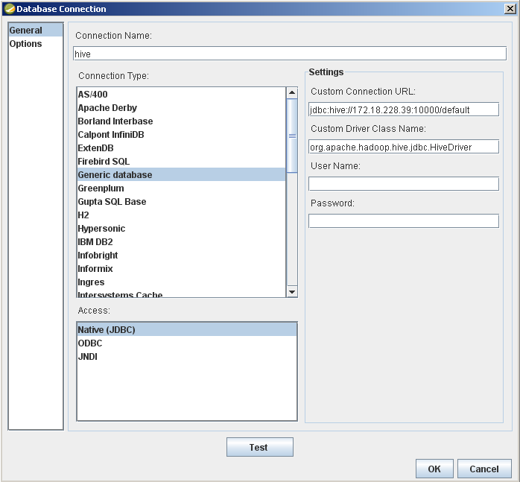
Establishing the connection
custom connection URL-jdbc:hive://host name:port no./default
Host name - IP address of the machine on which hive is running.
Port number - The port on which thrift server is running. By default thrift server runs on 10000
Custom Driver class name - org.apache.hadoop.hive.
jdbc. HiveDriver

Slide 25
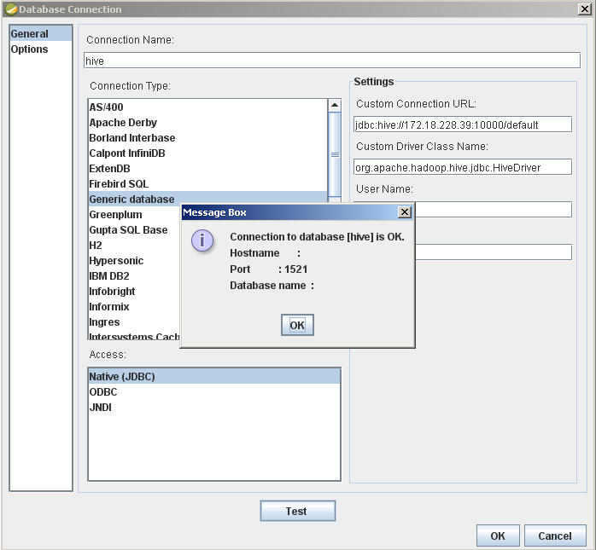
Testing the connection
Before you test the connectivity, start the thrift server from Hive.
Use the command -
hive --service hiveserver
After you start the thrift sever, check the connectivity between Hive and Pentaho. To do that, click the Test button.

Slide 26
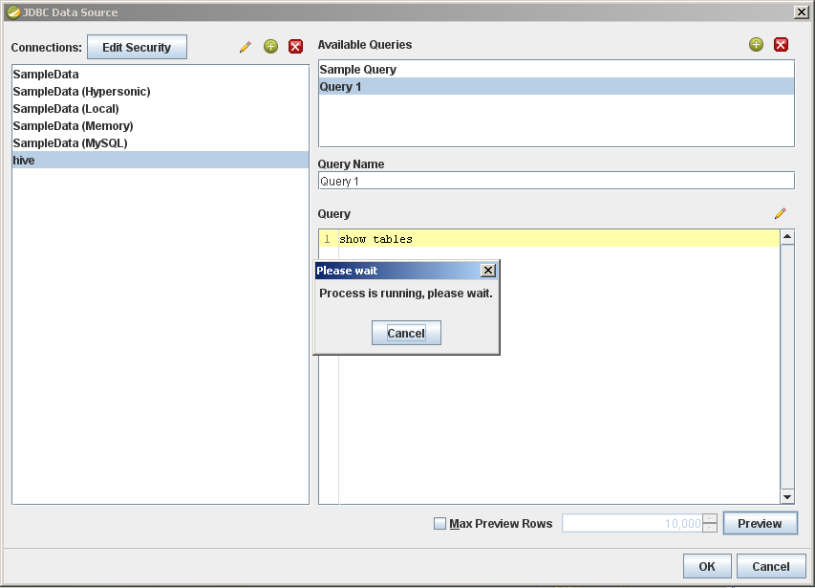
Running a query
Once the connection is successful you can access the Hive tables from Pentaho.

Slide 27
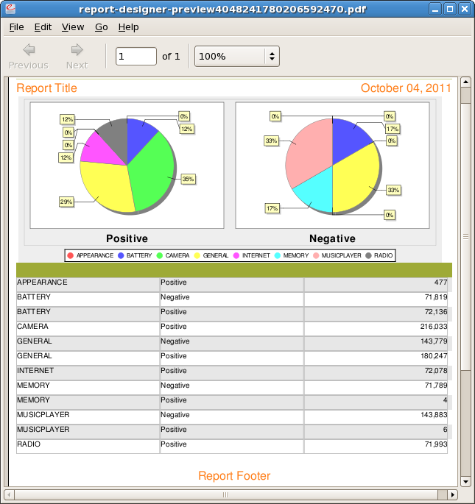
Sample report

Slide 28
Partitioning in Hive
Partitions are a way to divide a table into coarse-grained parts, based on the
value of a partition column such as ‘date’.
Using partitions, you can make it faster to do queries on slices of the data.
A table can have one or more partition columns. A separate data directory
is created for each distinct value combination in the partition columns.

Slide 29
Example
Partitions are defined at the of creating a table.
Usage: Use the clause, PARTITIONED BY. This creates a list of column
definitions.
You can add or remove partitions using the ALTER TABLE statement.
hive> create table logs(ts bigint, line string) partitioned
by(dt string, country string);
When you load data into a partitioned table, specify the partition values
explicitly:
hive> load data inpath '/files‘ into table logs partition
(dt='29-02-2012', country='India')
At the file system level, partitions are simply nested sub-directories of the table directory.

Slide 30
Accessing the partitions
We can view the partitions of a given table as follows
hive> show partitions logs;
dt=29-02-2012/country=India
dt=01-01-2012/country=US
Partition columns can be used in select query as usual. Hive performs input
pruning to scan only the relevant partitions
hive> select ts, dt, line from logs where country='India';

Slide 31
Performance Tuning using Hive
You can improve Hive performance by modifying certain properties in the hive-
site.xml file.
Name | Description | Default value
hive.exec.compress.output | Determines whether the output of the final map/reduce job in a query is compressed or not. | false
hive.exec.compress.intermediate | Determines whether the output of the intermediate map/reduce jobs in a query is compressed or not. | false
hive.default.fileformat | Default file format for CREATE TABLE statement. Options are TextFile, SequenceFile and RCFile | TextFile
hive.join.cache.size | How many rows in the joining tables (except the streaming table) should be cached in memory. | 25000
Many such properties can be tuned as per your requirements.
Tuning depends on the problem at hand and the hardware configuration of your Hadoop cluster

Slide 32
Thank You
Notes:
32

