Slide 1
Presto POC

Slide 2
Current Status
Completed
Installation of Presto on Developer machine (Virtual Box) & POC Environment
Integration with Druid
Able to query Druid from Presto
Able to Join tables existing on druid through a query from presto
Note: Small tables utilized for easier representation.
In Progress / Issue
Unable to perform aggregate operations on a existing table in druid, which is a key necessity for BI. Aggregate functions returning Null values.

Slide 3
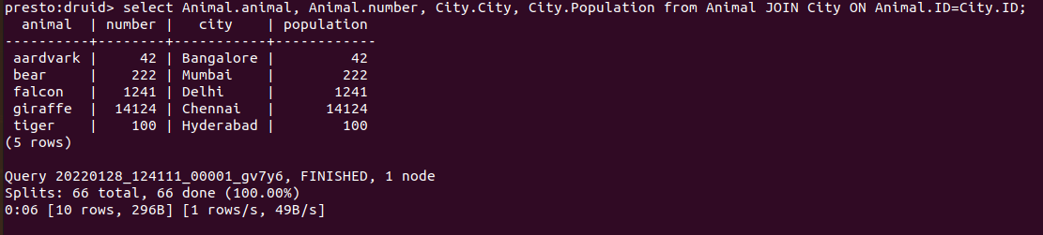
JOIN Using Presto

Slide 4
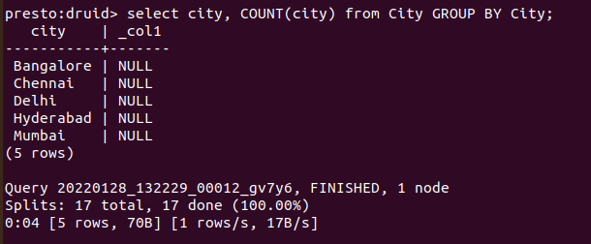
Aggregate Operations

Slide 5
Next Actions
To join Huge Data sets on Druid (Actual Limitation of druid - Joining Huge Datasets/Tables)
Save Presto queries output to JSON/CSV file (share with portal team for reporting purpose)
To understand usage of Presto API (apart from CLI being used so far) and it’s integration with Python or other platforms for query execution
If aggregate functions do not work as expected (based on current status), can presto be used as a value add or we should explore other options like integration with Spark?

